Slide 1
Hillsborough
Wynne Jones

Slide 2
Aims and objectives
Analyse Multi Agency Leadership ‘on the day’,
Critically Evaluate Organisational Leadership Failings in the Short, Medium and Long Term,
Identify Recommendations to Prevent reoccurrence.

Slide 3
15th April 1989
FA Cup semi final
Liverpool V Nottingham Forest
Hillsborough Stadium the home ground of Sheffield Wednesday

Slide 4
midday
Liverpool fans begin arriving around midday
Hillsborough stadium very old with ‘decrepit’ turnstiles
During 1970’s and 1980’s terraces had been enclosed with fencing due to football hooliganism which included pitch invasions
By around 2.50pm ‘pens’ 3 and 4 on terraces behind goals were full of Liverpool fans but many remained outside
Supporters ‘pens’ on terraces had official capacity of 2,200 (later found that this should have been reduced to 1600 when barriers were installed)

Slide 5
2.52pm
Police order Gate C to be opened to prevent crush of supporters attempting to get into ground
Approximately 2000 Liverpool fans enter ground and immediately head for pens 3 and 4 estimated that pens 3 and 4 later held 3000 fans
Crushing was now taking place in Pens 3 and 4, people climbing over side of pens into less crammed pens
3pm Game commences

Slide 6
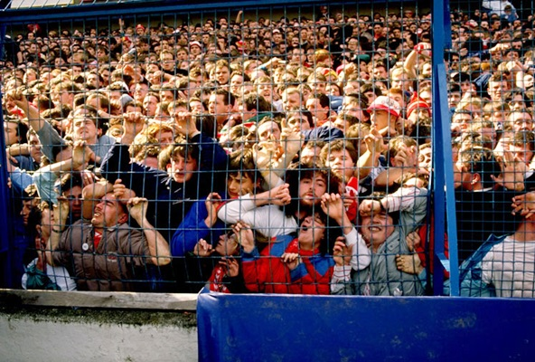

Slide 7
3.05pm
Barrier in pen 3 collapses causing spectators to be crushed
3.06pm Police Officer instructs referee to abandon game

Slide 8
https://www.youtube.com/watch?v=mCFuQLUD-LQ

Slide 9
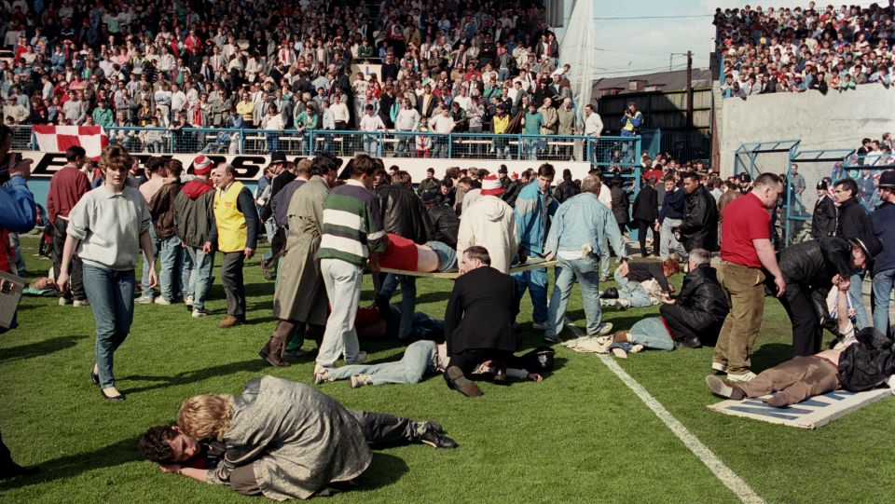

Slide 10
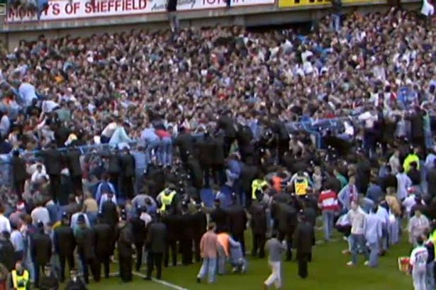

Slide 11
https://www.youtube.com/watch?v=Am6vmX9SuOY

Slide 12
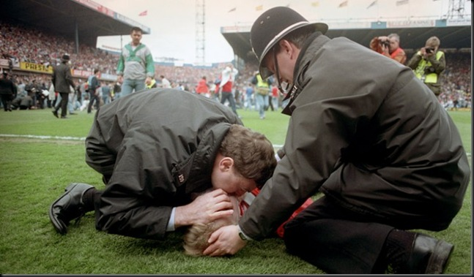

Slide 13
Emergency Response
Ambulance crews had difficulty gaining access to ground police reporting ‘crowd trouble’
Firefighters with cutting gear had difficulty accessing ground
Crush of supporters resulted in death of 96 Liverpool fans, hundreds more were injured
Lord Justice Taylor conducted enquiry

Slide 14
The Sun 19th April 1989 ‘The Truth’
The ‘Sun’ reports that Liverpool fans stole wallets from the dead and attacked and urinated on police and rescuers
Newspaper boycotted by Liverpool Newsagents

Slide 15
4th August 1989 Interim Report by Lord Justice Taylor
Police control at fault - failure to close off the tunnel leading to pens 3 and 4 once Gate C had been opened,
Police criticised for failure to handle the build-up of fans outside the ground,
Police criticised for slow response to events as they unfolded,
Ch. Supt David Duckenfield, criticised for "failing to take effective control",
South Yorkshire Police criticised as they initially attempted to blame supporters arriving at the ground "late and drunk".

Slide 16
Conditions at ground
Sheffield Wednesday Football Club and Sheffield City Council criticised for failure to maintain football ground,
14 August 1990 - Director of public prosecutions announces no criminal charges to be brought against any individual, group or body on the grounds of insufficient evidence.

Slide 17
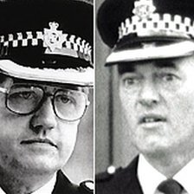
Inquests in 1991 returns majority verdict of accidental death, Coroner limits scope of inquests to events up to 15:15, on the grounds that all the victims were either dead or brain dead by this time.
Response of the police and ambulance services after 15:15 not examined.

Slide 18
July 1991 - Police Complaints Authority recommended that Ch Supt Duckenfield and Supt Bernard Murray, should face disciplinary charges.
Ch. Supt. Duckenfield retired on medical grounds - case against Supt. Murray dropped.

Slide 19
Hillsborogh docu-drama
Following Jimmy McGovern's documentary-drama ‘Hillsborough’ in 1996, Home Secretary Jack Straw ordered a "scrutiny of evidence“,
Lord Justice Stuart-Smith appointed to review "new" evidence which had not been submitted to the inquiry or inquests, and
Police and witness statements, apparently critical of police, which had allegedly been altered,

Slide 20
Review finds that whilst statements should not have been edited, this was simply an "error of judgement“,
Home Secretary accepted findings and ruled out a new inquiry,
August 1998 the Hillsborough Family Support Group bring charges of manslaughter against Ch.Supt. David Duckenfield and his deputy, Supt Bernard Murray, in a private prosecution.

Slide 21
Outcome of private prosecution
Ch. Supt Duckenfield – Not Guilty of Manslaughter,
Supt Murray – ‘Hung Jury’ - unable to come to verdict.

Slide 22
2006
Anne Williams, the mother of 15-year-old victim Kevin Williams, takes case to the ECHR challenging the verdict of the original inquest, claiming her son was still alive at 16:00 on the day of the disaster and did not die from traumatic asphyxia,
Court rejected the case in March 2009 on the grounds that the time period for her challenge had expired.

Slide 23
2009
20 years after the disaster campaigners continued to press for the release of information about the disaster, amid lingering suspicion that some details had been withheld,
In April 2009, Home Secretary Jacqui Smith requested South Yorkshire Police to release secret files containing detailed evidence,
December 2009 Hillsborough Independent Panel set up by Home Secretary Alan Johnson to oversee a "full public disclosure of relevant government and local information".

Slide 24
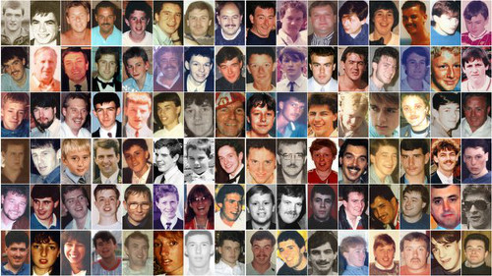

Slide 25
Police corruption
Panel found that police had deliberately altered more than 160 witness statements in an attempt to blame Liverpool fans for the fatal crush,
It found that crowd safety was "compromised at every level" and that 41 of the 96 who died could have survived, prompting calls for fresh inquests,
Source of the Sun newspaper story revealed as
"local Sheffield press agency informed by several SYP officers, an SYP Police Federation spokesperson and a local MP (Sir Irvine Patrick)".

Slide 26
Cameron Apology 2012
https://www.youtube.com/watch?v=mavTTc21sCY

Slide 27
PM Apology
Apologies from Prime Minister David Cameron and former Sun editor Kelvin Mackenzie, and calls for a criminal investigation into the police handling of the disaster,
December 2012 the High Court quashed the original inquest verdicts, Home Secretary Teresa May orders fresh police inquiry.

Slide 28
Witness statement
Former London firefighter Anthony O’Keefe tells new that he was 'dumbfounded' at the lack of help for stricken fans as disaster struck, the firefighter had left his seat and gone on the pitch to help victims, as supporters were being crushed to death on the Leppings Lane terrace of the Sheffield stadium he said he was 'amazed' at the lack of response from emergency services at Hillsborough.

Slide 29
Press box witness
Stephen Curry, a football writer for a national newspaper was reporting on the match from the press box in the main stand at the game.
He said around 15 minutes before kick-off, he noticed the build up of fans in the central pens of the Leppings Lane terrace behind the goal he said:
'You get a feeling for these things when you have been going around football matches four, five times a week. You get a feeling for when things are brewing. It's almost like an instinct. I felt it that day.
Curry said to a colleague, "I don't like the look of what's going on around there“ and agreed there was an 'extraordinary imbalance' between the central pens which were 'absolutely heaving' but plenty of room in the pens either side.

Slide 30
Police reaction
Asked about police reaction as it became apparent disaster was looming Curry replied:
'Well there did not seem to be any. I was actually shouting in the press box, "Open the gates!" Yet nobody opened the gates. I just could not understand it.'
He added that officers on the ground appeared to 'lack organisation and leadership,' and after the match was abandoned at 3.06pm the scene on the pitch was, 'Chaotic. Totally chaotic,' with the police, 'extremely slow to react to what was happening‘, he described the Hillsborough Stadium as 'not fit for purpose' to host the FA Cup semi-final.

Slide 31
Three separate investigations set up following the publication of the Hillsborough Independent Panel’s report in September 2012.
• The new inquests, begin on 31 March 2014, ongoing
• The Investigation by the Independent Police Complaints commission into the actions of the police in the aftermath of the tragedy, ongoing
• The investigation by former Durham Chief Constable Jon Stoddart into the cause of the tragedy and whether criminal charges should be brought in relation to it.

Slide 32
Football Violence
Michael Crick the political correspondent for Channel 4 – Safety measures at this time were appalling, and grounds often dangerously over-crowded.

Slide 33
Football Violence
According to Crick much of the coverage of Hillsborough overlooked what a huge, huge problem football violence was in the 1980s,
English clubs were banned from European competition, after Liverpool fans at the Heysel Stadium in 1985 attacked rival supporters from the Italian Club Juventus, and 39 people were killed (33 from Juventus and six from Liverpool),
Margaret Thatcher's government was determined to tackle the problem, not least because the violence was causing huge damage to Britain's reputation abroad.
Indeed, at the time of Hillsborough the government was trying to pass a bill to require all football fans to carry identity cards, though after Hillsborough the idea was dropped.

Slide 34
Football Violence
In those days football fans at most major clubs were often violent and drunk, and the trouble-makers invariably complained of ill-treatment by the police who were, on occasion guilty of over-reacting,
Police everywhere in the UK were under huge pressure from Whitehall to get football violence under control.
As the Hillsborough panel report explains, public order was the overwhelming priority - the "collective police mindset" it says - rather than crowd safety.

Slide 35
Evidence of New Enquiry
Flaws in the assertion that all the victims could not have been saved,
Questioned decision by the coroner Dr Stefan Popper not to look at evidence of things which happened beyond 3.15pm on that day, the point beyond which the coroner decided the victims would have been fatally injured and therefore beyond the help of the emergency services,
It was also wrongly asserted that the majority of victims died of the same cause - traumatic asphyxiation.

Slide 36
Post mortem reviews
"Some of those who died did so after a significant period of unconsciousness during which they might have been able to be resuscitated“,
"There was clear evidence from the post mortem reports that 28 of those who died did not have traumatic asphyxia with obstruction of the blood circulation, and asphyxia may have taken significantly longer to be fatal. There was separate evidence that in 31 the heart and lungs had continued to function after the crush, and in 16 of these this was for a prolonged period."

Slide 37
alcohol
The panel said: "There was no evidence to support the proposition that alcohol played any part in the genesis of the disaster and it is regrettable that those in positions of responsibility created and promoted a portrayal of drunkenness as contributing to the occurrence of the disaster and the ensuing loss of life without substantiating evidence."

Slide 38
South Yorkshire Police (SYP)
Disclosed documents show that police officers, particularly senior officers, interpreted crowd unrest in the Leppings Lane terrace central pens, as a sign of potential disorder or hooliganism and failed to see they were in "the throes of disaster“,
The report says when it became clear that Liverpool fans were being crushed, South Yorkshire police ignored their pleas for help or told them to be quiet.

Slide 39
Hooliganism or impending disaster
Eye-witness accounts said the tendency of the police to see the disturbance as hooliganism, was a major cause of the "significant delay" in helping out fans before anyone in authority recognised that it was "the throes of a disaster".
The force did not fully activate its major incident plan, meaning: "Communications between all emergency services were imprecise and inappropriately worded, leading to delay, misunderstanding and a failure to deploy officers to take control and coordinate the emergency response."

Slide 40
PC John Hood- HOW THE STATEMENT WAS CHANGED
The handwritten account, above, of what former PC John Hood saw was dated May 17, 1989. One paragraph reads: ‘Sergeants and Inspectors appeared to be aimlessly milling about and direct radio control appeared to be lost. There did not appear to be any leadership.’
But by the time the account had been typed, and submitted for the Taylor Inquiry and the subsequent inquest, the paragraph had disappeared.
PC Hood had refused to change his version of events.

Slide 41
PC John Hood – what else he said
‘I was one the first to arrive at the Penistone Road entrance to the ground that day and the fans were throwing bottles at us as they came off the coaches,’ said Mr Hood, who was continually moved to tears as he spoke.
‘I don’t know why they had a 3pm kick-off. If they had started the match earlier, the fans wouldn’t have been drinking so long before it started.’

Slide 42
South Yorkshire Metropolitan Ambulance Service (SYMAS)
The ambulance service also failed to activate its major incident plan, leading to delays, misunderstandings and inappropriately deployed aid,
Poor communication between teams inside and outside Hillsborough meant that basic urgent emergency equipment such as swabs was not available where it was needed,
The new documents show "clear and repeated evidence of failures in leadership and emergency response coordination." The report notes: "While this is understandable in the immediate moments of an overwhelming disaster, it was a situation that persisted for at least 45 minutes after injured spectators were released from the pens"
The panel rejected the service's attempts to portray criticism as the views of ill-informed and impulsive doctors caught up in the emotions of the disaster as "factually incorrect".

Slide 43
Culpability
Motivating factor in moves by SYP to blame drunken, ticketless fans.
Serious allegations were made by newspapers, most infamously The Sun, to discredit Liverpool supporters and back the police's version of events,
The claims included stories alleging that Liverpool fans had: "assaulted and urinated on police officers resuscitating the dying, stolen from the dead and verbally sexually abused an unconscious young woman“,
But the new documents and CCTV footage show: "there is no evidence to support these allegations other than a few isolated examples of aggressive or verbally abusive behaviour clearly reflecting frustration and desperation“.

Slide 44
TWO NEW ENQUIRIES 2012
Operation Resolve - Investigate the causes of the disaster,
IPCC Enquiry - to examine actions by police in the aftermath

Slide 45
The Goldring coroner's inquest
Lasted form 1 April 2014 to 26 April 2016, the longest jury case in British history.
Returned a verdict that the supporters were unlawfully Killed due to gross negligence by the Police and Ambulance services who failed in their duty of care to the supporters.
The inquest also found that the design of the stadium contributed to the crush, and that supporters were not to blame for the dangerous conditions.

Slide 46
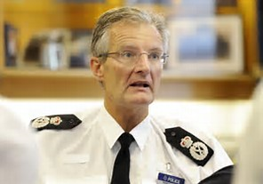
Chief Constable David Crompton
For the actions of his force during the second inquest was suspended,
In 2013 he had to apologise after accusing a Hillsborough campaign group of lying.
In a memo written before the Independent Panel report on the tragedy, Mr Crompton had said his force needed to be "innovative" in its media handling otherwise they'd "just be roadkill."

Slide 47
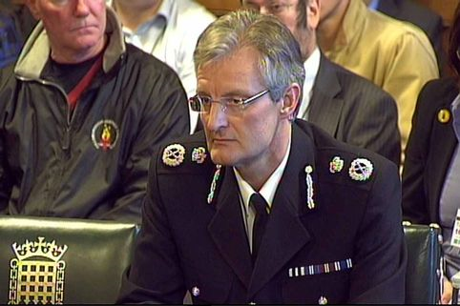
Chief Constable David Crompton
Two days after the verdict, a private prosecution was brought on behalf of hundreds of relatives against both SYP and the West Midlands Police force (who took statements from the SYP), alleging a concerted cover-up designed to shift blame away from the police.

Slide 48
Panorama 2013
https://www.youtube.com/watch?v=Jdt7oQV3NYc

Slide 49
thanks

