Slide 1
The role of ‘Design’ in Web sites
Gareth Jones

Slide 2
Today’s Lecture
Job roles in Web Design
Site diagrams
Wireframe diagrams
User Interface Design
Layout design
Search Engine Optimisation
Accessibility

Slide 3

First things first
“Web Design” encompasses many different disciplines.
Sometimes you need to have a handle on multiple aspects
But some areas have specialists who’ve been doing it for years.
A 10 credit module at Level4 doesn’t expect you to be an expert at everything!
(but you should be aware of the general concepts so you can discuss them and implement SOME in your assignment and report)

Slide 4
Question
What job roles do you think are available in web development?

Slide 5
Web Development Roles
Information Architect (IA)
User Experience (UX) Designer
User Interface (UI) Designer
  aka Front-end Developer
Web Developer
  aka Back-end Developer / Full-stack Developer
  May also be responsible for UI development
Web Content Specialists
SEO Specialists
Web Designer or Graphics Designer
Try searching a job site, e.g. jobsite.co.uk, to find out responsibilities for these roles.
Notes:
See more:
https://www.google.com/search?q=web+development+roles
https://room34.com/philosophy/roles/

Slide 6
Roles & Responsibilities
https://room34.com/philosophy/roles/
Notes:
See more:
https://www.google.com/search?q=web+development+roles
https://room34.com/philosophy/roles/

Slide 7
User Experience, Interaction, and User Interface design
Often, when we think of design, we think about how something looks.
On the Web, the first matter of business is designing how the site works. Before picking colors and fonts, it is important to identify the site’s goals, how it will be used, and how visitors move through it.
These tasks fall under the disciplines of Interaction Design (IxD), User Interface (UI) design, and User Experience (UX) design. There is a lot of overlap between these responsibilities, and it is not uncommon for one person or team to handle all three.

Slide 8
User Experience, Interaction, and User Interface design
The goal of the Interaction Designer is to make the site as easy, efficient, and delightful to use as possible.
Closely related to interaction design is User Interface design, which tends to be more narrowly focused on the functional organization of the page as well as the specific tools (buttons, links, menus, and so on) that users use to navigate content or accomplish tasks.

Slide 9
User Experience, Interaction, and User Interface design
A more recent job title in the web design realm is the User Experience Designer. The UX designer takes a more holistic view—ensuring the entire experience with the site is favourable.
UX design is based on a solid understanding of users and their needs based on observations and interviews.
According to Donald Norman (who coined the term), user experience design includes “all aspects of the user’s interaction with the product: how it is perceived, learned, and used.” For a website or application, that includes the visual design, the user interface, the quality and message of the content, and even overall site performance. The experience must be in line with the organization’s brand and business goals in order to be successful.

Slide 10
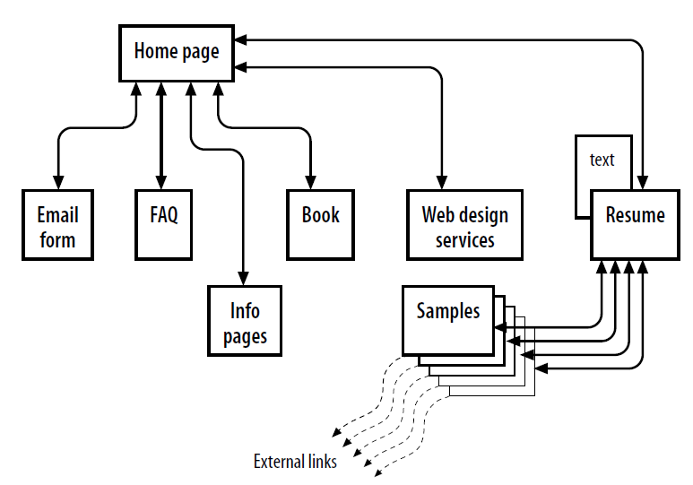
Site diagrams
A site diagram indicates the structure of the site as a whole and how individual pages relate to one another

Slide 11
Site diagrams
You should include a site diagram in your assignment report!

Slide 12
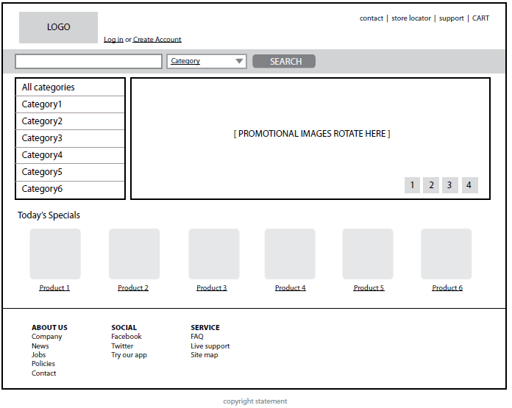
Wireframe diagrams
A wireframe diagram shows the structure of a web page using only outlines for each content type and widget

Slide 13
Wireframe diagrams
You should include wireframe diagrams in your assignment report!
(and ideally you should have STARTED with wireframe diagrams and a site layout BEFORE you opened up your HTML editor!!)

Slide 14
A brief article & video on wireframing
https://careerfoundry.com/en/blog/ux-design/how-to-create-your-first-wireframe/
(watch the video!)

Slide 15
A(nother) brief article & video on wireframing
https://webdesign.tutsplus.com/articles/a-beginners-guide-to-wireframing--webdesign-7399
https://www.youtube.com/watch?v=-4Ngcx0gFcQ

Slide 17
UID
UID – User interface design

Slide 18
Jakob Nielsen
Called ““the guru of Web page usability”
https://www.nngroup.com/people/jakob-nielsen/

Slide 19
Nielsen Norman Group articles:
F-Shaped Pattern For Reading Web Content (original study)
https://www.nngroup.com/articles/f-shaped-pattern-reading-web-content-discovered/
Updated:
https://www.nngroup.com/articles/f-shaped-pattern-reading-web-content/

Slide 20
Nielsen Normal Group articles:
Why Does a Design Look Good?
https://www.nngroup.com/articles/why-does-design-look-good/

Slide 21
Web page layout – quick guide
https://webflow.com/blog/web-page-layout-101-website-anatomy-every-designer-needs-to-learn

Slide 22
Don’t forget the C.R.A.P!
Many free sources out there – do a search.
One nice example:
https://vwo.com/blog/crap-design-principles/
“You know a good (or a bad) design when you see one! However, you cannot always objectively point out the qualities (or flaws) in design, especially if you’re not a designer. Even as marketers or front-end developers, you might often find it challenging to come up with designs that effectively engage your target audience and nudge them to take the desired action. What might help here is a thorough understanding of CRAP”

Slide 24
SEO – Search Engine Optimisation
https://linchpinseo.com/how-to-design-an-seo-friendly-website/#:~:text=SEO%20web%20design%20is%20a,index%20it%20in%20their%20database.

Slide 25
SERPs
“Nobody knows all of Google’s ranking factors, but we do know some of them”
https://ahrefs.com/blog/what-are-serps/

Slide 26
Ask google itself ….
https://developers.google.com/search/docs

Slide 28
Remember the Question?
What do you think Web Accessibility means?

Slide 29
Categories of disabilities
Vision impairment. People with low or no vision may use an assistive device such as a screen reader, Braille display, or a screen magnifier to get content from the screen. They may also simply use the browser’s text zoom function to make the text large enough to read.
Mobility impairment. Users with limited or no use of their hands may use special devices such as modified mice and keyboards, foot pedals, or joysticks to navigate the Web and enter information.
Auditory impairment. Users with limited or no hearing will miss out on audio aspects of multimedia, so it is necessary to provide alternatives, such as transcripts for audio tracks or captions for video.
Cognitive impairment. Users with memory, reading comprehension, problem solving, and attention limitations benefit when sites are designed simply and clearly. These qualities are helpful to anyone using your site.

Slide 30
Web Accessibility Initiative (WAI)
W3C driven:
https://www.w3.org/WAI/
https://www.w3.org/WAI/standards-guidelines/wcag/

Slide 31
Evaluating Web Accessibility
The W3C has some guidance and links to some tools
https://www.w3.org/WAI/test-evaluate/

Slide 32
Student Exercise
Re-read the assignment
Think how you can implement some of these concepts into your own web site and/or discuss them in your assignment report.
But bear in mind that some things will be tricky given the limited scope of the assignment – so remember:

