Slide 1

Debate Presentation
Module: Living with Care: The older person
Module code: BMHP_Birm
Lecturer: Joanne Davies
Students:
Iskra Valkova( 2026742)
Selina Shafiq (2028762)

Slide 2

Euthanasia and Assisted Suicide

Slide 3
Definitions:
EUTHANASIA
ASSISTED SUICIDE
Euthanasia is deliberately ending someone’s life in order to relieve their suffering. It is usually performed by a medical professional.(NHS,2020)
Euthanasia is the act of intentionally taking a person’s life, for instance with a lethal injection, to relieve his pain and suffering. (BBC News,2019)
It could also be withdrawing life-saving treatment from a patient who is in a permanent vegetative state.(BBC News,2018)
Euthanasia refers to ending a person’s life who is suffering from an incurable or painful disease or is in irreversible coma. (Premela,2022).
Assisted suicide is deliberately helping someone to end their own life. (NHS,2020)
Assisted suicide is intentionally helping a person to end their own life. (BBC News,2019)
Assisted suicide relates to helping someone to die who suffers from a long-term, progressive condition or terminal illness. (RightToLife,2023).
According to Section 2 of the Suicide Act of 1961, as amended by the Coroners and Justice Act of 2009, it is illegal to help or encourage someone else to commit suicide. (Suicide Act,1961).

Slide 4
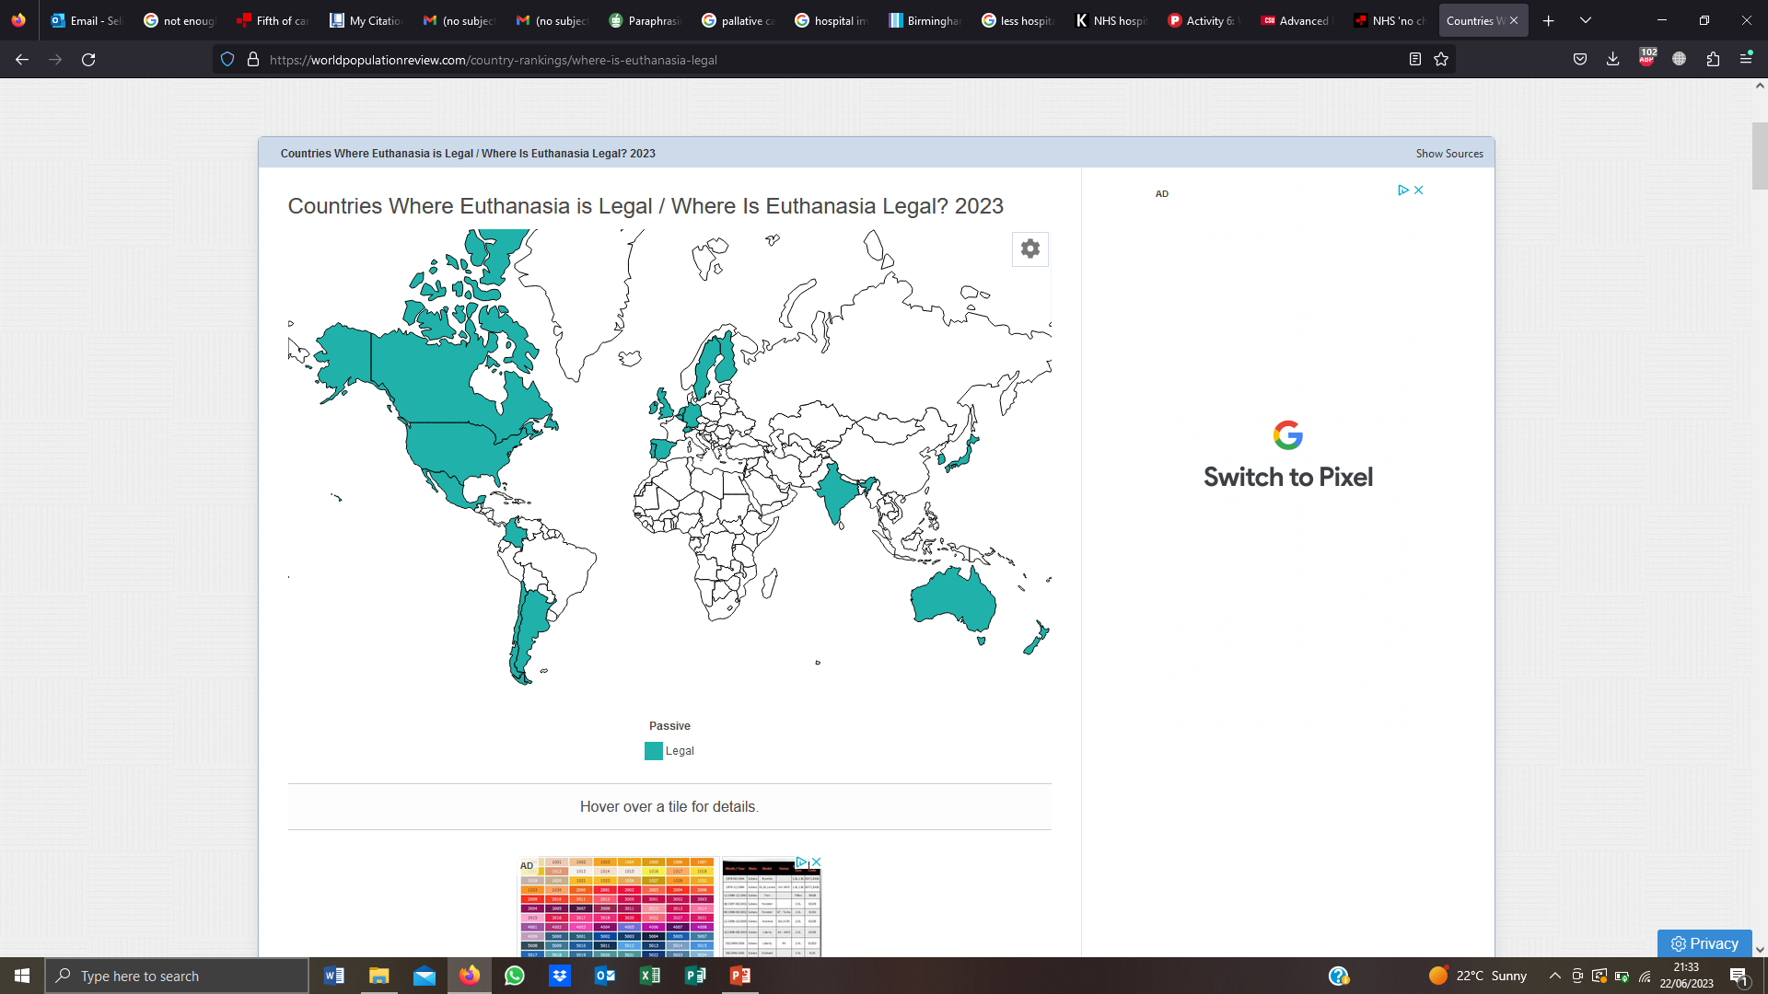
The LAW on Euthanasia & Assisted Suicide in the UK
Euthanasia and Assisted Suicide are illegal under English law (NHS, 2020).
According to the Suicide Act 1961 assisted suicide is against the law (Legislation.gov.uk, 1978).
(Countries Where Euthanasia is Legal no date)

Slide 5
End of Life and Palliative Care
End of Life and Palliative Care
End-of-life care supports people in the last months of their life. It includes dying with dignity and following your wishes and preferences. It also relates to supporting your friends and family. (NHS Choices,2022).
End of Life and Palliative Care and considered if a person’s life expectancy is approximately 12 months to live.(NHS Choices,2022)
End-of-life care can be provided at home, in a care home, hospice, or hospital depending on needs and preferences. (NHS Choices,2022).
End-of-life care focuses on providing physical( Pain treatment), as well as psychological, emotional, and spiritual support for people and their families.(Westgate,2019).
Palliative care can be received for a longer period of time for prolonged illnesses. It can also be used at any time during the treatment process. (Westgate,2019).
Palliative care improves the quality of life. (Palliative and end of life care – post,2022).
According to the World Health Organisation, around 56.8 millions people are in need of palliative care each year with only 14% of them actually receiving it. (WHO,2020).
According to the NICE guidelines,(2019),people should have access to the care they want and need in all types of care settings.
The National End of Life Care Intelligence Network (NEoLCIN), launched by Public Health England in 2019, aims to enhance data collection and analysis on the quantity, quality, and cost of care given to adults who are nearing the end of their lives by the NHS, social services, and nonprofit sector.

Slide 6

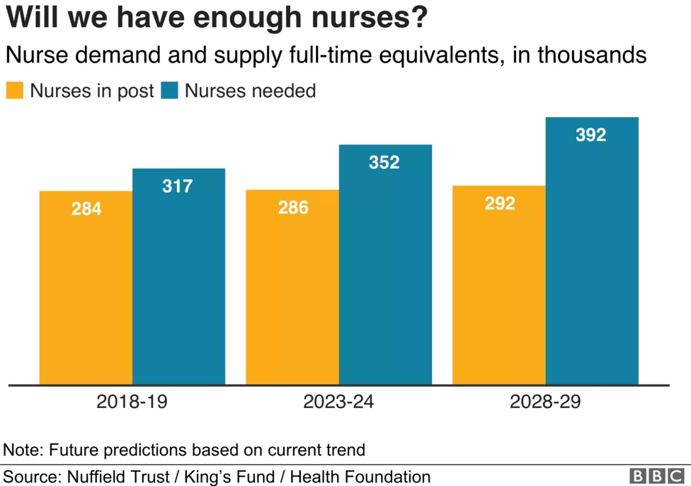

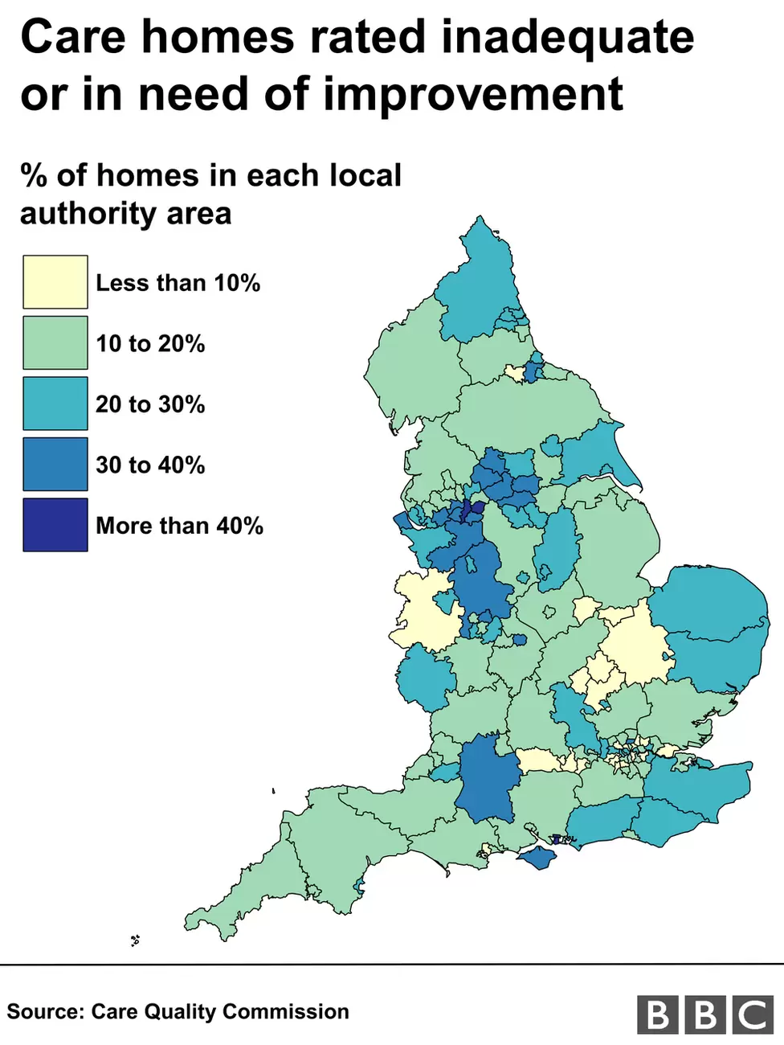

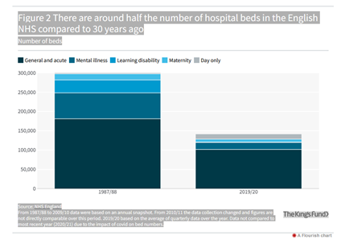

The Gap between the NEEDS and AVAILABILITY of End- of-Life Care
(NHS workers, 2022)
(Triggle, 2019)
NEEDS
(Bondcare, 2023)
AVAILABILITY
(Cawley, 2018)
(Temple, 2023)
(Ewbank et al, 2021)
(NHS, 2019)

Slide 7
Planning for end of life
Living wills
These are advanced decisions to refuse treatment when you are no longer able to communicate your needs. A living will allow you to accept or refuse treatment. Living wills should be written, and signed by you, and a witness. (NHS,2020).
Advances decision is bound by the Mental Capacity Act,(2005) –you should be over 18 and have the mental capacity to decide. (GOV.UK ,2011)
You can appoint a lasting power of attorney (LPA) to take decisions on your behalf when you are no longer able to decide for yourself.(GOV.UK,2011).
DNR and DNAR
DNR stands for Do Not Resuscitate and DNAR for Do Not Attempt Resuscitation. Cardiopulmonary Resuscitation is also known as CPR. The decision should be in line with the Mental Capacity Act 2005, Equality Act 2010, and Human Rights 1998. (Care Quality Commission,2022).
It is usually given when your heart stops beating and aims to get you breathing again. You should be trained to perform CPR and also you need equipment like a defibrillator available.(NHS,2021).

Slide 8

Legislations & Policies
Care Act 2014 – (GOV.UK, 2014)
Equality Act 2010 – (GOV.UK, 2013)
Human Rights Act 1998 – (Legislation.gov.uk, 1998)
(Legislation and policy, 2021)

Slide 9
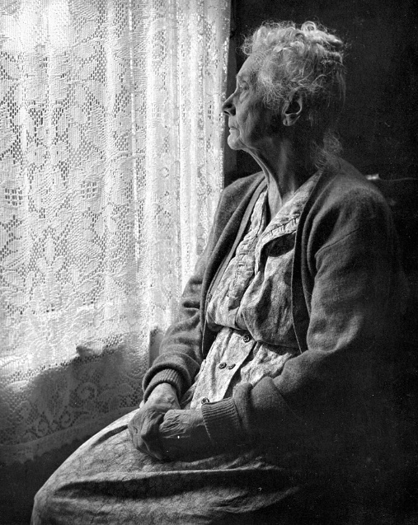

Psychological Theories of Ageing
Disengagement Theory
According to HRF (2017), the disengagement theory of ageing, people experience a withdrawal as they get older from social interactions and connections to the many systems to which they belong.
Activity Theory
The concept that roles and activities are two methods people use to form a sense of who they are shapes the grounds of the activity theory. As people age, they lose interests and responsibilities, which can contribute to a loss of identity.
(Winstead et al, 2014)
Disengagement theory, 2022)
(Ellsbells48, no date)

Slide 10
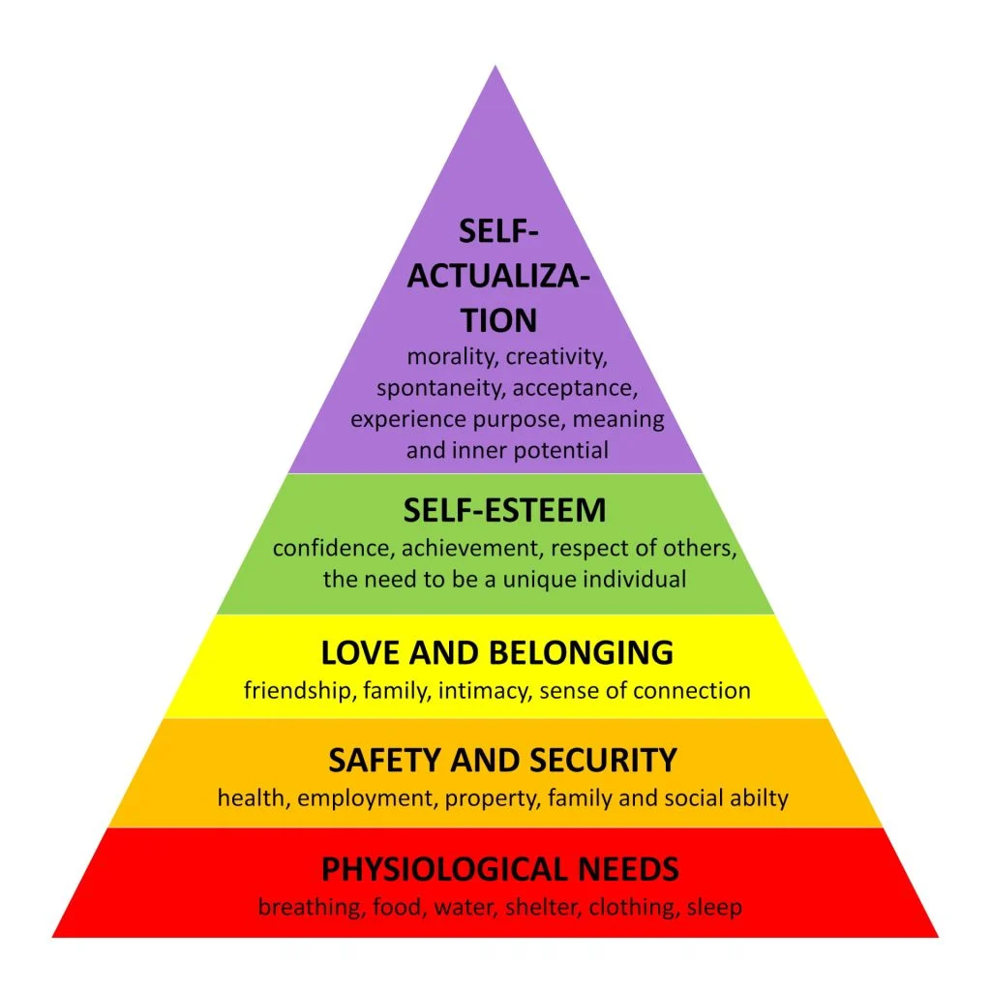
MASLOWS
THEORY
(Mcleod, 2023)

Slide 11
Cawley, L. (2018). Fifth of Care Homes ‘inadequate’ or ‘need improvement’, BBC News. Available at: https://www.bbc.co.uk/news/uk-england-45194202 (Accessed: 22 June 2023).
Countries Where Euthanasia is Legal (no date). Countries where Euthanasia is Legal / Where is Euthanasia Legal? 2023. Available at: https://worldpopulationreview.com/country-rankings/where-is-euthanasia-legal (Accessed: 22 June 2023).
Disengagement Theory (2022). Wikipedia. Available at: https://en.wikipedia.org/wiki/Disengagement_theory#/media/File:Elderly_Woman,_B&W_image_by_Chalmers_Butterfield.jpg (Accessed: 22 June 2023).
Ellsbells48, (no date). ellsbells48 Available at: https://ellsbells48.wordpress.com/ (Accessed: 22 June 2023).
Els van Wijngaarden, E., Goossensen, A., & Leget, C. (2018) 'The social–political challenges behind the wish to die in older people who consider their lives to be completed and no longer worth living'. Journal of European Social Policy, 28(4), 419–429. https://doi-org.ezproxy.uwtsd.ac.uk/10.1177/0958928717735064
Ewbank, L. et al. (2021) NHS Hospital Bed Numbers, The King’s Fund. Available at: https://www.kingsfund.org.uk/publications/nhs-hospital-bed-numbers (Accessed: 22 June 2023).
GOV.UK (2011). Make, register or end a lasting power of attorney. [online] GOV.uk. Available at: https://www.gov.uk/power-of-attorney. (Accessed: 21 July 2023).
GOV.UK (2013). Equality Act 2010: Guidance Available at: https://www.gov.uk/guidance/equality-act-2010-guidance:text (Accessed: 19 June 2023).
GOV.UK (2014). Care Act 2014, Available at: https://assets.publishing.service.gov.uk/government/uploads/system/uploads/attachment_data/file/365345/Making_Sure_the_Care_Act_Works_EASY_READ.pdf (Accessed: 19 June 2023).
HRF (2017). Disengagement theory of aging explained, healthreserachfunding.org. Available at: https://healthresearchfunding.org/disengagement-theory-of-aging-explained/ (Accessed: 22 June 2023).
References:

Slide 12
References:
Legislation and Policy (2021). NSW Public Service Commission. Available at: https://www.psc.nsw.gov.au/legislation-and-policy (Accessed: 22 June 2023).
Legislation.gov.uk (1978). Suicide Act 1961. Available at: https://www.legislation.gov.uk/ukpga/Eliz2/9-10/60 (Accessed: 22 June 2023).
Legislation.gov.uk (1998). Human Rights Act Statute Law Database Available at: https://www.legislation.gov.uk/ukpga/1998/42/contents (Accessed: 19 June 2023).
Legislation.gov.uk (2011). Mental Capacity Act 2005. [online] Legislation.gov.uk. Available at: https://www.legislation.gov.uk/ukpga/2005/9/part/1/crossheadings/advance-decisions-torefuse-treatment. (Accessed: 20 July 2023).
Mcleod, S. (2023). Maslow’s Hierarchy of Needs Theory, Simply Psychology. Available at: https://www.simplypsychology.org/maslow.html (Accessed: 22 June 2023).
NHS (2019). Birmingham City Hospital, NHS choices. Available at: https://www.swbh.nhs.uk/contact-locations/find-us/birmingham-city-hospital/ (Accessed: 22 June 2023).
NHS (2020) choices. Available at: https://www.nhs.uk/conditions/euthanasia-and-assisted-suicide/ (Accessed: 20 June 2023).
NHS (2020). End of Life Care. [online] NHS. Available at: https://www.nhs.uk/conditions/end-of-life-care/advance-decision-to-refuse-treatment/.​
NHS (2021). Do not attempt cardiopulmonary resuscitation (DNACPR) decisions. [online] NHS. Available at: https://www.nhs.uk/conditions/do-not-attempt-cardiopulmonary-resuscitation-dnacpr-decisions/.​ (Accessed: 22 June 2023).
NHS choices.(2022) Available at: https://www.nhs.uk/conditions/end-of-life-care/what-it-involves-and-when-it-starts/ (Accessed: 21 June 2023).
NHS workers (2022). Blues and Twos. Available at: https://www.bluesandtwos.org.uk/2022/06/10/affordable-loans-savings-accounts-nhs-workers-healthcare-north-west/ (Accessed: 22 June 2023).
Overview: End of life care for adults: Service delivery: Guidance (2019) NICE. Available at: https://www.nice.org.uk/guidance/ng142 (Accessed: 22 June 2023).

Slide 13
References:
Palliative and end of life care - post. (2022). Available at: https://post.parliament.uk/research-briefings/post-pn-0675/ (Accessed: 22 June 2023).
Premela, (2022) Euthanasia and assisted dying, The Medic Portal. Available at: https://www.themedicportal.com/application-guide/medical-school-interview/nhs-hot-topics/euthanasia-and-assisted-dying/?v=79cba1185463 (Accessed: 20 June 2023).
RightToLifeUK, (2023). Assisted suicide and euthanasia: Knowledge base, Right To Life UK. Available at: https://righttolife.org.uk/knowledgebase/assisted-suicide-and-euthanasia (Accessed: 22 June 2023).
Supreme Court backs agreed end-of-life decisions (2018). BBC News. Available at: https://www.bbc.co.uk/news/uk-45003947 (Accessed: 21 June 2023).
Temple, K.M. (2023). Community-based palliative care: Scaling access for rural populations, The Rural Monitor. Available at: https://www.ruralhealthinfo.org/rural-monitor/palliative-care/ (Accessed: 22 June 2023).
Triggle, N. (2019). NHS ‘no chance of training enough staff’, BBC News. Available at: https://www.bbc.co.uk/news/health-47616491 (Accessed: 22 June 2023).
UK government web archive (2019). The National Archives. Available at: https://webarchive.nationalarchives.gov.uk/ukgwa/20190501131821/http://www.endoflifecare-intelligence.org.uk//home (Accessed: 22 June 2023).
Westgate Healthcare (2019). The Difference Between Palliative Care and End-of-Life Care, and how Westgate can help. Available at: https://www.westgatehealthcare.co.uk/news-article/the-difference-between-palliative-care-and-end-of-life-care/ (Accessed: 20 June 2023).
Winstead, V. et al. (2014). The impact of activity interventions on the well-being of older adults in Continuing Care Communities, Journal of applied gerontology : the official journal of the Southern Gerontological Society. Available at: https://www.ncbi.nlm.nih.gov/pmc/articles/PMC5505561/. (Accessed: 22 June 2023).

