Slide 1

Talent Acquisition
Individual Presentation
Presenter: Petar Mitev (2122707)
Lecturer: Mushfiqur Rahman
Module:Managing People (LCBB5004)

Slide 2
Table Of Content
1.Introduction
2.About Talent Acquisition
3.Talent Acquisition Strategies
4. Design a competitive and comprehensive benefits plan.
5. Promote internal diversity
6. Partner with local universities to build an applicant pool.
7. Develop a clear job description that emphasizes role details
8. Leverage suitable technology for immediate recruitment
9. Empanel selected vendors for short-term recruitment needs
10. About Incentives
11. Flexibility Non-monetary Incentive
12. Food Non-monetary Incentives
13. Monthly Stipend Monetary Incentives
14.Reference List

Slide 3
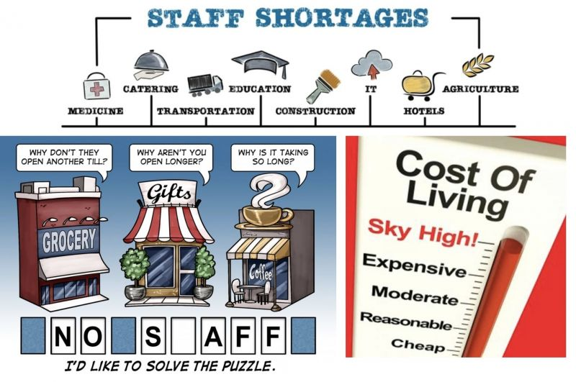
Introduction
COVID-19 has hit the hospitality industry hard.
The restaurant group, which runs Quaglino and Coq d'Argent in London and 20 Stories in Manchester, has estimated it has lost 10% of sales due to staff shortages.

Slide 4

About Talent acquisition
In order to find the best applicants for the organization's open positions, talent acquisition refers to the strategic search, investigation, and interviewing of appropriate personnel. Talent acquisition is always part of an organization's bigger HR role. The two most crucial resources for aiding talent acquisition professionals are data and technology.

Slide 5

Talent acquisition strategies
Every company is different. They have different goals, approaches, focuses, ways and cultures. When you have people, organizations must build their own strategy based on what they want to achieve in the market and what resources they are willing to provide.

Slide 6

Design a competitive and comprehensive benefits plan.
Long-Term Strategy
Employees want good benefits to cover mental health. Companies that invest in the mental health of their employees understand the value of a healthy mind. Employees are willing to accept lower wages in exchange for comprehensive health benefits, including medical, vision and dental insurance.

Slide 7

Promote internal diversity
Long-term Strategy
All industries are dominated by men, which leads to the perception that women are underrepresented in corporate culture. Although the number of women in the labour force has increased in recent decades, all members of the country still hold most of the power. To build a diverse and inclusive corporate culture, companies must give voice to people from diverse backgrounds.

Slide 8

Partner with local universities to build an applicant pool.
Long-term Strategy
Collaboration between corporations and higher education institutions may be extremely helpful in addressing the expanding human resource requirements of businesses. This can give organisations a dependable means to create a staff that is educated and trained. This can cut training expenses for employers. Also, it can raise output and quality of work life. This not only, it can boost regional and national competition.

Slide 9

Develop a clear job description that emphasizes role details
Short-term Strategy
Job descriptions are a crucial component of hiring and helping to decide if a candidate is a good match for a position. Which is why, it is the responsibility of employers to ensure that all job descriptions are accurate, clear, and updated.

Slide 10

Leverage suitable technology for immediate recruitment
Short-term Strategy
In the direct hiring process, one of the most significant limitations is time. Writing job descriptions, placing job advertising, and assessing applications take time in the beginning. Finding qualified people also requires time and effort through evaluation and interviews. One of the finest solutions to this time limitation is to use technology.

Slide 11

Empanel selected vendors for short-term recruitment needs
Short-term Strategy
One of the most common strategies to recruit temporary labour for a short time is to cooperate with suppliers. Unfortunately, not all temporary labour suppliers are qualified, therefore it's necessary to find and bargain with new ones every time. Companies can pre-assess and choose the contractual terms, service costs, and success rates of current temp agencies to avoid this.

Slide 12

About Incentives
The use of incentives has been shown to have a positive impact on employee behavior and, ultimately, firm productivity. There are many kinds of employee incentive programmes in use today by businesses. Finding a programme that works best for your organisation is what's most necessary, though.

Slide 13

Flexibility
Non-monetary Incentive
Younger generations are particularly interested in flexible work schedules as a benefit. Offering alternatives like having the freedom to establish your own hours, getting a half-day off every Friday, or having the opportunity to work from home may stimulate the entire firm to work long and hard towards its objectives.

Slide 14

Food
Non-monetary Incentives
The initial non-cash reward is basic. Although they might take many various forms, the fundamental idea is always that people should be happy. Relationships and improving may be raised by having provided lunches, communal dinners, or even a short display of the best employee's preferred snack in the break room. These incentives can pay dividends for a very long time since it also permits team deployment and a feeling of community.

Slide 15

Monthly Stipend
Monetary Incentives
An employee will spend a fixed amount of cash designated as a monthly allowance for a certain purpose. For instance, the allowance might be used to pay for regular living expenditures, gym membership fees, professional development, or travel and accommodation.

Slide 16

End-of-year bonus
Another motivation for employees to perform well each year, for instance by regularly reaching annual objectives, is the payment of a bonus. Employers reward workers' success with a monetary incentive when they accomplish goals and objectives.

Slide 17
Reference List
administrator and Software, S. (2022). How to Plan for Short-term and Long-term Talent Acquisition Strategy. [online] Resources Library. Available at: https://www.saviom.com/blog/how-to-plan-for-short-term-and-long-term-talent-acquisition-strategy/?fbclid=IwAR0ty1gyfYAm7pVFIzS8ttHLOQ02YwIeryOEebXVJKxnu9Qlua2aUdG4qBs [Accessed 27 Mar. 2023].
Arnold, H. (2022). Post-Covid Growth in Uk Hospitality Industry Could Be Hit by Staff Shortages & Soaring Costs. [online] The On Trade. Available at: https://theontrade.com/en/blog/your-business-11/human-resources-22/post-covid-growth-in-uk-hospitality-industry-could-be-hit-by-staff-shortages-soaring-costs--99.htm.
Kempton, B. (2022). What Is Talent Acquisition? Definition and Overview. [online] Upwork. Available at: What Is Talent Acquisition? Definition and Overview.
Litman, S., McBride, L., Kothari, T., Newman-Martin, C., Ebeling, R. and Breitling, F. (2022). How Higher Ed and Employers Can Partner to Power Talent Pipelines. [online] BCG Global. Available at: https://www.bcg.com/publications/2022/bridging-the-talent-gap-by-partnering-with-higher-ed-institutions?fbclid=IwAR0LtoglGMQ2x5FVCQyTXQmRRB3hi_5HC8ldawMC1XRAb286inVY-wJTI08 [Accessed 27 Mar. 2023].
Parker, P. (2019). Health Benefits are a Hot Topic Among Life Sciences Professionals. [online] BioSpace. Available at: https://www.biospace.com/article/health-benefits-are-a-hot-topic-for-life-science-professionals/ [Accessed 27 Mar. 2023].
Thangjam, T. (2021). Top 20 Examples of Employee Incentive Programs. [online] Nurture an Engaged and Satisfied Workforce | Vantage Circle HR Blog. Available at: https://blog.vantagecircle.com/employee-incentive-examples/.
Wai, F. (2022). 10 Effective Monetary Incentives & Rewardsfor 2023. [online] SnackNation. Available at: https://snacknation.com/blog/monetary-incentives/?fbclid=IwAR0zqxD0MGnPlsxLTI8XEGlqs15lWL3zSQYvQ7YrTZ2AySua_tehPpunF9k [Accessed 27 Mar. 2023].

