Slide 1
CSS3 Flexbox
Lecture 4: Introduction to Web Development (IWD)
Dr Kemi Ademoye

Slide 2
Today’s Lecture
CSS3 Flexbox
See more at W3Schools

Slide 3
CSS3 Flexbox
A Flexbox is made up of:
  Flexible Container: HTML container elements with the CSS display property set to either:
    flex (rendered as a block element), or
    inline-flex (rendered as an inline element)
  Flexible Items: the child elements in a flex box container element automatically become flex items.
Flex items are positioned inside a flex container along a flex line.
Flexbox defines how the flex items are laid out inside a flex container.
Notes:
Flexbox Tutorial: http://www.w3schools.com/css/css3_flexbox.asp

Slide 4
CSS3 Flexbox
CSS3 Flexbox addresses some of the limitations of the traditional box model:
  It does not use floats! ☺
  It is a different type of box model optimised for flexible layout design within a row or column.
It can easily centre content vertically.
It can automatically space and align elements within a box, assigning available space between them.
Note: it requires browser prefix codes in some browsers and not supported in some older ones.

Slide 5
CSS3: A Word of Caution
CSS3 feature support may not be available in some browsers, or is provided via special prefix codes:
You can check support at:
  http://caniuse.com/
  W3School's CSS Reference With Browser Support
Use https://autoprefixer.github.io/ to generate prefix codes
 | Internet Explorer | -ms-
 | Firefox | -moz-
 | Google Chrome | -webkit-
 | Safari | -webkit-
 | Opera | -webkit-

Slide 6
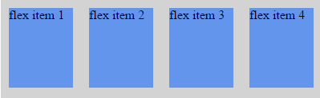
Flexbox, A Simple Example
HTML
    <div class="flex-container">
    <div class="flex-item">flex Item 1</div>
    <div class="flex-item">flex Item 2</div>
    <div class="flex-item">flex Item 3</div>
    <div class="flex-item">flex Item 4</div>
    </div>
CSS
    .flex-container {
    display: flex;
    width: 100%; height: 300px;
    }
    .flex-item {
    width: 25%; height: 100px; margin: 10px;
    background-color: cornflowerblue;
    }
Notes:
For simplicity, only the non-prefixed options are shown.

Slide 7
Flexbox Terms: Flex Container & Items
Flex Container: The parent element that contains the flex items.
Flex Item: each direct child element in a flex container becomes a flex item.
  Flex items are laid out in flex lines.
  They can be laid out horizontally (in rows) or vertically (in columns).
  The flex direction property of the Flex container determines the direction of the flex items.
By default a flex container has only one flex line.

Slide 8
Flexbox Terms: Axes
Axes: The axes are important concepts used in Flexbox layout.
Each flexbox layout has two axes:
  The main axis is the axis along which flex items follow each other.
  The cross axis is the axis perpendicular to the main axis.
  Note: The flex direction property determines which axes is the main axis and which is the cross axis.

Slide 9
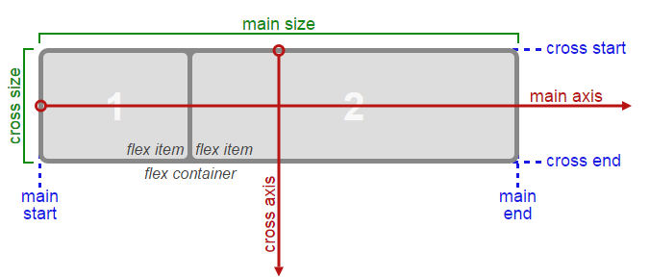
Flex Axes and Sizing for a Row Flex Container
The main axis and cross axis of a Flexbox if the flex-direction is set to row (the default).
Notes:
Source: https://www.w3.org/TR/css-flexbox-1/#box-model [accessed: 09-Nov-2016]

Slide 10
The flex-direction Property
The flex-direction property is used to specify the direction of the flexible items in the flexbox.
It depends on the current writing mode.
  row: (default) flex items laid out left-to-right, top-to-bottom, if the writing mode is left-to-right and horizontal (English writing mode).
  row-reverse: if the writing mode is left-to-right, the items will be laid out from the right to left.
  column: if the writing mode is horizontal, the items are laid out vertically, top-to-bottom.
  column-reverse: same as column, but reversed.

Slide 11
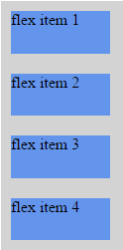
Flex Direction Example
The flex-direction property is added to the CSS for the flex container element.
  .flexContainer {
  display: flex;
  flex-direction: column;
  width: 100%;
  height: 300px;
  }
The flexible items will be displayed vertically in a column.

Slide 12
Flexbox Container CSS Properties
In addition to the flex-direction property, a flexbox container also has the following CSS properties:
justify-content
align-items
flex-wrap
align-content

Slide 13
The justify-content Property
Aligns flex items on the main axis when they do not use all available space.
flex-start: Default, items are positioned at the start of the container
flex-end: items are positioned at the end of the container
center: items are positioned towards the centre of the main axis line
space-between: items are distributed evenly on the line with equal spacing between them
space-around: items are positioned with space before, between and after
Illustration based on a row flex container

Slide 14
The align-items Property
Aligns flex items on the cross-axis when they do not use all available space.
flex-start
flex-end
foo foo foo foo
center
stretch
baseline
Default (noticeable when no height set on flex items)
Illustration based on a row flex container
Notes:
flex-start: The cross-start margin edge of the flex item is placed flush with the cross-start edge of the line.
flex-end: The cross-end margin edge of the flex item is placed flush with the cross-end edge of the line.
center: The flex item’s margin box is centered in the cross axis within the line. (If the cross size of the flex line is less than that of the flex item, it will overflow equally in both directions.)
baseline: If the flex item’s inline axis is the same as the cross axis, this value is identical to flex-start.

Slide 15
The flex-wrap Property
Controls whether the flex container is single or multi line.
nowrap: default, the flex container is single line. The flexible items will not wrap even if too wide.
wrap: the flex container is multi line – the flexible items will wrap if necessary.
wrap-reverse: same as wrap, but in reverse
1 | 2 | 3
4
4
1 | 2 | 3

Slide 16
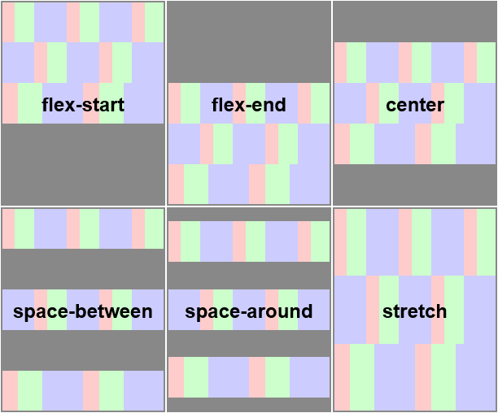
The align-content Property
Aligns flex lines (multi-line flex items) on the cross axis when they do not use all available space.
Default
Notes:
The align-content property has no effect when the flexbox only has a single line.

Slide 17
Flex Item CSS Properties
Flex items have the following CSS properties:
order: used to specify/change the ordering of a flex item.
margin: automatically absorbs extra space – used to push flex items into different positions.
  margin: auto; (perfectly centred)
  margin-left: auto; absorbs extra space on the right side of the flex item to its left side.
align-self: overrides the flex container’s align-items property for that flex item
flex: specifies the items of a flexible length.

Slide 18
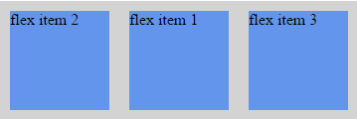
The order Property
Specifies the display order of a flex item in relation to the other flex items in the same parent container.
HTML
    <div class="flex-container">
    <div class="flex-item">flex Item 1</div>
    <div class="flex-item first">flex Item 2</div>
    <div class="flex-item">flex Item 3</div>
    </div>
CSS
    .flex-container{
    display: -webkit-flex; display: flex;
    }
    .flex-item {
    width: 25%; height: 100px; margin: 10px;
    background-color: cornflowerblue;
    }
    .first {
    -webkit-order: -1; order: -1;
    }
Order me one position before my normal position.

Slide 19

The margin Property
margin-right: auto;
<div class="flex-container">
<div class="flex-item first">flex Item 1</div>
<div class="flex-item">flex Item 2</div>
<div class="flex-item">flex Item 3</div>
</div>
.flex-container{
display: -webkit-flex; display: flex;
}
.flex-item {
width: 75px; height: 75px;
margin: auto;
background-color: cornflowerblue;
}
.first {
margin-right: auto;
}
Absorbs any extra space to the right of the item with class “first”

Slide 20
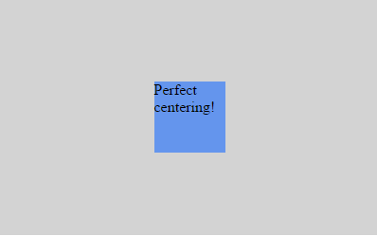
The margin Property: Perfect Centring
margin: auto; (Perfect centring)
<div class="flex-container">
<div class="flex-item">flex Item 1</div>
</div>
.flex-container{
display: -webkit-flex; display: flex;
}
.flex-item {
width: 75px; height: 75px;
margin: auto;
background-color: cornflowerblue;
}
The flex item is perfectly centred, horizontally and vertically.

Slide 21
The flex Property
Specifies the flex items of a flexible length
Syntax:
  flex: flex-grow flex-shrink flex-basis;
  flex-grow: determines how much the flexible item will grow relative to the other items in the container.
  flex-shrink: determines how much the flexible item will shrink relative to the other items in the container.
  flex-basis: the initial main size of the flex item before free space is distributed according to the flex factors.
  The default is: 0 1 auto.

Slide 22
flex Property Examples
flex: 1 1 auto;
  Item will grow 1 part into space available, or will shrink 1 part when not enough space and basis will be automatically determined based on its content.
flex: 0 0 50px;
  Item will neither grow nor shrink and it’s basis is 50px (will be 50px regardless of any free space).
flex: 2 0 50%;
  Item will take two lots of space, but won’t shrink and its initial base size is 50%.

Slide 23
Lab Exercise
Download instructions from Moodle

Slide 24
Homework
Come up with a wireframe mock-up of your proposed assignment website.

