Slide 1
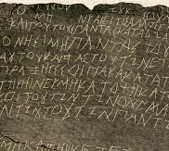

Curse Tablets
Michael Reynolds

Slide 2
“The spoken words of spells and incantations and the meaning of a ritual may be lost forever, but elements of the practice of magic can sometimes be identified in archaeological contexts.”
(Moretti 2015)
Notes:
What do people imagine when we think about spells and curses? Harry Potter, Lord of the Rings/Hobbit, Merlin, Maybe magical creatures, I always think of Gandalf (defensive spells).
All depictions of magic are linked back to a history of spells and curses. Moretti said in 2015 “The spoken words of spells and incantations and the meaning of a ritual may be lost forever, but elements of the practice of magic can sometimes be identified in archaeological contexts.”
Archaeologists always like to project meanings relating to rituals and magic onto artefacts and particularly onto things such as burials. However, one type of artefact is undoubtedly linked to curses and spells and this is the curse tablet.

Slide 3
What are curse tablets?
Small, thin sheets of lead
Shards of pottery
Selenite
Typically inscribed with various spells against other people using the help of supernatural agents
To date, almost 2000 curse tablets are known about
Mostly written in Greek
Some are in Latin
Notes:
Curse tablets are typically very thin sheets of lead with the text scratched on in tiny letters. The text might be written by a scribe for those who could not write themselves. They were then usually rolled or folded, or pierced with nails, and the tablets were then usually put underground, mostly buried in graves or tombs, sometimes thrown into wells or pools, sequestered in underground sanctuaries, or nailed to the walls of temples. Tablets were also used for love spells and when used for love spells they were put inside the house of the desired person. To date, almost 2000 curse tablets are known about. They’re mostly written in Greek and some are in Latin but there are also some from different cultures and periods other than Ancient Greece and Rome.
Although curses could be written on things like papyrus and stone, the curse tablets could also be made from other materials in addition to lead such as pottery (Harry Pottery) or even materials like selenite.

Slide 4
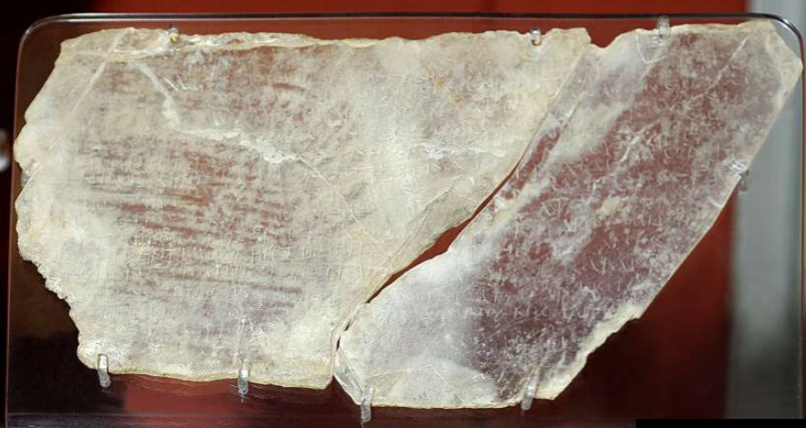
Selenite curse tablet, inscribed with a magical text in alphabetic Greek characters.
Image source: The British Museum, https://www.britishmuseum.org/collection/object/G_1891-0418-50
Notes:
Here is an example of a curse tablet made from selenite which is in the British Museum. This is from the Roman period around 200-300AD and was found in Cyprus. It is inscribed in Greek. The fragments were said to have been discovered in a deep shaft containing bones during the digging of a well.

Slide 5
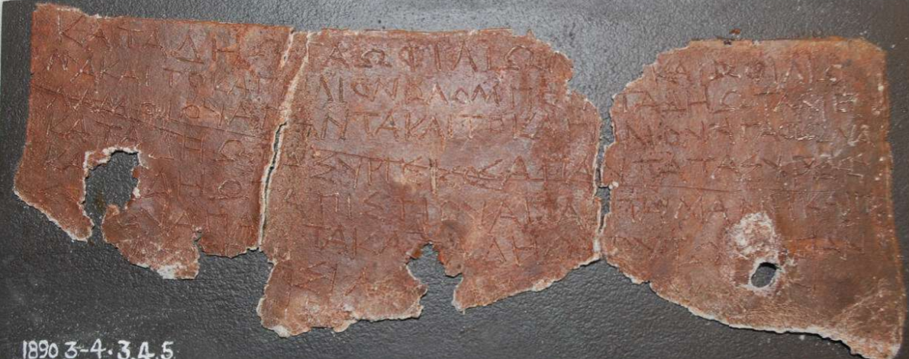
Fragment of a lead writing tablet with a curse text incised in Greek alphabetic characters.
Image source: The British Museum. https://www.britishmuseum.org/collection/object/G_1890-0304-3
Notes:
Here is a fragment of a lead curse tablet inscribed with Greek letters. It was found in Athens and dates from 300BC to 300AD.

Slide 6
Where have curse tablets been found?
Graves, sometimes with figurines of wax or lead
Wells or pools
Houses/homes
Temples
Notes:
Curse tablets have been found in a variety of contexts. In addition to the graves mentioned earlier, these include wells and pools, peoples’ houses and temples.

Slide 7
What can curse tablets tell us?
Social worlds
communities
relationships
Beliefs
Religion – the afterlife/the underworld
superstition
magic
Law
Notes:
What can curse tablets tell us? Well they can give us some information about social worlds including how communities functioned and peoples’ relationships to each other. They can give us insight into religious beliefs such as the afterlife and deities, superstitions, belief in magic and the law – as some curse tablets were about lawsuits.

Slide 8
Who wrote the curse tablets?
Important to consider levels of literacy in Ancient societies – high or low?
Professional curse writers who sold their skills in literacy and perhaps magic?
Which social classes cursed and were cursed? (Evidence suggests most social classes) Does this mean everyone did it?
Notes:
Another mystery is what type of people wrote the curse tablets? Were people writing their own or did they employ professional curse writers? In Plato’s text, The Republic, there is a reference to priests and seers” who were said to have traded “enchantments and bindings” to the rich and to have claimed that they could convince the gods to serve them

Slide 9
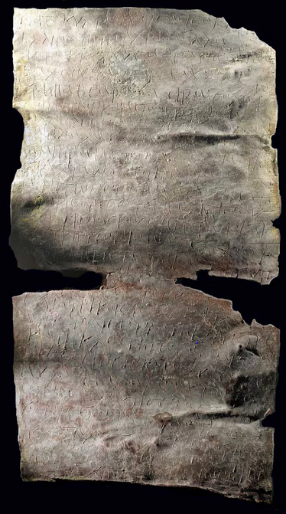
"O thunder-and-lightning-hurling iao, strike, bind, bind together Babylas the greengrocer…As you struck the chariot of Pharaoh, so strike his [Babylas'] offensiveness."
Notes:
An interesting curse tablet was found in a well in Antioch (now in Turkey) which was a part of the Roman Empire around 1700 years ago which the tablet dates to. It is a lead tablet and is inscribed in Greek. The curse was made against a greengrocer who was selling fruits and vegetables. The curse calls upon the god of the Old Testament, Iao, to afflict the greengrocer whose name was Babylas. This means that the curse writer could have been Jewish. It is possible that it was motivated by a business rivalry.
This tablet shows that in the ancient world, nobody, no matter how humble, was immune to being cursed!

Slide 10
References
Moretti, D. 2015. Binding spells and curse tablets through time Chapter in The Materiality of Magic.
Jarus, O. 2011. Deciphered ancient curse reveals curse of greengrocer. https://www.livescience.com
The British Museum.

