Slide 1
Assessment Task 2
Enterprise and Entrepreneurship
Presentation Template

Slide 2
Business Plan
Name: Elena-Beatrice Paun
ID NO: 2508054
Moodle: Enterprise & Entrepreneurship
Code: LCLM4006
Lecture: Andry Rakotovololona

Slide 3


Table of Contents
Introduction
Business Idea & Services
Market Need & USPs
Legal & Team Structure
PESTEL Analysis
Marketing Strategy
Financial Forecast
Startup Costs & Funding
Operating Costs
Break‑Even Analysis
Conclusion
Questions

Slide 4

Introduction
Introduce yourself.
Name: Elena Beatrice Paun
Founder of Elegance Hair Salon
Passionate about the beauty and haircare industry
Committed to providing high-quality and sustainable haircare services
Purpose of the Presentation
Introduce the business concept of Elegance Hair Salon
Explain the legal structure and management team
Present the key findings from the PESTEL analysis
Outline the marketing strategies
Demonstrate the funding requirements and business growth potential
Notes:
When introducing yourself remember to Keep the introduction section concise but impactful. The goal is to establish trust and confidence in your ability to lead the business successfully. Remember to focus on relevant information that aligns with your business idea and creates a positive impression of you. You may include the following information.
Name and Role: Start by stating your name and your position or role in the company. If you are the founder or one of the key team members, mention your title (e.g., CEO, Co-founder).
Background and Experience: Briefly share your relevant background and experience. Highlight any expertise, qualifications, or achievements that demonstrate your capability to lead and execute the business idea effectively.
Passion and Motivation: Explain why you are passionate about the business and the problem you are solving. Share your vision for the company and what drives you to pursue this venture.
Connection to the Industry: If you have a personal or professional connection to the industry in which your business operates, share that information. It could be an experience, personal story, or a passion for the industry that led you to start this venture.
Keep the introduction section concise but impactful. The goal is to establish trust and confidence in your ability to lead the business successfully. Remember to focus on relevant information that aligns with your business idea and creates a positive impression of you and your team.

Slide 5

Overview of the Business Idea
Elegance Hair Salon is a modern unisex salon located near Westfield London, offering professional haircare services for women, men and children.
Services
﻿﻿Haircuts & Styling
﻿﻿Hair Colouring
﻿﻿Balayage & Highlights
﻿﻿Hair Treatments
﻿﻿Beard Grooming
﻿﻿Eco-friendly Haircare Products
Unique Selling Points
﻿﻿Eco-friendly and cruelty-free products
﻿﻿Affordable pricing
﻿﻿Personalised customer service
﻿﻿Prime location near Westfield London
﻿﻿Student and senior discounts
Market Need
Growing demand for sustainable beauty services
Customers seeking affordable, high-quality haircare
Convenient location for local residents and shoppers

Slide 6
Legal Format and Management Structure
Legal Structure
Private Limited Company (Ltd)
Why a Limited Company?
Protects the owner’s personal assets
Creates a professional business image
Easier access to finance
Supports future business growth
Owner/ Salon Manager
Receptionist
Professional Hair Stylists
Notes:
Refer to week 3 slides: Legal format of Enterprises & Building a Founding team

Slide 7
PESTEL Analysis
PESTEL analysis
Legal
Compliance with UK employment law.
Data protection under GDPR.
Health and safety regulations for salons.
Political
Government regulations for health and safety.
Employment laws and minimum wage requirements.
Business licensing and local authority regulations.
Economic
Rising inflation increases operating costs
Customers expect value for money
Social
Increasing demand for sustainable beauty services
Customers value personalised experiences
Technological
Online booking systems
Digital payments
Social media marketing
Business Strategy
Online appointments
Active social media presence
Business Strategy
Protect customer information through secure booking systems.
Provide regular staff training on health and safety.
Ensure full compliance with employment and consumer protection laws.
Business Strategy
Comply with all UK health and safety regulations.
Ensure staff receive fair wages and legal employment contracts.
Keep all licences and permits up to date.
Business Strategy
Competitive pricing
Loyalty rewards
Business Strategy
Eco-friendly products
Excellent customer service
Notes:
You can use either MS Visio or MS Word to create this.

Slide 8
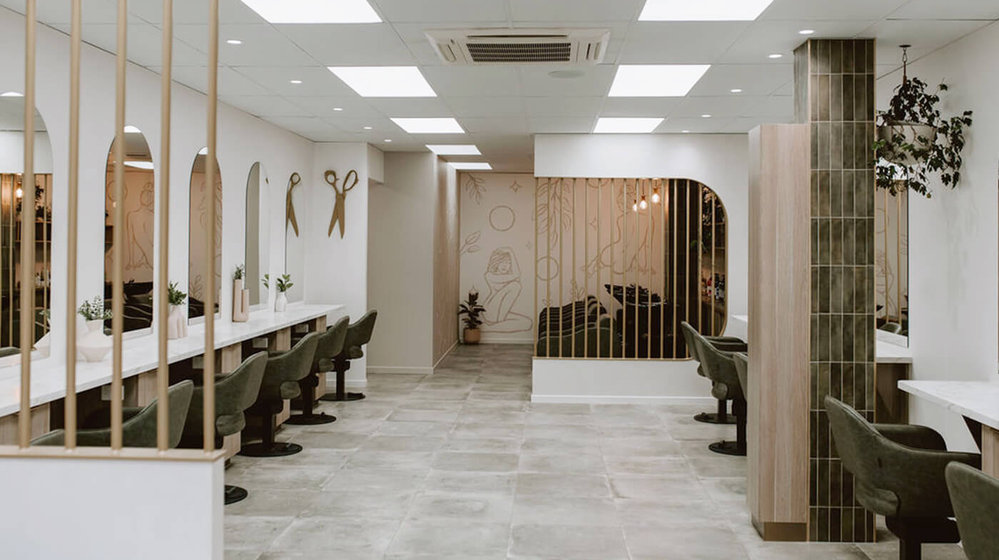
Marketing Strategies
Target Customers
Working professionals
Students
Families
Local residents
Westfield visitors
Social Media Marketing​
Instagram​
TikTok​
Facebook​
Before & After content​
Customer reviews​
Promotional campaigns
​
​ Customer Loyalty Programme​
Student discounts​
Senior discounts​
Loyalty cards​
Referral rewards​
Seasonal promotions
Notes:
Apply PESTEL analysis taught in week 4:
Analyse the following factors:
Political – Government policies, regulations, tax laws, trade restrictions.
Economic – Inflation, interest rates, economic growth, consumer spending.
Social – Demographics, cultural trends, lifestyle changes, education.
Technological – Innovation, digital transformation, automation.
Environmental – Sustainability, climate change regulations, waste management.
Legal – Employment laws, intellectual property rights, industry-specific regulations.
2. Align PESTEL with Business Strategy
After identifying key external factors, explain how they impact your business and what strategies you will adopt to mitigate risks or leverage opportunities.

Slide 9

Funding Requirements and Allocation
Total Funding Required​
£46,000​
​
Funding Sources​
Owner’s Investment – £23,000​
Bank Loan – £23,000
Allocation of Funds​
​
Equipment & Furniture​
Refurbishment​
Working Capital​
Initial Stock​
Marketing​
Licenses & Insurance​
Staff Salaries​

Slide 10

Financial Forecast
Year 1 Revenue
£90,000 – from hair services, repeat clients and local demand.
Year 3 Revenue£180,000 – driven by growth, loyalty, marketing and new customers.
Financial Performance
Positive cash flow: Month 3
Break-even: Month 12
Revenue doubles Year 1–3
Strong long‑term growth potential

Slide 11
Startup costs
Startup Costs | Amount £
Receptionist | £1,100
4 Professional hair stylists | £5,000
Rent and business rates | £1,800
Refurbishment and signage | £8,000
Equipment and furniture | £10.000
Initial stock | £2,500
License and insurance | £1,200
Marketing launch | £1,500
Working capital reserve | £15,000
Total Funding | £46,000
Funding Source | Amount £
Owner’s personal investment | £23,000
Bank business loan | £23,000
Total funding | £46,000

Slide 12
Operating costs
Operating costs | Annual costs
Rent and business rates | £21,600
Staff wages | £31,200
Stock requirements | £7,200
Utilities and insurance | £6,000
Marketing and miscellaneous | £4,500
Total annual costs | £70,500
Key points
Staff wages represent the largest operating expense.
Running costs have been carefully planned to support business growth.
Costs remain sustainable in relation to projected revenue.

Slide 13

Break-even Analysis
Break-even Analysis
Financial Summary
Total annual fixed costs: £70,500
Average monthly fixed costs: £6,250
Average profit margin per service: 60%
Monthly revenue required to break even: £10,400
Break-even point expected by Month 12

Slide 14

Conclusion​
The financial projections indicate that Elegance Hair Salon will become financially sustainable within the first year of operation.​
Revenue is expected to continue increasing as the customer base grows, supporting long-term profitability and future expansion.

Slide 15

Questions?

