Slide 1
The Origins of Seleucid Ruler Cult in Asia Minor
Or were the Seleucid kings divine before Antiochus III?

Slide 2
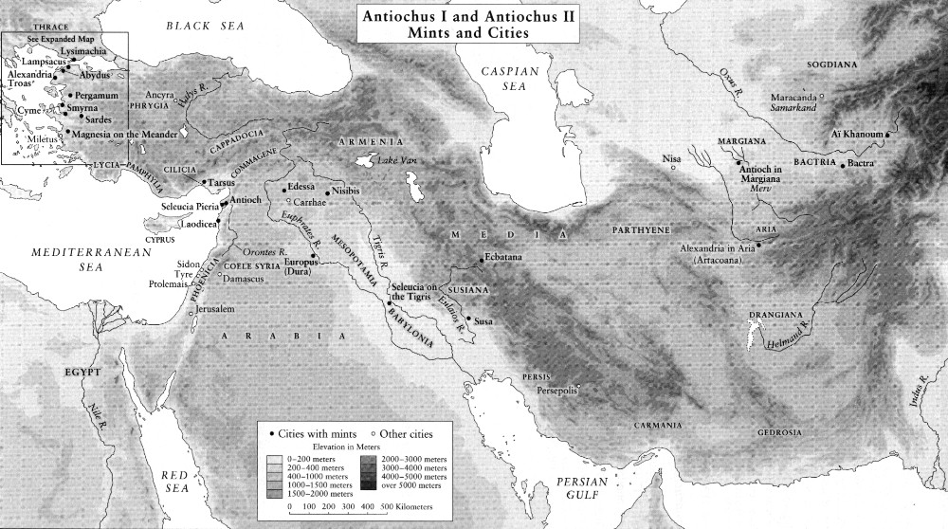

Slide 3
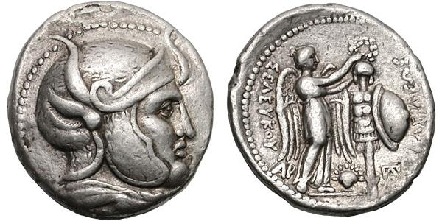
Seleucus in a horned-helmet

Slide 4
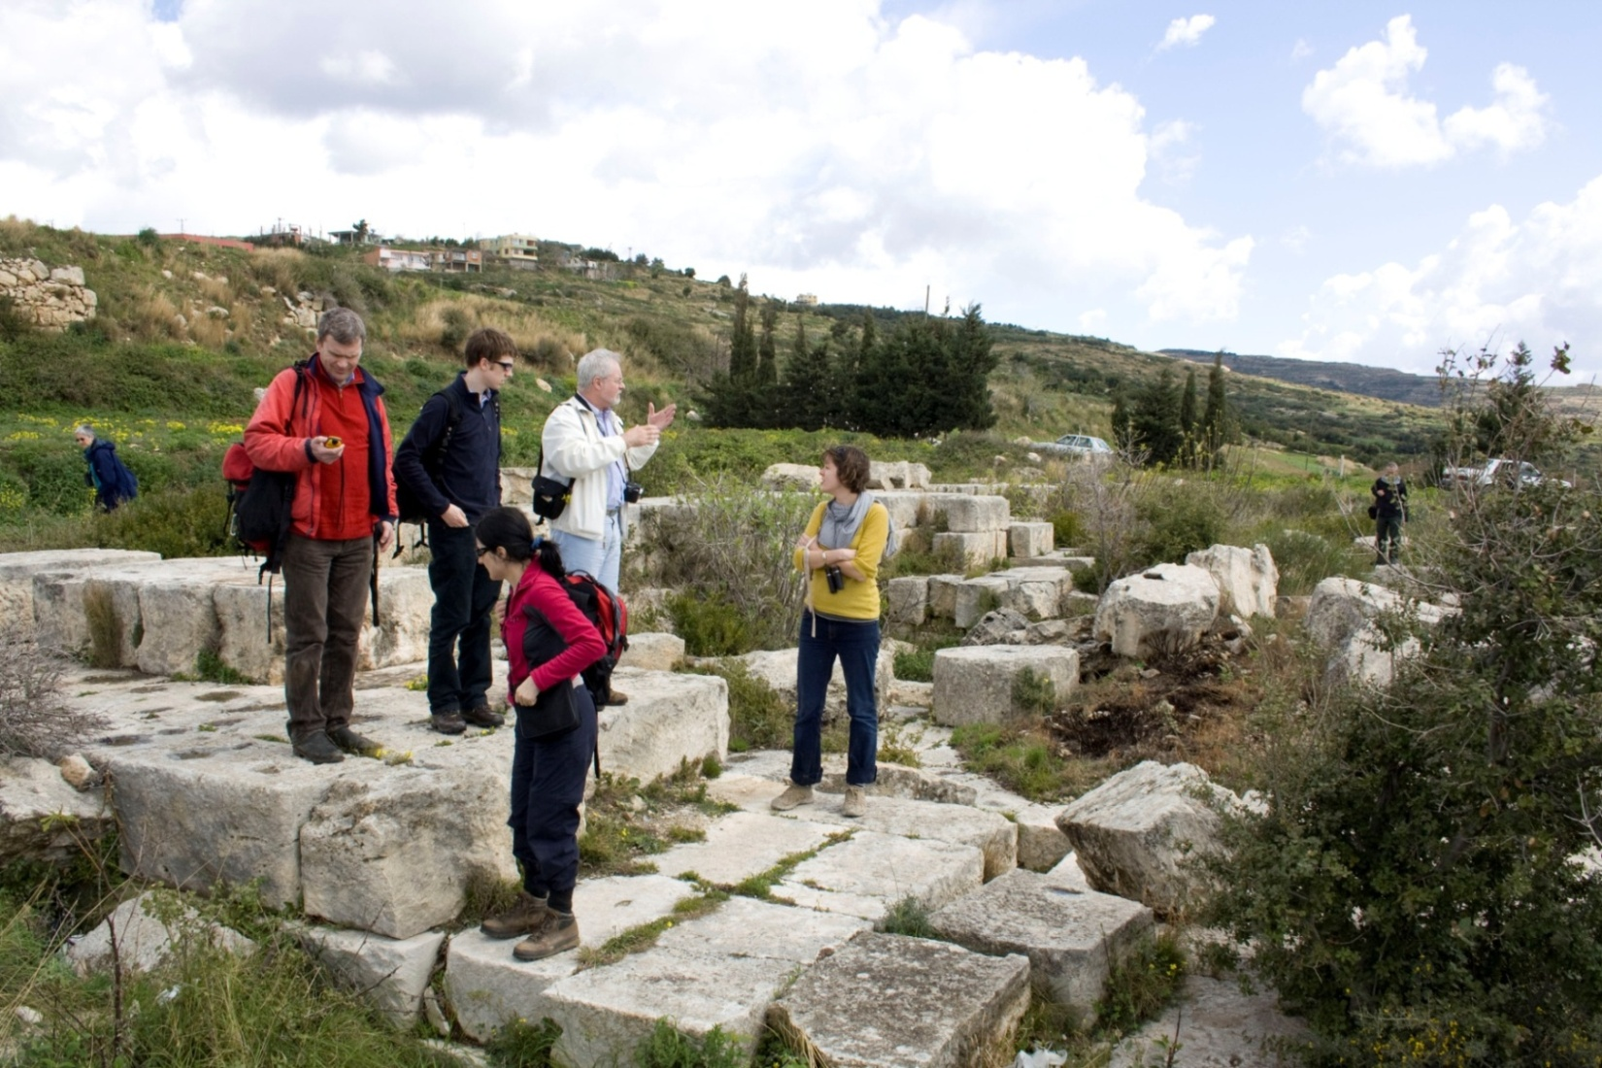
Temple of Seleucus?

Slide 5
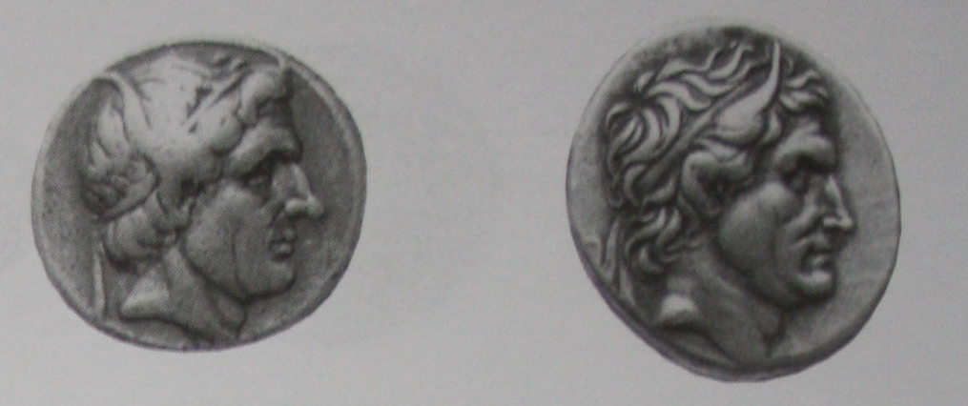
Horned Seleucus I

Slide 6
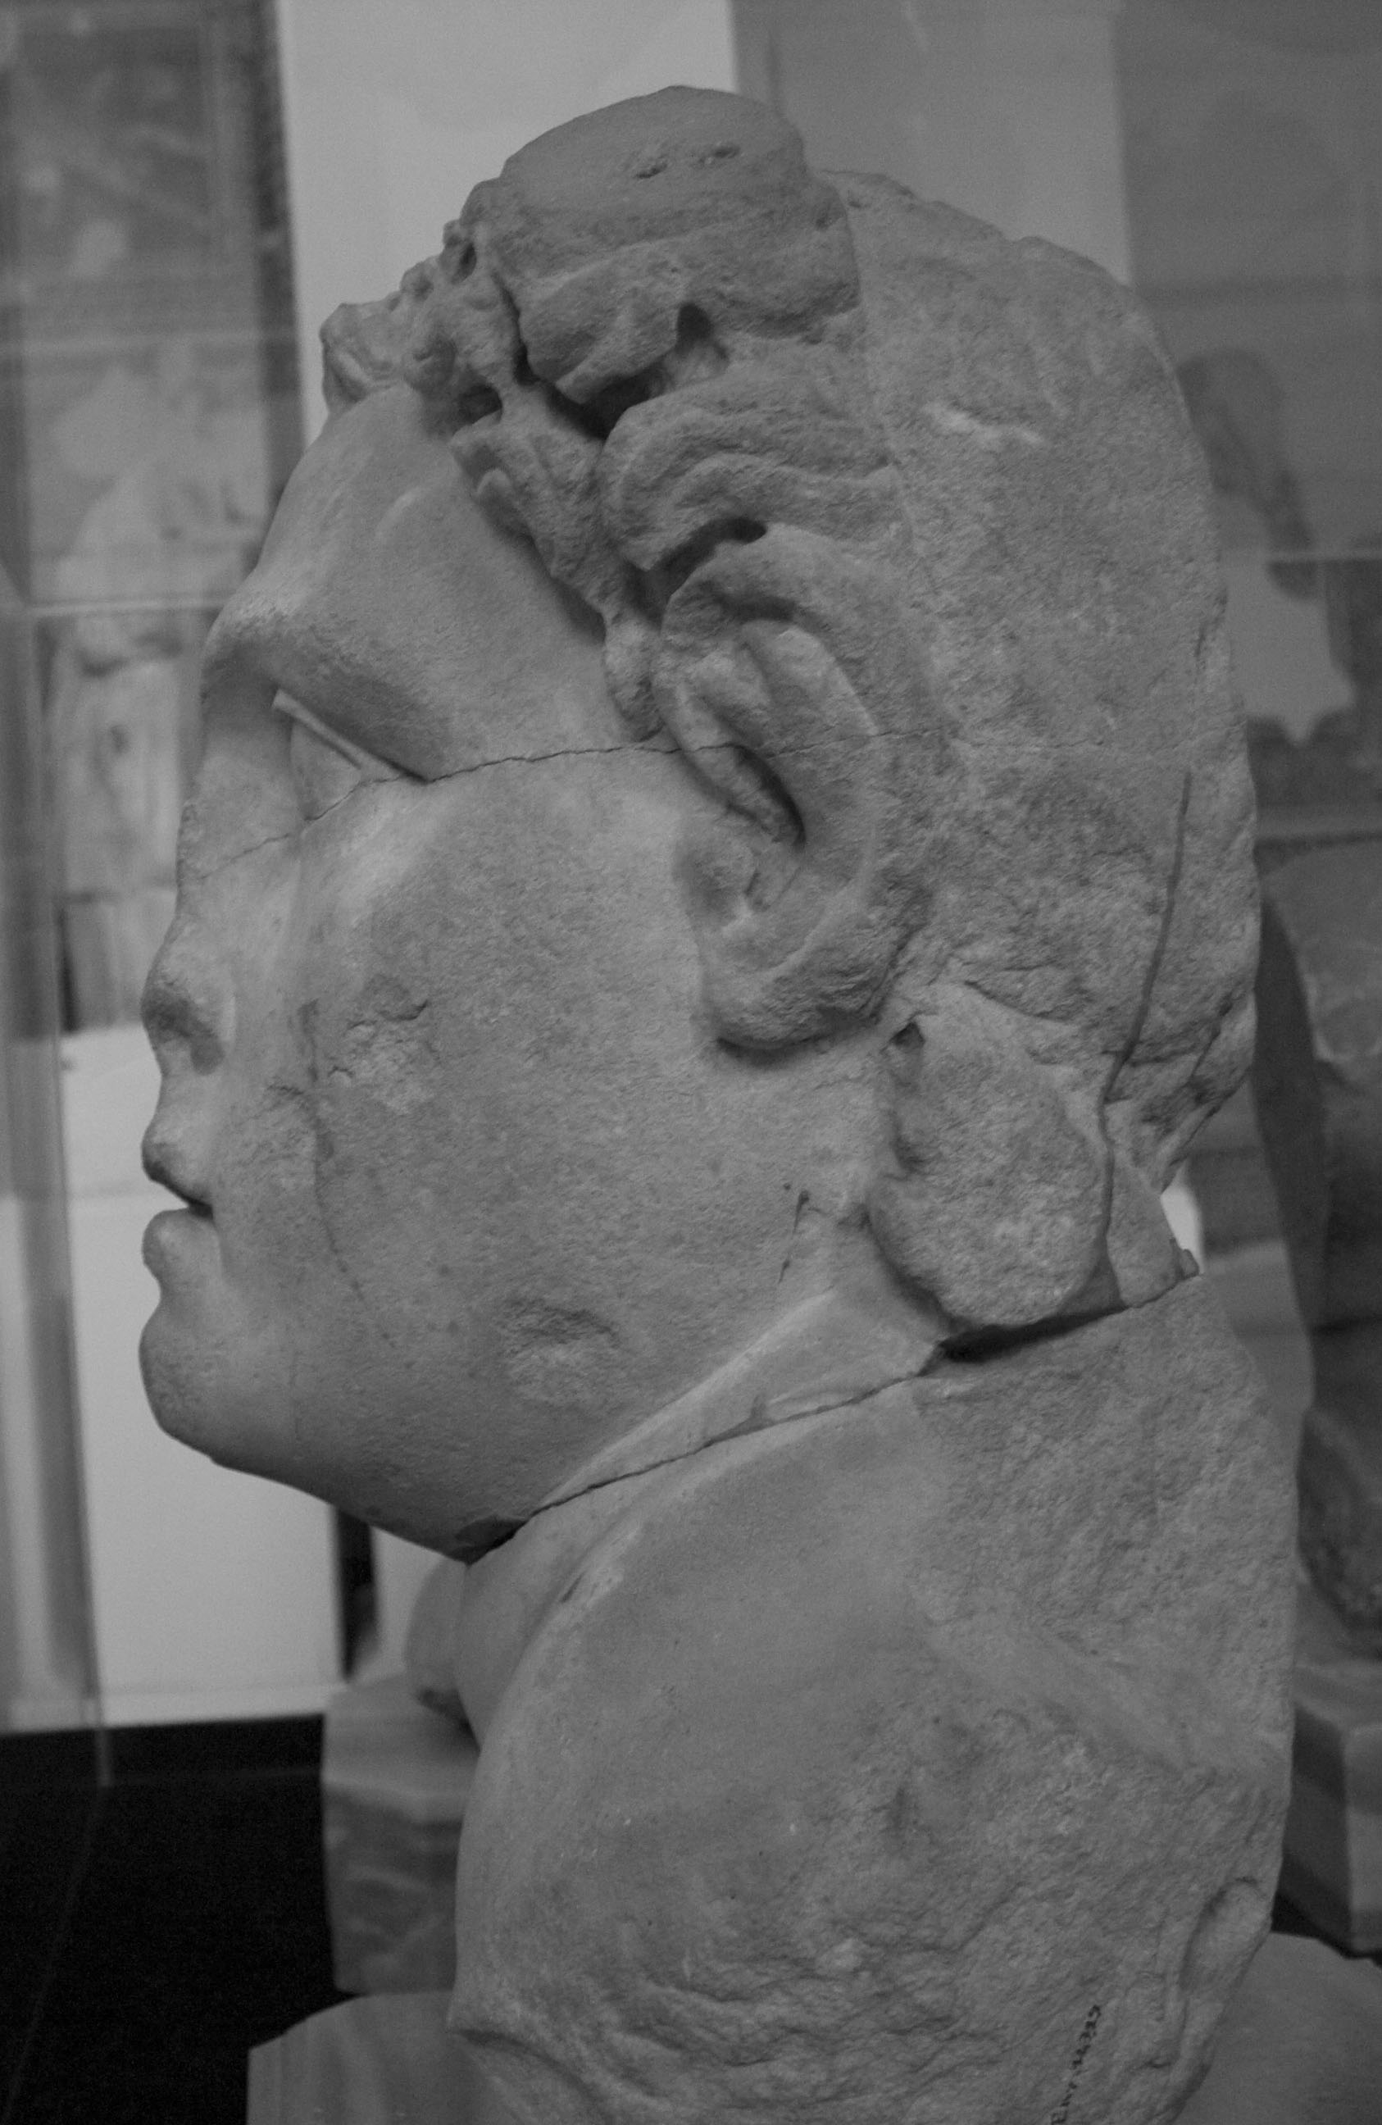
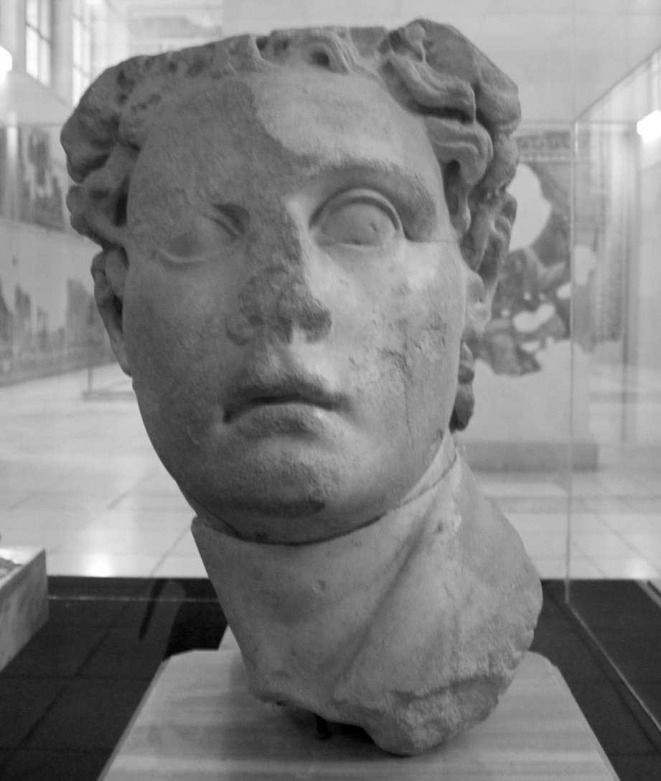
Horned Seleucus I

Slide 7
But Phylarchus says that those Athenians who settled in Lemnos were great flatterers, mentioning them as such in the thirteenth book of his History. For that they, wishing to display their gratitude to the descendants of Seleucus and Antiochus, because Seleucus not only delivered them when they were severely oppressed by Lysimachus but also restored both their cities to them, they, I say, the Athenians in Lemnos, not only erected temples to Seleucus, but also to his son Antiochus; and they have named the cup, which at their feasts is offered at the end of the banquet, the cup of Seleucus the Saviour.
- Athenaeus 254f-255a (Olson Translation) = Phylarchus FGrH 81 F 29

Slide 8
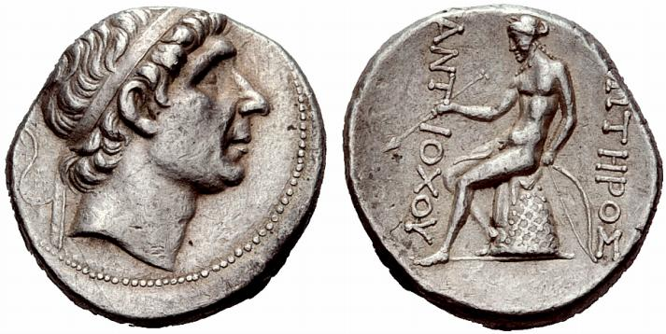
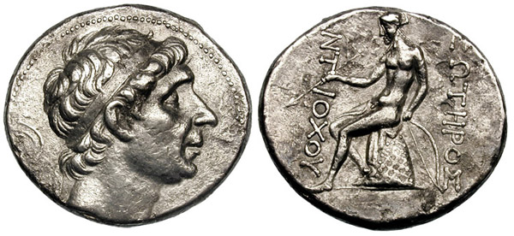
Antiochus Soter Coinage

Slide 9
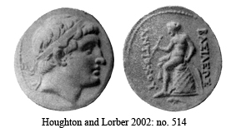
Deified Antiochus II?

Slide 10
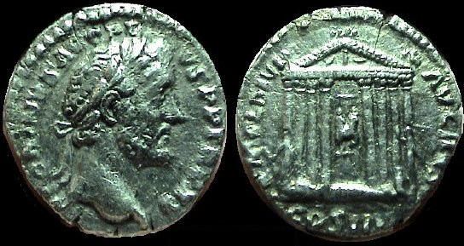
Things you don’t see on Seleucid Coins

Slide 11
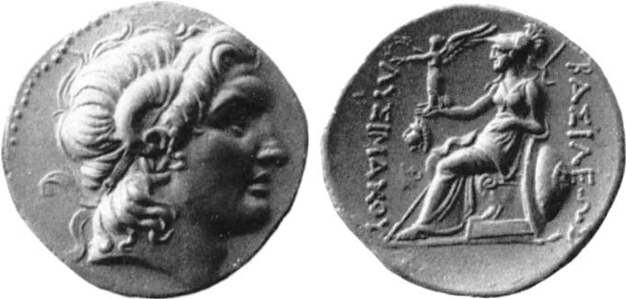
Divine Alexander

Slide 12
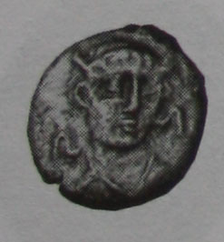
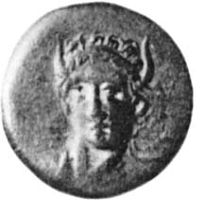
Horned Seleukos II
Seleucia-on-the Tigris
Susa

Slide 13
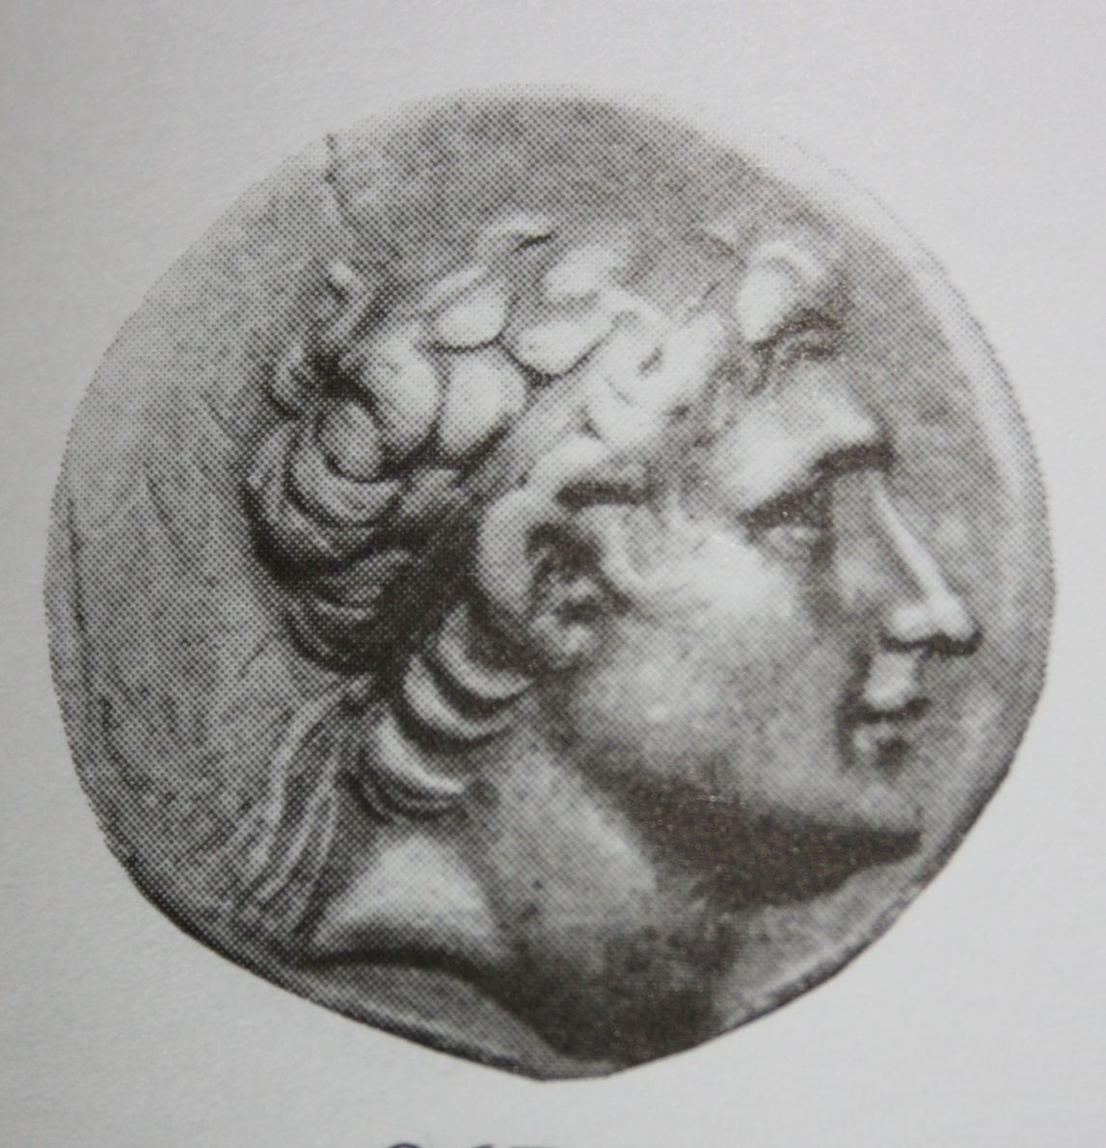
Antiochus Hierax Coinage

Slide 14
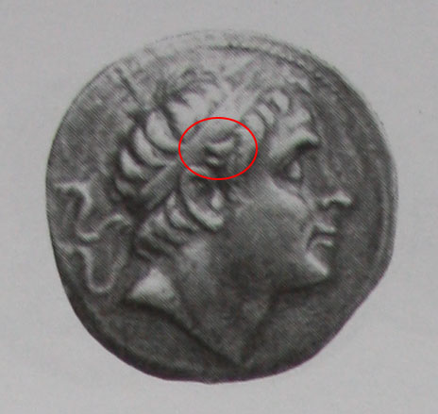
Seleucus III

Slide 15
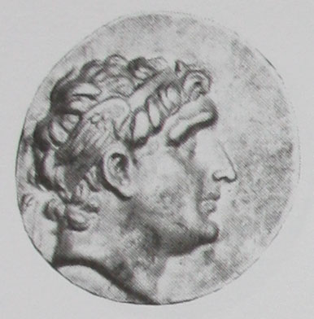
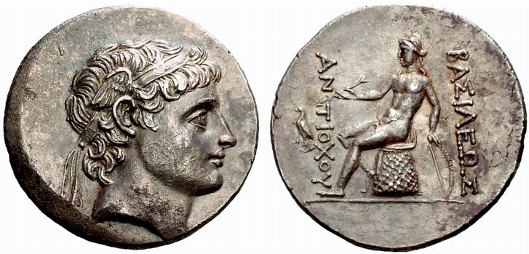
Winged Diadem under Hierax
Antiochus I
Hierax?

