Slide 1
Module Code and Title:
BMSW6010 Leadership and Change
Task 1: Presentation
Title: Analysing Leadership Approaches and Future Challenges at Aldi
Student Name: Mariana-Adela Sugar
Student ID:2244011
Data: 07/11/2025

Slide 2
Table of Contents
Introduction
Overview of Aldi and the UK Retail Context
Understanding Leadership: Theoretical Frameworks
Self-Assessment of Leadership Style
Critical Analysis of Leadership Style in Context
Linking Leadership to Organisational Strategy
Anticipating Future Organisational Challenges
Leadership and Change Management
Developing Leadership Competencies for the Future
Conclusion
References

Slide 3

Introduction
Aldi’s success in the UK retail market is built on a cost-effective, customer-focused business model (Marx, 2015).
Effective leadership is vital to maintaining competitiveness in a dynamic retail environment (Silva, 2016).
The essay evaluates personal leadership style in relation to Aldi’s strategic and operational context.
Fig: Aldi Logo (Silva, 2016)
Notes:
Introduction
Aldi is a foremost chain of discount supermarket in the United Kingdom which has a reputation of offering quality products at low prices. The company has been able to gain traction because of its effective business model and customer value orientation. A good leadership is essential in the ever-evolving retailing environment to ensure the performance of the operations as well as its competitiveness. This essay aims at critically evaluating my leadership style and justifying why it is appropriate in addressing the future challenges of Aldi. The essay shall examine the main theories of leadership, evaluate my approach to leadership, and apply the same to Aldi strategy and the UK retail market.

Slide 4
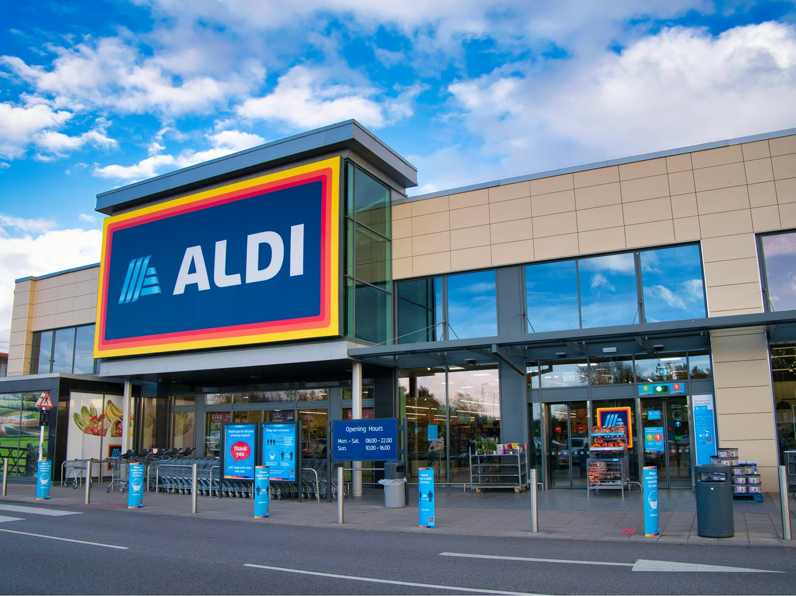
Overview of Aldi and the UK Retail Context
Aldi operates over 1,000 UK stores using a low-cost, high-efficiency model (Marx, 2015).
UK retail faces challenges like post-Brexit inflation, labour shortages, and supply chain disruptions.
Technological and sustainability pressures demand agile, adaptive leadership (Hanelt et al., 2021).
Fig: Aldi Store (Marx, 2015)
Notes:
Overview of Aldi and the UK Retail Context
Aldi entered the UK market in 1990 and has since opened at a very high rate to operate over 1,000 stores in the country. It has positioned itself as a major retailer in terms of low cost and high efficiency model which enables customers to enjoy quality products at competitive prices. According to Marx (2015), the strategy of a business directly affects the needs of its leadership, and in the case of Aldi, the model needs managers that are efficient, disciplined, and people-centered.
There are a number of threats impacting the leadership practices of Aldi in the UK economy. The uncertainty in the retail sector has been brought about by post Brexit inflation, labour shortages and continuous supply chain pressures. As Hanelt et al. (2021) observe, the digital transformation and the increasing demand on innovation is transforming business operations making leaders have to adjust fast. Aldi leaders in this environment will have to maintain stability and adopt technological and sustainability trends to remain competitive.

Slide 5
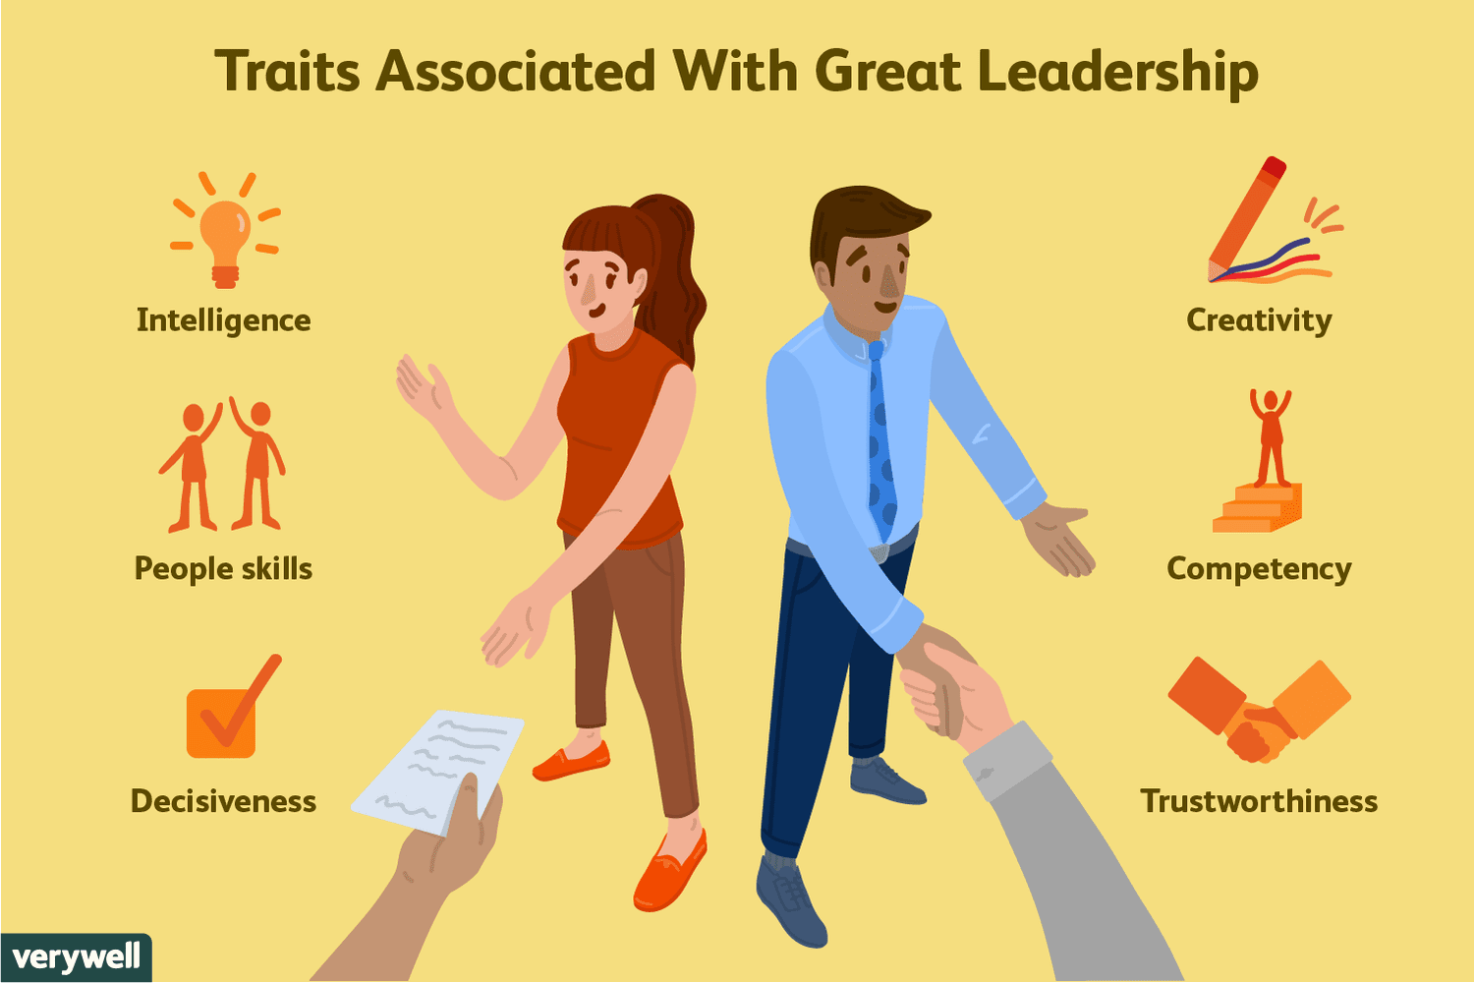
Understanding Leadership: Theoretical Frameworks
Early theories focused on innate traits (Trait Theory) and behavioural approaches (Silva, 2016).
Transformational leadership promotes creativity and shared vision (Anderson, 2017).
Quantum leadership emphasises adaptability and awareness in complex business environments (Tsao & Laszlo, 2020).
Fig: Trait Theory (Anderson, 2017)
Notes:
Understanding Leadership: Theoretical Frameworks
One can think of leadership as an act of inspiring, guiding and influencing others to work towards a common objective and management revolves more around planning and control (Silva, 2016). The initial theories of leadership like the Trait Theory, postulated that leaders are born with some inbuilt qualities such as confidence and intelligence. The behavioural theories were subsequently concerned with the behaviours and habits of leaders and contingency theories held that the best leadership style was a situational matter.
The motivational approach that helps in inspiring the followers and connecting with them on a personal level has been emphasised by modern approaches, including transformational leadership. According to Anderson (2017), transformational leaders are the ones who encourage creativity and devotion by engaging their followers with a shared vision and emotion. The authors develop this concept by introducing the concept of quantum leadership, according to which Tsao and Laszlo (2020) consider leadership as a dynamic process, conscious and adaptive to complex modern conditions. The strategies are particularly applicable to the retail business sector where leaders of the organisation need to be flexible and emotionally intelligent due to the fact that they must change very fast.

Slide 6
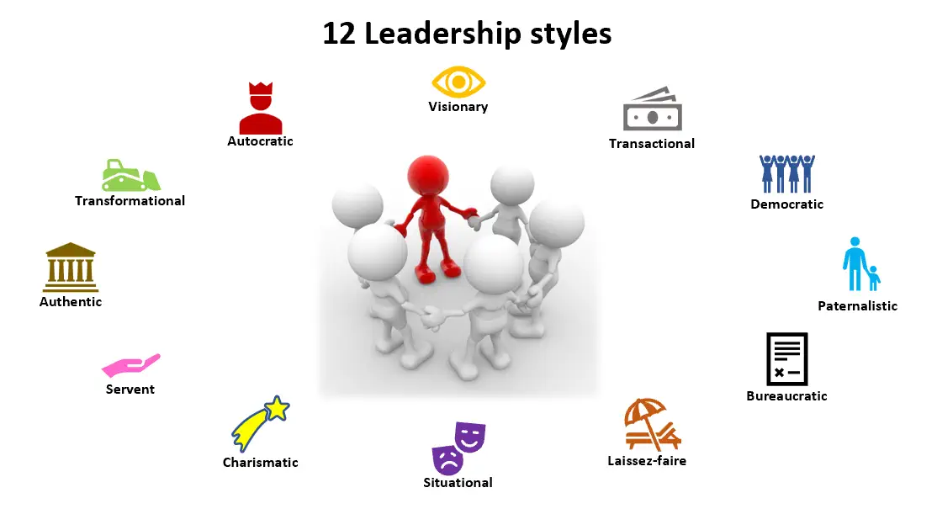
Self-Assessment of Leadership Style
The writer identifies a transformational and participative leadership style (Goleman, 2016).
Strengths include empathy, communication, and team motivation (Tannenbaum & Schmidt, 2017).
Weakness lies in reduced assertiveness during high-pressure decision-making (Anderson, 2017).
Fig: :Leadership Styles (Anderson, 2017)
Notes:
Self-Assessment of Leadership Style
Having analysed my leadership experiences and taken leadership questionnaires, I perceive that my leadership style is transformational with some aspects of participative approach. According to Goleman, emotional intelligence is a leading attribute to a successful leader (2016), and I have discovered that empathy, self-awareness, and enthusiasm are the essential qualities of my leadership style in guiding people. This was also supported by the feedback I received with my manager stating that I am approachable, clear in my communication and promote team work in the team.
The Tannenbaum and Schmidt (2017) invented a leadership continuum where leaders are rated on a spectrum between autocratic and participative. According to this model, I would lean more towards the participative side, which means that my team will be involved in the decision-making process to establish a sense of ownership and trust. According to Anderson (2017), such involvement improves motivation and performance, and this is my experience with small projects. Nevertheless, a weakness that I identify is being less assertive in times of great pressure when I tend to choose to be more generous to the team by compromising the need to make a firm decision.

Slide 7
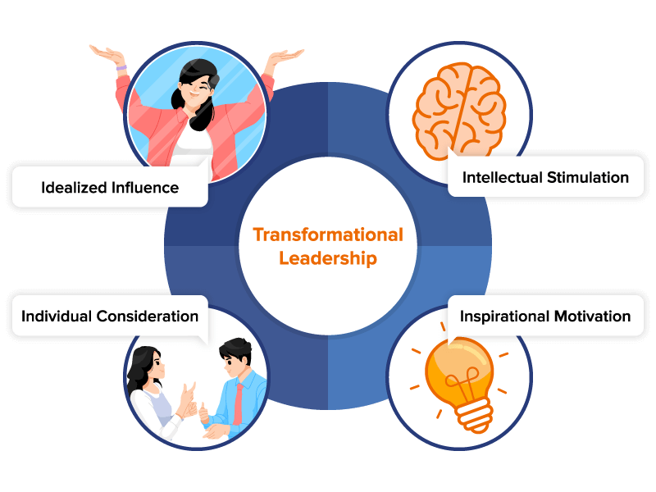
Critical Analysis of Leadership Style in Context
Transformational leadership aligns with Aldi’s collaborative and performance-driven culture (Silva, 2016).
Emotional intelligence enhances team morale and outcomes (Goleman, 2016).
Flexibility is needed to make decisive operational decisions when required (Marx, 2015).
Fig: Transformational Leadership (Marx, 2015)
Notes:
Critical Analysis of Leadership Style in Context
The culture in Aldi focuses on the collaboration within a team, efficiency in operations and performance, and my leadership style fits these values perfectly. Transformational leadership is also aimed at inspiring employees by vision and involvement, and this can be relevant to the goal of Aldi providing consistent quality and service (Silva, 2016). In actual sense, I put emphasis on open communication and motivate employees to generate ideas, which contributes to the creation of a collaborative atmosphere.
According to Goleman (2016), leaders with a high level of emotional intelligence build superior bonds and improved outcomes. My personal skills in the retail environment, where teamwork is crucial to the working process, are beneficial to morale and performance. Nonetheless, Marx (2015) points out that the style of leaders should be flexible to the needs of the organisation as well. I should be more decisive and directive in times when it is required to resolve operational issues that have to be completed quickly, which is common in Aldi.

Slide 8
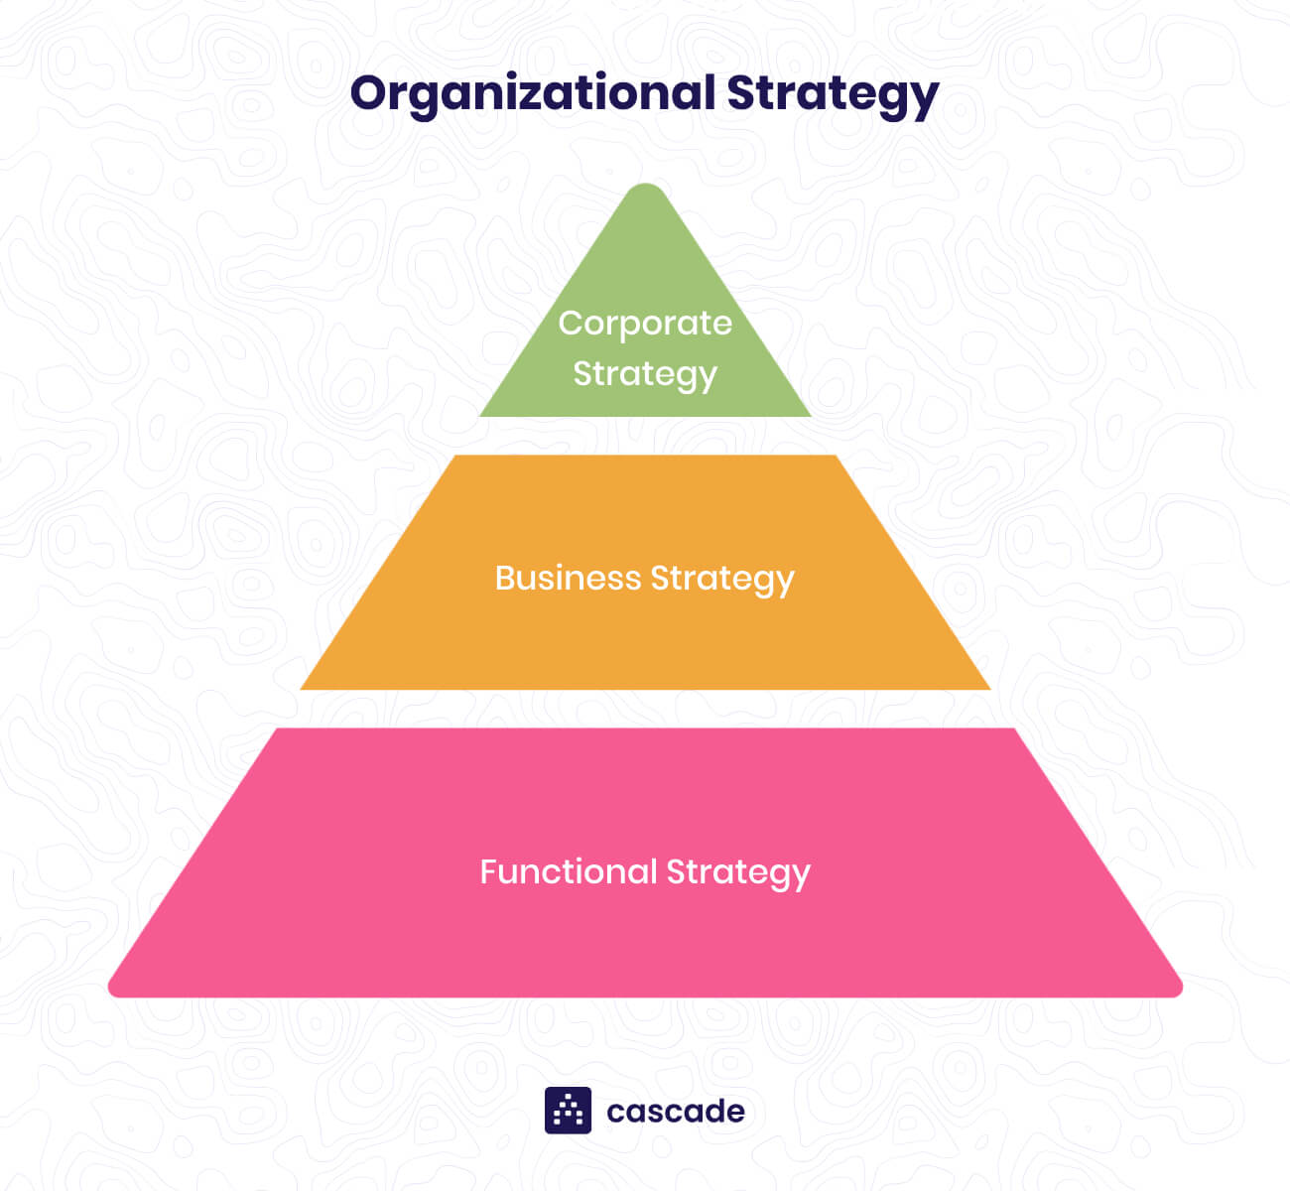
Linking Leadership to Organisational Strategy
Aldi’s cost-leadership strategy demands efficiency and employee engagement (Marx, 2015).
Participative leadership supports innovation and operational improvement.
Digital transformation requires open communication and adaptability (Hanelt et al., 2021).
Fig: Organisational Strategy (Hanelt et al., 2021)
Notes:
Linking Leadership to Organisational Strategy
Aldi relies on its cost-leadership strategy, which is based on high productivity and high engagement with its employees. According to Marx (2015), business strategy has to be matched to the leadership, and in the case of Aldi, it should be the promotion of efficiency and accountability culture. This is facilitated through my transformational and participative leadership style that inspires employees to be innovative in enhancing operations but remain devoted to organisational objectives.
According to Hanelt et al. (2021), digital transformation has become the key to business success, and the leaders of Aldi should focus on using new technologies to achieve efficiency. My leadership style promotes free communication and involvement, which may facilitate the adaptation of employees to digital technologies and new systems. Gauttier et al. (2024) also mention that leaders should be ready to work with such new digital trends like the metaverse and online shopping areas.

Slide 9

Anticipating Future Organisational Challenges
Aldi faces digitalisation, automation, and sustainability pressures (Hanelt et al., 2021).
Leaders must balance technology adoption with human-centric values (Gauttier et al., 2024).
Quantum leadership fosters adaptability in uncertain retail environments (Tsao & Laszlo, 2020).
Fig: Digitalisation (Hanelt et al., 2021)
Notes:
Anticipating Future Organisational Challenges
Retail industry is changing drastically and Aldi will encounter a number of obstacles in the next decade. They are digitalisation, automation, sustainability pressure and evolving consumer expectations. Customer behaviour has changed due to the emergence of online grocery shopping, and the issue of climatic change and environmental consciousness is compelling businesses to be more sustainable. The authors state that in order to cope with such transitions, leaders should gain strategic agility (Hanelt et al., 2021).
Moreover, Gauttier et al. (2024) comment on the necessity of the leaders to make a choice concerning the timing and the way of adopting digital innovation, including the introduction of virtual shopping experiences. In the case of Aldi, leaders that manage to juggle technological effectiveness with human-oriented values of the company will be successful. According to Tsao and Laszlo (2020), leaders can overcome uncertainty and complexity with the help of quantum leadership which is based on awareness, adaptability and connectedness.

Slide 10

Leadership and Change Management
Lewin’s model highlights unfreezing, changing, and refreezing stages for managing change (Hussain et al., 2018).
Participative leadership reduces resistance by promoting communication and inclusion (Hage & Aiken, 2018).
Trust and collaboration are key to successful organisational change (Fernandez & Rainey, 2017).
Fig: Change Management (Hage and Aiken, 2018)
Notes:
Leadership and Change Management
Change management is a very important aspect of leadership in organisations. The model by Kurt Lewin includes three important phases, namely: unfreezing, changing, and refreezing (Hussain et al., 2018). At Aldi, the leaders will need to begin change preparation by educating the workforce on the rationale of change, followed by an orientation process, and the last step will be supporting the new systems or practices. It is a strategy that can be used to make the employees perceive and embrace the change process. According to Hage and Aiken (2018), the engagement of staff in the decision-making process cultivates ownership and decreases resistance to change. The fact that my leadership style is participative helps to support this conception as it encourages open communication and teamwork. In a similar manner, Fernandez and Rainey (2017) emphasise the fact that successful change requires trust, communication, and employee participation.

Slide 11
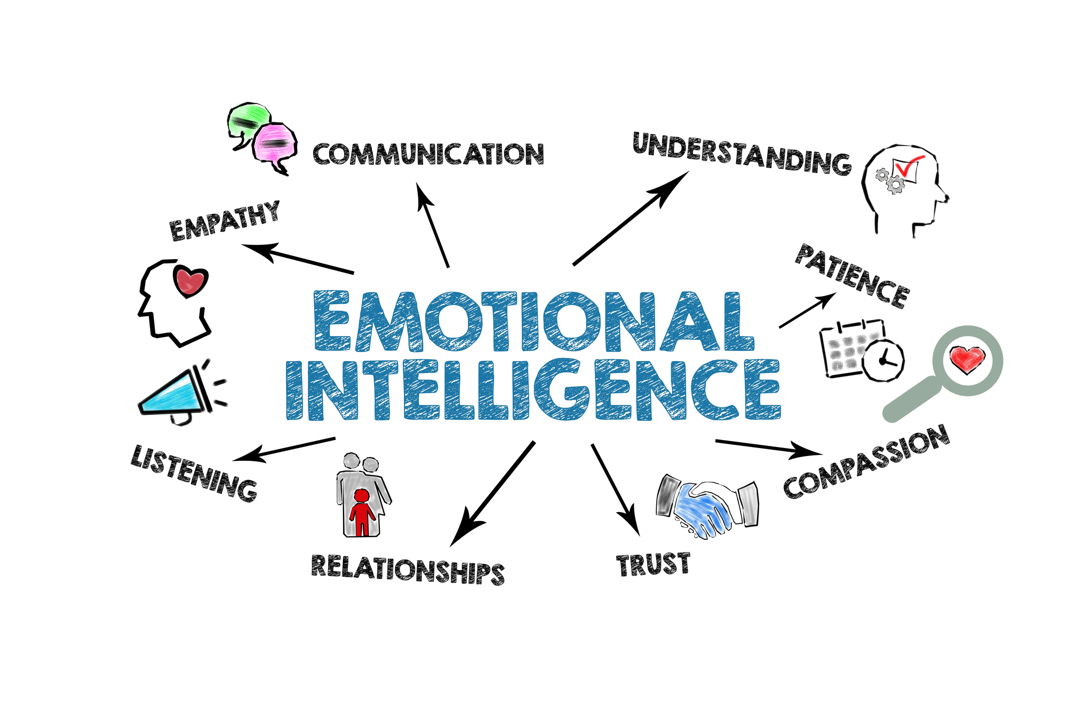
Developing Leadership Competencies for the Future
Leaders must develop digital literacy and sustainability awareness (Tsao & Laszlo, 2020).
Emotional intelligence strengthens self-regulation and empathy (Goleman, 2016).
Transformational leaders inspire growth and adaptability in teams (Anderson, 2017).
Fig: Emotional Intelligence (Anderson, 2017)
Notes:
Developing Leadership Competencies for the Future
Leaders need to constantly upgrade their skills in order to be effective. With Aldi steadily growing and preparing to make its operations digital, I am aware of the need to develop my digital literacy and knowledge of green business practices. According to Tsao and Laszlo (2020), contemporary leaders should be self-aware and versatile to manage the complex and rapidly evolving situations.
Emotional intelligence is one of the areas that can be improved. According to Goleman (2016), leadership based on the development of emotional intelligence allows leaders to deal with relationships and stress. Through strengthening my self regulation and empathy, I will be able to build better relationships with the colleagues. Anderson (2017) would like to add that transformational leaders set an example and inspire other people to improve themselves, and this example leads the teams to follow them.

Slide 12

Conclusion
Transformational and participative leadership fit Aldi’s collaborative culture.
Emotional intelligence and adaptability are essential for managing people and change (Goleman, 2016).
Continuous learning, assertiveness, and digital awareness will enhance future leadership effectiveness.
Fig: Conclusion (Goleman, 2016)
Notes:
Conclusion
To conclude, leadership has been instrumental in the current success of Aldi in the UK retail industry that is very competitive. Based on my analysis, I possess a transformational and participative leadership style, which is suitable to the team-oriented culture at Aldi. Based on emotional intelligence theory and the Lewin change model, it is obvious that empathy, communication and adaptability are significant in managing people and influencing change. In the future, I will work on becoming more assertive, digitally aware, and sustainable as these are the qualities that will enhance my performance as a leader. Leadership is a developing process which involves a lifetime learning and reflection. I will be able to aid in the expansion of Aldi and overcome the obstacles of the modern UK retail sector through self-development and flexibility.

Slide 13
References
Anderson, M. (2017) ‘Transformational leadership in education: A review of existing literature’, International Social Science Review, 93(1), pp. 1–13.
Fernandez, S. and Rainey, H.G. (2017) ‘Managing successful organizational change in the public sector’, in Debating public administration. Routledge, pp. 7–26.
Gauttier, S., Simouri, W. and Milliat, A. (2024) ‘When to enter the metaverse: business leaders offer perspectives’, Journal of Business Strategy, 45(1), pp. 2–9.
Goleman, D. (2016) ‘What makes a leader?’, in Organizational influence processes. Routledge, pp. 229–241.
Hage, J. and Aiken, M. (2018) ‘Program change and organizational properties: a comparative analysis’, in Organizational Innovation. Routledge, pp. 7–24.
Hanelt, A., Bohnsack, R., Marz, D. and Antunes Marante, C. (2021) ‘A systematic review of the literature on digital transformation: insights and implications for strategy and organizational change’, Journal of Management Studies, 58(5), pp. 1159–1197.
Hussain, S.T., Lei, S., Akram, T., Haider, M.J., Hussain, S.H. and Ali, M. (2018) ‘Kurt Lewin’s change model: a critical review of the role of leadership and employee involvement in organizational change’, Journal of Innovation & Knowledge, 3(3), pp. 123–127.
Marx, T.G. (2015) ‘The impact of business strategy on leadership’, Journal of Strategy and Management, 8(2), pp. 110–126.
Silva, A. (2016) ‘What is leadership?’, Journal of Business Studies Quarterly, 8(1), p. 1.
Tannenbaum, R. and Schmidt, W.H. (2017) ‘How to choose a leadership pattern’, in Leadership perspectives. Routledge, pp. 75–84.
Tsao, F.C. and Laszlo, C. (2020) Quantum leadership: new consciousness in business. Stanford: Stanford University Press.

