Slide 1
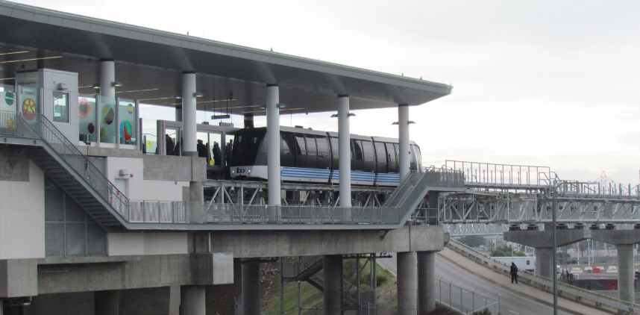
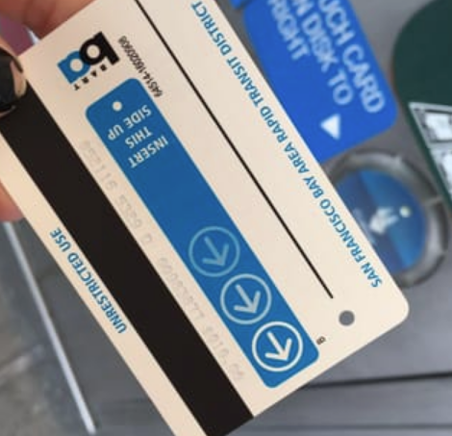
Task Analysis

Slide 2
Outline
Example
Overview of task analysis
Why task analysis?
How to perform a task analysis
Selecting tasks
Using tasks in design
Reading: Dix chapter 7

Slide 3
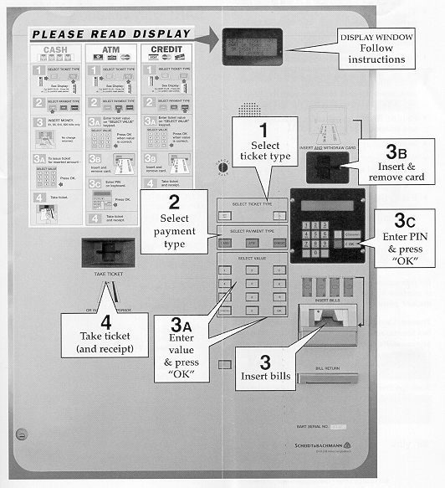

Slide 4
BART “Charge-a-Ticket”
BART “Charge-a-Ticket” machines
  allow riders to buy BART tickets or add fare
  takes bank cards, credit cards, & cash
Problems
  one “path” of operation
    ticket type -> payment type -> payment -> ticket
  Some tickets have minimum of $28, no indication of this until after inserting >= $1
    can’t switch to ticket type after selecting
  large dismiss transaction button does nothing

Slide 5
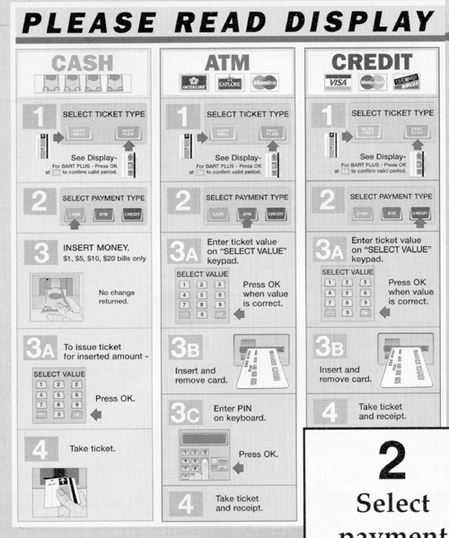

Slide 6
Lessons from the BART machine
Failure to create convenient machine
Did the designers understand or care?
  range of customers using the machine
  what tasks they would want to carry out
  some would find the behaviour of the machine difficult
How can we avoid similar results?
  “What is required to perform the user’s task?”

Slide 7
Task Analysis
Find out
  who users are
  what tasks they need to perform
Observe existing work practices
Create scenarios of actual use
Try-out new ideas before building software

Slide 8
Why Task Analysis?
System will fail if not done?
  does not do what the user needs
  is inappropriate to the user
“System must match users’ tasks”
Why not define “good” interfaces?
  infinite variety of tasks and users
  guidelines are usually too vague (e.g.,“give adequate feedback”)

Slide 9
Questions
Task
Analysis
Who is going to use system?
What tasks do they now perform?
What tasks are desired?
How are the tasks learned?
Where are the tasks performed?
What’s the relationship between user & data?
What other tools does the user have?
How do users communicate with each other?
How often are the tasks performed?
What are the time constraints on the tasks?
What happens when things go wrong?

Slide 10
Who?
Identity?
  in-house or specific customer is easy
  need several typical users for broad product
Background
Skills
Work habits and preferences
Physical characteristics

Slide 11
Who (BART)?
Identity?
  people who use the train service
Background
  have an bank or credit card
  use BART fare machines
Skills
  know how to put cards into cash machines
  know how to buy BART tickets

Slide 12
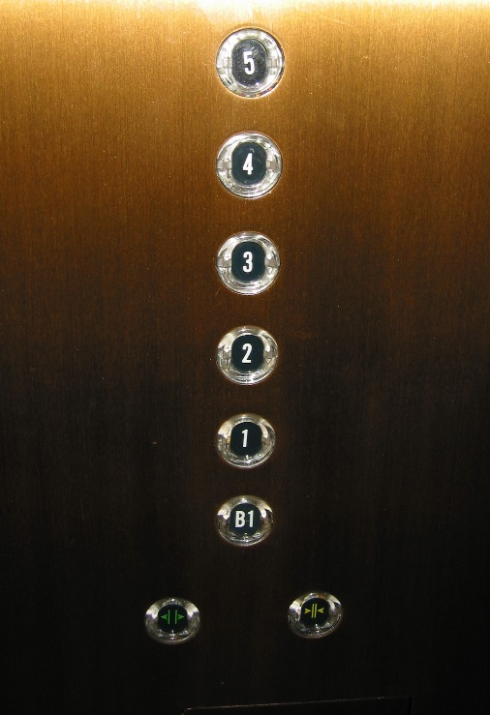
Who (BART cont.)?
Work habits and preferences
  not applicable
Physical characteristics
  varying heights −> don’t make it too high or too low! (think about lift controls)

Slide 13
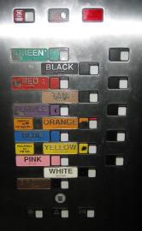
Let’s take a moment to appreciate the world’s worst lift panel.
Source: http://www2.isye.gatech.edu/~jjb/misc/elevators/elevators.html

Slide 14
Talk to Them
Find some real users
Talk to them
  find out what they do
  how would your system fit in

Slide 15
What Tasks?
Important for both automation & new functionality
Relative importance of tasks?
Observe users
  on-line billing example
    A small dentists office had billing automated
    assistants were unhappy with new system
    old forms contained hand-written margin notes

Slide 16
What Tasks (BART)?
Old tasks?
  cash to buy new ticket
  cash to add fare to existing ticket
  cash or credit to buy a BART Plus at window
New tasks?
  cash, credit, or bank card to
    buy new ticket or add fare to existing ticket
    buy a BART Plus ticket
    new currency!
Level of detail can vary

Slide 17
How are Tasks Learned?
What does the user need to know?
Do they need training?
  academic
  general knowledge / skills
  special instruction / training

Slide 18
How are Tasks Learned (BART)?
Walk up & use system
  can’t assume much background/training
Training?
  too time consuming
Must be simple & similar to existing systems such as cash machines

Slide 19
Where is the Task Performed?
Office, laboratory, point of sale?
Effects of environment on users?
Users under stress?
Confidentiality required?
Do they have wet, dirty, or slippery hands?
Soft drinks?
Lighting?
Noise?

Slide 20
Where (BART)? Train Station
Loud
  dependence on voice I/O not a good idea
Others looking over your shoulder
  not private
  PIN input must be confidential
    do not confirm with sound
Lighting is dim
  make sure messages are readable

Slide 21
What is the Relationship Between Users & Data?
Personal data
  always accessed at same machine?
  do users move between machines?
Common data
  used concurrently?
  passed sequentially between users?
Remote access required?
Access to data restricted?

Slide 22
Data Relationships (BART)
Personal data
  users may use any machine -> store on card
Common data
  fare rules (e.g., how much for BART Plus)
  used concurrently
Access to data restricted?
  only you can use your bank or credit card
No need for remote access

Slide 23
What Other Tools Does the User Have?
More than just compatibility
How user works with collection of tools
  example: automating lab data collection
    how is data collected now?
    by what instruments and manual procedures?
    how is the information analysed?
    are the results transcribed for records or publication?
    what media/forms are used and how are they handled?

Slide 24
How do Users Communicate With Each Other?
Who communicates with whom? About what?
Follow lines of organization? For/against it?
Example: assistant to manager
  installation of computers changes communication between them
  people would rather change their computer usage than their relationship

Slide 25
How Often do Users Perform the Tasks?
Frequent users remember more details
Infrequent users may need more help
  even for simple operations
Which function is performed
  most frequently?
  by which users?
  optimise system for these tasks will improve perception of good performance

Slide 26
How Often (BART)?
Varying frequency of users
  some take BART every day (most)
  some take it only occasionally
Varying frequency of tasks
  can only buy travelcard every 2 weeks
    not frequent −> more instructions
  might do add fare or buy new ticket every day
    probably more common
Observe users to find out for sure

Slide 27
What are the Time Constraints on the Task?
What functions will users be in a hurry for?
Which can wait?
Is there a timing relationship between tasks?

Slide 28
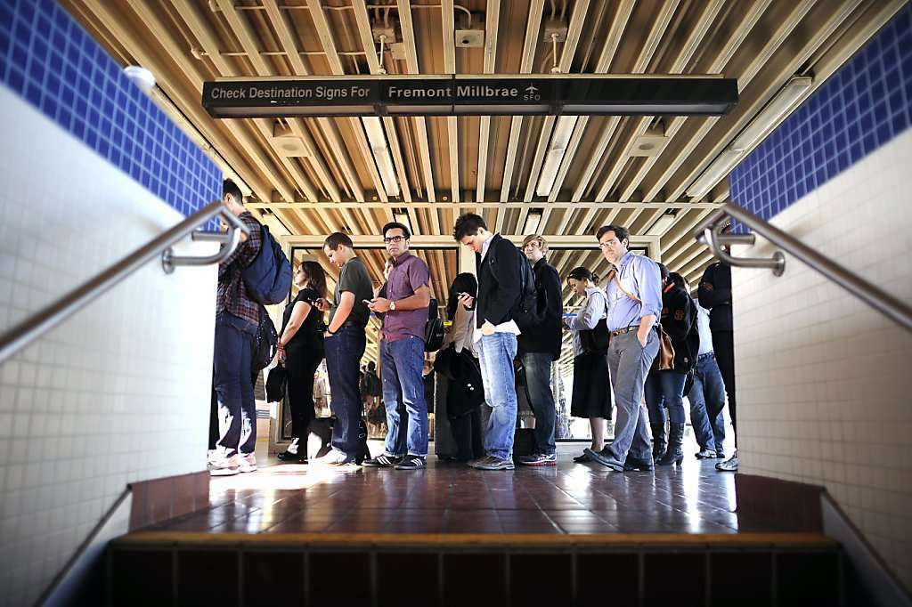
Time Constraints (BART)?
Users will almost always be in a hurry
Queues form
Take less than 1 minute/transaction
Be able to do any task in any order

Slide 29
What Happens When Things Go Wrong?
How do people deal with
  task-related errors?
  practical difficulties?
  catastrophes?
Is there a backup strategy?

Slide 30
Things Go Wrong (BART)?
Confusion on task
  “dismiss transaction” button
Practical difficulty
  generated ticket with too much money
  cash-in policy?
Catastrophe
  machine eats card −> swipe instead of insert
Backup strategy
  Go to ticket booth

Slide 31
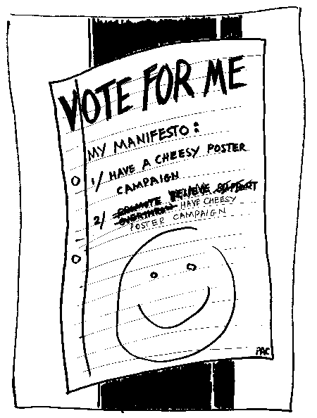
Task Analysis Example
Consider the Task Analysis questions for a Student Union officers voting app
  Who is going to use system?
  What tasks do they now perform?
  What tasks are desired?
  How are the tasks learned?
  Where are the tasks performed?
  What’s the relationship between user & data?
  What other tools does the user have?
  How do users communicate with each other?
  How often are the tasks performed?
  What are the time constraints on the tasks?
  What happens when things go wrong?
Notes:
Who is going to use system?
Students
Age (mainly 18-25 but also many mature students)
Mostly very comfortable voting via web
What tasks do they now perform?
Vote for candidates, order preferences
Research roles and candidates
Stand for election
What tasks are desired?
Ask candidate a question
How are the tasks learned?
Basic support available. Not needed for most users
Where are the tasks performed?
Campus, home, travelling……. Likely to use smartphone
Campuses are spread out around the country
What’s the relationship between user & data?
What other tools does the user have?
Email, personal contact, campaign posters
How do users communicate with each other?
Social media, messaging, emails, hustings
How often are the tasks performed?
Once a year
What are the time constraints on the tasks?
Campaign takes a month
Plenty of time to vote but no votes after the deadline (best if during a work day)
What happens when things go wrong?
Error message with contact details for SU office.

Slide 32
Selecting Tasks
Real tasks users have faced
  collect any necessary materials
Should provide reasonable coverage
  compare check list of functions to tasks
Mixture of simple & complex tasks
When you move to rough design stage
  discard features that don’t support your tasks
  add a real task that exercises that feature

Slide 33
What Should Tasks Look Like?
Say what the user wants to do, but not how the user would do it
  allows comparing different design alternatives
They should be very specific
  forces us to fill out description with other details that become relevant
    example: file browser story
Some should describe a complete job
  forces us to consider how features work together
    example: phone-in bank functions

Slide 34
Look of Tasks (cont.)
See where inputs come from and where outputs go
  working with other tools
  saving / loading
Tasks should say who the users are
  design can really differ depending on who
  if possible, name names
    allows getting more info. as it becomes relevant
  characteristics of the users
    job, expertise, etc.

Slide 35
Look of Tasks (cont.)
Reflect interests of potential users
  illustrate proposed functionality in context of work users really want to do
Users are not always right
  cannot anticipate new technology accurately
Job is to build system users will want
  not system users say they want
  be very careful about this (you are outsider)
    if you can’t get users interested in your great idea, you’re probably missing something

Slide 36
Using Tasks in Design
Write up a description of tasks
  formally or informally
  run by users and rest of the design team
  get more information where needed
Rough out an interface design
  major screens & functions (not too detailed)
  hand sketched
Produce scenarios for each task
  what user has to do & what they would see
  step-by-step performance of task

Slide 37
Scenarios (cont.)
Scenarios are design specific
Tasks are not design specific
Scenarios force us to get specific
  how various features will work together
  settle design arguments by seeing examples
Show users storyboards
  sequences of sketches showing screens
  actions users can take

Slide 38
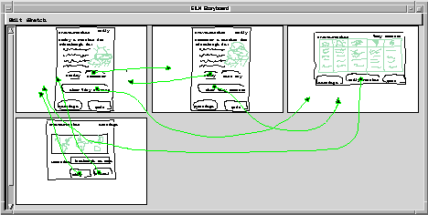
Storyboards

Slide 39
Review
Answer questions before designing
  who, what, where, when, how often?
  relationship between users & data?
  what other tools do users have?
  what happens when things go wrong?
Selecting tasks
  real tasks with a reasonable range of functions
What should tasks look like?
  complete, specific tasks of what user wants to do

