Slide 1
UNVERSTIRY OF WALES TRINITY SAINT DAVID
BMMB7007
HUMAN RESOURCE MANAGEMENT
Student name: Mr. Wong, Wai Chun
Student ID: 1818499

Slide 2

Human Resource Management
For

Slide 3
Introduction to Walmart
External and internal analysis for drivers of transformation in Walmart
Digital transmission facilitates HR management
Limitations and Challenges to HR manager
Recommendations
Conclusion
      Content

Slide 4

1
Introduction to Walmart

Slide 5

About Walmart
Since 1962, Walmart started as a single small discounted store in Arkansas. For over 56 years, it has now grown into the largest retailer with over 11,300 stores under 58 banners in 27 countries and ecommerce websites (Walmart, 2019).
Walmart is the largest private employer in the world with over 2.2 million staffs (Walmart, 2019).

Slide 6

2
External and internal analysis for drivers of transformation in Walmart

Slide 7
External analysis for factors to use digital transformation
Wal-Mart's opportunity is primarily to expand and improve business practices. The external factors in the macro-environment analysis based on below (Walmart,2018) (Yuksel, 2012):
Important environmental factors are related:
Business sustainability trend.
Environmentally friendly products trend.
Social factors affect Walmart:
Customer life style.
Online shopping trend.
Cultural diversity trend.
Technologies external factors affect the retail industry’s competitive landscape:
Increasing business automation.
Business analytics or big data.
Increasing mobile device usage among consumers.
Notes:
Walmart must improve operational efficiency. Technological innovation helps improve efficiency in business. Improved policies and standards on products sold at its retail stores can also strengthen Walmart in addressing these ecological factors.
Walmart is the successful retailer in the United States but failed in Germany at a loss of $1 billion.
The company can increase its array of healthful products. Walmart can also increase the variety of its products to satisfy various cultural preferences.
Walmart currently robots and automated units – for store maintenance, fulfilling online orders – are functioning in few locations and that it is testing this technology for months and looking for positive response. This new technology is a great opportunity for Walmart and this technology allow its staff to concentrate on selling products and serving customers.
In exploiting the opportunity in mobile device usage of customers, the company must boost its online presence. Online marketing and online selling increase Walmart’s revenues.

Slide 8
External analysis for global human capital trends in 2018
Notes:
Regarding to Delotte global human capital trends survey in 2018, we find that expected emphasis on workforce skills as ai robotics are integrated in the enterprise. The technical skills and complex problem solving were increasing on workforce skills but physical abilities become less important.

Slide 9

Internal analysis for factors to use digital transformation
Walmart uses the cost leadership generic strategy, which leads to the following Walmart’s weaknesses (Panmore,2019). It should be using digital transmission to solve that:
Low profit margins.
Easily copied business model.
Weak in employee treatment and working conditions.
Competitive disadvantage against high-end specialty sellers such as e-commerce’s Amazon and subsidiary Whole food market, Costco wholesale etc.
Notes:
Walmart focuses on a cost leadership strategy. It results in thin profit margins for the company
Walmart’s business model can be easily copied. The company doesn’t own any specific competitive edge over its rivals except its huge business size.
Walmart has received criticisms and lawsuits several times regarding its workforce. Low wages, inadequate healthcare, and poor working conditions are few of the issues that have been publically criticized.
the company is frequently criticized about its failure to address employees’ concerns regarding low wages
Its highly extended size and massive span of control could leave Walmart weak in some areas.
Many small-scale and individual online selling companies have entered the market offering similar products at similar prices on their websites. It can be a threat to the company’s future standing.
These components guide employees’ behaviors, which determine organizational capacities to add value in the provision of retail service and related services to consumers.
the company prioritizes customers in its operations. Walmart also recognizes the contributions of each employee to the success of the business. In addition, the firm strives for excellence in the performance of individual workers, teams, and the entire organization. In terms of maintaining integrity, Walmart promotes the virtues of honesty, fairness, and impartiality in decision-making processes.

Slide 10
Selected digital drivers are sharping the factors of transformation in Walmart
Artificial intelligence (AI):
Register for employment and pre-employment assessment test are done though online website (Careers Walmart,2019).
AI facilitates big data analytics, decision making and administration in Walmart (Forbes,2017).
Reshaping business with Ai to close the gap between ambition and action (Ransbotham et al,2017).
Walmart is using AI robots to replace human tasks which humans didn’t like to do (The verge,2019).
Big data:
Walmart use “Big Data analytics” in HR helps in forecasting peoples’ management requirements, evidence-based decision making and cost reduction (Balachandran & Prasad,2017) (Noe et al., 2017).
Big data analytics help to trace new products to meet customers’ needs (Tan & Zhan,2017).
Increased and better decision making for strategic management and recruitment (Noe et al., 2017).
Machine learning:
Virtual reality (VR) is transforming corporate training in Walmart (Corporate Walmart,2018).

Slide 11
3
Digital transmission facilitates HR management

Slide 12
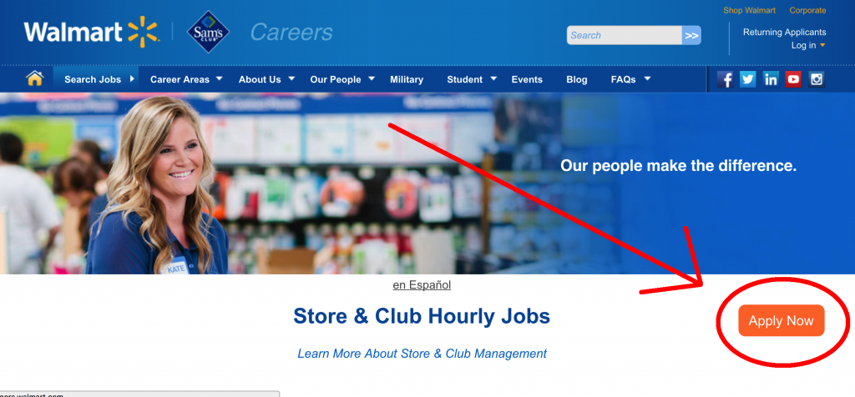
1) On line job application and On line pre-employment assessment test:
HR manager actively connects job seekers through innovative Walmart’s website, mobile app or email services (Careers Walmart, 2019).
Online screening tests to see if job seekers who are able to perform certain skills before in-person interview (Bauer et al.,2004).
Desirable impact:
Tests can save time on interviews (Williams,Kunda, and Myers,2003).
Tests can be strictly job related (Rosse, et al, 1998)
Undesirable impact:
Tests result in longer time to fill (Ryan & LASER,1991).
Tests rarely give the whole picture (Rosse, et al. 1998).
Figure 2: On line job application for Walmart (Careers Walmart, 2019).

Slide 13

2) Big data helps Walmart pharmacy staff scheduling and efficient in service:
Wal-Mart uses simulations in pharmacies to find out how many prescriptions to open in a day and to determine the day or month of business (Walmart 2017).
Desirable impact:
Big data helps pharmacy staff scheduling and increase efficiency in service delivery by reducing lead time and staff cost-effective (Minelli, Chambers and Dhiraj, 2013).
Big data helps to track number of staffs attendance or slack hours per day or predict for employee day off (Easton and Goodale, 2005).
Big data helps to calculate bonus or benefit for motivating staffs (Danish & Usman, 2010).
Undesirable impact:
Staff dislikes inconstant working time table (Chambers,1986).
High initial investment on system and needs high data storage systems (Lee & Lee ,2015).
Figure 3: Pharmacy in Walmart (Walmart, 2017).

Slide 14

3) HR uses big data to determine staffs scheduling and checkout experience:
Wal-Mart uses simulations to find out how many customers checking out on cashier duration and amount of spending (Walmart 2017).
Desirable impact:
Wal-Mart is using big data to improve the store checkout experience and predict determine number of staffs and checkout counters (Davenport,2014).
By analyzing the data, Wal-Mart can determine the best way to checkout for each store: self-checkout and convenient checkout (Shmarzo, 2013).
Big data helps to track number of staffs attendance or slack hours per day or predict for employee day off (Easton and Goodale, 2005).
Undesirable impact:
High initial investment on self check out system and needs high storage data systems (Lee & Lee ,2015).
Figure 4: Self-checkout counters in Walmart (Vox,2018).

Slide 15
3) HR determines big data in efficient scheduling of driver time and reduction in costs of transportation.
Wal-Mart uses simulation to track the number of steps from the dock to the store. This allows staffs to optimize the routers that lead to the cargo terminal and tracks the number of times when a product is touched by the customer. Wal-Mart also uses data and routes to the company's truck fleet (Walmart,2017).
Desirable impact:
Big data improves management of the supply chain through data analytics for time and cost-effective (Wang et al,2016).
Undesirable impact:
Staff dislikes inconstant working time table (Chambers,1986).
High initial investment on system and needs high data storage systems (Lee & Lee ,2015).
Figure 5: Walmart supply chain flow chat (logisticsmgepsupv wordpress,2019).

Slide 16
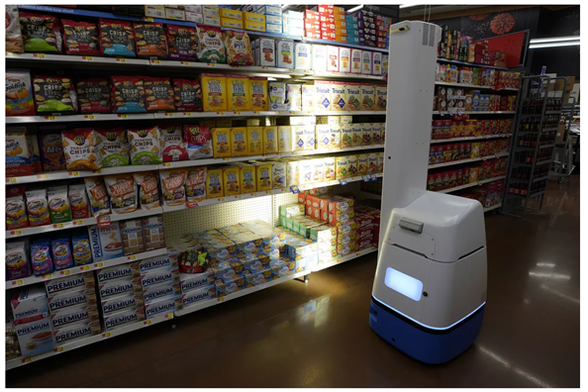
5) HR manger is hiring more AI robots (The verge,2019).
Robots replace human for cleaning floors, checking inventory and replenish out-of-stock items at night (The verge,2019).
Desirable impact:
Walmart reduces manpower requirements , improve efficiency and speed up deliveries (Bogue,2019).
Robots replace human’s dislike job (Welfare et al, 2019) .
Collect accurate data (Shankar,2019)
Undesirable impact:
High initial investment costs (Lee & Lee ,2015).
Employees must be trained before using (Reilly,2019).
Figure 6: Walmart AI jobs robot workers (The Verge,2019).

Slide 17
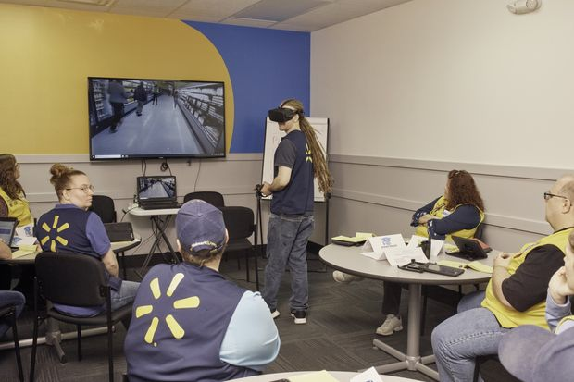
6) Walmart uses virtual reality (VR) transforming corporate training
Walmart uses virtual reality headsets to gauge employee potential and skill levels to help identify promotions and pay cuts (The wall street journal,2019).
Desirable impact:
Better engagement and motivation in training (Hauze and Frazee, 2019).
Increases employees role awareness and information retention (Hauze and Frazee, 2019)(Gallerati et al,2019).
.
Undesirable impact:
Staff dislikes training at off work time.
Someone feels Virtual reality sickness (Żukowska et al 2019).
Figure 7: Walmart uses virtual reality (The wall street journal,2019).

Slide 18
4
Limitations and Challenges to HR manager

Slide 19
Challenges of digital implementation to HR manager
1. Choosing the right systems
Wal-Mart has begun experimenting with technology to implement the system rather than really benefiting employees.
2. Culture
As the workforce continues to change, it is necessary to consider employees of different ages and their reactions to new software and methods.
3. Data
With huge data available, Walmart is needed to clean up and organize existing data so that it can be entered into a new system
4. Lack of communication
Significant investment will be required in training employees to use the system correctly and effectively
5. Language
For global companies, choosing which common languages to keep and which will no longer be used with new systems is essential
6. Security & Legality
Today, cybercrime is so common in businesses that businesses need to implement a secure system to ensure that employment data is not compromised and virus-attacked

Slide 20
Limitations to HR manager
The limitations for HR managers while implementing AI ,Big Data analytics and machine learning include:
  Lack of support of top management
  Financial factors can affect their functioning.
  Collecting all data from all departments can be highly time-consuming.
  Implementing an HRM solution can be very expensive

Slide 21
5
Recommendations

Slide 22
Recommendations
Organizational leaders can leverage key change drivers in HR practices through the following ways.
1. Hiring professional persons with technology and business-related knowledge in digital transformation drivers (Hoberg et al., 2017)
  Example data scientist experts
2. Integrity outsourcing to the most reliable outsourcing service provider (Reed, 2018)
  Manage tasks such as recruitment and interviewing

Slide 23
66
Conclusion

Slide 24

Conclusion
The world is changing fast. The driving force of digital transmission is reshaping business, providing HR management’s decision-making basis for sustainable business development and success. Although Walmart are well developed, “Discover more on Innovation” should be going on.

Slide 25
Thank you

Slide 26
References
Balachandran, B. M., & Prasad, S. (2017). Challenges and benefits of deploying big data analytics in the cloud for business intelligence. Procedia Computer Science, 112, 1112-1122.
Bauer, T. N., Truxillo, D. M., Paronto, M. E., Weekley, J. A., & Campion, M. A. (2004). Applicant reactions to different selection technology: Face‐to‐face, interactive voice response, and computer‐assisted telephone screening interviews. International Journal of Selection and Assessment, 12(1‐2), 135-148.
Bogue, R. (2019). Strong prospects for robots in retail. Industrial Robot: the international journal of robotics research and application.
Careers Walmart (2019). Walmart Careers. Walmart Inc. Available at: https://careers.walmart.com/ (Acessed 29 Nov., 2019).
Chambers, D. A. (1986). The constraints of work and domestic schedules on women's leisure. Leisure Studies, 5(3), 309-325.
Corporate Walmart (2018). How VR is Transforming the Way We Train Associates. Walmart Inc. Available at: https://corporate.walmart.com/newsroom/innovation/20180920/how-vr-is-transforming-the-way-we-train-associates (Acessed 29 Nov., 2019).
Danish, R. Q., & Usman, A. (2010). Impact of reward and recognition on job satisfaction and motivation: An empirical study from Pakistan. International journal of business and management, 5(2), 159.
Davenport, T. (2014). Big data at work: dispelling the myths, uncovering the opportunities. Harvard Business Review Press
DeFanti, C. (2019). Co-Located Augmented and Virtual Reality Systems (Doctoral dissertation, New York University).
Deloitte (2018) AI, robotics, and automation: Put humans in the loop, 2018 Global Human Capital Trends. Available at: https://www2.deloitte.com/us/en/insights/focus/human-capital-trends/2018/ai-robotics-intelligent-machines.html (Accessed 20 Nov., 2019).
Easton, F. F., & Goodale, J. C. (2005). Schedule recovery: Unplanned absences in service operations. Decision Sciences, 36(3), 459-488.

Slide 27
Forbes(2017). How Walmart Is Using Machine Learning AI, IoT And Big Data To Boost Retail Performance. Forbes media LLC. Available at: https://www.forbes.com/sites/bernardmarr/2017/08/29/how-walmart-is-using-machine-learning-ai-iot-and-big-data-to-boost-retail-performance/#1652fbfb6cb1 (Accessed 29 Nov.,2019).
Gallerati, P., Maisano, M., Valiante, C., Conte, A., & Casciaro, D. (2019, May). The Use of Virtual Reality and Simulators for Emergency Management Training Increases Employees' Role Awareness, Commitment and Information Retention, While Helping Companies to Stay Compliant .In Offshore Mediterranean Conference and Exhibition. Offshore Mediterranean Conference.
Hauze, S., & Frazee, J. (2019, June). Virtual Immersive Teaching and Learning: How Immersive Technology is Shaping the Way Students Learn. In EdMedia+ Innovate Learning (pp. 1427-1432). Association for the Advancement of Computing in Education (AACE).
Hoberg, P., Krcmar, H., Oswald, G. and Welz, B. (2017) Skills for digital transformation. In Technical University of Munich, Chair for Information Systems, Study.
Lee, I., & Lee, K. (2015). The Internet of Things (IoT): Applications, investments, and challenges for enterprises. Business Horizons, 58(4), 431-440.
Logisticsmgepsupv wordpress (2016). Wal-Mart SCM. logisticsmgepsupv.wordpress.com.10 March,2016. Available at: https://logisticsmgepsupv.wordpress.com/2016/03/10/wal-mart-scm/ (Accessed 20 Nov,2019)
Minelli, M., Chambers, M. and Dhiraj, A., 2013. Big data, big analytics: emerging business intelligence and analytic trends for today's businesses (Vol. 578). John Wiley & Sons.
Noe, R.A., Hollenbeck, J.R., Gerhart, B. and Wright, P.M. (2017) Human resource management: gaining a competitive advantage. New York, NY: McGraw-Hill Education.
Noe, R.A., Hollenbeck, J.R., Gerhart, B. and Wright, P.M. (2017) Human resources management. Instructor.

Slide 28
Panmore, (2019).. Walmart SWOT Analysis & Recommendations Business management.19 February,2019. http://panmore.com/walmart-swot-analysis-recommendations-case-study (Accessed 25 Nov. 2019).
Ransbotham, S., Kiron, D., Gerbert, P., & Reeves, M. (2017). Reshaping business with artificial intelligence: Closing the gap between ambition and action. MIT Sloan Management Review, 59(1).
Reed, K. E. (2018). How Outsourcing Influences the Human Resource Functions in the Federal Government: An Exploratory Multiple Case Study (Doctoral dissertation, Northcentral University).
Reilly, P. (2019). The impact of artificial intelligence on the HR function. Which way now for HR and organisational changes?, 41.
Rosse, J.G., Stecher, M.D., Miller, J.L. and Levin, R.A., (1998). The impact of response distortion on preemployment personality testing and hiring decisions. Journal of Applied Psychology, 83(4), p.634.
Ryan, A. M., & LASER, M. (1991). Negligent hiring and defamation: Areas of liability related to pre‐employment inquiries. Personnel Psychology, 44(2), 293-319.
Schmarzo, B. (2013). Big Data: Understanding how data powers big business. John Wiley & Sons.
Shankar, V. (2019). Big Data and Analytics in Retailing. NIM Marketing Intelligence Review, 11(1), 36-40.
Tan, K. H., & Zhan, Y. (2017). Improving new product development using big data: a case study of an electronics company. R&D Management, 47(4), 570-582.
The Wall Street Journal. 2019. Walmart Turns to VR to Pick Middle Managers. WSJ. 30 June.,2019 Available at: https://www.wsj.com/articles/walmart-turns-to-vr-to-pick-middle-managers-11561887001 (Accessed 24 Nov.2019).
The Verge (2019). Walmart is hiring more robots to replace human tasks like cleaning floors and scanning inventory. The verge. 9 April.2019. Available at: https://www.theverge.com/2019/4/9/18302356/walmart-robots-labor-costs-replacing-human-tasks-floors-scanning-inventory (Accessed 25 Nov. 2019).
Vox (2018). Wouldn’t it be better if self-checkout just died? Vox.com. 2 Oct, 2018. Available at: https://www.vox.com/the-goods/2018/10/2/17923050/self-checkout-amazon-walmart-automation-jobs-surveillance (Accessed 25 Nov. 2019).

Slide 29
Walmart (2017) 5 ways Walmart uses big data to help customers. Walmart website. Available at: https://corporate.walmart.com/newsroom/innovation/20170807/5-ways-walmart-uses-big-data-to-help-customers (Accessed 11 Nov.2019).
Walmart (2018) 2018 Global responsibility report summary. Walmart Inc. Available at: https://s2.q4cdn.com/056532643/files/doc_financials/2018/annual/WMT-2018-GRR-Summary-for-digital.pdf (Accessed 11 Nov 2019).
Walmart, (2019). Walmart China Factsheet sheet. Walmart Inc.Available at: http://www.wal-martchina.com/english/walmart/index.htm (Accessed 9 Nov 2019).
Wang, G., Gunasekaran, A., Ngai, E. W., & Papadopoulos, T. (2016). Big data analytics in logistics and supply chain management: Certain investigations for research and applications. International Journal of Production Economics, 176, 98-110.
Welfare, K. S., Hallowell, M. R., Shah, J. A., & Riek, L. D. (2019, March). Consider the Human Work Experience When Integrating Robotics in the Workplace. In 2019 14th ACM/IEEE International Conference on Human-Robot Interaction (HRI) (pp. 75-84). IEEE.
Williams, C.J., Kunda, A.K. and Myers, E.J., Spherion Assessment Inc, (2003). Pre-employment screening and assessment interview process. U.S. Patent 6,618,734.
Yuksel, I. (2012). Developing a multi-criteria decision making model for PESTEL analysis. International Journal of Business and Management, 7(24), 52.
Żukowska, M., Buń, P., Górski, F., & Starzyńska, B. (2019). Cyber Sickness in Industrial Virtual Reality Training. In Advances in Manufacturing II (pp. 137-149). Springer, Cham.

