Slide 1


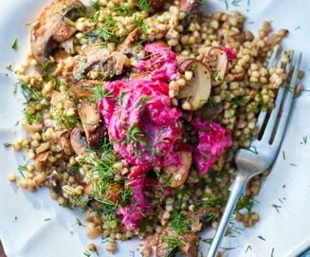
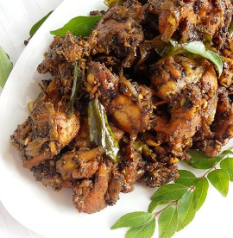
Hotel Trinity Limited Menu Card
Coast in Swansea, South Wales
Beverages
Espresso shot (250 ml) £1.20
A concentrated form of coffee, served in strong shots, with a higher caffeine quantity; tastes smooth with the rich creamy flavour
English Breakfast (250 ml) £1.52
A strong black tea, with a robust and rich blend that goes well with sugar; has a strange combination of sweetness, maltiness, and bitterness
Virgin Margarita (250 ml) £2.65
Adult limeade with lime juice and sugar at the base and tequila and triple sec at the top, giving it a perfectly balanced and sweet taste
Rhubarb cordial (250 ml) £2.30
A refreshing cordial with a glut of rhubarb, lemon zest, orange zest, along with the fresh ginger root, giving it a tangy punch
Wines
Verdichio 750 ml 15.70
verdichi0
Whitw wines
Main course
Chicken pasta bake served with tortilla £14.70
Enjoy the gooey taste of cheese and chicken pasta bake that is dressed with a green salad; made with sliced chicken breasts, mascarpone, chilli flakes, garlic cloves, onion, penne, and matured cheddar
Smoky hake, beans & greens served with rice £16.40
Grilled white fish fillets that are served with spinach and cannellini beans, made with raw chorizo for the smoky and tangy flavour
Mushroom buckwheat risotto served with tortillas £14.50
The earthy flavour of the dish comes from porcini mushrooms and buckwheat, making it a rich and flavourful dish
Balsamic lentil pies with vegetable mash
served with plain rice £13.90
A vegetarian version of comfort food that is prepared with lentils, broccoli, potato, rosemary, onions, spinach, and hard-cheese
Starters
Pepper chicken £7.10
The extravagant taste of one-pot chicken, uniquely flavoured with the sprinkles of crushed peppercorns, ginger, garlic, and cardamoms on the skinned pieces of chicken breasts
Sea bass marinated in mustard seeds and turmeric £7.50
The spicy taste of marinated sea bass. playfully presented with the robust taste of mustard seeds along with a fantastic tang of turmeric for matching the heat of the spices
Omlette Arnold Bennett £5.50
An open-faced omelette dish made with hollandaise and haddock sauce and lightly beaten eggs that are served with grated chives and cheese
Arancini balls £5.10
Rice balls that have been prepared with fresh herbs and chopped tomatoes, giving it a punch of the savoury taste
Baked feta with sesame and honey £6.20
Flavours of sesame, sweet honey and salty cheese, come together to create a dish that is both rich and decadent; served with warm pitta
Buffalo cauliflower £6.00
Enjoy the American classic with the spicy dish that is made with cauliflower, mixed with grounded cumin, garlic, smoked paprika, plain flour, maple syrup, butter, kefir, and hot sauce
Wines pinot noir rose 750 ml 15.00
Sangiovese rose 750 ml 14.20

Slide 2
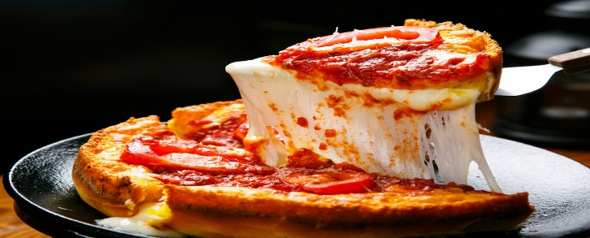
Hotel Trinity Limited Menu Card
Coast in Swansea, South Wales
Desserts
Jam Roly Poly £7.40
The classic version of a suet-based sponge, which is rolled out and slathered with mixed fruit jam; slowly baked over a warm water bath for the steam to heat over the dish
Syllabub £7.52
A mixture of both dairy and alcohol for a pleasant flavour, punched together for better appetising along with a layer of cottage cheese-like layer floating on top of it
Cranachan Pie £7.80
Bringing to you the Scottish classic with a nice layer of toasted oats, giving it a crunchy taste, and whisky for the tipsiness that lies within
Traditional Dorset Apple Cake £6.70
Our special hand-made, lightly spiced cake is stuffed with dried fruit and apple bites
Wines marsala 750 ml 14.50
Sherry 750 ml 13.80
Chef’s special
Green mango and prawn salad with
one bottle of Sauvignon Blanc (White wine) £20.10
Our special Thai salad is prepared with green mangoes and succulent prawns that have the flavours of mint, roasted salted peanuts, shallots, fish sauce, lime juice, and red chillies
Goat’s cheese, herb & lemon patties
with one bottle of Malbec (Red wine) £19.30
Check out our special medium-bodied red wine with the vegetarian patties that are wrapped up with the freshness of herbs and finely grated lemon zest
Kid’s special
BBQ chicken pizza with Pink lemonade £19.80
A delicious but healthy and low-calorie pizza with main toppings of BBQ chicken that gives off the special smoky flavour; Refreshing pink lemonade that gives off the tangy flavour of orange, lemon, raspberries, and fresh mint.
Zucchini and ricotta pizza with Mango and banana smoothie £18.40
A tasty dish made with ricotta and zucchini that has the gooiness of cheese; Cool down the exhaustion with our favourite Mango and banana smoothie that has the fruity and refreshing flavour of summer fruits.
Location: Coast of Swansea, South Wales Allergens Statement: Please do note that the food contains specific ingredients and food items that may act as allergens and result in food intolerance. This includes dairy, nuts, seafood, and eggs. Food hygiene statement: Our food items are well prepared by complying with the Food Safety Act 1990 and audited by the Food Standards Agency. Each of the food items has been prepared by maintaining a high-level hygienic environment. Our staff also maintains their hygiene by properly washing hands, and earning gloves and masks. Calories per dish: 40-350 (3-10 calories for beverages) Time availability: 12:00 to 23:00 Contact details: We are accepting orders through telephone or mobile app. Please do note that our online orders are delivered via UberEats. You can contact us on XXXXXX5768 Collection: Customers can collect orders from the delivery person for home deliveries. For takeaways, customers are requested to wear masks and use sanitisers before collecting the food parcel. Contactless delivery: For home delivery, our delivery person will be keeping the order at a safe distance of three-foot; It is mandatory to follow the social distancing rule by keeping a safe distance of one foot. Payment options: No cash, only digital payments through e-wallets and net banking are accepted
Bibliography
Acaai, (2022) Food Allergies | Causes, Symptoms & Treatment | ACAAI Public Website Available at: https://acaai.org/allergies/allergic-conditions/food/ (Accessed: 14 June 2022).
School of wok, (2022) Green Mango and Prawn Salad Available at: https://schoolofwok.co.uk/tips-and-recipes/green-mango-and-prawn-salad (Accessed: 14 June 2022).
Serious Eats (2022) Chicken Pepper Fry Recipe Available at: https://www.seriouseats.com/beyond-curry-chicken-pepper-fry-recipe (Accessed: 14 June 2022).
Tbsp (2022) Mexican Chicken Pasta Bake Available at: https://www.tablespoon.com/recipes/mexican-chicken-pasta-bake/f6b45196-f850-4a39-82d2-c7c24378e927 (Accessed: 14 June 2022).

