Slide 1
BMSW 4004
Problem Solving and Decision Making
TASK 1
STUDENT NAME: VIOLETA FLORICICA SALCA

Slide 2

Problem recognised
The absenteeism of the staff is considered as a complex problem and it affects the business functioning and work activities within Mid Cheshire Hospitals NHS Foundation Trust (MCHT).
The staff members are not going to Mid Cheshire Hospitals NHS Foundation Trust (MCHT) and their absence is costing the organisation more than £1 million each year and per percentage point and a high level of absenteeism of the staff members was also leading to poorer quality of service, because of the increase in the use of temporary and agency staff.
This Photo by Unknown Author is licensed under CC BY-SA-NC

Slide 3

Definition of stress
Over the years, several definitions of stress have appeared. Initially, it was conceptualized as such environmental pressure, later as internal tension. People's actions, particularly changes in behaviour, might show symptoms of stress. Extreme stress reactions might manifest as emotions (for example, anxiousness, melancholy, anger, exhaustion), behaviour (for example, becoming distant, angry, emotional, or uninspired), thoughts (for example, trouble concentrating and creative thinking) (Michie, 2002).
This Photo by Unknown Author is licensed under CC BY

Slide 4

Nature of the problem
Bad working condition that made staff members taking frequent leaves and absent from the work.
Lack of flexible working schedule that make staff members feel stressed.
Low employee engagement make employee feel less connected.
Harassment at the workplace make employees feels hurts and consider taking leave from work (Jensen et al., 2019).

Slide 5

Impact of the problem
Impact on productivity of the employees and on the hospital trust.
Low morale of the employees that make them feel discouraged and less involved.
Financial impact on the hospital trust, the trust is facing financial loss and poor quality of service.
The declining performance of the organisation and staff members at the individual level (Karimbil, 2019).

Slide 6

PESTLE analysis
The six factors of the PESTLE analysis will be conducted to understand the contribution to the problem of staff absenteeism
By analysing all the external factors, the cause of the problem of absenteeism of the staff members can be identified.
It helps in understanding the external influences on the hospital trust.
This Photo by Unknown Author is licensed under CC BY-NC-ND

Slide 7
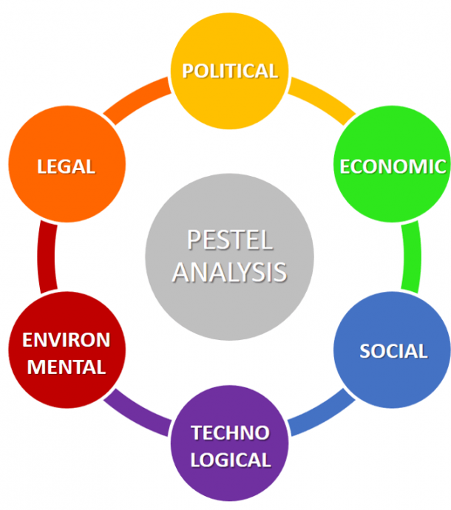
PESTLE analysis
Political factors- changes in the laws created by the government (Perera, 2017).
Economic factors- The increase in the globalisation
Social factors- changing demographics at the workplace, rights of the staff members
Technological factors- overload information, use of traditional approach
Legal factors- legal aspects created by the government
Environmental factors- bad and negative working surrounding and condition (Perera, 2017).
This Photo by Unknown Author is licensed under CC BY-SA

Slide 8
Cause-and-effect analysis
It is an effective tool use for identifying all the possible causes to the problem.
It helps in fixing and finding the main cause to the problem
It is done by brainstorming and using various tools.
Here fishbone analysis tool is used for identifying the cause of the problem.

Slide 9
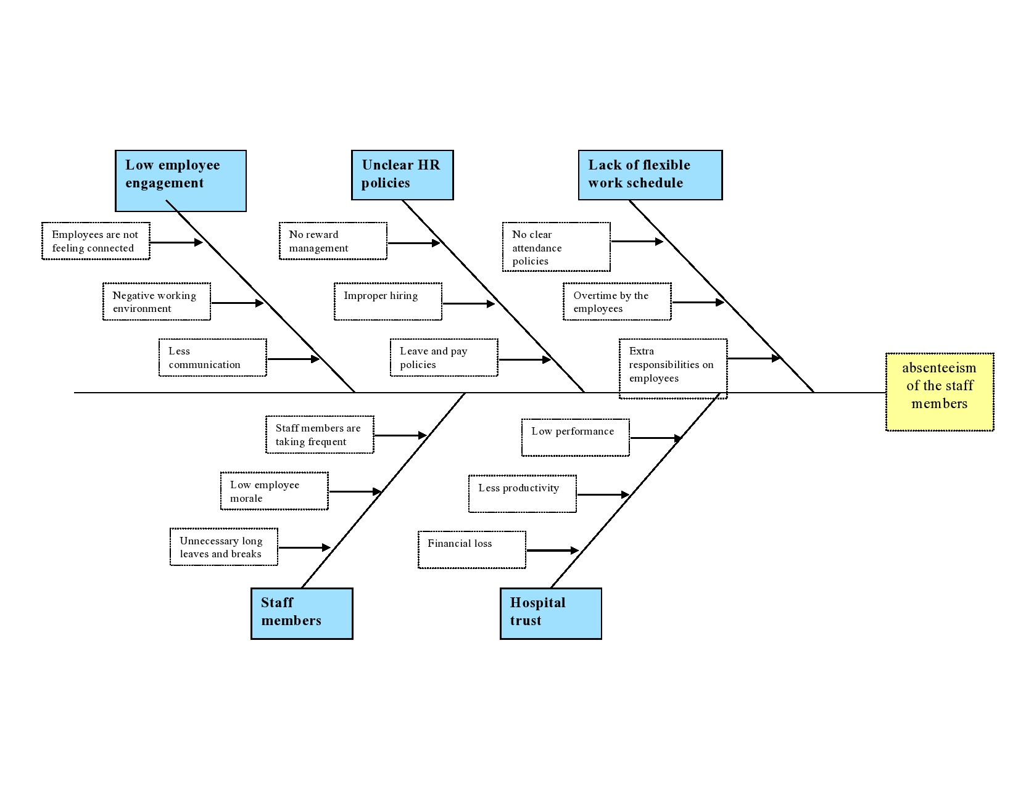
Cause-and-effect analysis
The cause and effect analysis is done by using fishbone analysis tool.

Slide 10

Evaluation of alternative solutions
psychologist
Creating a clear HR attendance policy. This method will bring results for a short period of time. If it is applied, the employees will feel more stressed having to respect one rule more and the work environment will became a stressful one (Nunes et al., 2018).
Providing required support: the mental health represent an important factor which affects the productivity of the employees. The organisation will allocate time for each employee to have a nice meeting with a psychologist which has the role to identify the possible symptoms on the employees and help them (Livingstone, 2020) .
Flexible work time- this solution may attract the employees back to work but still, the environment remains the same, and this will be a solution for a short period of time (Scognamiglio, 2020).
Reducing workplace stress- this solution appears to be the perfect one for the employees. A friendly environment will help them to increase their productivity and maintain a good relationship with the colleagues and management staff. The benefit of this solution is that it will increase the productivity on a long period of time.
Reward maximum attendance- this solution may attract the employees for a short period of time (Buzet, 2020).
This Photo by Unknown Author is licensed under CC BY-NC

Slide 11

references
Buzet, J., 2020. Association between field of work, years of service, and sickness absenteeism in public administration. Organizacija, 53(1), pp.53-67
Jensen, U.T., Andersen, L.B. and Holten, A.L., 2019. Explaining a dark side: Public service motivation, presenteeism, and absenteeism. Review of Public Personnel Administration, 39(4), pp.487-510.
Karimbil, M.R., 2019. A study on employee absenteeism in today’s workplace. Journal of the Gujarat Research Society, 21(17), pp.273-279.
Livingstone, Z., 2020. Managing stress in the workplace. Veterinary Nursing Journal, 35(5), pp.127-128.
Michie, S., 2002. CAUSES AND MANAGEMENT OF STRESS AT WORK. Occupational and Environmental Medicine, 59(1), pp.67-72.
Nunes, A.P., Richmond, M.K., Pampel, F.C. and Wood, R.C., 2018. The effect of employee assistance services on reductions in employee absenteeism. Journal of Business and Psychology, 33(6), pp.699-709.
Perera, R., 2017. The PESTLE analysis. Nerdynaut.
Scognamiglio, A., 2020. Paid sick leave and employee absences. Labour, 34(3), pp.305-322.
This Photo by Unknown Author is licensed under CC BY

Slide 12
Thank you!

