Slide 1

Introducing The modern Workplace

Slide 2
Cover Page
Constantin Marian Grigoras - 2124074
Danica Kanchevska- 2124692
Maricela Broasca – 2125147
Gheorghe Stanescu Laurentiu – 2124714
Mariana Ionela Popa - 2122750

Slide 3
Introduction
This presentation aims at analyzing the operational components of Amazon, which is a UK leading retailer.
Through the presentation, the main objectives will be:
Describe Amazon Organization Profile
Explore relationship between the organizations structure and its performance
Discuss tasks and skills that a manger uses to run this organization
Explain how leadership theories can be applied on this organization
Discuss the factors which influences group and team behaviors

Slide 4

Describe Amazon Profile
Competitors
Large e-commerce website eBay faces fierce competition with Amazon.
San Jose, California serves as its company's headquarters. It was founded there in 1995.
eBay's sales have reportedly started to decline in current history, but the company nevertheless generated $10.2 billion in net profits in 2020, the most since 2013.
Customers might purchase goods from sellers using eBay.
There are vendors advertising similar products on both Amazon and eBay.
What is the main distinction then? Items on eBay could be bought for a specified price or by placing a bid. Bargain buys are not available on Amazon.
eBay has a special advantage over Amazon since it works more like a big garage sale
Figure 1

Slide 5
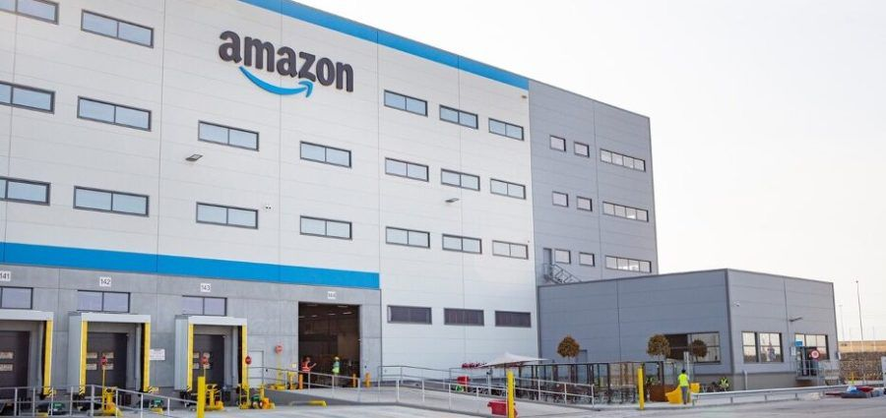
Describe Amazon Profile
Financial performance
Net sales increased by 15% to $127.1 billion during its third quarter compared to the same period in 2021.
Even after adjusting for the $5.0 billion negative effect of year-to-year swings in currency values throughout the period, sales rose by 19% as compared to the previous quarter of 2021.
Cash flow from operations decreased by 27% to $39.7 b from $54.7 b in the following 12 months ended September 30, 2021, to the following 12 months ended September 30, 2022.
Free cash flow decreased to a $19.7 billion deficit compared to the previous twelve months ending September 30, 2021 (from an inflow of $2.6 billion).
Figure 2

Slide 6

Explore the relationship between the organization's structure and its performance
Over the past few decades, organizations' views on the best ways to manage and structure themselves have changed.
Chandler's theory of organizational structure concentrated on the fundamental ideas of organizational design.
Contingency theories from the 1970s claim that there are multiple healthier options, and that organizational design needs to be customized for each location.
Organizational theorists embrace the notion of an organic flow, which promotes the necessity of switching from hierarchies to networks in organizational structure

Slide 7

Explore the relationship between the organization's structure and its performance
Typical organizational structures cannot provide the speed and elasticity needed when dealing with quickly changing conditions.
Creativity can be fostered by organizational structures that value education, knowledge sharing, problem-solving teams, and job rotation.
The organizational structure of a company is very important since some of its elements are essential to its effectiveness and employee relations.

Slide 8
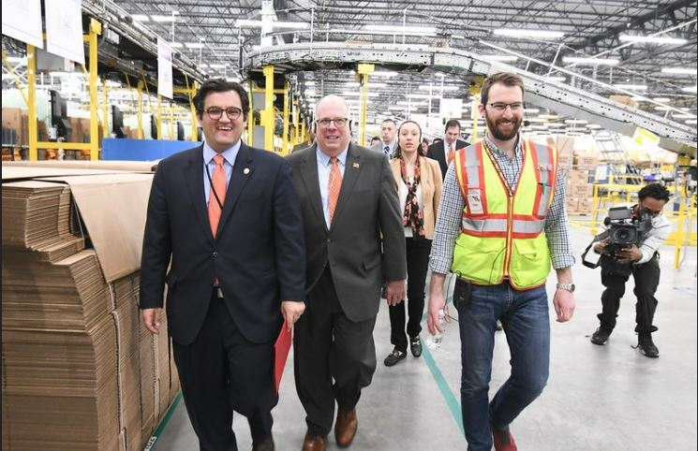
Explore the relationship between the organization's structure and its performance
According to studies, an organizational structure affects a company's capacity for innovation. Elements that encourage creativity include freedom, flexibility, and possibilities for collaboration.
On the other hand, strictness or harsher kinds of correction tend to hurt the processes of creativity and innovation.
To improve each employee's performance, leaders should create an environment that stimulates innovation among their team members.
Employees should concentrate on creating cutting-edge products, processes, and services that are crucial to the sustainability of the business.
Figure 3

Slide 9

Discuss tasks and skills that a manager uses to run this organization
Every corporate organization depends on a variety of management roles.
The five functions mentioned below assist a manager in creating opportunities that boost productivity by resolving workplace conflicts, inspiring employees, and ensuring that the organization reaches its goals and objectives.
The management team's responsibility is to facilitate the organization's efficient use of resources to achieve the set objectives (Dyer and Gregersen, 2017).

Slide 10

Discuss tasks and skills that a manager uses to run this organization
Planning, staffing, organizing, leading, and controlling are all part of management functions.
The five functions are crucial for enabling the organization's growth and improved control of operations once the manager assumes management responsibilities in the Amazon warehouse.
Additionally, they will aid in maximizing the efficiency necessary for the group of 100 individuals to produce the desired results
Figure 4

Slide 11

Discuss tasks and skills that a manager uses to run this organization
Planning activities is the most crucial of the five management functions. It is referred to as a methodical process that enables managers to decide with knowledge about upcoming organizational actions and the objectives meant to be achieved within a certain time frame.
The major goals to be reached in succession planning are formed by the core elements involved, which include strategic planning and preparing for the organization's future.
The alternative tactic entails examining the analytics procedure to identify potential product placement sites. Customers buy a range of goods at once. Therefore, it is crucial to make sure they are close to one another.
Given the enormous size of the warehouse, this is crucial in minimizing the distance and time that staff must go to obtain the merchandise.
To route the ideal path for item collecting, software is also necessary. The main objective is to ensure that both customers and employees travel a significantly shorter distance. Customer satisfaction is immediately impacted by efficiency gains, and sales are indirectly affected as well (Harracá, 2017).
Planning

Slide 12
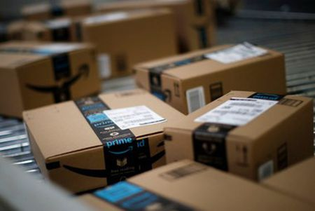
Discuss tasks and skills that a manager uses to run this organization
Developing organizational structures and ensuring proper resource allocation are both necessary for organizing management functions. It includes creating unique positions and ensuring that they are in line with the requirements of the organization.
Making choices about who should perform what tasks and responsibilities also fall under this category.
Departmentalization of Amazon packing involves a variety of methods, including product, function, and customer (Dyer and Gregersen, 2017).
Amazon employs more rudimentary organizational structures and operates through the bureaucracy.
This will make it simple for a few tiers, like supervisors, packers, and managers, to report information.
Organizing

Slide 13

Discuss tasks and skills that a manager uses to run this organization
A specific company's recruitment, hiring, advancement, compensation, and hrm training procedures are all constituent elements of the employment process. It is necessary for the effective and successful execution of a variety of managerial tasks.
Every business experiences personnel churn and ongoing hiring as a result of people getting promoted or leaving the company.
Starting in places where there are possible applicants is crucial.
The large corporation Amazon prides itself on having a strong web presence that aids applicants in landing a particular position there (Harracá, 2017).
The database's availability enables centers to hire and obtain precise information about each position.
Making posts on numerous websites and social media platforms is one of the other actions conducted. LinkedIn and Monster are two examples of the media.
Staffing
Figure 5

Slide 14
Discuss tasks and skills that a manager uses to run this organization
Controlling is a managerial task that involves following protocols to ensure that goals and outcomes are on track. Performance is often examined using a variety of techniques based on numerous elements such as client satisfaction, appraisals, bank documents, and production results. Thus, tight management requires plans which set the appropriate quality requirements and goals. Both accounting and production audits are often used as control tools that inform a company of discrepancies between expected and actual results. It will be essential to establish benchmark performance standards for what an average Amazon staff should achieve. It helps in measuring performance before the conclusion of the training session. After informing the staff of the expectations, quarterly performance assessments are necessary
Controlling

Slide 15
Discuss tasks and skills that a manager uses to run this organization
Leading refers to the informal and social forms of power which are employed to inspire others to intervene. To direct employees' work and accomplish company goals, a supervisor must have strong managerial skills.
The first practice is to fully understand the values, temperaments, and feelings of the employees (Harracá, 2017). The motivational theory provides crucial advice about how to motivate staff to exert productive effort.
The styles and marketing channels that can be used for engaging and convincing communication are also outlined in communication research.
Leading

Slide 16

Explain how leadership theories can be applied to this organization
Employee management and leadership will be successful with transformational leadership.
It comprises motivating, inspiring, and encouraging staff to participate in creative projects that will probably determine the future success of the organization (Dyer and Gregersen, 2017).
The design encourages more employee creativity and the development of creative solutions to particular business problems.
It entails offering direction to workers, earning their trust, and cultivating others' leadership abilities.
There is a domino effect that affects newcomers and other employees as a result of transformational leadership.
It offers a more substantial method of enhancing morale and cultivating a sense of cooperation throughout the entire Amazon warehouse.

Slide 17

Discuss the factors which influence group and team behaviors
The success of an organization depends on this factor because it has an impact on both management and non-management staff.
Every corporate employee wants their efforts and contributions to various business processes to be acknowledged by the management.
A company's recognition program and evaluation method operate together (Janmaimool, 2017).
When it comes to Amazon, if the management of the firm appreciates their participation and effort, this not only boosts their confidence but also inspires employees to accomplish the company's objectives effectively and efficiently.
The company must follow a policy of rewarding efforts and valuing them.
Rewards

Slide 18

Discuss the factors which influence group and team behaviors
Corporate social responsibility
Workers who feel their employer is "doing the right thing" are increasingly willing to "do the right thing" personally.
When businesses use CSR guiding principles, like stepping beyond that to help a colleague, workers are more willing to display collaborative attitudes to their colleagues as well as the organization.
Corresponding to this, CSR promotes closer relationships among employees.
Figure 6

Slide 19
Discuss the factors which influence group and team behaviors
Employees must feel comfortable at work if they are to stay positive as well as pleased.
The same rules and guidelines need to apply to everybody.
Workers must be urged to obey their assigned superiors as well as the company's ethical standards.
Avoid using complicated reporting processes.
At all stages, honesty is vital.
You and your colleagues must be informed of one another's actions.
Job stability is among the most significant factors that influence worker conduct.
Work cultures

Slide 20
Conclusion
According to the survey, employees will be most productive in accomplishing their jobs if an organization has a positive and healthy work environment.
From a business standpoint, managers need to communicate effectively with their workers.
This has a positive impact on how the company runs. According to the paper, Amazon's executive team is driven by a particular motivational worldview.
Additionally, several variables have been identified that have an impact on an employee's general performance concerning the employer.

Slide 21
References
Dyer, J. and Gregersen, H., 2017. How Does Amazon Stay At Day One?. Forbes [online]. Disponibile su https://www. forbes. com/sites/innovatorsdna/2017/08/08/how-does-amazonstay-at-day-one.
Harracá, M., 2017. Business models and organizational forms: searching the edge of innovation in Google and Amazon (Doctoral dissertation, Tesis de maestría, París XIII, Francia).
Janmaimool, P., 2017. Application of protection motivation theory to investigate sustainable waste management behaviors. Sustainability, 9(7), p.1079.

Slide 22
Photos collected
Fig. 1 - https://static.independent.co.uk/2021/03/02/10/AFP_9369FW-1.jpg?width=982&height=726&auto=webp&quality=75
Fig. 2 - https://s33009.pcdn.co/wp-content/uploads/elementor/thumbs/Amazon-e1662143350507-pu6lasz3rbxda9kl8eribk94ig7xz6mv5cg2qdnwka.jpg.optimal.jpg
Fig. 3 - https://www.shortform.com/blog/wp-content/uploads/2021/06/amazon-managers.jpg
Fig. 4 - https://cmtfl.com/img/casestudy/amazon/company.png
Fig. 5 – https://d39w7f4ix9f5s9.cloudfront.net/dims4/default/2a6f1b0/2147483647/strip/true/crop/2699x1218+0+251/resize/1440x650!/quality/90/?url=http:%2F%2Famazon-blogs-brightspot.s3.amazonaws.com%2Fff%2F1c%2F88ea5ef842f8a9e2eca9454ee2bc%2Funp-amazon-41727-dpn1-dan-white-carlisle-082.JPG
Fig. 6 - https://images-na.ssl-images-amazon.com/images/G/01/DiversityCampaign2016_Q3/latinos_at_amazon._V525968771_.png

