Slide 1
PandaModium
Lecturer: Paul Morrow
By Vlad Dobritoiu (1902439)

Slide 2

Mood Board

Slide 3
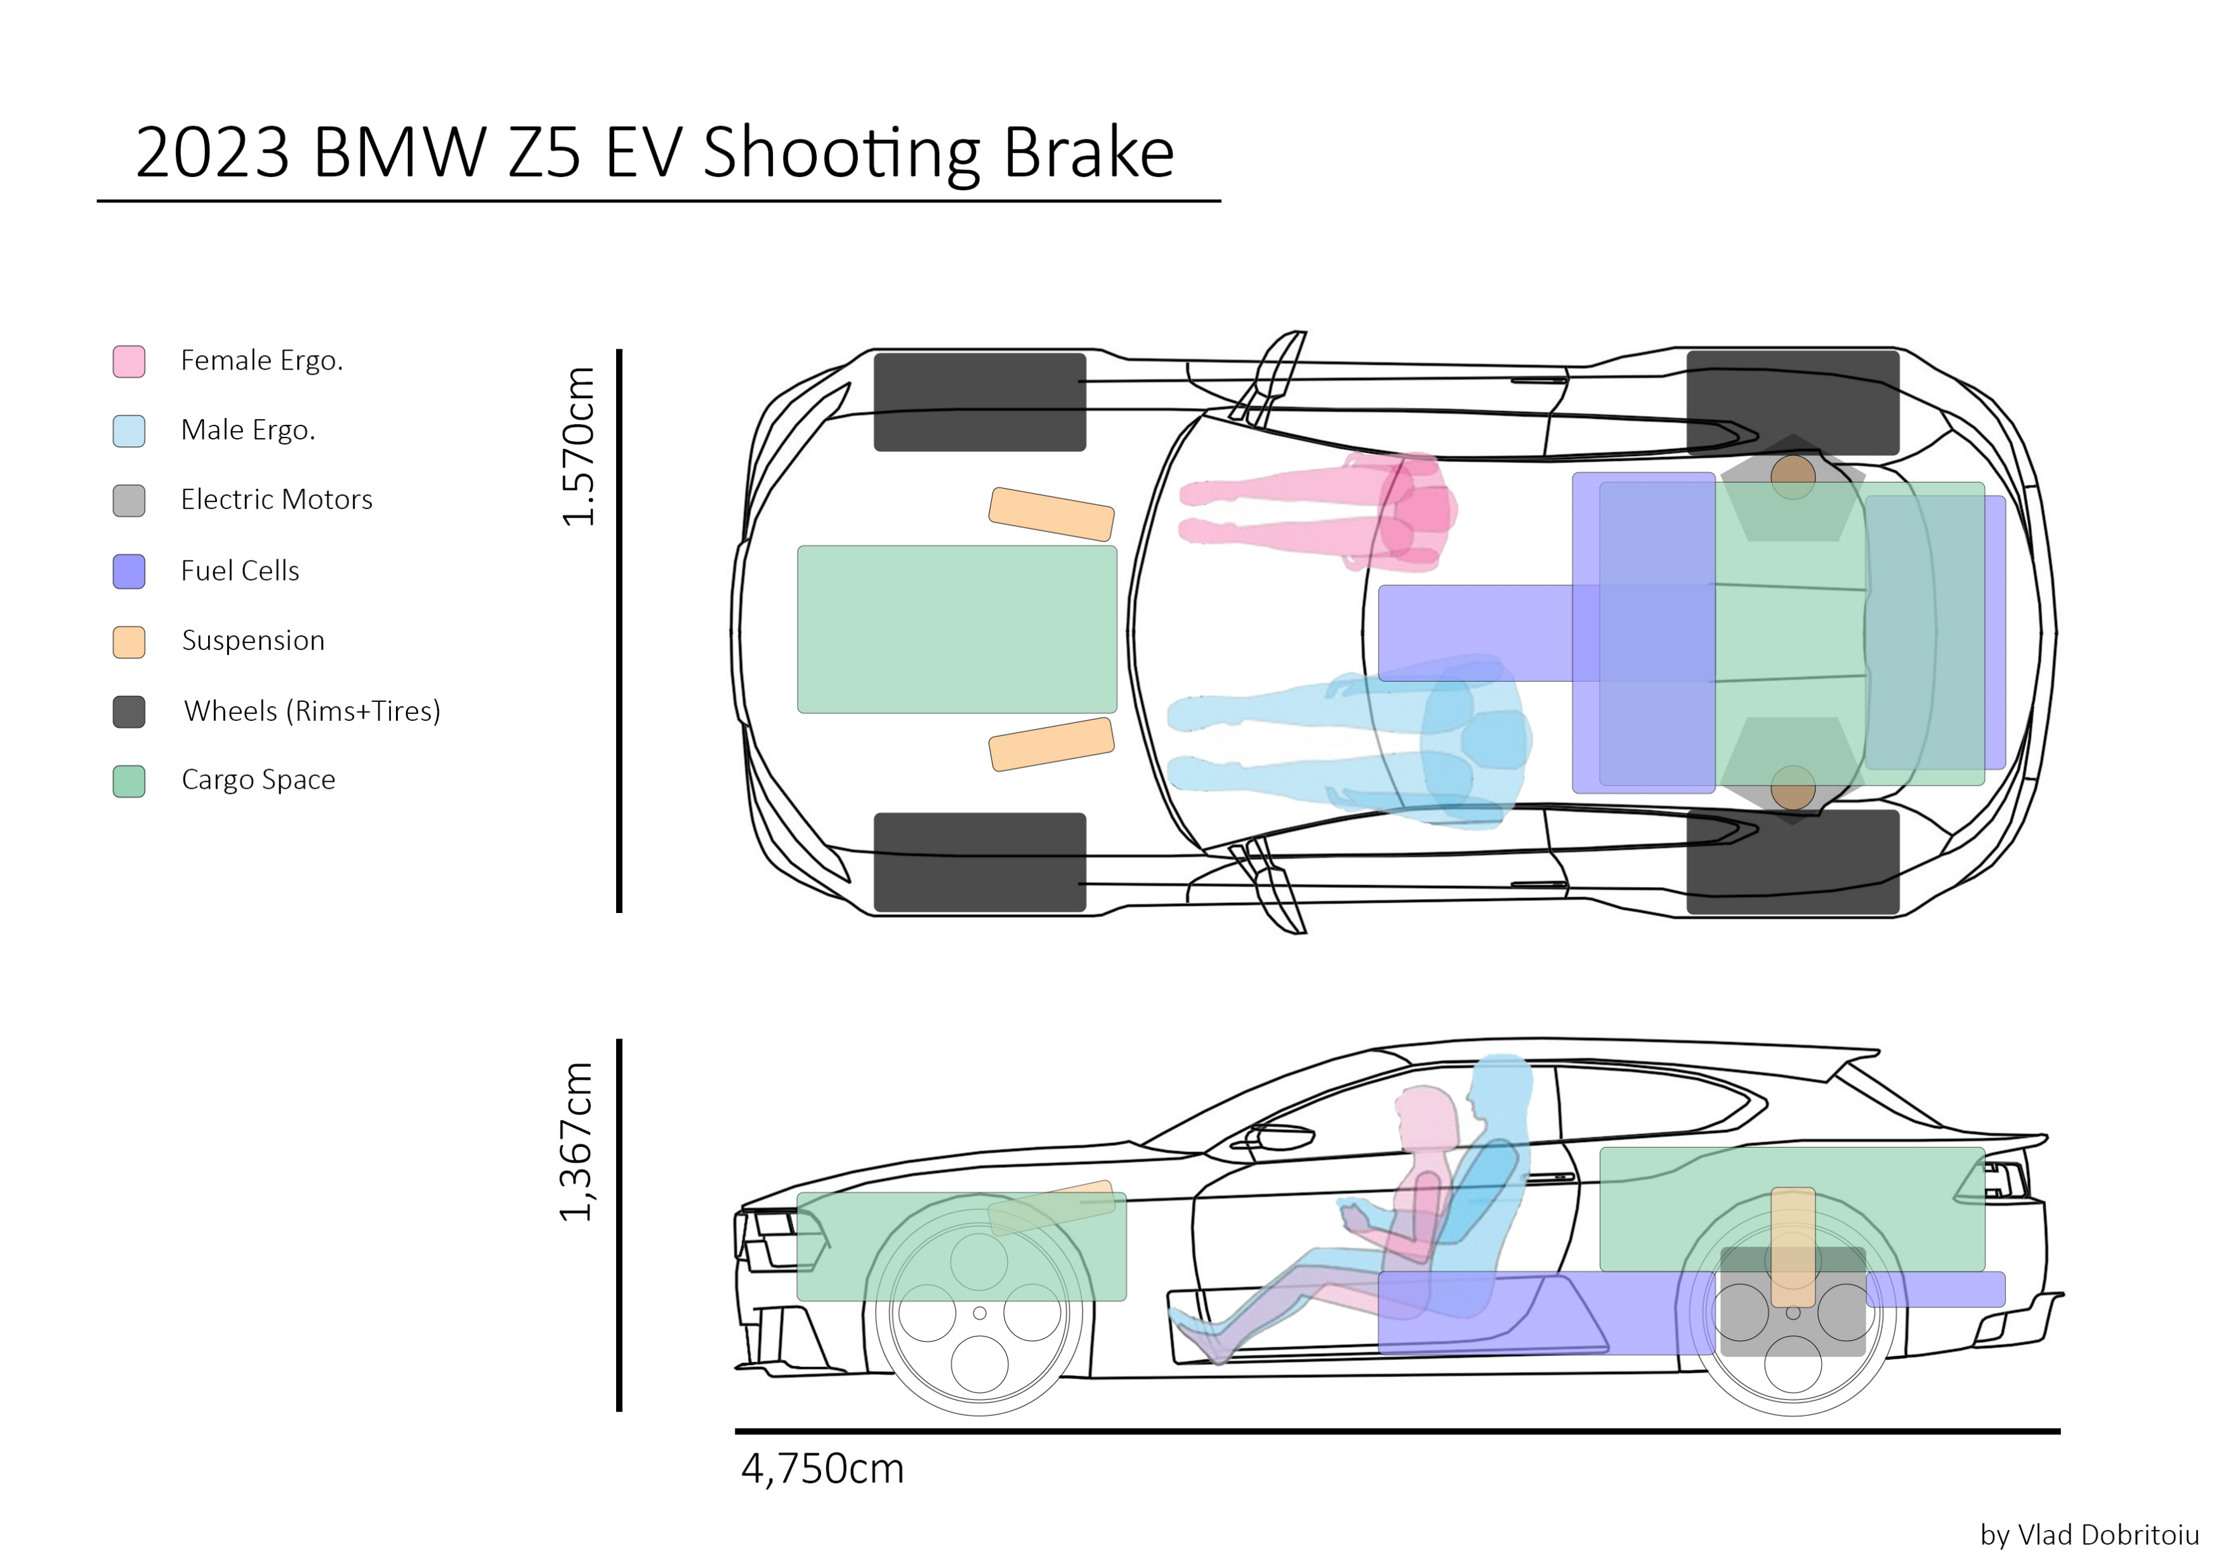
Package Drawing

Slide 4
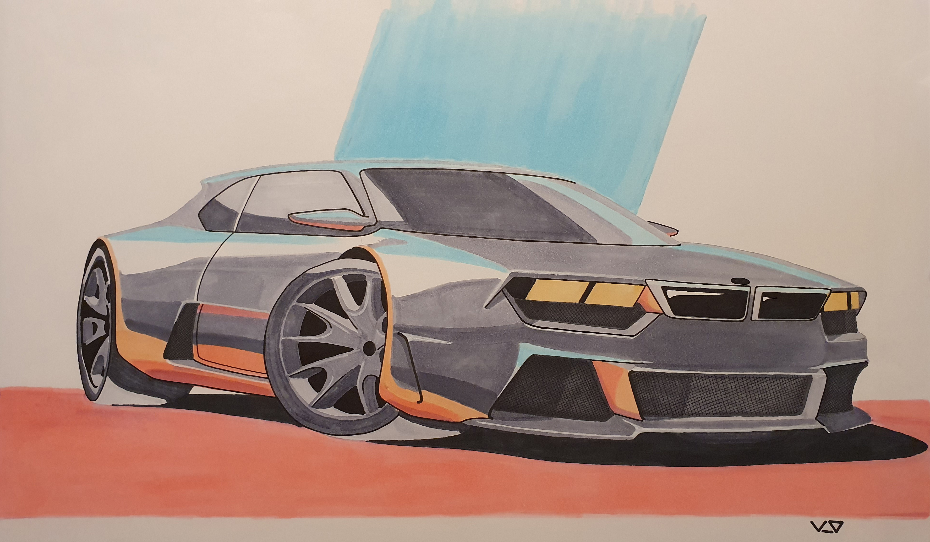
Front ¾ Marker Render

Slide 5
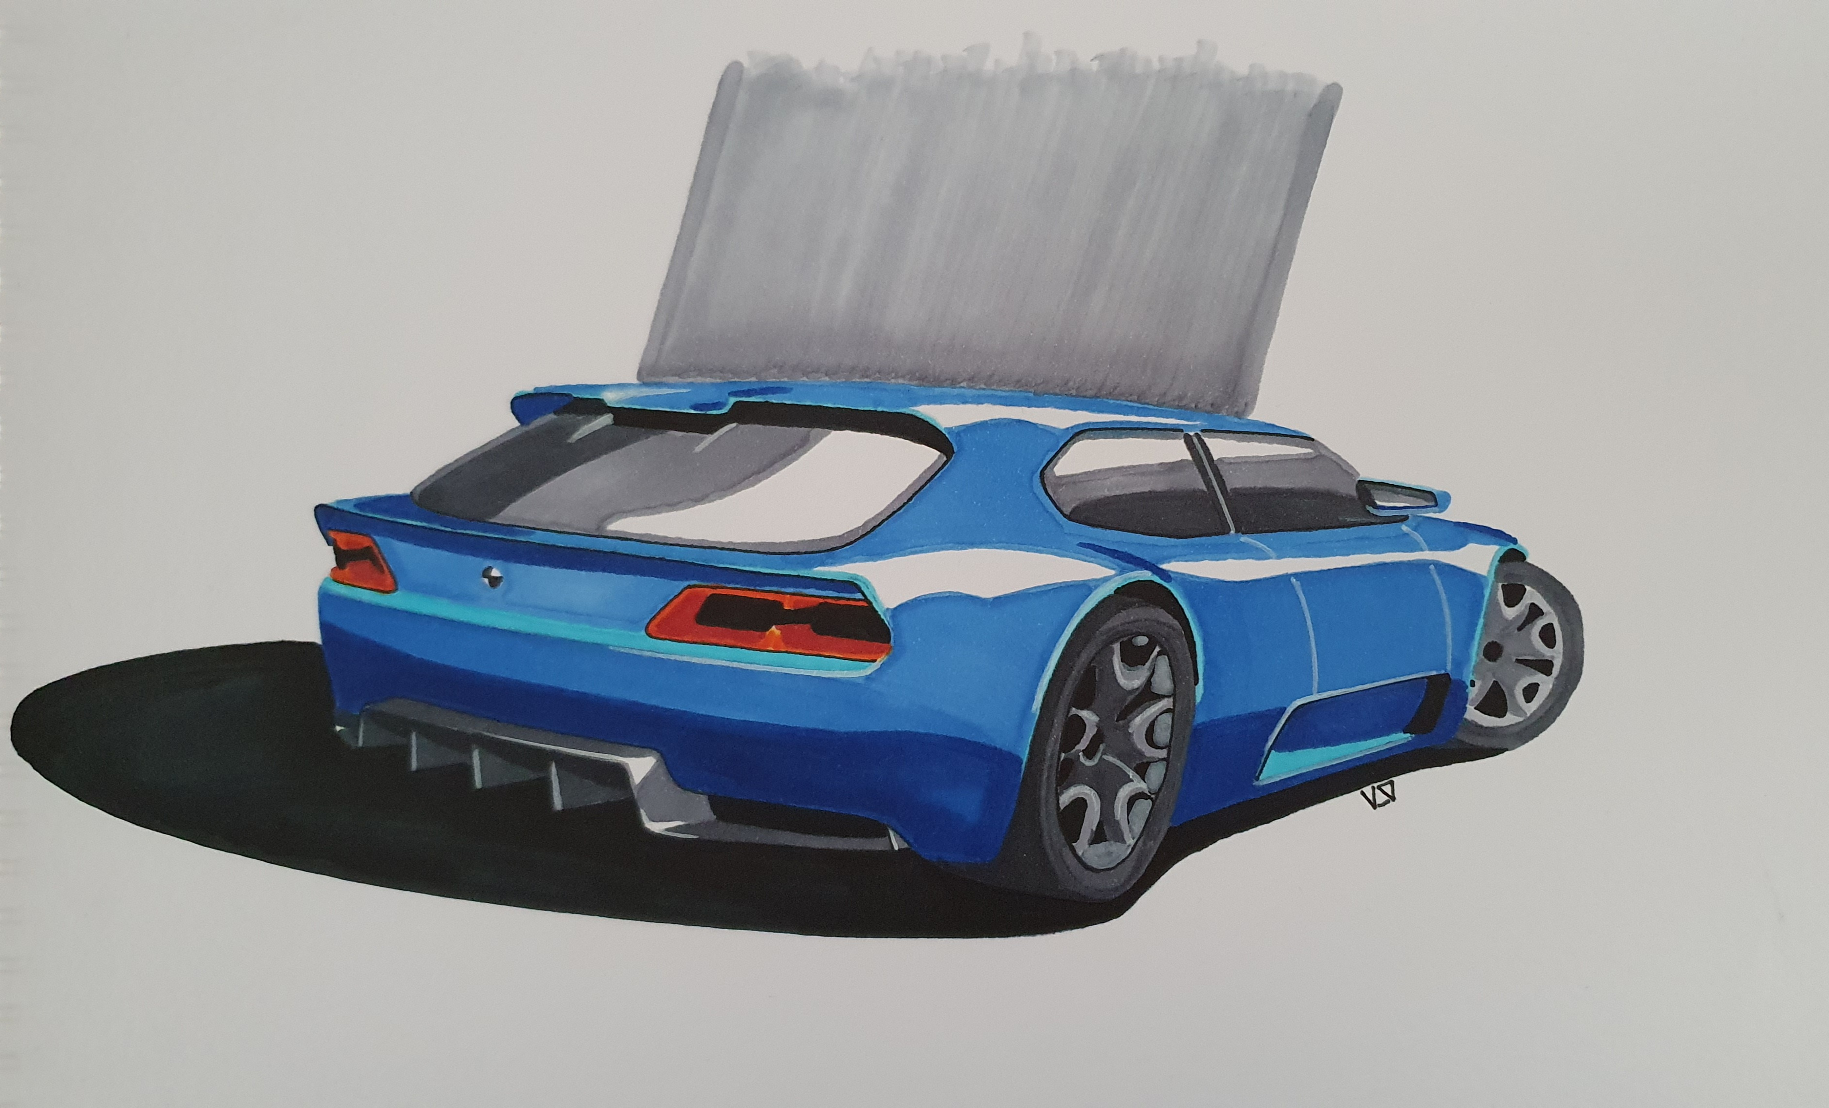
Rear ¾ Marker Render

