Slide 1
BSc (Hons) Health and Social Care
Psychological Classifications and Provisions
Module Code: BMHP6029
Lecturer:Kennedy Obohwemu
Assignment: Component 1: Individual Presentation (Academic Poster)
Student name:Mihai Boldizsar
Student ID:2247855
Submission deadline: 9th March 2026

Slide 2



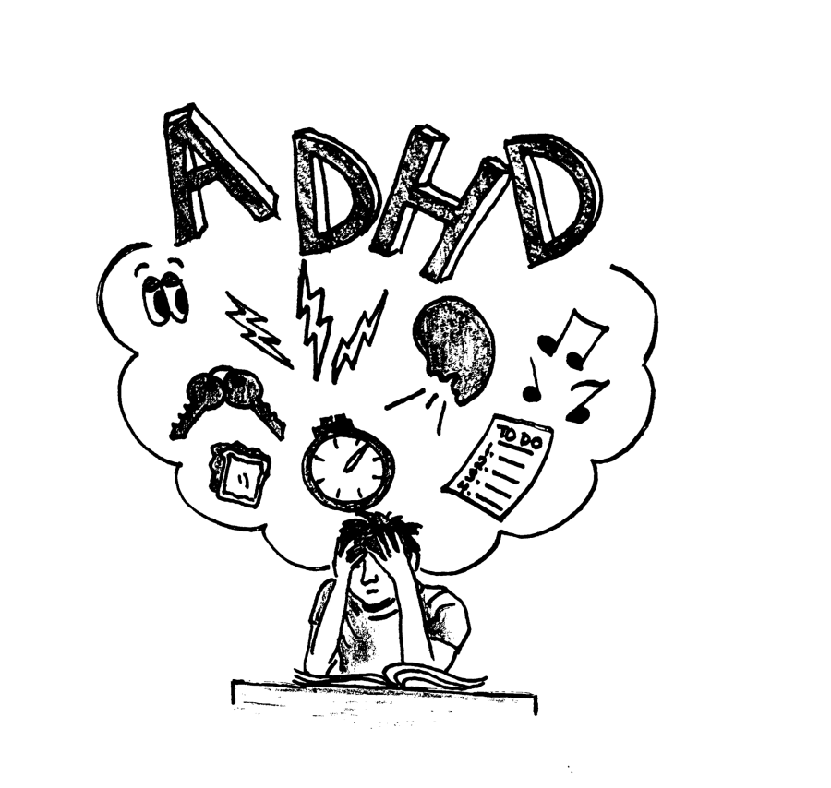

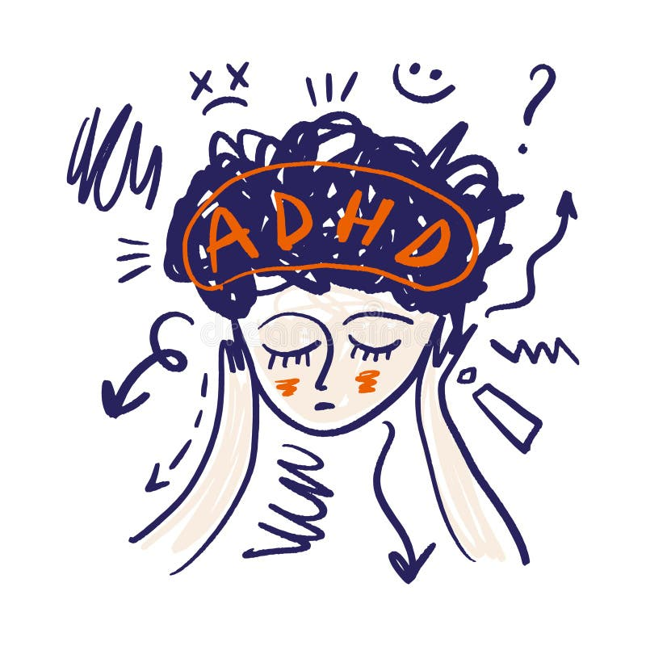
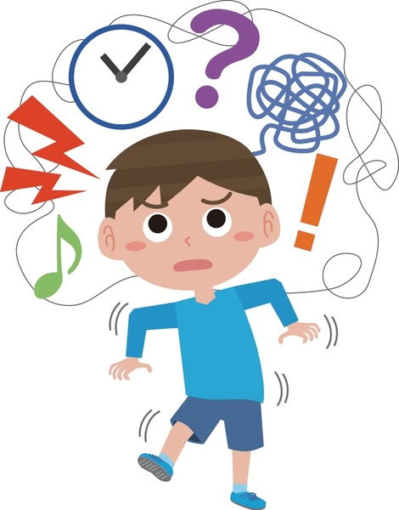
2,498,000 people in England
Attention Deficit Hyperactivity Disorder (ADHD)
741,000 aged 5-24
13.5% increase since 2024
Historical and Contemporary Perspectives on Care and Treatment
(NHS England, 2025)
2. EARLY UNDERSTANDING
1798 Sir Alexander Crichton described it as 'the incapacity of attending with necessary degree of constancy to any one object'. Children were described as easily distracted, constantly shifting attention, and unable to sustain focus (Lange et al., 2010)
1902 Sir George Frederic Still Lecture are considered the starting point of ADHD whom described children showing the symptoms as 'defect of moral control (Still, 1902)
Late 19th & early 20th centuries ADHD children were often perceived as deficient or poorly disciplined.
(Mahone & Denckla, 2017)
1. Attention deficit hyperactivity disorder is characterised by a persistent pattern (at least 6 months) of inattention and/or hyperactivity-impulsivity that has a direct negative impact on academic, occupational, or social functioning. (WHO, 2026)
Symptoms appear before age of 12:
Inattention – Hyperactivity – Impulsivity
(ADDA, 2025)
1
3. FIRST CLINICAL DESCRIPTIONS
1937 Charles Bradely use of stimulants like Benzedrine to treat hyperactivity mark the first documented approach laying the foundation for modern pharmacological treatment of hyperactive behaviour (Gross, 1995)
1944 Leandro Panizzon first synthesized methylphenidate as treatment for hyperkinetic children creating one of the most effective stimulant treatment (Ritalin) for ADHD symptoms reduction (Colzato & Arntz, 2017).
2
Growing attention to neurodevelopmental disorder has improved diagnosis and awareness of ADHD
(Cainelli & Bisiacchi, 2022)
Children still face negative labels like 'problematic' or 'difficult'
(Mueller et al., 2012)
Cultural differences & socioeconomic inequalities limit access to diagnosis & treatment
(Moore et al., 2025)
3
Special Educational Needs and Disability (SEND) system
(Gov.uk, 2026)
4
4. DEVELOPMENT OF DIAGNOSIS
1963 Oxford International Study Group of Child Neurology experts label children with hyperactivity, impulsivity, and attention problems with the Minimal Brain Dysfunction diagnosis (Ross & Ross, 1976).
1968 DSM-II introduced the diagnosis Hyperkinetic Reaction of Childhood as the first official psychiatric classification of hyperactivity.
1980 DSM-III renamed the disorder as Attention Deficit Disorder (ADD)
1987 DSM-III-R replaced the previous term with Attention‑Deficit/Hyperactivity Disorder (ADHD).
1994 DSM-IV introduced subtypes based on empirical evidence dividing ADHD into three groups: predominantly inattentive, predominantly hyperactive-impulsive, combined type, ad acknowledging it as a lifelong disorder.
2000 DSM-IV-TR revised the previous definition maintaining the diagnostic criteria but introducing explanation, examples, background information, and the ADHD diagnosis in adults (APA, 2000).
RECOMMENDATIONS
1. Increase public awareness to reduce negative bias & stigma
2. Develop support services for vulnerable groups
3. Train teachers and educators
4. Provide support for early identification
(Kooij, 2025)
(Mahone & Denckla, 2017)
5
5. MODERN TREATMENT FOR CHILDREN
Pharmacological treatment reduces symptom, yet behavioural therapy, parent training, school intervention , and lifestyle strategies are essential to improve functional outcomes and life quality (Peterson et al, 2024)
Historically ADHD has been misunderstood and often associated with brain damage or poor parenting.
Modern research demonstrated ADHD is a complex neurodevelopmental disorder that needs efficient policies and practice to ensure those diagnosed are able to live quality life.
6. MODERN TREATMENT FOR ADULTS
A multimodal approach that combines medication with psychological intervention like cognitive-behavioural therapy or mindfulness have effective outcomes (Wakelin et al., 2023)
6

Slide 3
RERERENCES
APA (2000) Diagnostic and statistical manual of mental disorders: DSM‑IV‑TR. 4th ed., text revision. Washington, DC: American Psychiatric Association.
Cainelli, E., & Bisiacchi, P. (2022). Neurodevelopmental Disorders: Past, Present, and Future. Children (Basel, Switzerland), 10(1), 31 [Online] Available at: < https://doi.org/10.3390/children10010031 > (Accessed 6 March 2026)
Colzato, L.S., Arntz, F.E. (2017). Ritalin. In: Theory-Driven Approaches to Cognitive Enhancement. Springer, Cham. [Online] Available at: < https://doi.org/10.1007/978-3-319-57505-6_6 > (Accessed 6 March 2026).
Gross, M.D. (1995) Origin of stimulant use for treatment of attention deficit disorder. The American Journal of Psychiatry, 152(2), 298–299. [Online] Available at: < https://doi.org/10.1176/ajp.152.2.298b > (Accessed 6 March 2026)
Gov.uk (2026) CHildren with special educational needs & disabilities (SEND). [Online] Available at: < Children with special educational needs and disabilities (SEND): Overview - GOV.UK > (Accessed 6 March 2026)
Kooij J. J. S. (2025). New developments and potential future research directions in adult ADHD. World psychiatry : official journal of the World Psychiatric Association (WPA), 24(3), 381–382. [Online] Available at: < https://doi.org/10.1002/wps.21351 > (Accessed 6 March 2026)
Lange, K.W., Reichl, S., Lange, K.M., Tucha, L. & Tucha, O. (2010) The history of attention deficit hyperactivity disorder. ADHD Attention Deficit and Hyperactivity Disorder, 2, 241–255 [Online] Available at: < https://doi.org/10.1007/s12402-010-0045-8 > (Accessed 6 March 2026)
Mahone, E. M., & Denckla, M. B. (2017). Attention-Deficit/Hyperactivity Disorder: A Historical Neuropsychological Perspective. Journal of the International Neuropsychological Society : JINS, 23(9-10), 916–929 [Online] Available at: < https://doi.org/10.1017/S1355617717000807 > (Accessed 6 March 2026)
Moore, T., Perdomo, J., Sargado, S. (2025). Race, Culture, and Ethnicity in ADHD. In: Schonwald, A., Cormier, D., McCafferty, S. (eds) ADHD in Adolescents. Springer, Cham. [Online] Available at: < https://doi.org/10.1007/978-3-031-96950-8_17 > (Accessed 6 March 2026)
Mueller, A. K., Fuermaier, A. B., Koerts, J., & Tucha, L. (2012). Stigma in attention deficit hyperactivity disorder. Attention deficit and hyperactivity disorders, 4(3), 101–114. [Online] Available at: < https://doi.org/10.1007/s12402-012-0085-3 > (Accessed 6 March 2026)
NHS England (2025) ADHD Management Information: May 2025. NHS England. Available at: < https://digital.nhs.uk/data-and-information/publications/statistical/mi-adhd/may-2025 > (Accessed 6 March 2026)
Peterson, B.S., Trampush, J., Maglione, M., Bolshakova, M., Rozelle, M., Miles, J., Pakdaman, S., Brown, M., Yagyu, S., Motala, A. and Hempel, S. (2024) Treatments for ADHD in children and adolescents: A systematic review. Pediatrics, 153(4). [Online] Available at: < https://doi.org/10.1542/peds.2024-065787 > (Accessed 6 March 2026)
Still, G.F. (1902) Some abnormal psychical conditions in children. Lancet (1), 1008–1012, 1077–1082.
Ross, D. M., & Ross, S. A. (1976) Hyperactivity: Research, theory, and action. John Wiley & Sons.
Wakelin, C., Willemse, M. and Munnik, E. (2023) A review of recent treatments for adults living with attention-deficit/hyperactivity disorder. South African Journal of Psychiatry, 5. [Online] Available at: < https://doi.org/10.4102/sajpsychiatry.v29i0.2152 > (Accessed 6 March 2026)
World Health Organization (2024) ICD‑11 for Mortality and Morbidity Statistics (Version: 2024‑01). World Health Organization. [Online] Available at: < https://icd.who.int/browse/2024-01/mms/en (Accessed 6 March 2026)

