Slide 1

PRACTICE-BASED RESEARCH
LCHS7001
Research Ethics
Created by: Dr Aishat Bakre
Modified by: Dr Zeno Leung

Slide 2
Aims of the Session
To understand
The term ethical consideration in research
Research ethics
Why research ethics is important
How a researcher can get ethical approval
The different types of ethical issues/principles

Slide 3

What is Research Ethics?

Slide 4
Ethical considerations in research
Ethical considerations in research are a set of principles that guide your research designs and practices.
Scientists and researchers must always adhere to a certain code of conduct when collecting data from people.
“Ethics helps us decide what we should do and why”, Barrett et al. (2016, p7)

Slide 5
Research Ethics
The goals of human research often include understanding real-life phenomena, studying effective treatments, investigating behaviours, and improving lives in other ways.
What you decide to research and how you conduct that research involve key ethical considerations.
Notes:
Oxford dictionary, 2020

Slide 6
Research Ethics
These ethical considerations work to
protect the rights of research participants
enhance research validity
maintain scientific integrity
Note ethical considerations are also important in animal research, but our main focus is on research ethics in human research

Slide 7
Why do research ethics?

Slide 8

Tuskegee Syphilis Study (1932-1972)

Slide 9
Importance of Research Ethics
Research ethics is essential for scientific integrity, human rights and dignity, and collaboration between science and society.
These principles make sure that participation in studies is voluntary, informed, and safe for research subjects/participants.

Slide 10
Importance of Research Ethics
Research ethics is also essential
To protect participants/patients/society/researchers.
To ensure accuracy and
To protect intellectual and property rights.

Slide 11
Research Ethics
You will balance pursuing important research aims by using ethical research methods and procedures.
It is always necessary to prevent permanent or excessive harm to participants, whether unintentional or not.
Disregarding research ethics will also lower the credibility of your research because it will be hard for others to trust your data if your methods are morally questionable.
Even if a research idea is valuable to society, it does not justify violating the human rights or dignity of your study participants.

Slide 12
How can a researcher get ethical approval

Slide 13
Getting ethical approval
A research proposal must be submitted to an institutional review board (IRB) before starting any study involving data collection with people.
An IRB is a committee that checks whether your research aims and research design are ethically acceptable and follow your institution’s code of conduct.
They check that your research materials and procedures are up to the code of conduct.

Slide 14
Getting ethical approval
If the ethical application is successful, an approval will be issued by the IRB, and you can begin the data collection according to the approved procedures.
If you need to make any changes to your procedures or materials, you will need to submit a modification application to the IRB for approval.

Slide 15
Getting ethical approval
If unsuccessful, you may be asked to re-submit with modifications or your research proposal may receive a rejection.
To get IRB approval, it is important to explicitly note how you will tackle each of the ethical issues that may arise in your study.
https://www.uwtsd.ac.uk/research/research-ethics/

Slide 16
Common ethical concerns
There are several ethical issues you should always pay attention to in your research design, and these issues can overlap with each other.
You must outline ways to deal with each issue in your research proposal if you plan to collect data from participants.

Slide 17
Conducting ethical research
Saunders et al (2019) outlines a series of key ethical principles that any researcher needs to be aware of, the first six principles apply to working with the participants.
Integrity, fairness and open-mindedness.
Respect for others
Privacy of those taking part
Avoidance of harm
Voluntary nature of participation and right to withdraw
Informed consent of those taking part
Notes:
Integrity, fairness and open-mindedness of the researcher - The quality of research depends in part on the integrity, fairness and openmindedness of the researcher. This means acting openly, being truthful and promoting accuracy. Conversely it also means avoiding deception, dishonesty, misrepresentation (of data and findings etc.), partiality, reckless commitments or disingenuous promises. Where appropriate, any conflict of interest or commercial association should be declared.
Respect for others - A researcher’s position is based on the development of trust and respect. The conduct of research entails social responsibility and obligations to those who participate in or are affected by it. The rights of all persons should be recognised and their dignity respected.
Avoidance of harm - Any harm to participants must be avoided. Harm may occur through risks to emotional well-being, mental or physical health, or social or group cohesion. It may take a number of forms including embarrassment, stress, discomfort, pain or conflict. It may be caused by using a research method in an intrusive or zealous way that involves mental or social pressure causing anxiety or stress. It may also be caused by violating assurances about confidentiality and anonymity, or through harassment or discrimination.
Privacy of those taking part.
Privacy is a key principle that links to or underpins several other principles considered here. Respect for others, the avoidance of harm, the voluntary nature of participation, informed consent, ensuring confidentiality and maintaining anonymity, responsibility in the analysis of data and reporting of findings, and compliance in the management of data are all linked to or motivated by the principle of ensuring the privacy of those taking part.
Voluntary nature of participation and right to withdraw
The right not to participate in a research project is unchallengeable. This is accompanied by the right not to be harassed to participate. It is also unacceptable to attempt to extend the scope of participation beyond that freely given. Those taking part continue to exercise the right to determine how they will participate in the data collection process, including rights: not to answer any question, or set of questions; not to provide any data requested; to modify the nature of their consent; to withdraw from participation and possibly to withdraw data they have provided.
Informed consent of those taking part.
The principle of informed consent involves researchers providing sufficient information and assurances about taking part to allow individuals to understand the implications of participation and to reach a fully informed, considered and freely given decision about whether or not to do so, without the exercise of any pressure or coercion. This leads to the right of those taking part to expect the researcher to abide by the extent of the consent given and not to find that the researcher wishes to prolong the duration of an interview or observation, or to widen the scope of the research without first seeking and obtaining permission, or to commit any subsequent breach of the consent given

Slide 18
Integrity, fairness and open-mindedness
The quality of research depends in part on the integrity, fairness and open-mindedness of the researcher.
This means acting openly, being truthful and promoting accuracy.
Conversely it also means avoiding deception, dishonesty, misrepresentation (of data and findings etc.), partiality, reckless commitments or disingenuous promises.
Where appropriate, any conflict of interest or commercial association should be declared.

Slide 19
Respect for others
A researcher’s position is based on the development of trust and respect.
The conduct of research entails social responsibility and obligations to those who participate in or are affected by it.
The rights of all persons should be recognised and their dignity respected.

Slide 20
Avoidance of harm
As a researcher, you have to consider all possible sources of harm to participants. Harm can come in many different forms.
Psychological harm: Sensitive questions or tasks may trigger negative emotions such as shame or anxiety.
Social harm: Participation can involve social risks, public embarrassment, or stigma.
Physical harm: Pain or injury can result from the study procedures.
Legal harm: Reporting sensitive data could lead to legal risks or a breach of privacy.

Slide 21
Avoidance of harm
It is best to consider every possible source of harm in your study as well as concrete ways to mitigate them.
Make sure to disclose all possible risks of harm to participants before the study to get informed consent.
If there is a risk of harm, prepare to provide participants with resources or counselling or medical services if needed.

Slide 22
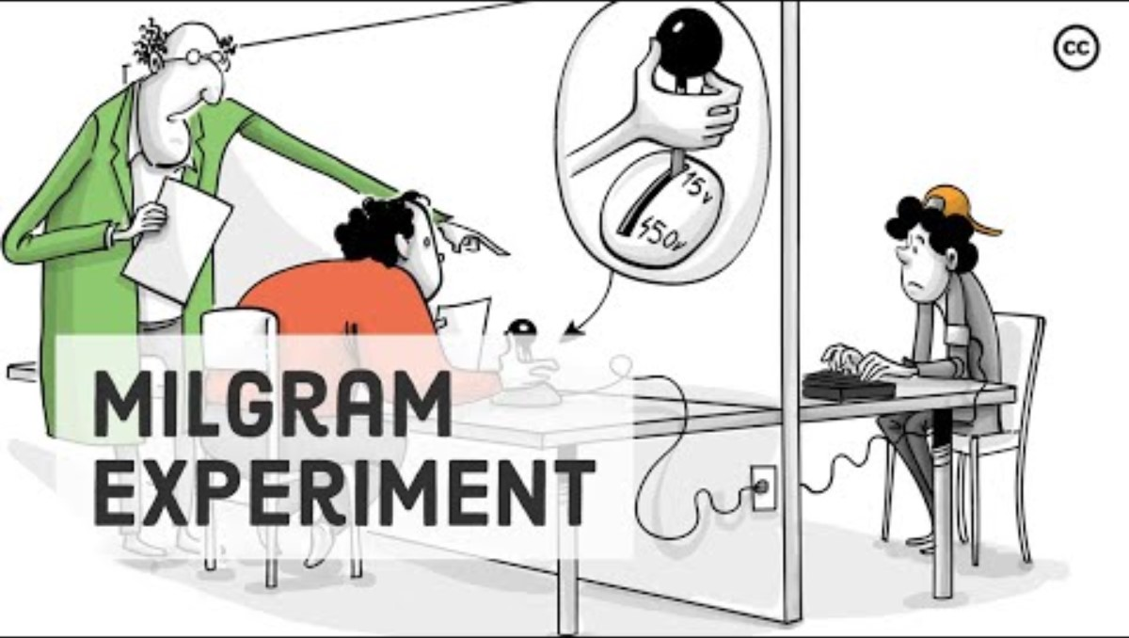
The Milgram Experiment

Slide 23
Privacy & anonymity
Anonymity means that “you don’t know who the participants are and you can’t link any individual participant to their data”.
Anonymity is guaranteed by not collecting any personally identifying information—for example, names, phone numbers, email addresses, IP addresses, physical characteristics, photos, and videos.
In many cases, it may be impossible to truly anonymise data collection. For example, data collected in person or by phone cannot be considered fully anonymous because some personal identifiers (demographic information or phone numbers) are impossible to hide.

Slide 24
Privacy & anonymity
Identifying information is also collected, if participant are given the option to withdraw their data at a later stage.
Data pseudonymization is an alternative method where you replace identifying information about participants with pseudonymous, or fake, identifiers.
The data can still be linked to participants but it is harder to do so because personal information from the study data would have been separate.

Slide 25
Voluntary participation
Voluntary participation means that “all research subjects are free to choose to participate without any pressure or coercion”.
All participants are able to withdraw from, or leave, the study at any point without feeling an obligation to continue.
Your participants do not need to provide a reason for leaving the study.

Slide 26
Voluntary participation
It is important to make it clear to participants that there are no negative consequences or repercussions to their refusal to participate.
After all, they are taking the time to help you in the research process, so you should respect their decisions without trying to change their minds.

Slide 27
Informed consent
Informed consent refers to a situation in which all potential participants receive and understand all the information they need to decide whether they want to participate.
This includes information about the study’s benefits, risks, funding, and institutional approval.
For example
You plan to recruit participants on campus for a quick survey.
You must ensure all the potential participants are provided with all the relevant information about the study. This is called the participant information sheet.

Slide 28
Informed consent
The details must include
What the study is about
The risks and benefits of taking part
How long the study will take
Your supervisor’s contact information and the institution’s approval number

Slide 29
Informed consent
You must also inform the participants that their data will be kept confidential, and they are free to stop completing the survey at any point for any reason.
They are also allowed to withdraw their information by contacting you or your supervisor.
Usually, participants are provided with a text for them to read and ask them if they have any questions.
If they agree to participate, they can sign or initial the consent form.
Note that this may not be sufficient for informed consent when working with particularly vulnerable groups of people.

Slide 30
Informed consent
If you’re collecting data from people with low literacy, make sure to verbally explain the consent form to them before they agree to participate.
For participants with very limited English proficiency, you should always translate the study materials or work with an interpreter so they have all the information in their first language.
In research with children, you’ll often need informed permission for their participation from their parents or guardians. Although children cannot give informed consent, it’s best to also ask for their assent (agreement) to participate, depending on their age and maturity level.

Slide 31
Conducting ethical research
Three of the ten principles outlined by Saunders et al (2019) apply to how data is stored and analysed.
Ensuring confidentiality of data
Accurate analysis and reporting of data
Uphold data protection laws
  Last but not the least:
Ensure the safety of the researcher
Notes:
Ensuring confidentiality of data and maintenance of anonymity of those taking part
Research is designed to answer ‘who’, ‘what’, ‘when’, ‘where’, ‘how’ and ‘why’ questions, not to focus on those who provided the data to answer these. Individuals and organisations should therefore remain anonymous and the data they provide should be processed to make it non-attributable, unless there is an explicit agreement to attribute comments. Harm may result from unauthorised attribution or identification. Reliability of data is also likely to be enhanced where confidentiality and anonymity are assured. This principle leads to the right to expect assurances about anonymity and confidentiality to be observed strictly.
Accurate analysis and reporting of data
Assurances about privacy, anonymity and confidentiality must be upheld when analysing and reporting data. Primary data should not be made up or altered and results should not be falsified. Findings should be reported fully and accurately, irrespective of whether they contradict expected outcomes. The same conditions apply to secondary data, the source or sources of which should also be clearly acknowledged. Analyses and the interpretations that follow from these should be checked carefully and corrections made to ensure the accuracy of the research report and any other outcome.
Uphold data protection laws
Research is likely to involve the collection of personal data. Many governments have passed legislation to regulate the processing, security and possible sharing of personal data. There is therefore a statutory requirement to comply with such legislation. In the European Union, Directive 95/46/CE and subsequently the General Data Protection Regulation EU2016/679 required member states to pass data protection legislation. Other laws may exist in particular countries relating to the processing, security and possible sharing of data. It will therefore be essential for researchers to understand and comply with the legal restrictions and regulations that relate to the management of research data within the country or countries within which they conduct research.
Ensuring the safety of the researcher
The safety of researchers is a very important consideration when planning and conducting a research project. The Social Research Association’s Code of Practice for the Safety of Social Researchers identifies possible risks from social interactions including ‘risk of physical threat or abuse; risk of psychological trauma . . . ; risk of being in a compromising situation . . . ; increased exposure to risks of everyday life’ (Social Research Association 2001: 1). Research design therefore needs to consider risks to researchers as well as to participants.

Slide 32
Confidentiality & data protection
Confidentiality means that you know who the participants are, but you remove all identifying information from your report.
All participants have a right to privacy, so you should protect their personal data for as long as you store or use it.
Even when you cannot collect data anonymously, you should secure confidentiality whenever you can.
Notes:
Privacy of those taking part.
Privacy is a key principle that links to or underpins several other principles considered here. Respect for others, the avoidance of harm, the voluntary nature of participation, informed consent, ensuring confidentiality and maintaining anonymity, responsibility in the analysis of data and reporting of findings, and compliance in the management of data are all linked to or motivated by the principle of ensuring the privacy of those taking part.

Slide 33
Confidentiality & data protection
To ensure data confidentiality, steps must be taken to safeguard it and prevent any threats to data privacy.
All signed consent forms must be stored in a locked file drawer, and all files with survey data must be password-protect.
Only other researchers approved by the IRB are allowed to access the study data,
And everyone must know and ensure they follow the institution’s data privacy protocols.

Slide 34
Accurate analysis & reporting
Result communication must be honest, reliable and credible and must be free of plagiarism and research misconduct.
Research misconduct by making up or falsifying data, manipulating data analyses, or misrepresenting results in research reports”.
Plagiarism by submitting others’ peoples works as your own
Self-plagiarism as when you republish or re-submit parts of your own papers or reports without properly citing your original work.

Slide 35
References
Barrett, D. et al. (2016) Public Health Ethics: Cases Spanning the Globe. 1st ed. Cham: Springer International Publishing. doi:10.1007/978-3-319-23847-0.
Bhandari, P. (2022, December 02). Ethical Considerations in Research | Types & Examples. Scribbr., Available at: https://www.scribbr.com/methodology/research-ethics/ (Accessed date 12th October 2022).
Cresswell JW, Cresswell JD. (2017). Research design: qualitative, quantitative and mixed method approaches. (Edn: 5th). Sage Publications Inc: London.
Creswell, J.W. (2008). Educational Research: Planning, conducting, and evaluating quantitative and qualitative research (3rd ed.). Upper Saddle River: Pearson
Maxwell JA. (2012). Qualitative Research Design: An Interactive Approach: 41 (Applied Social Research Methods). Sage Publications Inc: London.
Saunders, M.N.K., Lewis, P. and Thornhill, A. (2019) Research methods for business students. 8th edition. Harlow: Pearson.

