Slide 1


Importance of Employee Engagement
IN THE HOTEL INDUSTRY
By Waheed Farid 2019666
Operating Hotel Facilities BMIH4006

Slide 2





What is employee engagement ?
Weinger, A. (2021). Employee Engagement: The Essential Guide for 2021. [online] Double the Donation. Available at: https://doublethedonation.com/employee-engagement/ [Accessed 19 Nov. 2022].

Slide 3
Benefits of employee engagement?
More productive team
Increased employee productivity
Better work atmosphere
Less workplace stress
Lower risk of burnout
Achieved team objectives
A much happier team
deBara, D. and St-Aubin, N. (2017). 6 Amazing Benefits Of Employee Engagement. [online] Officevibe. Available at: https://officevibe.com/blog/employee-engagement-benefits.

Slide 4
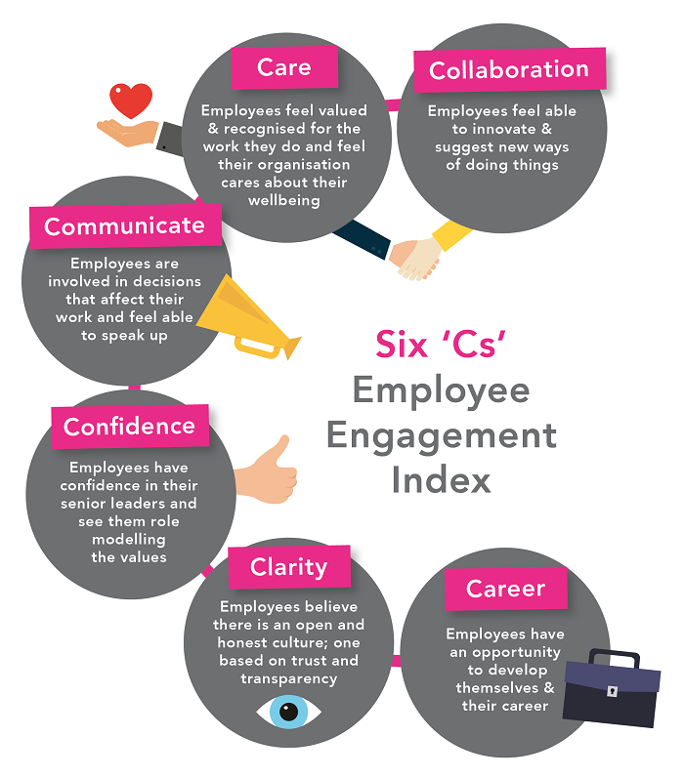

Employee engagement research. (n.d.). Employee Engagement models :: DJS Employee Research. [online] Available at: https://employeeengagementcompany.com/employee-surveys/employee-engagement-models/ [Accessed 22 Nov. 2022].

Slide 5
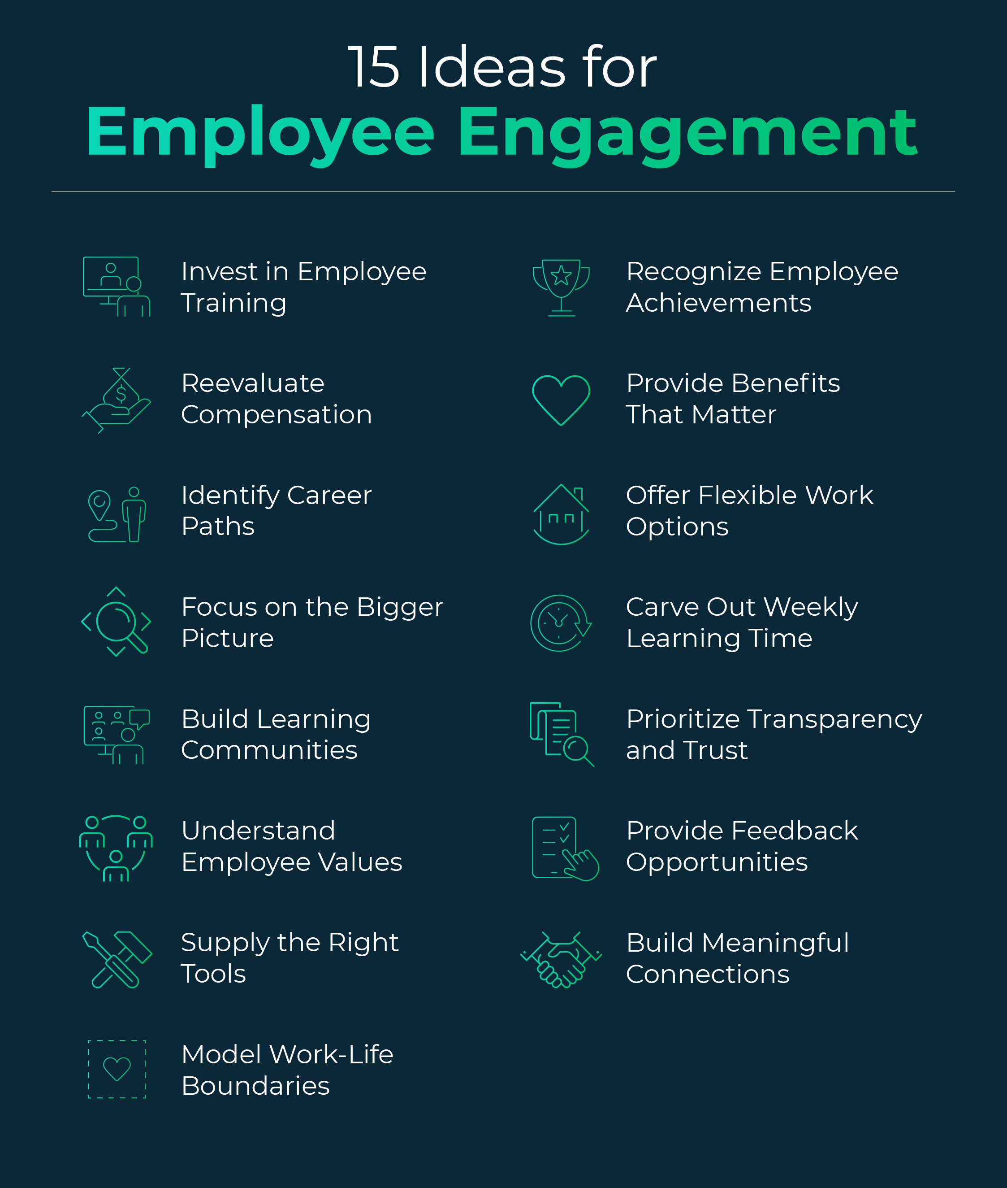
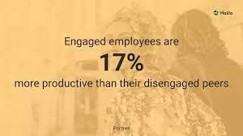
Organizations can magnify the benefits of upskilling and reskilling by allowing employees to learn and grow together.
jordan.friedman (2022). 15 Employee Engagement Ideas and Strategies That Work. [online] Emeritus Online Courses. Available at: https://emeritus.org/blog/employee-engagement-ideas-strategies/ [Accessed 24 Nov. 2022].
mark (2022). Top 7 Benefits of Employee Engagement [& How to Improve It]. [online] Haiilo. Available at: https://haiilo.com/blog/employee-engagement-benefits/.

Slide 6
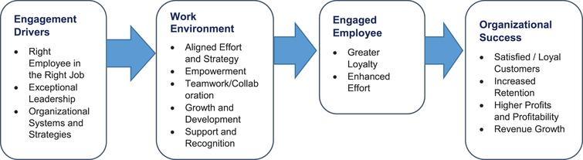
Industry benefits from employee engagement
Ahmed, T., Khan, M.S., Thitivesa, D., Siraphatthada, Y. and Phumdara, T. (2020). Impact of employees engagement and knowledge sharing on organizational performance: Study of HR challenges in COVID-19 pandemic. Human Systems Management, [online] 39(4), pp.589–601. doi:10.3233/HSM-201052.

Slide 7
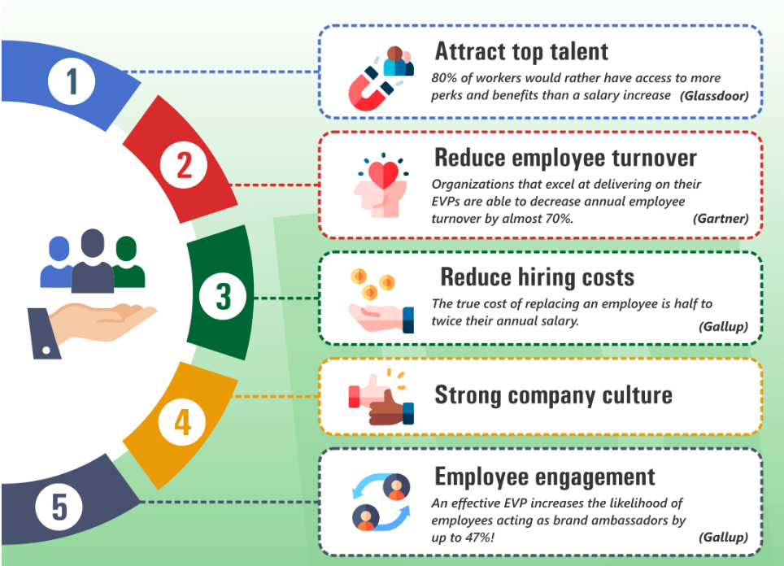
EMPLOYEE VALUE PROPOSITION AND HOW IT CONNECTS WITH EMPLOYEE ENGAGEMENT
Duncan, C. (n.d.). Employee Value Proposition: Step by Step Guide to Creating | DeskAlerts. [online] www.alert-software.com. Available at: https://www.alert-software.com/blog/employee-value-proposition [Accessed 25 Nov. 2022].

Slide 8
Overview of the importance of employee engagement in the hotel industry
Keep employees happy
Continuous support portals
Regular team building activities
Regular buzz team meetings
Internal growth opportunities
Take on feedback as the employees are first point of contact for guest
Regular incentive initiatives
Relay the business goals and growth plans to employees

Slide 9
Reference page
Weinger, A. (2021). Employee Engagement: The Essential Guide for 2021. [online] Double the Donation. Available at: https://doublethedonation.com/employee-engagement/ [Accessed 19 Nov. 2022].
deBara, D. and St-Aubin, N. (2017). 6 Amazing Benefits Of Employee Engagement. [online] Officevibe. Available at: https://officevibe.com/blog/employee-engagement-benefits.
Employee engagement research. (n.d.). Employee Engagement models :: DJS Employee Research. [online] Available at: https://employeeengagementcompany.com/employee-surveys/employee-engagement-models/ [Accessed 22 Nov. 2022]
jordan.friedman (2022). 15 Employee Engagement Ideas and Strategies That Work. [online] Emeritus Online Courses. Available at: https://emeritus.org/blog/employee-engagement-ideas-strategies/ [Accessed 24 Nov. 2022].
mark (2022). Top 7 Benefits of Employee Engagement [& How to Improve It]. [online] Haiilo. Available at: https://haiilo.com/blog/employee-engagement-benefits/.
Ahmed, T., Khan, M.S., Thitivesa, D., Siraphatthada, Y. and Phumdara, T. (2020). Impact of employees engagement and knowledge sharing on organizational performance: Study of HR challenges in COVID-19 pandemic. Human Systems Management, [online] 39(4), pp.589–601. doi:10.3233/HSM-201052.
Duncan, C. (n.d.). Employee Value Proposition: Step by Step Guide to Creating | DeskAlerts. [online] www.alert-software.com. Available at: https://www.alert-software.com/blog/employee-value-proposition [Accessed 25 Nov. 2022].

