Slide 1
Mark Huntly
m.huntly@uwtsd.ac.uk
Software Engineering Principles and Practice
Software Testing

Slide 2
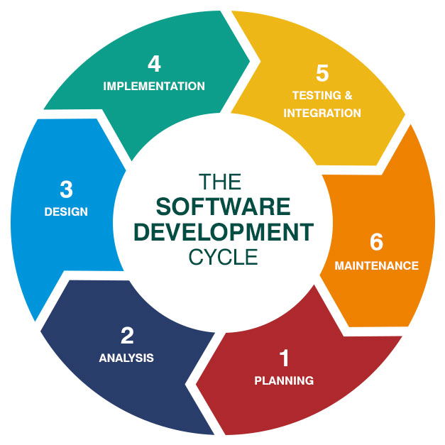
Software Testing
Why test?
Black box testing
  Test Strategy
  Equivalence partintioning
  Functional testing
    Data tests
    Other tests
  Non-functional testing (Performance)

Slide 3
Software Testing
White box testing
  Path testing
  Unit testing
Test cycle
Test documentation

Slide 4
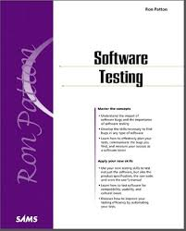
Software Bugs
When the software:
  Doesn’t do something the product specification says it should do
  Does something that the product specification says it shouldn’t
  Does something the product specification doesn’t mention
    Undocumented behaviour is unpredictable behaviour.
  Doesn’t do something that the product specification doesn’t mention but should
  Is difficult to understand, hard to use, slow, or will be viewed by the end user as not correct – Think usability
The specification is your contract, and the software has broken it.
Notes:
Patton gives us five conditions, any one of which qualifies something as a software bug.
The key takeaway is that a bug is not just a crash or an error message.
It's any deviation from expected, specified, or reasonable behaviour — including things that were never written down but were implicitly expected.

Slide 5
Testability
The degree to which software can be tested completely and efficiently.
SOCK:
  Simple –
    Simpler components and applications are easier to test.
  Observable –
    Visibility of internal structures and data to determine accurately if test passes or fails
  Control –
    If an application has a threshold, the ability to set and reset thresholds makes testing easier
  Knowledge –
    The tester should be able to refer to documentation (e.g. specifications) to ensure test results are correct
Notes:
Good software should have testability built in from the start – Design Quality.

Slide 6
Static vs Dynamic Testing
Static testing → testing something that is not running
  Visual inspection of specification (static black box testing: testing the specification)
    What is the software supposed to do? Is it complete? Is it ambiguous?
  Review of the design and code (static white box testing: examining the design and code)
    Code review, Walkthrough, linting etc…
    Look for logic errors, poor structure, vulnerabilities, coding standards etc…
Dynamic testing → running the software and using it
  Dynamic black box testing – interacting as a user would.
  Dynamic white box testing – target testing based on knowledge.
Notes:
Testing doesn't begin when coding ends.
Static testing means you should start testing from the very beginning of the development lifecycle, as soon as you have a specification or a design.

Slide 7
Black Box Testing
Aka data-driven, or input/output- driven testing
Your goal is to be completely unconcerned about the internal behaviour and structure of the program.
Instead, concentrate on finding circumstances in which the program does not behave according to its specification(s).
Functional Testing: Test specific behaviour or feature
  Given a set of inputs check the outputs
    click on a button does the correct page display?
    enter two numbers click “add”, does the correct value display
Notes:
Does the software do what it's supposed to do? That's the main question you're asking.

Slide 8
Performance (Non-Functional) Testing
Repetition testing
  Doing the same operation over and over → May find memory leaks
Stress testing
  Running the code in less than ideal conditions e.g. low memory, slow CPU, etc. Starve the software of resources
Load testing
  Largest possible file
  Large number of simultaneous connections to server
  Feed the software all it can handle
Fuzz testing
  Feed software invalid input data
Race conditions and bad timing
  Do multiple things at the same time e.g. clicking buttons when the program is loading a file, etc.
Usability testing – Think point 5 from Software Bugs.
Security testing, etc
Notes:
Does the software do what it's supposed to do? That's the main question you're asking.
Black box testing is specification driven.
What unites all of these techniques is that they test conditions beyond normal happy-path usage.
Real software lives in a messy world — limited resources, heavy load, impatient users, malicious actors, and unfortunate timing.
Non-functional testing ensures that software is built to survive that reality.

Slide 9
Test Strategy
Test to Pass: test the software minimally passes
  First tests to try
  Not trying to break the code (Happy path should always pass)
Test to Fail: be sneaky, conniving and devious to force bugs out (also known as error-forcing)
  Perform after “test to pass”
  Probe common weaknesses in software
Anticipated errors can be considered either test to pass or fail, the distinction is not important e.g. not entering correct password multiple times
Behave like a dumb user…

Slide 10
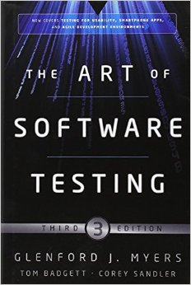
Equivalence Partitioning Heuristics (guidelines)
Range: contiguous set of data → any value between the minima and maxima is expected to produce the same result
Group: items that can be handled together e.g. if picking a vehicle from a list puts you in a specific tax category
Unique: Data that must be handled differently to other data
Specific: The condition must or must not be present e.g. @ symbol in e-mail address
Also see:
http://web.mit.edu/6.005/www/sp16/classes/03-testing/
Notes:
The idea of equivalence partitioning heuristics is:
Rather than testing every possible input value (which is usually infinite or impractical);
divide inputs into groups where all values in a group are expected to behave the same way.
then test one representative value from each group.
The theory is:
If one value in a partition works, they should all work.
If one fails, they should all fail.

Slide 11
Combinatorial Testing
What if input values are dependent on each other?
Setting one changes the effect of the other
  pressure < 10 && volume > 300
Use Combinatorial Analysis
  Each choice once
  Base choice
  Pair-wise independent combinatorial test (PICT)
  Etc
Beyond the scope of this lecture!!!
Also see:
http://web.mit.edu/6.005/www/sp16/classes/03-testing/
Notes:
When inputs interact with each other, testing them in isolation is not sufficient.
Specialised techniques exist to handle this efficiently.

Slide 12
Data (Functional) Testing
Test data input
  Buttons clicked
  Text entered
  Numbers in spreadsheet
Test data output
  File created
  Data written to database
Also see:
http://web.mit.edu/6.005/www/sp16/classes/03-testing/

Slide 13
Boundary Conditions
Boundary conditions are those situations at the edge of the planned operational limits of the software
  Always test data that lies on a boundary (include tests in equivalence partition)
Create two equivalence boundaries
  Last one or two valid points inside the
  boundary
  One or two points outside of the boundary
Example, number must be between
0 and 10 – if (value >= 0 && value <= 10)
Test
Here
-1
0
Test
Here
1
10
Test
Here
11
Test
Here
Test
Here
Boundary Value Analysis
Notes:
Bugs love boundaries.
In practice, developers are generally pretty good at handling values well within a valid range.
Where things go wrong is right at the edges.
Off-by-one errors are one of the most common bugs in software development.
A loop that runs one too many times, a condition that uses > instead of >= — these are boundary failures.

Slide 14
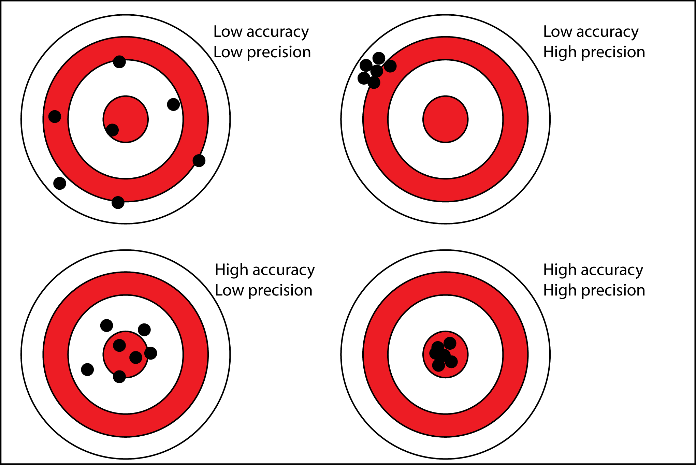
Boundary Conditions - Examples
If text entry allows 1 to 255 characters, try 1 character and 255 characters. Also try 254, 0 and 256.
If writing to a file, try the smallest amount of data you can write, also an empty file, a file just at the limit of a USB drive size and maybe a file that is too large for the drive.
Be careful with floating point values: what precision are you working to?
For currency probably 2 decimal places e.g. £3.99p
Precision and Accuracy are not the same thing!!
  A system that always returns £3.9999999 when the answer is £4.00
  is highly precise (consistent) but inaccurate (wrong).
  You need both!
Notes:
When defining your expected outputs in test cases, be explicit about the required precision —
Especially for financial or scientific calculations.

Slide 15
Sub-Boundary Conditions
Aka internal boundary conditions → internal to the software
Examples:
  Powers of Two:
  Nibble: 0-15
  Byte: 0-255
  Word: 0-65,535
  Consider integer overflow… if a variable is stored as a byte and its value reaches 255, incrementing it by 1 wraps around to 0.
  ASCII Table:
  If program is reading characters A-Z and a-z, check characters below and above those in ASCII table i.e. @; [; `; {
Notes:
Sub-boundary conditions arise from how the hardware and software internally represent data, not from business rules.
A tester needs some awareness of the underlying technology to identify and test these.
As software engineers, rather than general users, we need to be thinking about this.
The Ariane 5 rocket exploded in 1996 partly due to an overflow error where a 64-bit floating point value was converted into a 16-bit integer and exceeded its maximum value.
The boundary was internal, not specified — and it wasn't tested.
In the ASCII character encoding system, characters are represented as numbers.
The uppercase letters A–Z occupy positions 65–90, and lowercase a–z occupy 97–122.
@ is 64, [ is 91, ` is 96 and { is 123.

Slide 16
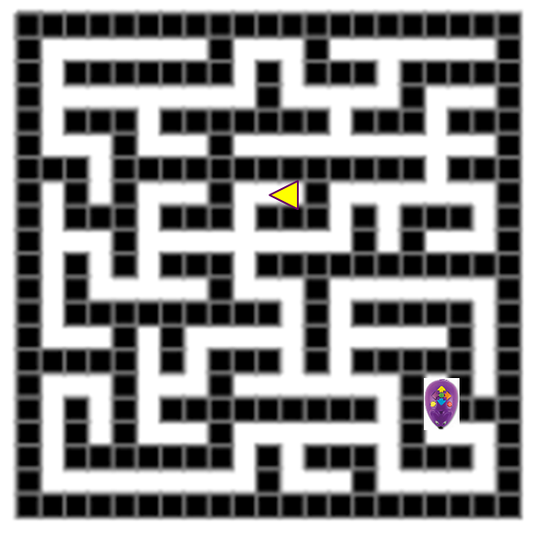
Exercise
A robot mouse needs to travel through a maze, pick up some hidden cheese and return to the start
For simplicity we will assume the world is divided into a grid and entrances are aligned to grid edges
The robot moves one grid position at a time and can rotate 90, 180 and 270 degrees
  Assume the code has been written for this robot.
  How would you test this robot?
  Hint:
    Make sure it never gets stuck
    Make sure it always finds the cheese

Slide 17


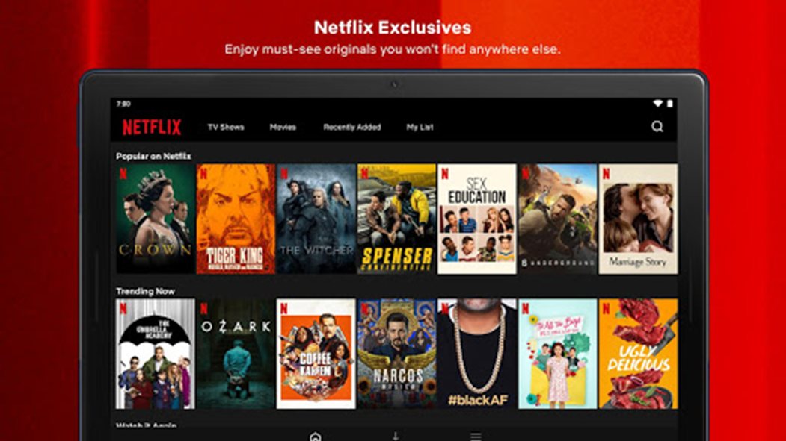
Exercise - Netflix
What functional testing and non-functional testing could you perform?
How would you reduce the amount of testing required?
What automated tests could you use?

Slide 18

White Box Testing
White-box or logic-driven testing;
  “Opens the lid”
  Permits you to examine the internal structure, code and logic of the program.
  This strategy derives test data from an examination of the program’s logic
The Risk:
  Easy to become biased and tailor the tests to match the codes operation, rather than what it is required to do
Notes:
This level of insight allows for very precise, targeted testing that black box testing simply cannot achieve.

Slide 19
White Box Testing
Directly test low level functions or libraries.
Test the software from the top level by adjusting test cases based on the code operation
Gain access to the real variable and state information from the code
  Test that they are correct
  Force code into states it would be difficult to achieve otherwise under test
    Fault injection
Code coverage analysis → check how much of the code has been tested and tailor tests so that all the code is tested
Notes:
With access to the internal structure, a white box tester can:
Identify every branch in the code — every if/else, every switch statement — and write tests to ensure each one is executed
Trace every possible path through a function
Identify loops and test their boundaries — zero iterations, one iteration, maximum iterations
Spot dead code — logic that can never be reached
Check that every condition in a complex boolean expression is properly evaluated
With visibility of the code, you can intelligently refine your test cases.
If you can see that a particular branch in the code will never be reached with the inputs you originally planned, you can adjust.
You're not guessing — you're making informed decisions based on what the code actually does. This makes your testing more efficient and more thorough simultaneously.

Slide 20
White Box Testing
Code coverage analysis → check how much of the code has been tested and tailor tests so that all the code is tested
  There are several levels of coverage to be aware of:
    Statement coverage — has every line been executed?
    Branch coverage — has every possible branch (every true and false of every condition) been taken?
    Path coverage — has every possible route through the code been traversed?
Coverage analysis should guide your testing, not replace careful thinking about what each test actually verifies.
Notes:
Code coverage analysis tools instrument your code and track which lines, branches, and paths are actually executed when your tests run.
The result is a coverage percentage and a detailed report showing exactly which parts of the code your tests never reached.
If your coverage report shows that 30% of your code is never executed by your tests, you have a significant gap.
Either that code is dead and should be removed, or your tests are insufficient and need extending.

Slide 21
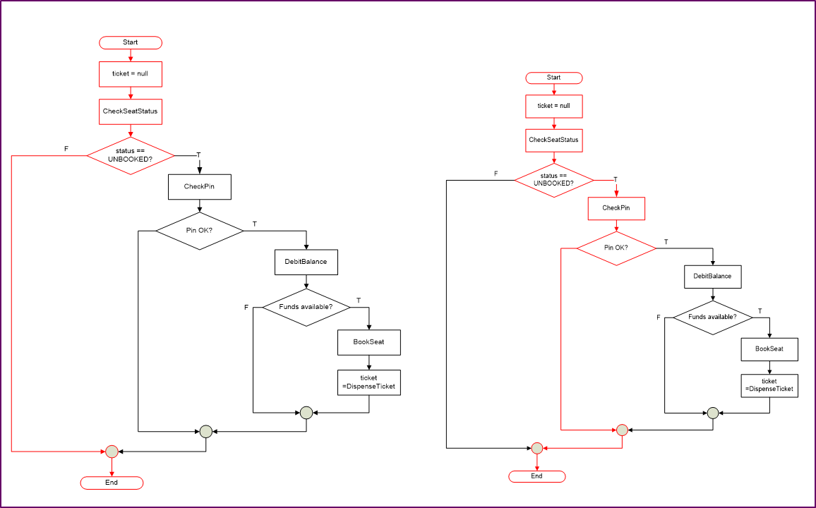
Path Testing
Test each path through code
Simplest form is
Branch Coverage Testing
Condition Coverage:
Test each condition at branch
e.g. if a Boolean operator has
been used
Notes:
Path testing means identifying every possible route that execution can take through a piece of code — every combination of branches, loops, and decisions — and ensuring each one is covered by at least one test case.

Slide 22
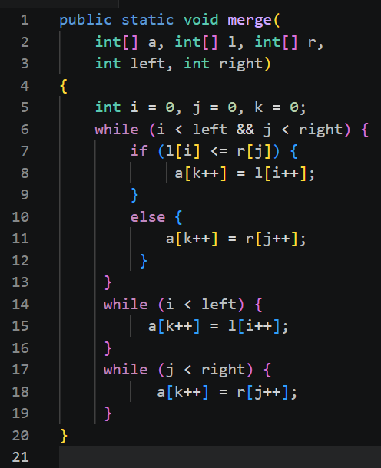
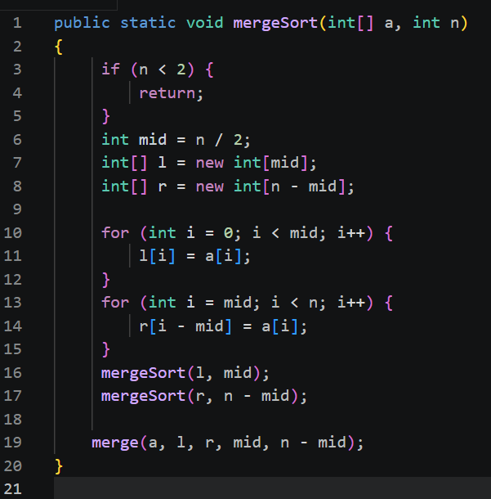
Exercise
How would you test this code?

Slide 23
Exercise
How would you test this code?
NOT EASY
Notes:
This is a classic well known Merge Sort algorithm split across two methods.
mergeSort(int[] a, int n) — the recursive method that splits the array in half repeatedly until subarrays of size less than 2 are reached
merge(int[] a, int[] l, int[] r, int left, int right) — the method that merges two sorted subarrays back together in the correct order

Slide 24
Why is the Merge Sort Algorithm not easy?
Recursion: MergeSort calls itself – Nonlinear.
Multiple interacting loops: The merge method contains three while loops that interact with shared indices i, j, and k. Each loop with its own condition.
Boundary Conditions Everywhere: Every one of these is a boundary condition requiring careful testing.
Array Manipulation: Testing correctness requires verifying not just that the method returns without error, but that the contents of the array are correct after execution.
Notes:
This is a classic well known Merge Sort algorithm split across two methods.
mergeSort(int[] a, int n) — the recursive method that splits the array in half repeatedly until subarrays of size less than 2 are reached
merge(int[] a, int[] l, int[] r, int left, int right) — the method that merges two sorted subarrays back together in the correct order

Slide 25
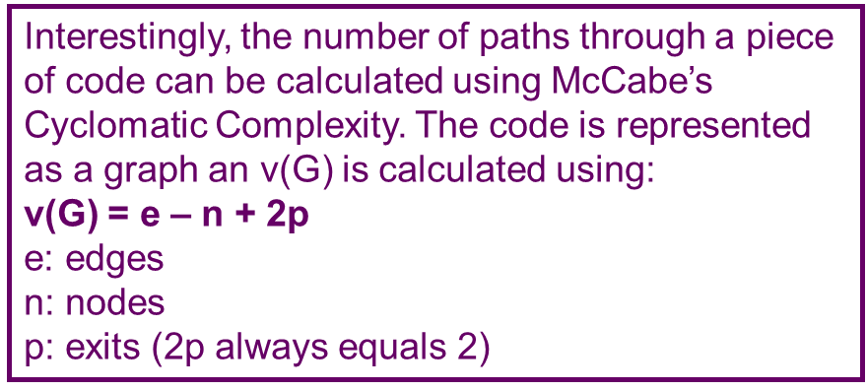
Why is the Merge Sort Algorithm not easy?
Execute, via test cases, all possible paths of control flow through the program, then possibly the program has been completely tested.
  Not actually possible, too many paths to test
  Won’t catch data-sensitive errors i.e. too many values to test
The goal is never to test everything — it's to test smartly enough that you have justified confidence in the software's correctness.
Notes:
Even moderately complex programs have an astronomical number of paths.
Consider a loop that iterates up to 20 times with a decision inside — the path combinations explode rapidly.
For any real-world system, exhaustive path testing is computationally impossible.
You simply cannot run enough test cases in any reasonable timeframe.
Even if you somehow covered every path, you still haven't tested every possible data value on each path.
A path might execute correctly with input value 100 but fail with input value 0.
Paths and data are two separate dimensions of the testing problem — covering all paths doesn't mean covering all data, and vice versa.

Slide 26
Exercise
How would you test this code?

Slide 27
Exercise 2
How would you test this code?

Slide 28
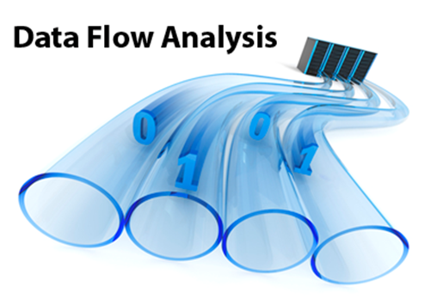
Testing Using the Debugger
Data Flow Testing
Track a piece of data completely through the code
Where does it change, how does it change?
Error Forcing
Force variable to specific values to cause errors and see if your code handles them
Notes:
The debugger leverages the internal visibility that white box testing affords us.
Step through code line by line and input a breakpoint
Change values in branch statements at the breakpoint
The debugger is not just a tool for fixing bugs — it's a testing instrument in its own right.

Slide 29
Debugging
When you find an error you may want to fix it immediately
However, it is likely that the fix for the defect will cause another defect
Instead:
  Verify that you can reproduce the error – No reproducing, no verifying fixed.
  Find the smallest-scale demo of the defect in the code – Isolation.
  Write an automated test that fails but succeeds when error is fixed – Proof.
  Fix the defect - This approach is closely related to Test-Driven Development.
Finding the smallest reliable reproduction of the defect gives you the opportunity to really examine the cause of the defect.
Notes:
This is a well-documented phenomenon in software engineering — sometimes called a regression.
You fix one thing and inadvertently break something else.
Code is interconnected — a change in one place can have unexpected consequences elsewhere.
Rushing to fix without understanding fully is how bugs multiply.
The four step process is industry best practice.

Slide 30
Test Harness
Test harness (or automated test framework) is a collection of software and test data configured to test a program unit by running it under varying conditions and monitoring its behaviour and outputs
  To supply inputs to the software being tested;
  To receive outputs generated by the software being tested;
  To execute a set of tests within the framework or using the test harness;
  To record the pass/fail results of each test (framework tools);
  To store tests (framework tools);
  Provide support for debugging (framework tools);
  To do coverage measurement at code level (framework tools).
Notes:
Think of a test harness as the scaffolding around your tests — the environment, tools, and data that allow your tests to run automatically, consistently, and repeatedly without manual intervention.
A SUPPORTING PIECE OF CODE IN ORDER TO TEST YOUR SOFTWARE OR CODE IN ISOLATION
In the real world, you'll encounter test harnesses in frameworks like JUnit (Java), NUnit (.NET), pytest (Python), and Jest (JavaScript) — among many others.
A test harness is what makes Continuous Integration (CI) possible — the practice of automatically running the full test suite every time code is committed to the repository.

Slide 31
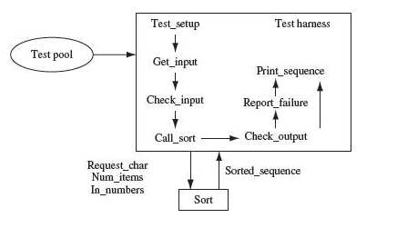
Test Harness - Example
The test cases are completely separated from the harness machinery — you add tests by adding to the test pool, not by modifying code
The process is fully automated — once running, it cycles through every test case without human intervention
Every outcome is recorded — nothing is lost or forgotten
The system under test (Sort) is completely unaware it's being tested — it just receives inputs and returns outputs as normal
Test cases in test pool file
The diagram is abstract, but the pattern is universal across all modern testing frameworks.

Slide 32

Test Software Terms
Test Double is a generic term for any kind of pretend object used in place of a real object for testing purposes. Four particular kinds of double:
  Dummy objects are passed around but never actually used. Usually they are just used to fill parameter lists.
  Stubs provide canned answers to calls made during the test. Can have state i.e. remember what happened in previous calls
    Stub Collaborator: implement a simple collaborator as concrete class that only exhibits a small part of the overall behaviour of the collaborator which is needed by the class under test
  Fake objects actually have working implementations, but usually take some shortcut which makes them not suitable for production (e.g. in memory database).
  Mocks are objects pre-programmed with expectations which form a specification of the calls they are expected to receive.
Notes:
This is an important slide that introduces vocabulary you will encounter constantly in professional software testing and in frameworks like JUnit, Mockito, and others.
Understanding the differences between these four types is important for writing precise, meaningful tests.
Using the wrong type of test double can make tests harder to understand, less reliable, or misleading.

Slide 33
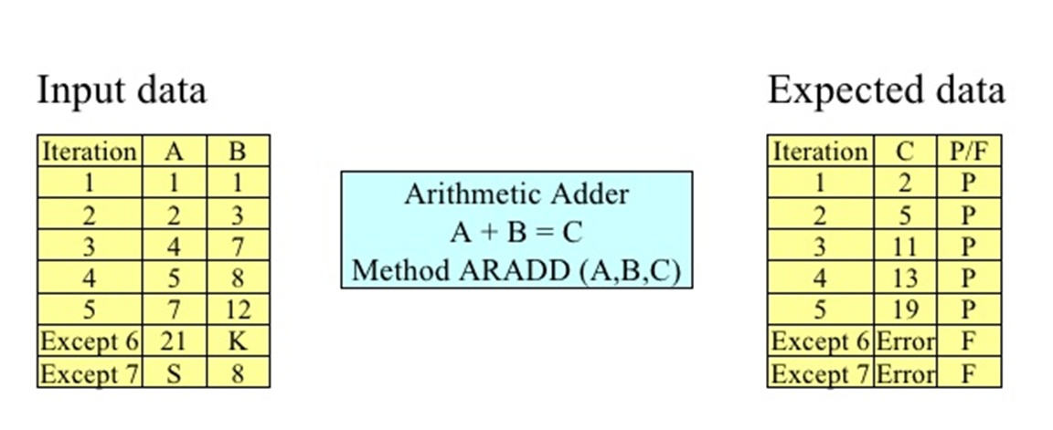
Unit Testing
Small piece of code design to test some aspect of the source code
Test each individual class and method separately
Warning:
Build black box test based on
the product specification before
the unit tests to avoid
knowledge of the internal code
influencing the black box testing.
Notes:
Unit testing is the practice of testing the smallest meaningful pieces of your software — individual methods and classes — in complete isolation from everything else. The goal is to verify that each unit of code does exactly what it's supposed to do, independently of the rest of the system.
CODED TESTS MAY NOT BE REPEATABLE – USE THROW AWAY CODE – NOT REPEATABLE

Slide 34
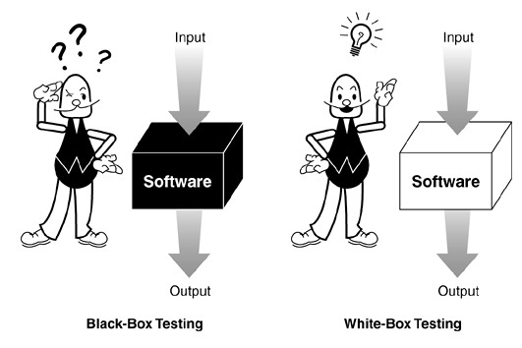
Summary
Use a combination of black box and white box testing
Black box testing often ends up over testing certain parts of the application while under testing others.
White box testing are typically thorough, but nearly always miss key end-user scenarios.
Gray box testing (Aka Glass Box Testing)
  Design tests with a customer focused perspective
  Use white box approach to ensure efficiency and test case coverage

