Slide 1

Coffee Shop promotion plan

Slide 2
Silvia Matache Coffee Shop
My coffee shop is a local shop students and workers come for coffee, tea, snacks and desserts in a cozy, comfortable environment
Our targeted customers are students aged 18-25, office workers, local residents and people who enjoy coffee and social spaces
Our promotion goals are to increase customer visits, attract new customers, improve sales, and increase social media followers
Methods of promotion could be creating social media platform accounts and content, such as TikTok posts and Instagram reels, create student discounts, and give loyalty cards, buy 5 coffees get 1 free, as well as run seasonal offers

Slide 3
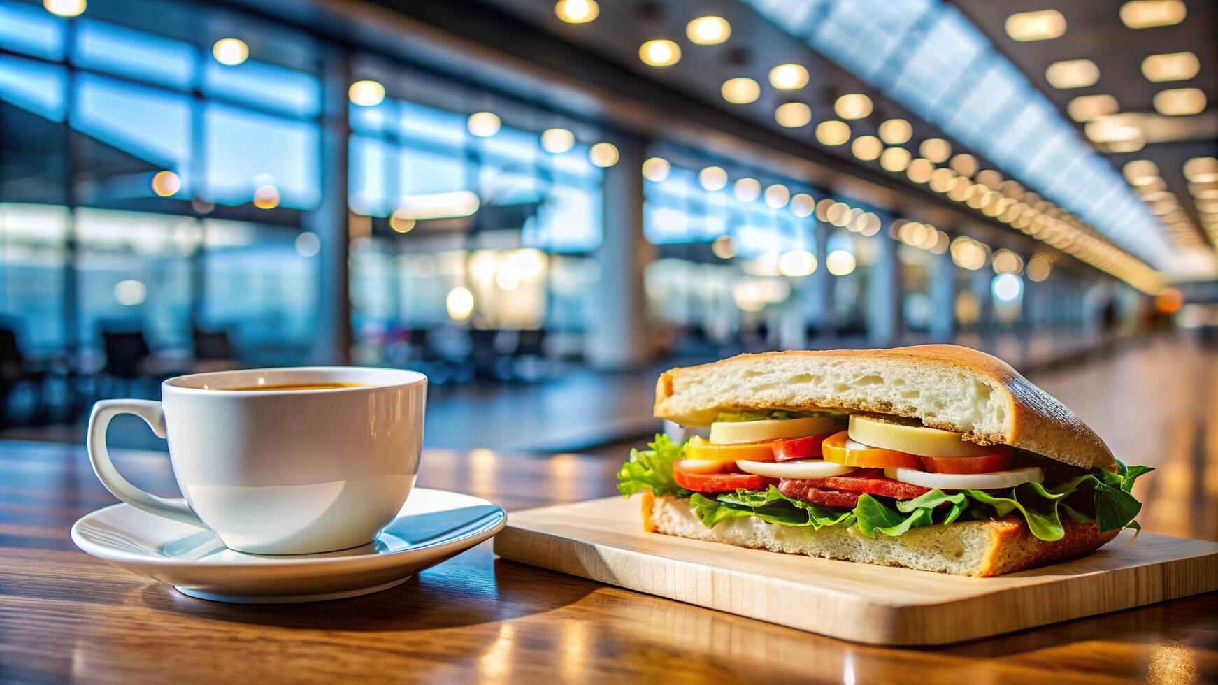
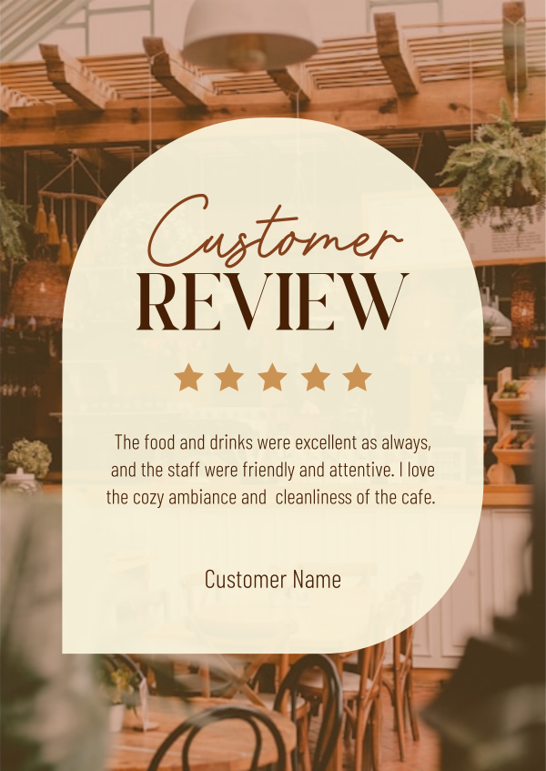

SMART targets
Increase Instagram followers by 20% in 3 months
Increase customer visits by 15% in 2 months
Gain 10 new customer reviews each month.
The coffee shop will target students, office workers and local residents. Social media promotions and affordable meal deals can attract younger customers, while loyalty cards can encourage regular visits. The coffee shop will monitor nearby cafes to compare their prices, menus and special offers. It can stand out by offering unique drinks affordable food deals and friendly customer service. It can track social media engagement, customer reviews, loyalty card usage and weekly sales. This shows which promotions attracts the most customers and help the business improve its marketing strategies.
Content ideas:
Photos of drinks and food
Customer reviews
Short creation videos
Daily promotions
Content Batching Day: Once a month, dedicate a full day to creating photos, posts, and planning content. This saves you time and keeps your quality consistent.
Social Media Conversations: Respond to every comment and engage with local hashtags; your follower growth can increase.
Coffee Explorer Series: A weekly email featuring a single-origin coffee, its story, and a special offer. This series has a 58% higher conversion rate than regular promotions.
WiFi Marketing: Your free WiFi requires an email sign-up. You offer instant rewards, growing your email list by 267+ qualified leads each month.
Location is the single biggest factor determining your cafe's success. Unlike restaurants that people specifically travel to, cafes depend heavily on convenience, foot traffic, and being in the right neighborhood. Here is what to look for:
Near Offices and Co-working Spaces: Office workers are your best weekday customers. Morning coffee runs, lunch meetings, and post-work hangouts drive consistent traffic.
Near Colleges and Universities: Students are the core cafe demographic. They stay longer, visit frequently, and bring friends. Budget-friendly cafes near campuses thrive.
High Foot Traffic Areas: Main roads, market streets, and shopping areas ensure visibility and walk-in customers.
Residential Neighbourhoods: Weekend brunch cafes in upscale residential areas benefit from families and weekend crowds.

Slide 4
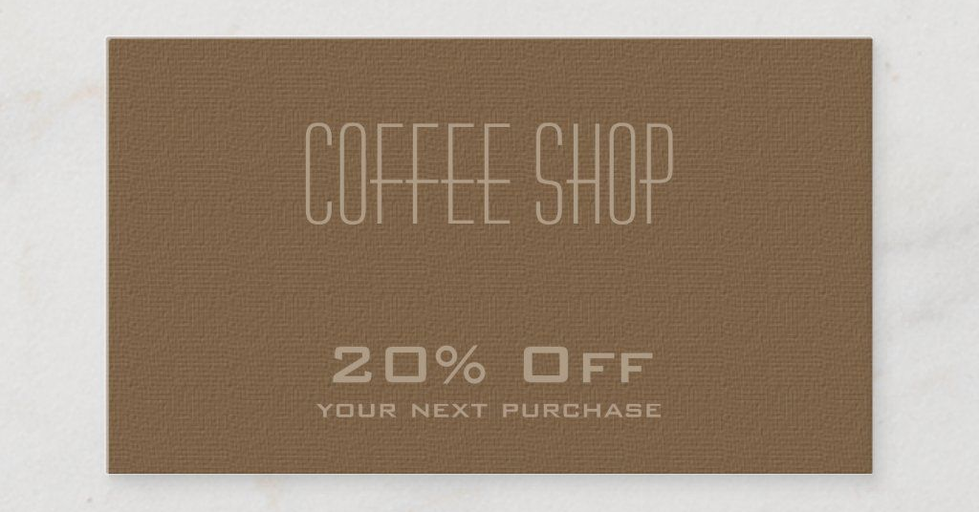


Special offers
Grand opening offer: 20% off all drinks during the first week
Referral offer: bring a friend and receive a free cookie
Loyalty cards: buy nine coffees get the tenths coffee for free
Happy hour: 14:00-16:00 with half prices on lattes and bakery items
Bring your own cup discount: 10% off your drink when you bring your own cup
Offers: buy one get one free on weekends
Student discount: 20% off drinks when shown a valid student id
Birthday offer: free coffee on their birthday
Morning deal: offer cheaper coffee and breakfast pastry before 11 am
Coffee subscription: customers pay a weekly fee to receive a set of numbers
Family deal: discounts when family order together

Slide 5
Expected outcomes
More customers
Better customer engagement
Increased sales
Stronger online presence
Stand Out from Competitors: With many coffee shops dying for attention, a strong marketing strategy helps differentiate your brand and showcase what makes your cafe unique.
Attract New Customers: Effective marketing efforts can help you reach potential customers who might not have discovered your cafe otherwise.
Build Customer Loyalty: By consistently engaging with your audience, you can foster a sense of community and encourage repeat business.
Maximize Your Marketing Budget: A well-planned strategy ensures that your marketing spend is focused on the most effective channels for your target audience.
Adapt to Market Changes: The coffee market is dynamic, and a good marketing strategy allows you to stay agile and respond to industry trends and consumer preferences.
Increase brand awareness: more people will recognize the coffee shop through social media marketing.
Improve customer relationships: replying to comments and messages can help customers feel valued.
Promote new products: advertising new drinks and snacks can encourage customers to try new products.
Improve customers satisfaction: better service and customer service can improve feedback.

Slide 6
I chose PowerPoint because it presents information clearly and professionally. I used information about coffee shop marketing strategies and customer preferences. I added images and organized the content into sections, and I improved my work by making the slides easier to read and more visually appealing. I changed the layout and added images, and I improved the design by adding heading and making the slide easier to read. Making this easier to read will give higher chances of going through with the plan because it seems easier to complete. I made several changes during the process of creating this promotion plan to improve the quality of the work. I organized the information into clear sections so that each slide focused on one topic. I added headings and images to make the presentation more attractive and easier to understand. I also reviewed the content and removed unnecessary information that could confuse the audience. I improved the design by using a consistent layout and keeping the text short and clear. This helped make the presentation look more professional and helped communicate the promotion ideas in a simple and effective way.

Slide 7

Reference
10 Best Coffee Shop Marketing Strategies in 2026
Coffee Shop Marketing Plan: Complete Strategy Guide (2026)
How to Start a Cafe or Coffee Shop in India: Complete Guide (2026) | DineOpen Blog
https://www.sba.gov/blog/2020/2020-06/5-tips-make-your-small-business-social-media-savvy/￼. ￼
https://support.cim.co.uk/training/list-courses/the-cim-marketing-programme/￼. ￼

