Slide 1
Defenders Conquerors and Vanquished
Lecture 7: The Crisis at Babylon

Slide 2
Babylon, June 10 323BC
The king is dead! Long live the king!
Alexander the Great dies
Successor?
→ The strongest? The best?
Signet ring to Perdikkas(?)

Slide 3
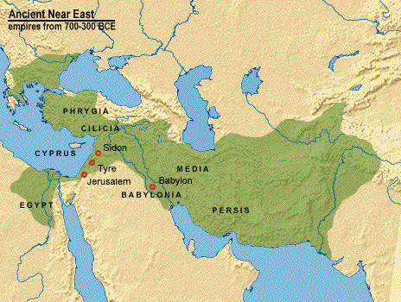

Slide 4
Macedonian Kingship
The nature of Argead Monarchy?
- absolutist
- democratic
- something in-between
It seems the king could do whatever he could get away with, but relation with nobles
Succession procedure? King, nobles, army?

Slide 5
A Problem of Interpretation
we do not know what to expect
it could not happen anyway

Slide 6
A Unique Situation
On his accession Alexander had eliminated all his rivals for the throne
except for his mentally ill half-brother Arrhidaios
Children?
- Herakles, considered illegitimate?
- Rhoxane was pregnant (6 or 8 months)
Very far from home without a clear leader

Slide 7
The contenders for the diadem
Herakles | Roxane’s Child | Arrhidaios
Child Son of Barsine (Persian) Un-recognised? | Unborn Male? Half-Persian | Mentally deficient? Adult Argead

Slide 8
And a Problem of Sources
no contemporary sources preserved
preserved sources are only relatively informative about the period 336-315.
almost all the evidence concerns king and army away from home
evidence from Antigonid Macedonia is not necessarily useful

Slide 9
Reliability of the speeches?
Most are very short and factual
fit the context and earlier and later events very well
the case of Nearchos (married to Herakles half-sister)

Slide 10
A Radical Alternative
Aristonous proposes to appoint Perdikkas king
Perdikkas hesitates
→ too many nobles (present and absent) would not accept this

Slide 11
The Reaction of the People
Meleagros stirs up the soldiers to seize their 'fair share' of the booty
enthusiasm of the soldiers
they want Arrhidaios on the throne

Slide 12
The Nobles Counteract
they close the ranks against the nobles
compromise:
- Rhoxane's son king
- Perdikkas and Leonnatos guardians of the king
- Antipatros and Krateros viceroys of Europe

Slide 13
Civil War?
The Infantry (led by Meleagros) does not accept this settlement => revolt
The nobles and the cavalry flee from the city
Perdikkas and some of his close collaborators stay to try to come to terms
Meleagros sends hit squad to kill Perdikkas; he manages to escape

Slide 14
The compromise
Perdikkas manages to reach a compromise:
- Arrhidaios (Philippos III) and Rhoxane's child joint kings
- 3 regents:
* Perdikkas: commands cavalry
* Meleagros : commands infantry
* Krateros: finances
- Antipatros: viceroy of Europe

Slide 15
Perdikkas' machinations
Perdikkas had made concessions to reach compromise
he had greater ambitions
=> plans to get rid of Meleagros
wins Meleagros' confidence
they organize ritual purification of the army
Perdikkas seizes ringleaders of revolt
Meleagros flees and is killed

Slide 16
The final settlement of the nobles
no more resistance in council of regents
infantry scared into submission
nobles revisit the compromise:
- Rhoxane's child and Philippos III Arrhidaios joint kings
- Perdikkas sole regent
- Antipatros and Krateros viceroys of Europe
- Alexander buried at Siwah
- satrapy distribution

Slide 17
Division of the empire
Perdikkas – regent
Antipater – confirmed in Macedon
Krateros – had been sent to Macedon to replace Antipater, now to share office with Antipater
  “Protector of the Kings”
New division of functions and satrapies
  i.e. Ptolemy to Egypt, Antigonos remains in Phrygia

Slide 18
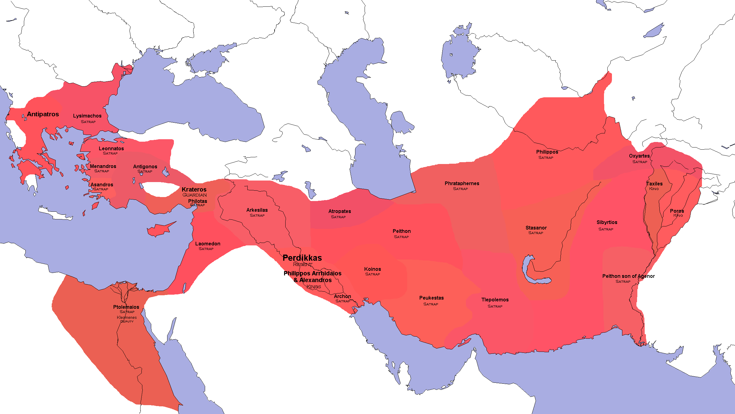
Satrapies after settlement of 323

Slide 19
Perdikkas’ Problems
What to do with the body of Alexander?
Where to set up a power base? Macedon?
Advantage: Time?
Antipater?

Slide 20
The body of Alexander
In Babylon
Wants to be buried in Siwa
Traditional burial for kings at Vergina (Aigai)
Solution: build a grand procession carriage and delay

Slide 21
Alexander’s body
First they prepared a coffin of the proper size for the body, made of hammered gold, and the space about the body they filled with spices such as could make the body sweet smelling and incorruptible. Upon this chest there had been placed a cover of gold, matching it to a nicety, and fitting about its upper rim. Over this was laid a magnificent purple robe embroidered with gold, beside which they placed the arms of the deceased, wishing the design of the whole to be in harmony with his accomplishments. Then they set up next to it the covered carriage that was to carry it. At the top of the carriage was built a vault of gold, eight cubits wide and twelve long, covered with overlapping scales set with precious stones. Beneath the roof all along the work was a rectangular cornice of gold, from which projected heads of goat-stags in high relief. Gold rings two palms broad were suspended from these, and through the rings there ran a festive garland beautifully decorated in bright colours of all kinds. At the ends there were tassels of network suspending large bells, so that any who were approaching heard the sound from a great distance. On each corner of the vault on each side was a golden figure of Victory holding a trophy. The colonnade that supported the vault was of gold with Ionic capitals. Within the colonnade was a golden net, made of cords the thickness of a finger, which carried four long painted tablets, their ends adjoining, each equal in length to a side of the colonnade….
Diodorus 18.26

Slide 22
A new alliance?
Perdikkas proposes a marriage alliance to Antipater
Recall Philip II’s use of marriage as a political tool in establishing his rule.

Slide 23
Problems in Greece
Athens, Aitolian League, a variety of states in northern and central Greece, and Thessaly revolt
New alliance traps Antipater in Lamia by winter of 323/2
Antipater needs Krateros’ troops
Athens opens dialogue with Perdikkas to undermine Antipater

Slide 24
The Lamian War
Leonnatos arrives with an army from Asia, but is defeated (Spring 322)
Summer 322: Krateros finally arrives
Combined armies of Krateros and Antipater defeat the Greeks at Krannon

Slide 25
Results of the war
Each individual state has a separate treaty
Aitolians refuse and continue to fight
Athens’ navy is destroyed in battle (Diodorus 18.8-17)
Macedonian garrison in the Peiraieus
New property qualification for citizenship
Restoration of Samian exiles
Hunting down and execution of Athenian leaders

Slide 26
Marriage alliances
Perdikkas finally will receive Antipater’s daughter Nikaia (2 years after he first asked)
Krateros marries Antipater’s daughter Phila
Kleopatra (sister of Alexander) arrives at Sardis (where Perdikkas is to receive Nikaia) and offers herself and an alliance with Olympias to Perdikkas
Perdikkas marries Nikaia

Slide 27
Growing Problems for Perdikkas
Krateros wants part of Asia
Marriage of Philip III to Adea (renamed Eurydice)
Antigonos (in Phrygia) had refused to help Perikkas and Eumenes – now flees to Antipater and Krateros
Punish Ptolemy for stealing the body?

Slide 28
Invasion of Egypt
Winter 321/0
Fails to cross the Nile near Memphis
  ~2000 men drown
Perdikkas assassinated by his commanding officers, who join Ptolemy
Eumenes condemned to death
Kings are sent to Antipater who is moving towards Syria

Slide 29
Settlement at Triparadeisos
Antigonos now “Strategos of Asia”
    Marriage of Phila to Demetrios
    War against Eumenes
Assassins of Perdikkas
  Seleucus – satrap of Babylon
  Antigenes – satrap of Susiana

Slide 30
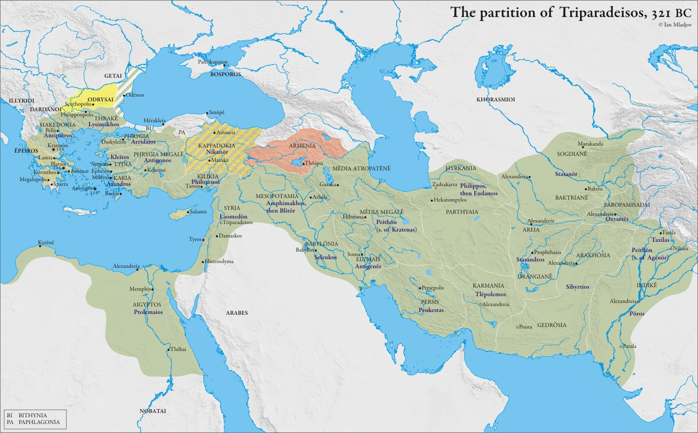

Slide 31
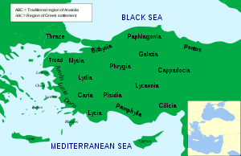
Eumenes and Krateros
Krateros moves against Eumenes in Bithynia
Krateros dies

Slide 32
Death of Antipater
Appoints Polyperchon as regent
Kassander appointed “Chiliarch” under Polyperchon
Kassander seeks aid from Ptolemy and Antigonos
Antiognos sends ships

Slide 33
Polyperchon
Olympias
Royal decree to restore all exiles to Greek cities
Army to Greece to win support
Athens goes over to him

Slide 34
Athens
Now certain Athenians who had been friends of Antipater, of whom Phocion was one, fearing the punishment due them in accordance with the laws, went to Alexander and, by showing him what was to his own advantage, persuaded him to hold the forts for himself and not deliver them to the Athenians until after the defeat of Cassander. Alexander, who had pitched his camp near the Piraeus, did not admit the Athenians to his parley with Nicanor; but by conferring with him in private and negotiating secretly, he made it evident that he did not intend to deal fairly with the Athenians. The people, coming together in an assembly, removed from office the existing magistrates, filling the offices with men from the extreme democrats and they condemned those who had held office under the oligarchy, decreeing the death penalty for some of them, exile and confiscation of property for others, among whom was Phocion, who had held supreme authority under Antipater.
Diodorus 18.65

Slide 35
Athens
Demetrios of Phaleron
  Student of Aristotle
  Installed as governor by Kassander

Slide 36
Return of Eumenes
Polyperchon re-affirms royal support for Eumenes
Eumenes leaves Cappadocia and goes into Iran to get money and troops
Antigonos must follow him

Slide 37
Olympias’ return
Olympias now returns to Macedonia after the offer of support from Polyperchon
Eurydike (Adea) and Philip III ask Cassander for help
Eurydike raises her own army and marches against Olympias

Slide 38
Death of Philip III (Diodorus 19.11)
So, as soon as he heard that Eurydicê was at Euia in Macedonia with her army, he hastened against her with the intention of deciding the campaign in a single battle. When, however, the armies were drawn up facing each other, the Macedonians, out of respect for the position of Olympias and remembering the benefits that they had received from Alexander, changed their allegiance. King Philip with his court was captured at once, while Eurydicê was taken as she was making her way to Amphipolis with Polycles, one of her counsellors. But after Olympias had thus captured the royal persons and had seized the kingdom without a fight, she did not carry her good fortune as a human being should, but first she placed Eurydicê and her husband Philip under guard and began to maltreat them. Indeed she walled them up in a small space and supplied them with what was necessary through a single narrow opening. But after she had for many days unlawfully treated the unfortunate captives, she ordered certain Thracians to stab Philip to death, who had been king for six years and four months; but she judged that Eurydicê, who was expressing herself without restraint and declaring that the kingdom belonged to herself rather than to Olympias, was worthy of greater punishment. She therefore sent to her a sword, a noose, and some hemlock, and ordered her to employ whichever of these she pleased as a means of death, neither displaying any respect whatever for the former dignity of the victim whom she was unlawfully treating, nor moved to pity for the fate that is common to all.

Slide 39
Follow-up reading
Anson, E.M. 1986. “Diodorus and the Date of Triparadeisus” The American Journal of Philology vol. 107, no. 2, pp. 208-217.
Errington, R. M. 1970. “From Babylon to Triparadeisos: 323-320 B.C.” The Journal of Hellenic Studies , Vol. 90, pp. 49-77.

