Slide 1
Group Project
Dr Rachel Alexander
Assessment: 50% Coursework Viva 50%

Slide 2
Communication
1minute no prep/ 2 mins prep

Slide 3
Exercise rules
Person 1: has diagram and describes to person 2 5 mins
Person 2: draws diagram and describes to person 3 5 mins
Person 3: draws diagram and describes to person 4 5 mins
Person 4 draws on the board 5 mins

Slide 4
Communication
Vertical communication – the up and down communications based on the hierarchical relationships established on the organisation chart
Horizontal communications – horizontal or lateral communications involve communicating and coordinating activities with peers
Diagonal communications – upward relationships with managers from other departments
Have a communications plan: what information should be collected, when and who by, who will analyse the data, who will distribute it when and to whom

Slide 5
Good Communication
Regular meetings – never/rarely cancelled
Meet individually –things may be said one to one which will never be brought out in the team meeting. Conflicts can be prevented this way
Provide constant feedback on the project’s status
Keep meetings short and to the point – don’t waste their time and if funds allow, buy lunch. Boosts morale and allows more chat time.
Written communications should be few and important. Golden bullets.
Before you write a message, be aware it may be passed around.

Slide 6
Listening effectively
Face the speaker and maintain eye contact.
Listen twice as much as you talk
Be attentive, but relaxed. (be present, give attention, apply or direct yourself, pay attention, remain ready to serve)
Keep an open mind.(Listen without judging the other person or mentally criticizing the things she tells you)
Listen to the words and try to picture what the speaker is saying.(don’t spend the time planning what to say next)
Don’t interrupt and don’t impose your solutions. (This isn’t a conversation, it’s a contest, and I’m going to win.)
Wait for the speaker to pause to ask clarifying questions
Ask questions only to ensure understanding: What kind of trouble? How often is this happening? What have you done about it so far? Learn the facts of the problem before giving a solution
Try to feel what the speaker is feeling.
Give the speaker regular feedback.

Slide 7
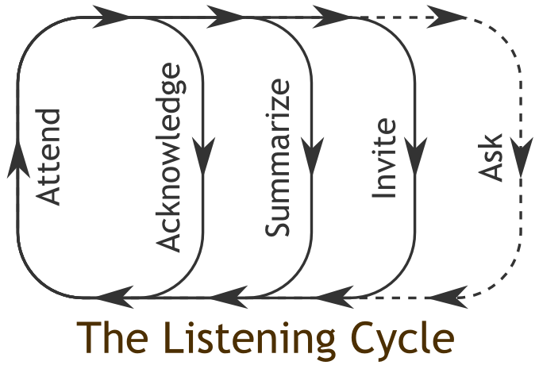
Active Listening

Slide 8
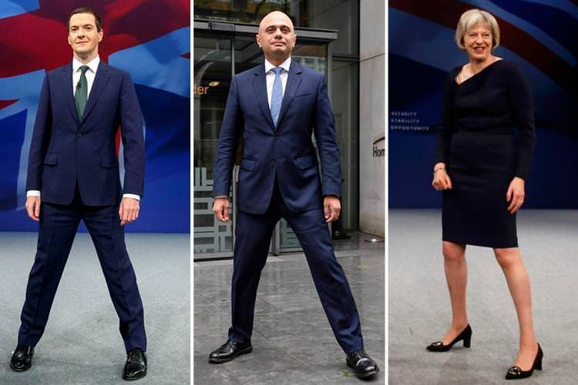
The Power pose

Slide 9
Body Language
https://www.youtube.com/watch?v=rk_SMBIW1mg&nohtml5=False

