Slide 1






Celebrating Language and Culture
Belonging to Wales
Urdd Gbaith Cymru
(Urdd Gobaith Cymru, 2023)
Notes:
Hi my name is Nicola Parsons - welcome to this seminar on the Urdd’s impact on Welsh Education.

Slide 2
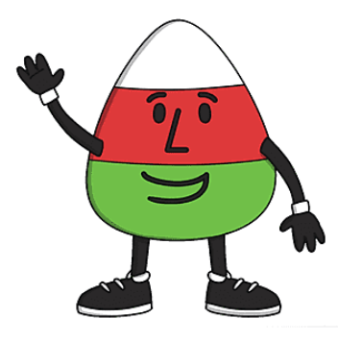
Aim of the Seminar
To critically examine the historical significance the Urdd organisation has had on the impact of Welsh Language in Education via...
The context of the time when the Urdd was formed.
The main principles of the Urdd’s provision and the interaction of these with Welsh education in Wales.
The impact that the Urdd’s interaction with Welsh education has had.
(Urdd Gobaith Cymru, 2023)
Notes:
The seminar will follow the module’s assessment aims via examining the…

Slide 3

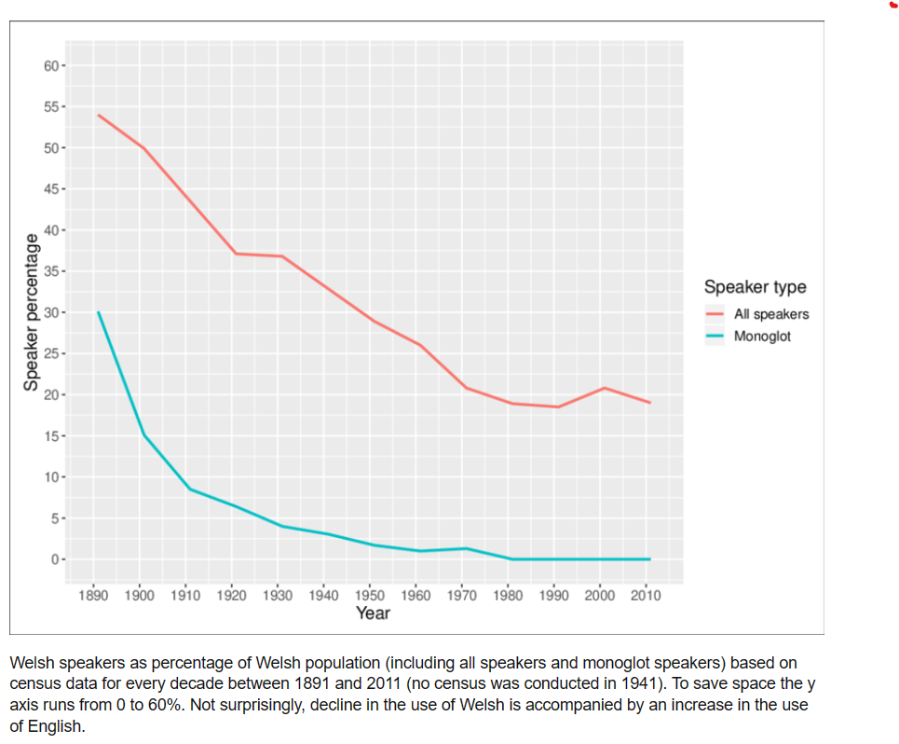
Context of the Urdd’s Inception
Birth of Urdd Gobaith Cymru
The League of Welsh Hope
In 1911 the Welsh language and culture was in decline.
Sir Ifan ab Owen Edwards - Editor of Cymru’r Plant, building on the work of his father, established ‘Urdd Gobaith Cymru Fach’ at Treuddyn in Flintshire in 1922.
The organisation enthusiastically grew and by 1927 it had 5,000 members and 80 branches.
(Urdd Gobaith Cymru, 2023)
(White and Roberts, 1922)
Notes:
In 1911 the census recorded for the first time that the Welsh language was the minority language of Wales as this White and Roberts graph illustrates.
Building on the work of his father – who famously remarked that the children of Wales were no longer playing in the street using the language of Welsh and had lost their Welshness, Sir Edwards established the Urdd in 1922
From humble beginnings the Urdd quickly grew.

Slide 4
The first 50 years 1922 - 1952
1922 | First Urdd Gobaith Cymru Fach branch in Treuddyn, Flintshire.
1924 | First Urdd branch in a non-Welsh speaking area in Abercynon, RCT.
1925 | First message of Peace and Goodwill was given jointly by the Urdd and the League of Nations, its aim to build bridges between different cultures and nations.
1927 | 5,000 Urdd members and 80 branches.
1928 | First camp for 100 boys held at Llanuwchllyn.
1928/31 | Camps held annually at Llangollen both for girls and boys.
1929 | Fach (small) dropped from Urdd’s name. First annual National Eisteddfod held in Corwen.
1930 | 20 Urdd cylchoed (areas) established across Wales, to reflect the diversity of localities. Each area had their own flag and organisational structure. Second Urdd National Eisteddfod held in Caernarfon. First voyage for boys undertaken to the League of Nations in Geneva. These trips and voyages continued for boys and girls to multiple destinations.
1931 | The first Sul yr Urdd (Urdd Sunday) which developed into an annual event.
1932 | Residential camp established at Llangrannog, Ceredigion.
1932/54 | Sports events were regularly held to integrate Welsh learners and speakers.
1934 | The annual message of Peace and Goodwill was extended so that May became the month of Goodwill. Second residential camp established at Porth Dinllaen. Boys were now sent there and girls to Llangrannog. Welsh learners were encouraged to stay alongside Welsh speakers.
1935 | Eisteddfod held in Carmarthen extremely successful with 12,000 competitors and worldwide recognition.
1937/65 | The Urdd’s structured Welsh language books campaign to support Welsh literature. Taken over by the Welsh Book Council in 1962.
1938 | First mixed sex camp held at Llangrannog. Porth Dinllaen residential camp closed.
1939 | Sir Ifan established the first Welsh language medium school in Aberystwyth. The success of which had a great impact on Education Authorities influencing them to instigate the provision of Welsh medium education schools across Wales.
1941 | 83 aelwydydd (community centres) and 817 adrannau (branches) now established.
1948/60 | Annual International Peace Camps held inviting children from other countries and cultures to meet Welsh children to mutually learn of each other’s cultures.
1950 | Residential camp Glan-llyn established at Bala Lake for older campers.
1952 | 50th anniversary celebrations
(Urdd Gobaith Cymru, 2023)
Notes:
This timeline of the Urdd’s first 50 years illustrates just how quickly the Urdd developed its overarching principles of offering the children and youth of Wales opportunities
to share in WELSH LANGUAGE IMMERSION and WELSH CULTURAL ACTIVITIES via its camps, eistedfoddau, trips and other activities.

Slide 5
The second 50 years 1953 - 2023
1954 | 22,500 Cymru’r Plant magazines distributed to schools via the education authorities. The magazine ‘Cymraeg’ launched for Welsh learners and circulation leaped to 26,000.
1955 | New cabin built at Glan-llyn for eisteddfodau and noson lawen to take place.
1957 | A further magazine were launched. Cymru for older children and Cymru’r Plant was aimed at the younger children. The magazine’s popularity grew throughout the 1960s.
1958 | The Eisteddfod had developed into a more Welsh cultural competition-based event. Urdd touring Welsh language cinema established.
1960 | Science introduced into the competitions of the annual Eisteddfod, meaning all subjects were now included.
1961 | Measures to make the Urdd Eisteddfod more inclusive to Welsh learners were introduced.
1970 | Eisteddfod was extended to a four-day event.
1970/99 | The magazines were adapted several times leading to the three magazines Cip, Bore Da and Iaw being distributed to schools.
1975 | 65,000 people visited the Eisteddfod.
1976 | Mistar Urdd launched.
1979 | Mistar Urdd tour of Wales.
1983 | Eisteddfod extended to a five-day event.
1989 | Eisteddfod extended to a six-day event.
1995 | Investment meant the residential centres were now highly resourced, with activities provided of a high standard. Celebrations held with the League of Nations.
1997 | 75th anniversary celebrations. Jamboree for 10,0000 and national concert.
2001/3 | Sports events, competitions and associations extended.
2002 | The magazines were further developed to include their own web sites. Hei Mr Urdd song re-released.
2003 | Key Skills courses introduced for secondary age pupils. Mr Urdd toured 607 primary schools across Wales.
2004 | New residential centre opened in Cardiff Bay.
2005 | Welsh Millenium Centre used to perform Les Miserables.
2006 | Bardd Plant Cymru scheme to promote poetry through schools.
2022 | Cariad Urdd day, 95,000 took part to celebrate the Urdd’s 100 birthday. The centenary peace and goodwill message launched on ‘The Climate Change’. Urdd Eisteddfod entry made free following Welsh Government sponsorship.
2023 | Opening of new environmental residential centre at Pentre Ifan in Pembrokeshire. Launch of the eleven future priorities of the Urdd.
(Urdd Gobaith Cymru, 2023)
Notes:
This timeline of the second 50 years of the Urdd, illustrates that the Urdd’s popularity and involvement with school children continued to grow from strength to strength

Slide 6

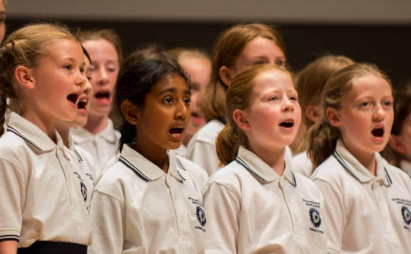
How significant is the Urdd’s impact on Welsh language and cultural diversity needs in education in Wales?
The Urdd has regional residential centres for students to attend. These reflect the regional Welsh language dialect and culture of their locality and give opportunities for their residents to explore and become immersed within Welsh language and culture.
The Urdd divides Wales into cychoed (areas) each with their own identifiable flag. Each cychoed reflects the Welsh language and culture of their locality.
The annual Urdd eisteddfod commences with heats for all of its multiple competitions which are held at a locality level with schoolchildren competing in the Eisteddfod Cylch in February, the winners of which go onto the regional Eisteddfod Rhanbarth and then onto Urdd National Eisteddfod in May.
The Urdd Eisteddfod competitions are linked to the Welsh Government’s Siarter Iaith Framework.
The Welsh Government’s Future Generations Report 2020 states that all public organisations require to meet greater focus on the diversity and cultural equality of Wales.
(Theatr Iolo, 2023)
(Classic FM, 2023)
(Urdd Gobaith Cymru, 2023, Welsh Government, 2017, Welsh Government, 2020)
Notes:
Does the Urdd meet the Welsh language and cultural needs of Welsh Education? Well, let’s go through these points listed on the slide and see.
The Urdd’s regional centres give opportunities for school children’s immersion in their locality’s Welsh dialect and culture…

Slide 7
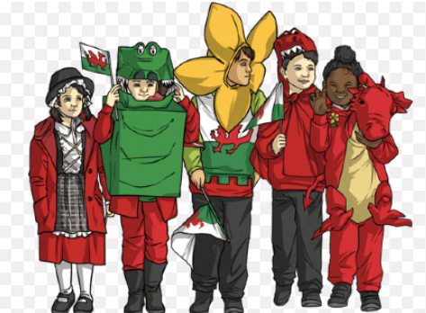
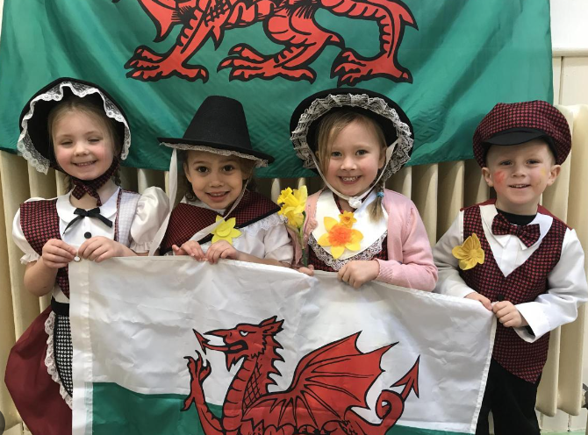
How significant is the Urdd’s impact in meeting Welsh language and culture’s identity & belonging needs in Education in Wales?
Through the Urdd’s promotion of the use of the Welsh language and culture within its residential centres and annual eisteddfod the Urdd has created a 100 years of opportunities for school children to learn their national and regional language dialects and through the competitions of the eisteddfod learn about multiple aspects of Welsh culture thus facilitating the development of their feelings of identity and belonging to their Welsh heritage.
The decades of Urdd magazines distributed to school children has also fostered identity and belonging to their Welsh language and culture.
Mr Urdd is an identifiable character to Welsh school children, encouraging their feeling of attachment, as does the Mr Urdd selfie benches campaign and Hei Mr Urdd song.
The Urdd Peace and Goodwill ethos encourages school children’s identity and belonging to the world as global citizens.
The family around the school-child, supporting them, as audience members, as they take part in Eisteddfod Cylch competitions, encourages wider participation in developing community identity and belonging to the locality’s Welsh language and cultural heritage.
(Twinkl, 2023)
(Penarth Times, 2018)
(Urdd Gobaith Cymru, 2023)
Notes:
Does the Urdd meet the Educational needs in Wales of identity and belonging well, here are some examples for you to think about.
100 years of opportunities for school children to learn national and regional language dialects through the eisteddfodau competitions
The Urdd magazines, Mr Urdd, the Urdd Peace and Goodwill messages for fostering global citizenship and the opportunities the Urdd offers to extend Welsh language immersion beyond the school child.

Slide 8


The Urdd’s impact on Welsh language & culture in education in Wales
The Urdd says:
Flintshire Council in their WESP for 2022 to 2023 says:
“It is part of our long-term WESP strategy to encourage the focussed activities that the Urdd provision provides.”
The Welsh Government announces in 2021:
The Welsh Government announces in 2012:
Welsh Government states in its Welsh Language Strategy Review 2012… “This review concluded that the activities being undertaken by the Urdd were having a positive effect on spreading and promoting the social use of the Welsh language in Wales.” However, in the report’s recommendations it cautioned that a more robust data collection of evidence required to be developed in Wales.
Notes:
Here are some ‘information bites’ that can be used to illustrate the Urdd’s impact on Welsh education.

Slide 9
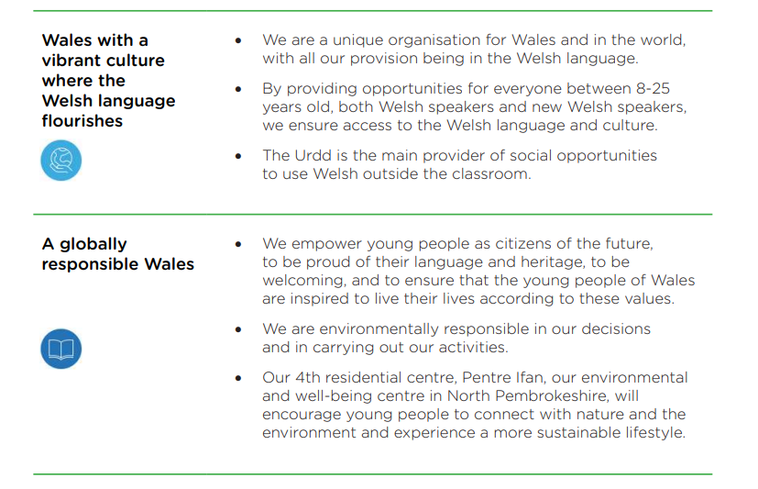
Conclusion & The Future
Welsh Government’s aims:
1 million Welsh speakers by 2050
A Wales of a vibrant culture and thriving Welsh language.
A globally responsible Wales.
Taken from the Urdd’s Strategic Plan 2023…
(Welsh Government, 2015 & 2017)
So, do you think the Urdd makes a significant contribution to support and promote Welsh language & culture in education across Wales?
Notes:
Finally, the Urdd’s ongoing strategic plan synchronises to the Welsh Governments aims. Present final question.

Slide 10
Reference List
Classic FM (2023) Junior school chamber choir picture. Available at: Government says ‘no singing, wind or brass playing’ for older pupils in school... - Classic FM (Accessed 18 December 2023).
Flinshire County council (2022) WESP 2022-2023. Available at: Flintshire WELSH IN EDUCATION STRATEGIC PLAN (2022-2032) (Accessed: 19 December 2023).
Penarth Times (2018) School celebrates Welsh Identity with Eisteddfod. Available at: Albert Primary children celebrate Welsh identity with Eisteddfod | Penarth Times (Accessed: 18 December 2023).
Theatr Iolo (2023) Theatr Iolo’s Welsh Language Plan. Available at: At-A-Glance-FG-Report.pdf (futuregenerations.wales) (Accessed 18 December 2023).
Twinkl (2023) What is Welsh Culture Poster. Available at: What is Welsh Culture? Answered by Twinkl – Twinkl (Accessed 18 December 2023).
Urdd Gobaith Cymru (2023) About us. Available at: Urdd Gobaith Cymru (Accessed 18 December 2023).
Urdd Gobaith Cymru (2023) Strategic Plan 2023. Available at: Cynllun_Strategol_2023_Saesneg_compressed.pdf (urdd.cymru) (Accessed 19 December 2023).
Urdd Gobiaith Cymru (2023) Urdd education provision & Curriculum 2022 Available at: Urdd_information_pack.pdf (Accessed 19 December 2023).
Welsh Government (2021) £1.3 million to help the Urdd recover and rebuild. Available at: £1.3 million to help the Urdd “recover and rebuild” | GOV.WALES (Accessed 19 December 2021).
Welsh Government (2017) Cymraeg 2050: a million Welsh speakers. Available at: Cymraeg 2050: A million Welsh speakers (gov.wales) (Accessed 19 December 2023).
Welsh Government (2017) Siarter Iaith Framework. Available at: WG48543 (gov.wales) (Accessed 19 December 2023).
Welsh Government (2020) The future generations report 2020. Available at: At-A-Glance-FG-Report.pdf (futuregenerations.wales) (Accessed 18 December 2023).
Welsh Government (2015) The Well-being of future generations. Available at: The Well-being of Future Generations | GOV.WALES (Accessed 19 December 2023).
Welsh Government (2012) Welsh Language Strategy Evidence Report. Available at: 120301welshlanguageen.pdf (gov.wales) (Accessed 19 December 2023).
White, Y. and Roberts, G. (2022). ‘Variability in speaker expectations of morphosyntactic mutation in Welsh’, Glossa: a journal of general linguistics, 7(10), pp. 2-44.
Notes:
Thanks for watching, these are the references used through the seminar. Bye…

