Slide 1

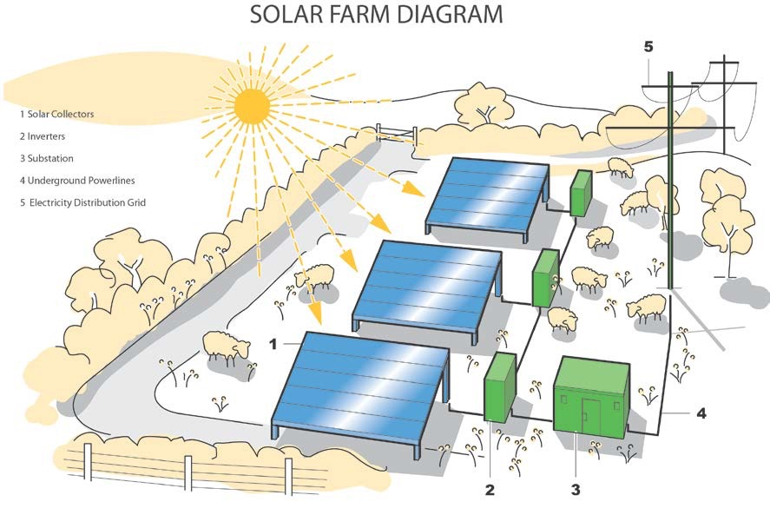
EIA Evaluation- Mynydd Y Gwyrhyd Solar Farm
Joseph Blackmore- UWTSD
Dulas Ltd. 2019

Slide 2
Contents
Project Location
Scale of project
The environmental assessment in question
Impact significance and the phase 1 habitat survey
Habitat risk assessment
Construction operation and decommissioning
Mitigation and enhancement
2014 EIA directive amendment
…….
Significant omissions
Conclusion
References
Questions?

Slide 3
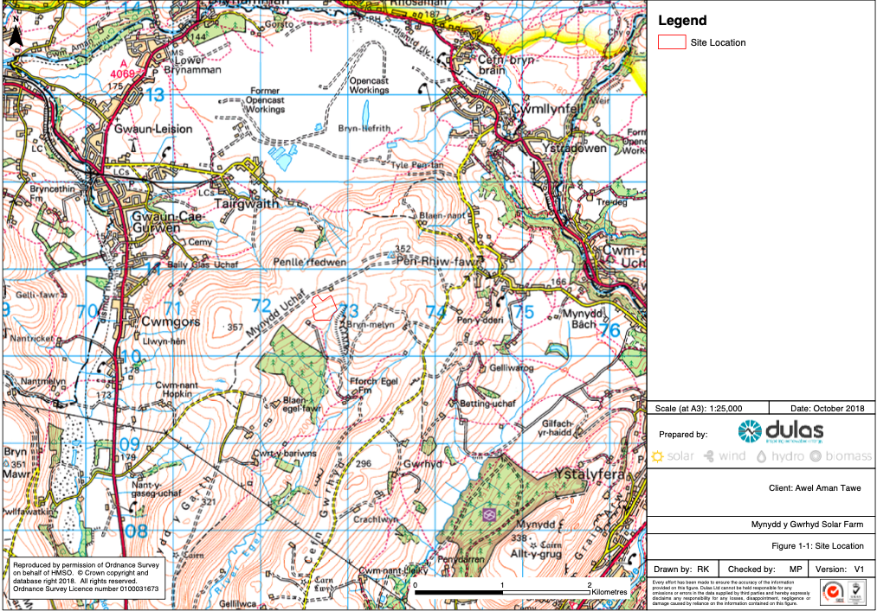




Project Location
Neath Port Talbot County, South Wales
Moorland area situated between the villages of Tairgwaith and cwm twrch Uchaf
Not within any recognized area of protection
Grade 5 very poor quality agricultural land
Figure 1: OS map of site location (Dulas Ltd., 2019)

Slide 4
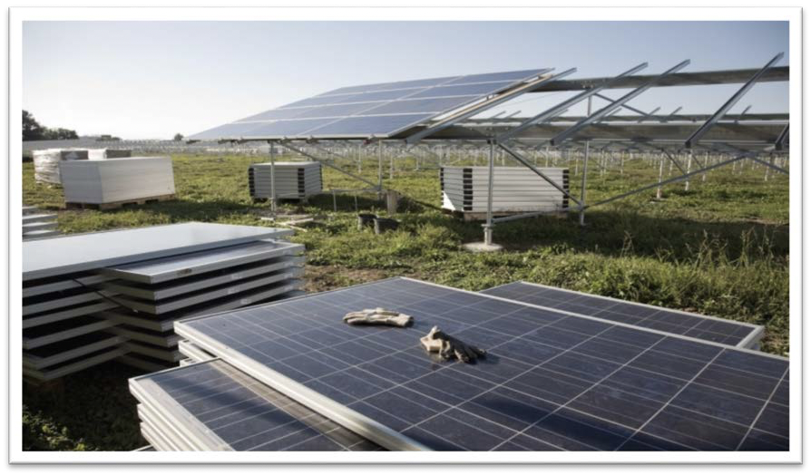
Scale of Project
As prescribed in ‘The Town and Country Planning (Environmental Impact Assessment) Regulations 2017’, developments applicable to the definition of ‘schedule 2’ include any industrial installation for the production of electricity where the area of construction exceeds 0.5 hectares (UK Government , 2017).
Boundary area encompasses 3.3 hectares
6972 panels measuring 1m x 1.67m each
Extruded aluminium mounting frames installed on galvanized steel piles driven 1.5m into the ground
Battery storage units measure 6.1m long x 2.9m high x 2.4m wide
Capacity = 2.23 Megawatts
12 week construction phase, approximately 109 articulated lorry loads (precautionary principle)

Slide 5

The Environmental Assessment
Published on 9/01/2019 by Dulas Ltd (a Welsh renewable energy installer and consultancy agency)
The key sections of the report include;
Introduction
Planning Policy Context
Description of Proposed Development
Landscape and Visual Assessment
Preliminary Ecological Appraisal
Archaeology and Cultural Heritage Assessment
Hydrology and Hydrogeology
Traffic and Transport
Glint and Glare
Noise

Slide 6
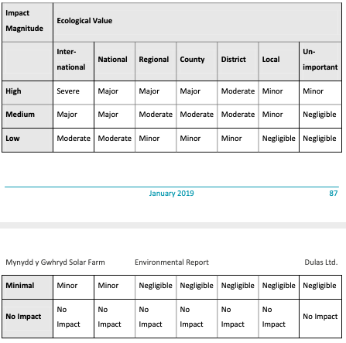
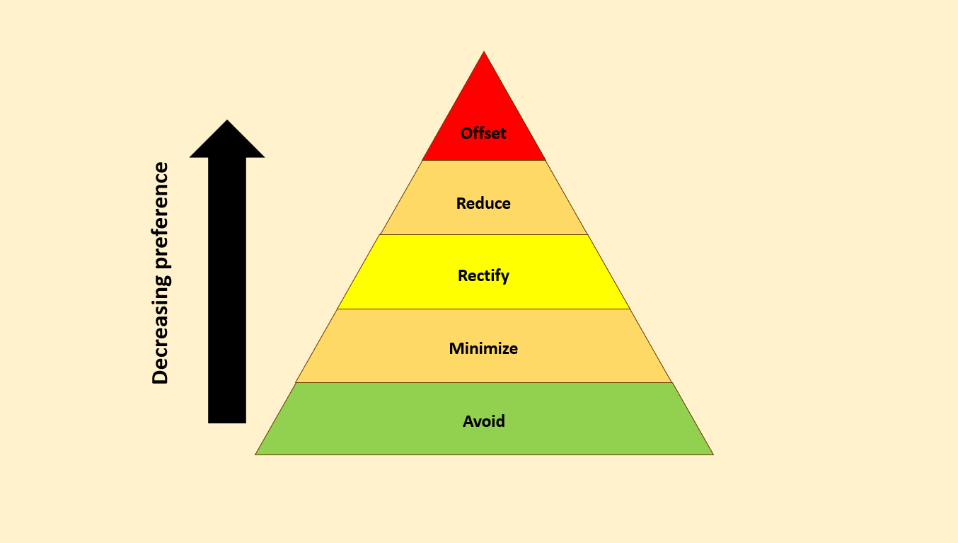
Phase 1 Habitat Risk Assessment- Hierarchy of impact significance
Impact = Effect x Sensitivity (Boughton, et al., 1999).
Figure 2: A 5 step mitigation hierarchy for environmental impacts.
(Babu, 2016).
Table 1: Criteria for determining significance of impacts (Dulas Ltd., 2019).

Slide 7
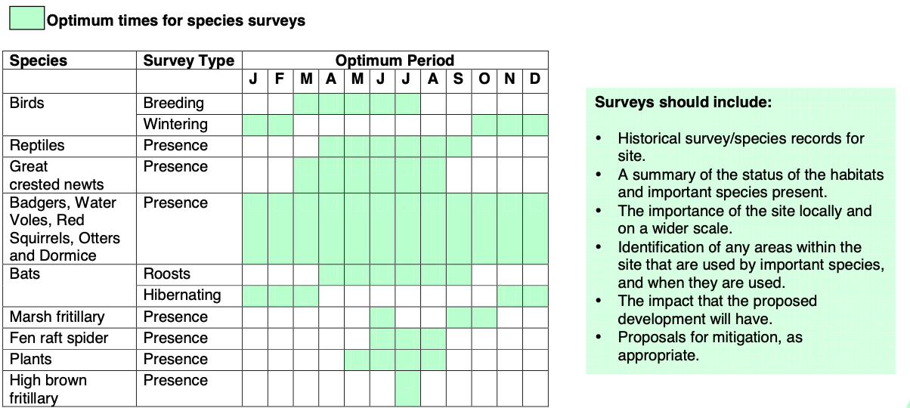
Habitat Risk Assessment (HRA)~
Despite the UK leaving the European Union in 2020, legislation protecting European sites has been maintained within the Conservation of Habitats and Species Regulations (2017).
A desk study was completed- No European Protected Species present
South East Wales Biodiversity Record Centre (SEWBReC) information relating to protected species and sites of statutory designation was used.
6 records of species of local conservation concern, the nearest being 160m from the site, all of which were bryophytes except for one vascular plant.
Table 4: Optimum times for surveying species in Wales (Glamorgan Biodiversity Advisory Group; Gwent Biodiversity Action Group, 2010)

Slide 8
Construction, Operation & Decommissioning Phases
Reference made to the requirement of a Construction Environmental Management Plan (CEMP) e.g. temporary geotextile membrane used for construction roads.
Minimal disturbance during site operation
Reference is made to the Waste Electrical & Electronic Equipment (WEEE) EU Directive (2012/19/EU), illustrating a considered approach to the life cycle environmental impact of the scheme.
Figure 3: Strategic Solar Group

Slide 9
Mitigation and Enhancement
Native planting to be introduced along boundary during operational phase, Rowan, Holly and Hawthorn which will provide berries for birds and flowers for pollinators, together with Pedunculate Oak, Ash and Lodgepole Pine (150m length of existing boundary)
Trenches dug for cabling will be refilled, any damaged land reseeded
Reseeding and restoration of tracks (2 years to restore)
Lighting to comply with the Bat Conservation Trust guidelines
all construction works taking place when amphibians and reptiles are active i.e. April to September rather than in the hibernation period & a suitably experienced ecologist present during construction in order to catch and move any animals.

Slide 10
The Role of the 2014 EIA Directive Amendment (historical & cultural heritage)
Desk study completed on previous archaeological assessments in addition to site visit
The site lies within the Landmap Historic Landscape of Clydach Cwm Du (NPTHL041) - a well-preserved extensive upland valley of medieval or post-medieval origin with evidence of prehistoric ritual activity
No Scheduled Ancient Monuments lie within the boundary of the proposed development area.
“As with the Iron Age, there is currently no recorded evidence of activity during the Roman, or Romano-British period within the study area”
“remains of the post-medieval farmsteads of Pen-y-waun (PRN 3352w) 95m to the southwest, and Penwaun-uchaf (PRN 3406w) 100m to the northeast, and post- medieval boundary stone (PRN 3395w) 55m to the north”
Figure 4: LIDAR Drone
Intro to Lidar for Archaeology- Kristina Georgieva 2020

Slide 11
The Role of the 2014 EIA Directive Amendment~ Climate change
CO2 offsets~
annual domestic electricity requirements of approximately 672 households per year
annual offsetting of carbon dioxide emissions associated with fossil fuels equal to approximately 630 tonnes.
Does the site damage carbon sinks? What is the embedded emissions within the materials?
Renewable energy projects themselves can be considered as a response to climate change
IEEE- Maybe we won't need to bury carbon dioxide after all
2013

Slide 12
Significant Omissions from the Mynydd Y Gwyrhyd Assessment
voluntary accreditation- UK Institute of Environmental Management and Assessment's (IEMA's) EIA quality mark- no mention within report
Public participation such as surveys or meetings – No plans for this presented

Slide 13
Conclusion
There are some significant omissions when compared to published guides on good EIA practice- however
The project has a minimal environmental impact
The EIA provides practical mitigation solutions
The EIA considers contemporary developments

Slide 14
References
Babu, S., 2016. Mitigation Hierarchy: Levels of mitigation in Environmental Impact Assessment. [Online]
Available at: https://eco-intelligent.com/2016/12/11/levels-of-mitigation-in-environmental-impact-assessment/
[Accessed 24 March 2021].
Bond, A., Fischer, T. B. & Fothergill, J., 2017. Progressing quality control in environmental impact assessment beyond legislative compliance: An evaluation of the IEMA EIA Quality Mark certification scheme. Environmental Impact Assessment Review, 63(1), pp. 160-171.
Boughton, D. A., Smith, E. R. & O'neill, R. V., 1999. Regional Vulnerability: A Conceptual Framework. Ecosystem Loss, 5(4), pp. 312-322.
UK Government , 2017. The Town and Country Planning (Environmental Impact Assessment) Regulations 2017. [Online]
Available at: https://www.legislation.gov.uk/uksi/2017/571/schedule/2/made
Lawrence, D. P., 2007. Impact significance determination—Back to basics. Environmental impact assessment review,, 27(8), pp. 755-769.
Maron, M., 2015. Conservation: Stop misuse of biodiversity offsets. Nature, 523(7561), pp. 401-403.
Georgieva, Kristina 2020. Intro to LIDAR for Archaeology, Computational Archaeology https://computationalarchaeology.wordpress.com/2020/10/04/intro-to-lidar-for-archaeology/
Glamorgan Biodiversity Advisory Group; Gwent Biodiversity Action Group, 2010. Quick Reference Guide for Planning Officers. [Online]
Available at: https://www.merthyr.gov.uk/media/1244/think-wildlife-think-protected-species.pdf
Lawrence, D. P., 2007. Impact significance determination—Back to basics. Environmental impact assessment review,, 27(8), pp. 755-769.
Josimović, B., Cvjetić, A. & Furundžić, D., 2021. Strategic Environmental Assessment and the precautionary principle in the spatial planning of wind farms. Renewable & sustainable energy reviews, Volume 136.
Tweed, Katherine, 2013A Cheaper Option to Turn Carbon Dioxide Into Synthetic Fuel Maybe we won't need to bury carbon dioxide after all https://spectrum.ieee.org/energywise/green-tech/clean-coal/a-cheaper-way-to-turn-co2-into-synthetic-fuel

Slide 15
Thank you for listening!
Any questions?

