Slide 1



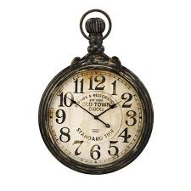
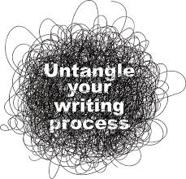

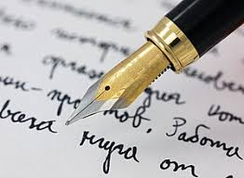
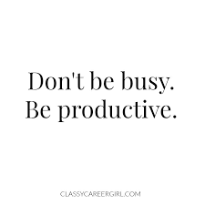
Skills and personal qualities that aid critical thinking in Psychology
Rosie Fletcher 1701922
What is critical thinking?
Critical Reading
How do I keep writing interesting?
Critical thinking is a cognitive activity largely linked to using the mind that enables us to;
Identify the views of others
Evaluate evidence
Fairly evaluate contrasting arguments
Draw conclusions
Logically reflect on issues
(Cottrell, 2005).
How do I find the relevant information? | Note taking when reading
Focus on certain parts of the text | Rests your brain
Analyse, reflect, evaluate | Cuts information down
Scan book introductions and chapters | Makes for easier reading
Read abstracts | Recall made easier
Identify and evaluate the argument
Find conclusions and research
 | (Cottrell, 2005)
Make it clear and understandable
Keep it to the point and professional
Only use key points, do not add too much information
Do not be too descriptive, stick to the point
Add good and relevant evidence
(Cottrell, 2005)
The benefits
Time management
Developing critical thinking skills;
Improve one’s attention and observation
Aid individuals to be able to identify key points when looking at important information
Improve an individual’s knowledge on how to appropriately get their point across to others
(Cottrell, 2005).
Struggling to find time?
Left feeling overwhelmed?
Juggling deadlines?
Critical Writing
Set goals, plan better
Get a diary
Make to-do-list
Therese Hoff Macan, Comila Shahani, Robert. L. Dipboye and Amanada Peek Philips (1990) carried out a study on time management. They found that individuals who practised good time management tended to be clearer on where they stood at work, home and school and found that the subjects agreed that they performed better as a result of time management.
Presenting a strong case
Summarise important points
Write things clearly so the reader can follow your work easily!
Structure it well and include relevant evidence
Consider your reader!!
(Cottrell, 2005)

Slide 2


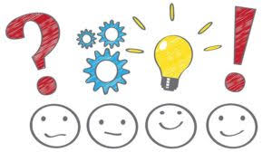
References
Cotrell, S., (2005). Critical Thinking Skills: Developing Effective Analysis and Argument. Hampshire: Palgrave Macmillan
Macan, T. H., Shahani, C., Dipboye, R. L., & Phillips, A. P. (1990). College students' time management: Correlations with academic performance and stress. Journal of educational psychology, 82(4), 760.
All images accessed from Google: https://images.google.com/

