Slide 1

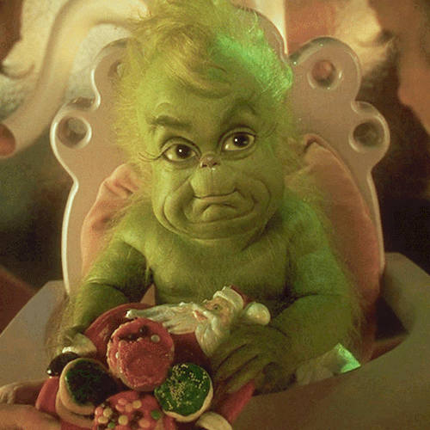


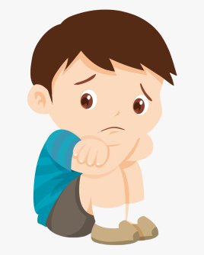

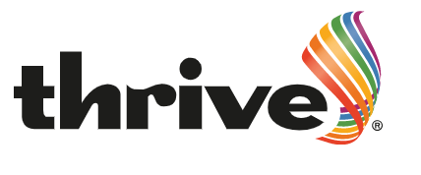
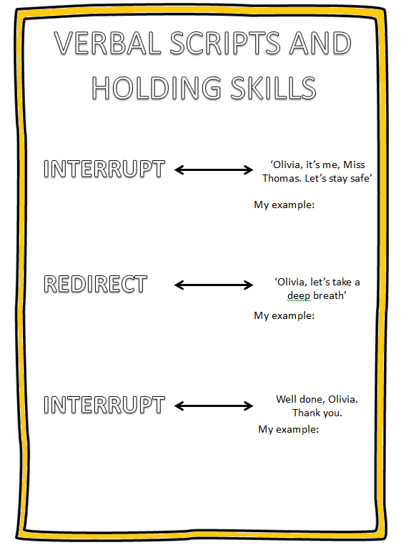
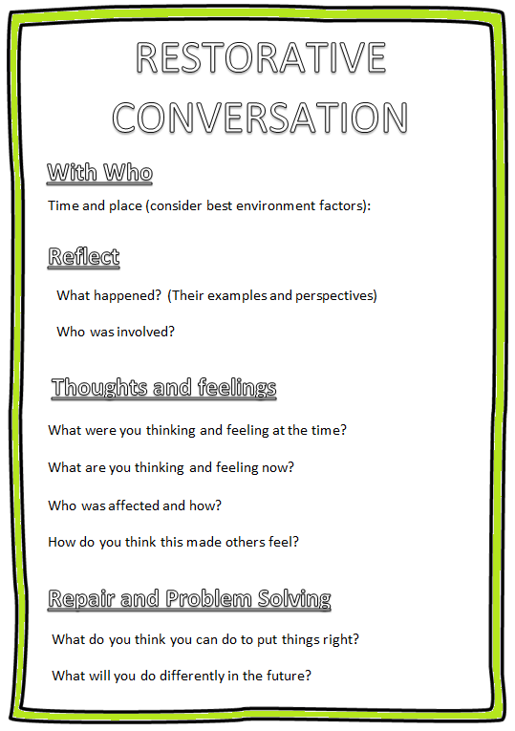
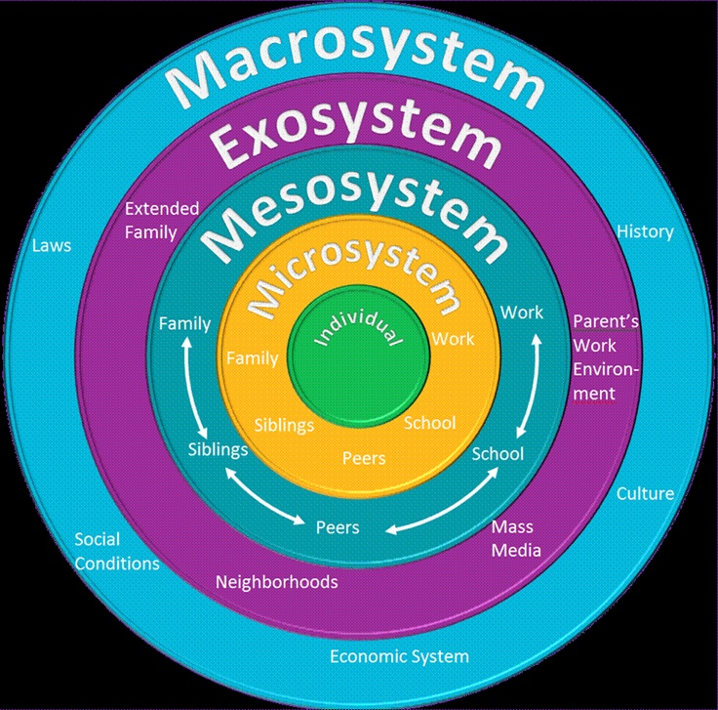
Anti bullying
‘Bullying is unwanted, aggressive behavior among school aged children that involves a real or perceived power imbalance. The behavior is repeated, or has the potential to be repeated, over time. Bullying includes actions such as making threats, spreading rumors, attacking someone physically or verbally, and excluding someone from a group on purpose’.
(StopBullying.Gov, 2020)
Friendly
Different types of bullying:
Caring
Safe
Verbal
Physical
Cyber
Social
Teasing
Name calling
Sexual comments
Taunting
Threatening to cause harm
Hitting
Kicking
Shaking
Poisoning
Burning and scalding
Gaming sites
Chat rooms
Facebook
Snapchat
Instagram
Posting about a person on social media.
Convincing others not to exclude someone.
Weiss (2015) indicates:
‘The Grinch was bullied when he
was young and because of this
he started to really hate the Whos
and anything they enjoyed, like Christmas for example. ... Since the Grinch isolated himself for so long he started to become more and more different from the Whos every day.’
(StickPNG, 2020)
(Thrive Approach 2021)
Flowering (2020)
Support from Thrive and
the Pupil Referral Team.
(MAPA, 2018, p.170)
(Marie, 2017)
(Kissclipart, 2021)

Slide 2
Referencing
Bowen, R and Holtom, D. (2010) A Survey into the Prevalence and Incidence of School Bullying in Wales Summary Report. Cardiff:Crown
Bronfenbrenner, U. and Morris, P. (1998) The ecology of developmental process. New York: John Wiley
Cheprasov, A. (2018) Anti-Bullying: Definition & Policy. Available at: https://study.com/academy/lesson/anti-bullying-definition-policy.html#:~:text=Anti%2Dbullying%20refers%20to%20laws,real%20or%20perceived%20power%20imbalance (Accessed on: 15.12.2020)
Crisis Prevention Institute. (2018) Management of actual or Potential Aggression Foundation Programme for Schools. United States: CPI, MAPA.
Dodge and Coie, (1987) The Bullying Prevention Program: Blueprints for Violence Prevention, Vol. https://www.scirp.org/(S(i43dyn45teexjx455qlt3d2q))/reference/ReferencesPapers.aspx?ReferenceID=1088542
Family Lives (2019) What is bullying? Available at: https://www.bullying.co.uk/general-advice/what-is-bullying/ (accessed on: 18.12.2020)
Flowering, C. (2020) arrow doodle floweringwords. Available at: https://giphy.com/stickers/arrow-doodle-floweringwords-eKCnGX0GGAaFrY3tHY (accessed on: 22.12.2020)
Gordon, S. (2019) The Different Types of Bullies Parents Should Watch For. Available at: https://www.verywellfamily.com/types-of-bullying-parents-should-know-about-4153882 (accessed on: 18.12.2020)
Gov.Wales (2019) New guidance will challenge bullying in Welsh schools Available at: https://gov.wales/new-guidance-will-challenge-bullying-welsh-schools (accessed on: 10.01.2021)
Kissclipart (2020) Children’s Day Available at:https://www.kissclipart.com/universal-childrens-day-convention-on-the-rights-o-b88g6v/ (accessed on: 17.01.2021)

Slide 3
Referencing
School P, anti-bullying. 2020.
School P, Lets help every child Thrive policy. (2020)
School P, Pupil support policy. (2020)
School P, Values policy. (2020)
StopBullying.Gov (2020) What Is Bullying. Available at: https://www.stopbullying.gov/bullying/what-is-bullying (Accessed on: 15.12.2020)
Stick, PNG. (2020) Download School Clipart transparent PNG. Available at: https: //www .stickpng.com/img/miscellaneous/buildings/school-clipart (Accessed on: 18.12.2020)
Sushi,Z, (2015) Das Leben Im Sushi Treehouse. Available at: https://sushi-zusi.tumblr.com/post/135451401169 (accessed on: 03.01.2021)
The Thrive Approach (2020) Who we work with. Available at: https://www.thriveapproach.com/ (accessed on 10.01.2021)
Weiss, A (2015) The Grinch. Available at: https://medium.com/@manda_weiss/the-grinch- fb29453954d3# :~:text=The%20Grinch%20was%20bullied%20when,enjoy ed %2C% 20like%20Christmas%20for%20example.&text=Since%20the%20Grinch%20isolated%20himself,from%20the%20Whos%20every%20day. (accessed on: 03.01.2021)

