Slide 1
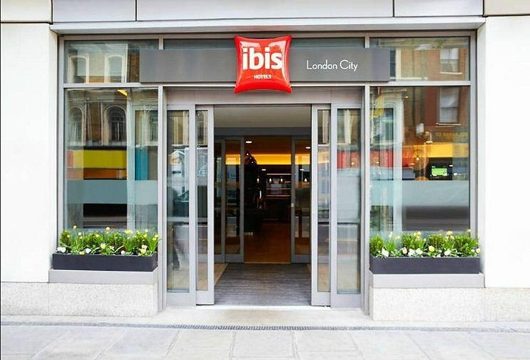
Health and Safety Training for Housekeeping Team Ibis Stratford London
Safe and Clean
Environment
Jayson Luba 2245377
Hotel Placement – Operating Hotel Facilities
2024.

Slide 2


Introduction
Overview of the importance of health and safety in housekeeping
Preventing accidents and injuries
Disease prevention
Compliance with regulations
Enhancing resident, guests and staff morale
Risk management
Maintaining hotel equipment and infrastructure
Emergency preparedness
Respect for diverse needs
The role of the cleaning team is essential in maintaining a safe and clean environment for guests!

Slide 3
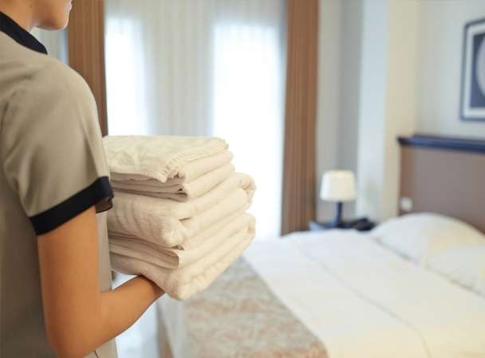
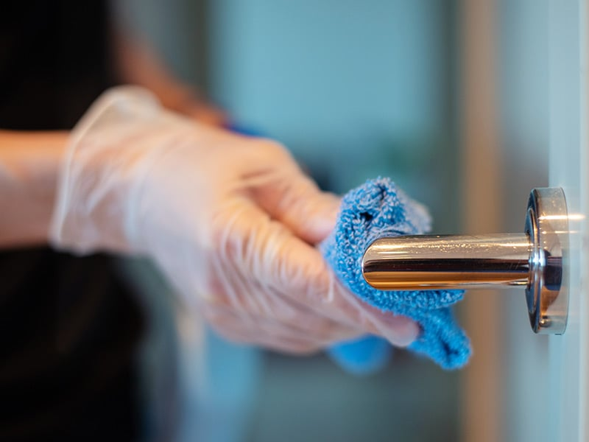
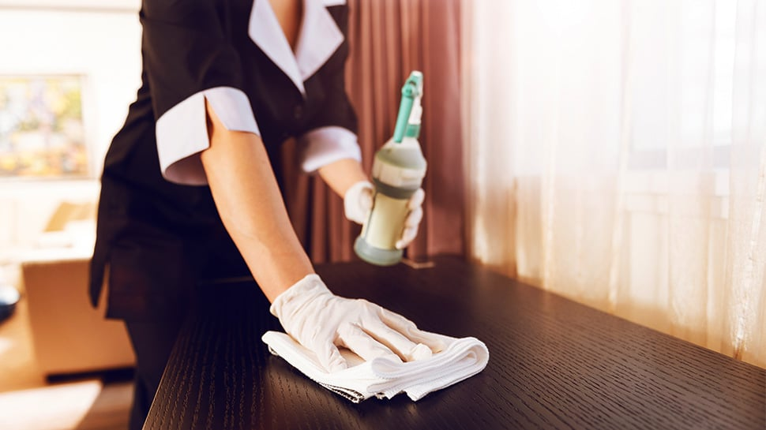
Overview of Health and Safety Guidelines (by Estena)
General safety protocols
Emergency procedures
First aid and medical assistance
Personal Protective Equipment (PPE)
Cleaning and sanitization
Food safety and hygiene
Occupational health and safety for staff
Security measures
Guest education
Communication channels
Adherence to the guidelines is crucial for the well-being of team members and guests.

Slide 4
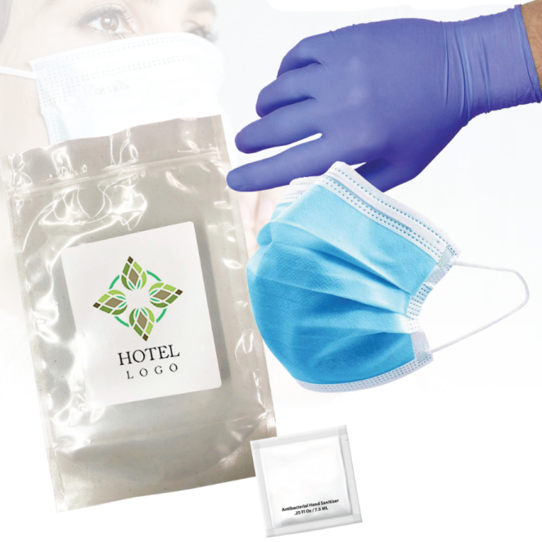
Personal Protective Equipment (PPE)
Protection from chemicals (Labelling and Logging)
Prevention of cross-contamination (Colour coded utensils)
Infection control (First Aid Supplies and Reports)
Occupational safety ( Assembly points and reporting)
Compliance with health and ssafety regulations (Legal requirements)
Skin protection ( Gloves) (Masks) (Steel toe cap shoes)
Enhanced hygiene practices ( Personal Grooming/ washing hands)
Professional image ( Personal conduct, Neat/tidy groomed and clean uniform )
Prevention of injury and illness ( Awareness of surroundings and knowledge )
The role of PPE is prominent in the prevention of injuries and exposure to harmful substances!

Slide 5
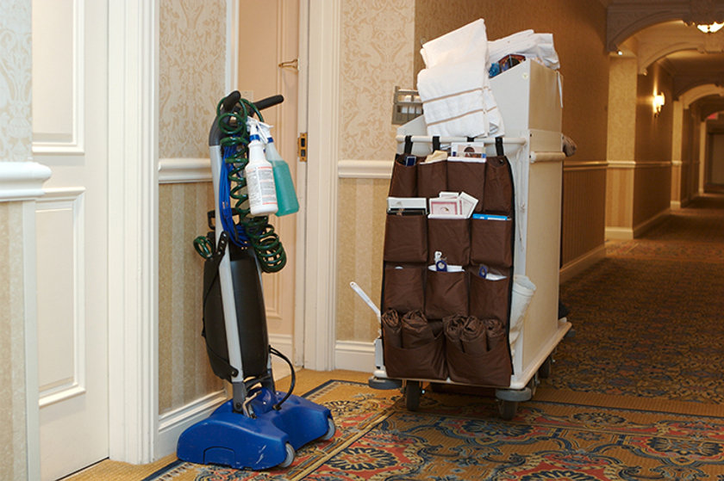
Chemical Handling and Storage
Staff training
Use of appropriate PPE (gloves,masks,steel shoes,reflective)
Ventilation
Labeling and storage
Dilution and mixing
Safe handling of concentrates
Emergency response plans
Regular inspections
Communication with guests
Collaboration with suppliers
Waste disposal
Documentation and records
The safe handling of cleaning chemicals in hotels is crucial to ensure the well-being of guests, staff, and the overall hygiene of the establishment!

Slide 6
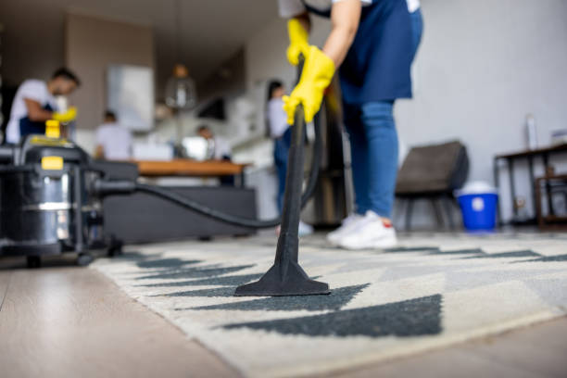
Ergonomics and Body Mechanics
Injury prevention
Long-term health
Increased efficiency
Energy conservation
Improved focus and alertness
Enhanced safety
Reduced strain on joints
Customer perception
Employee morale
Lower healthcare costs
Maintaining good posture and using proper body mechanics during hotel cleaning tasks is significant!

Slide 7
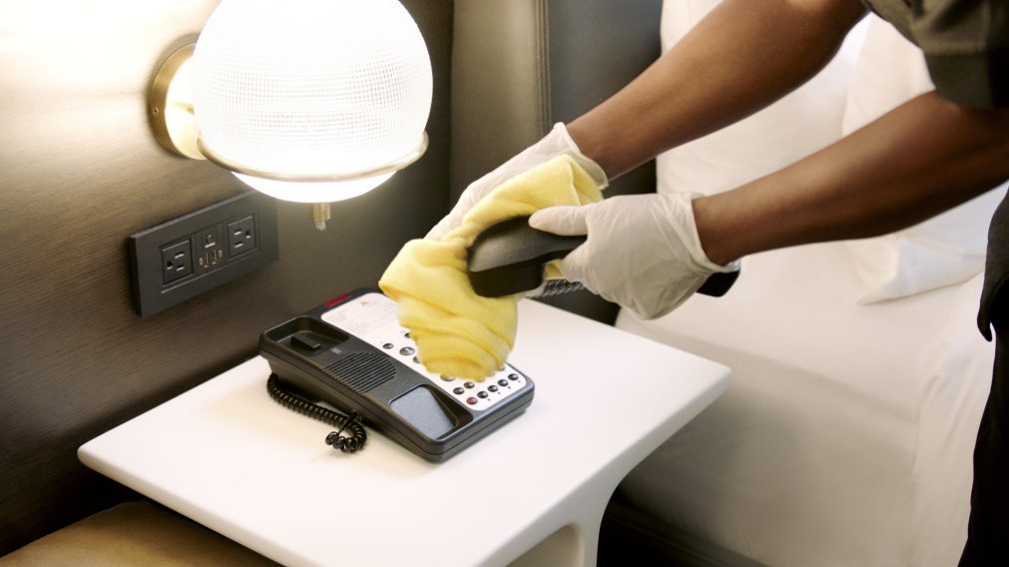
Infection Control
Guest health and safety
Staff well-being
Operational continuity
Guest satisfaction and reputation
Legal and regulatory compliance
Emergency preparedness
Reduced liability
Public health contribution
Financial implications
Adaptation to changing expectations
Preventing the spread of infections in hotels is a multifaceted imperative that extends beyond immediate health considerations!

Slide 8

Emergency Procedures
Fire emergency
Chemical spills or exposures
Injury or medical emergency
Slips, trips, and falls
Security threats
Communication protocols
Emergency equipment
Evacuation procedures
Reporting and documentation
Training and drills
Emergency procedures for hotel cleaning staff are crucial to ensure their safety and the safety of others in the event of unexpected incidents!

Slide 9

Conclusion
In conclusion, the success of our health and safety training for the housekeeping team hinges on several crucial points
Team commitment
Adherence to guidelines
Personal Protective Equipment (PPE)
Chemical Handling and Storage
Ergonomics and Body Mechanics
Infection Control
Emergency Procedures

Slide 10

Questions & Answers

Slide 11
References
Smith, J. (2018). Occupational Health and Safety in the Hospitality Industry. Journal of Workplace Safety, 15(3), 210-225.
Johnson, M. (2020). Effective Training Strategies for Housekeeping Staff. Safety and Health Management, 8(2), 45-60.
Brown, A. (Ed.). (2019). Ensuring Cleanliness: A Guide to Housekeeping Safety. Safety Publishing House.
National Institute for Occupational Safety and Health (NIOSH). (2017). Guidelines for Safe Chemical Handling in Hospitality.
Occupational Safety and Health Administration (OSHA). (2016). Hotel Industry Safety and Health Guide.
World Health Organization (WHO). (2019). Infection Control in Housekeeping: Best Practices.
Health and Safety Executive (HSE). (2018). Ergonomics for Housekeeping Staff: A Practical Guide.
Centers for Disease Control and Prevention (CDC). (2020). Emergency Procedures for Hospitality Workers.
European Agency for Safety and Health at Work. (2017). Communication and Reporting in Housekeeping.
International Labour Organization (ILO). (2016). Safety Training Programs for Hotel Housekeeping Teams.

