Slide 1
LCHS4010 Psychology in Health and Social Care
Component 1: Presentation
NAME : JOYNAL MIAH STUDENT NUMBER : 2423302

Slide 2
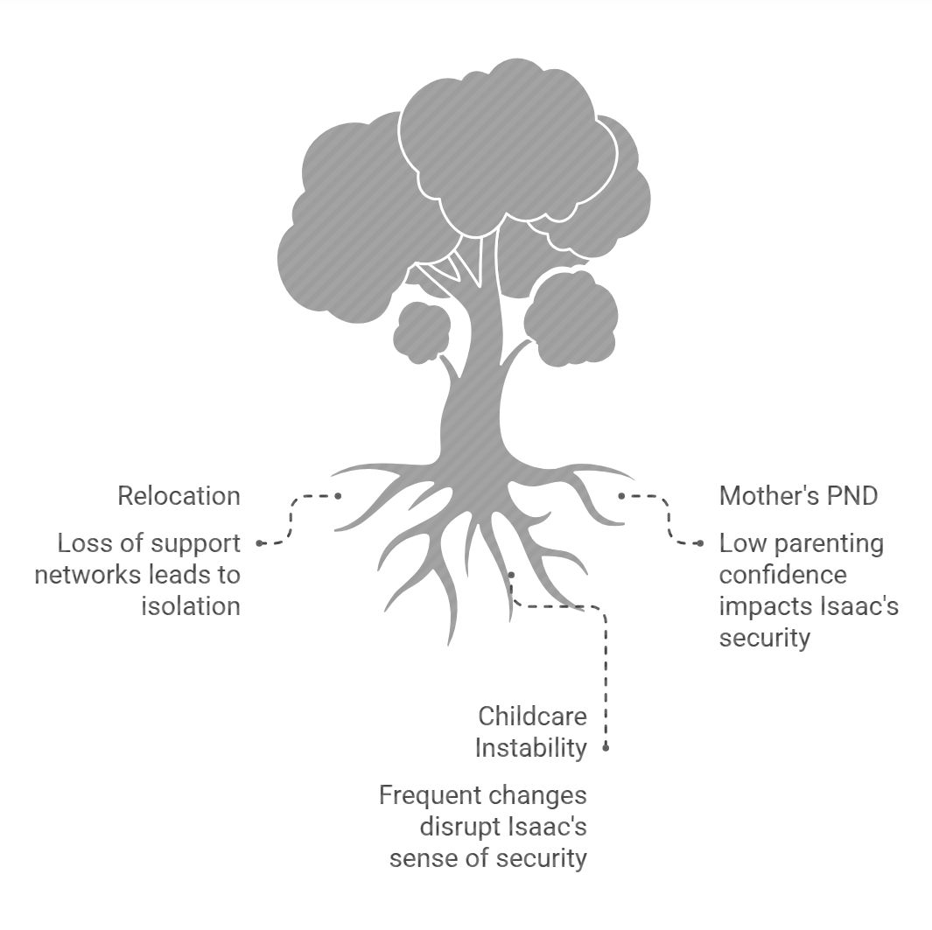
Introduction & Professional Context
In my capacity as a Trainee Early Years Support Worker within a multi-disciplinary Children’s Centre, this presentation aims to critically analyse the developmental needs of Isaac, a four-year-old child, using the framework of Bowlby’s Attachment Theory.
The ultimate goal is to formulate a theory-led Early Help support plan that addresses his emotional and social challenges (Bauer et al., 2021).
Significant environmental and domestic stressors define Isaac’s current situation. His family recently relocated to London, resulting in a sudden loss of extended family networks and subsequent social isolation. This transition is compounded by his mother’s history of Postnatal Depression (PND) and her current low levels of parenting confidence.
Notes:
I am working as a Trainee Early Years Support Worker in a Children’s Centre. This presentation analyses Isaac, a 4-year-old boy who shows separation anxiety, social withdrawal, language delay and difficulty joining group activities. I will use Bowlby’s Attachment Theory to explain how disrupted childcare, maternal postnatal depression and limited social support may have affected his development, before proposing an Early Help support plan.

Slide 3
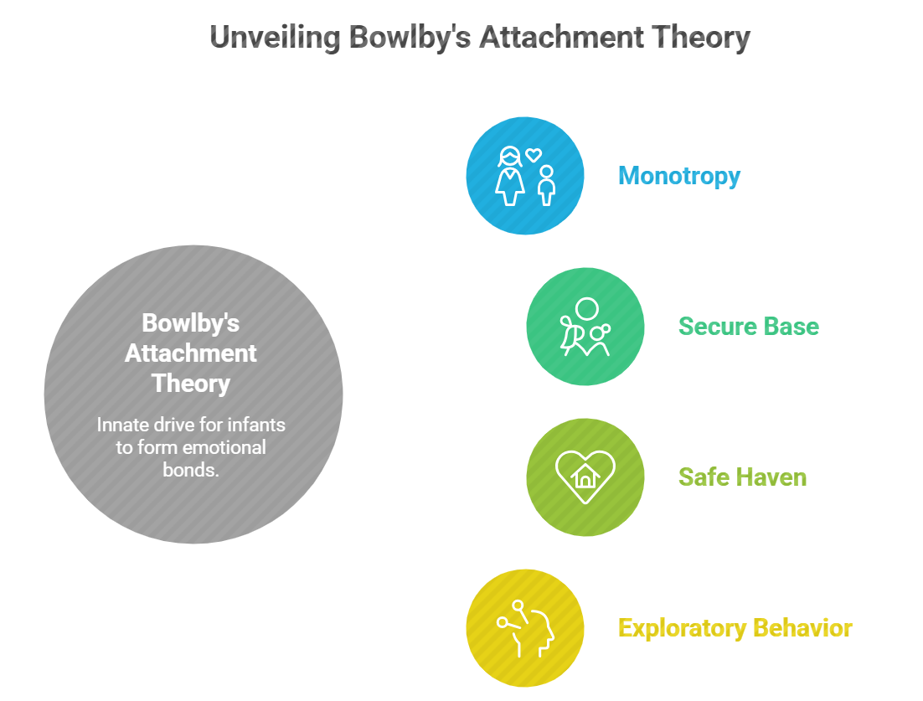
Theoretical Framework: Bowlby’s Attachment Theory
John Bowlby’s Attachment Theory (1969) posits that infants possess an innate, biological drive to form a deep emotional bond with a primary caregiver. This evolutionary mechanism is designed to ensure the child’s survival by maintaining proximity to a protector.
A central tenet of this theory is the concept of 'Monotropy,' which emphasises the singular importance of the primary attachment figure in a child’s early development.
Furthermore, a secure attachment provides the child with a 'Secure Base' and a 'Safe Haven (Music, 2024).‘ A secure base allows the child to explore their environment with confidence, knowing they can return to the caregiver for emotional refueling.
Notes:
The first step to examining the requirements of Isaac is to examine the principles of John Bowlby's attachment theory (1969). Bowlby argued that attachment is a biologically based emotional bond that helps children seek safety and protection. This idea of Monotropy, proposed by Bowlby, indicated that a child can have many attachments. A secure attachment gives the child a “secure base” for exploration and a “safe haven” during stress. A healthy, secure attachment serves as a foundation for children in learning, and from it, they learn to expand outward into the world (Music, 2024). This is relevant to Isaac because he becomes distressed during separation, withdraws from play and struggles with peer interaction.

Slide 4
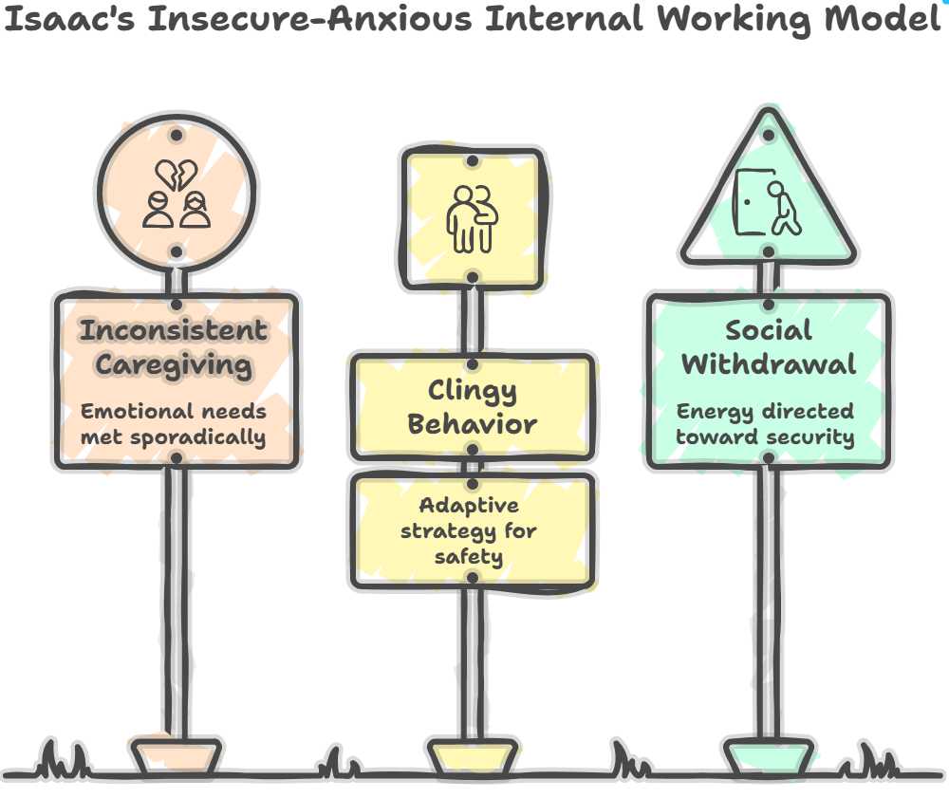
Developmental Assumptions: The Internal Working Model
The Internal Working Model (IWM) represents a fundamental developmental assumption within Attachment Theory, acting as a cognitive framework or mental 'blueprint' for all future social relationships (DePinto, 2022).
This model is constructed based on the infant's experience of the primary caregiver’s responsiveness and emotional availability.
In Isaac’s case, the presence of maternal Postnatal Depression (PND) may have resulted in inconsistent caregiving, where emotional needs were met sporadically..
Notes:
A second concept in our analysis is the 'Internal Working Model,' IWM. Bowlby called this a child's “cognitive map” that would take them to all new situations (Tottenham and Vannucci, 2025). Developed during the first several years of childhood, it serves as a template for relationship expectations. Isaac's blueprint has been strongly influenced by his mother's experience with Postnatal Depression. Bowlby’s Internal Working Model suggests that early relationships shape a child’s expectations of adults and the world. If care is inconsistent, the child may expect adults to be unavailable or unpredictable. Isaac’s clinginess and anxiety may therefore be understood as attempts to maintain closeness and safety.

Slide 5
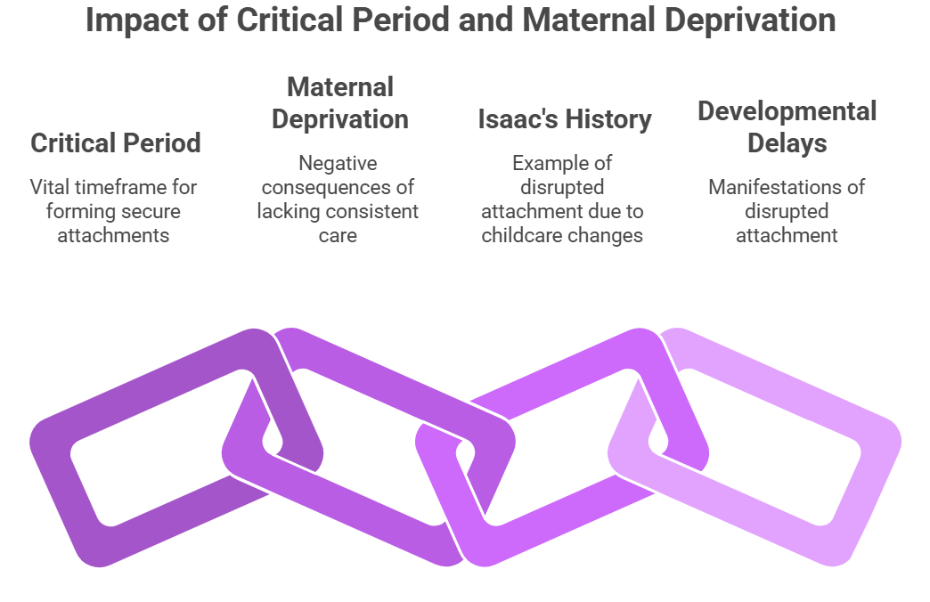
Developmental Assumptions: The Critical Period and Maternal Deprivation
Another fundamental assumption of Attachment Theory is the existence of a 'Critical Period‘, a specific timeframe, typically identified as the first 2.5 to 3 years of life, during which the formation of a stable attachment bond is vital for healthy development.
Bowlby suggested that if a child is denied this opportunity or experiences frequent disruptions in care, they may suffer from 'Maternal Deprivation,' leading to long-term emotional, social, and cognitive difficulties (Vertel, 2023).
Isaac’s history presents a significant risk factor in this regard, as he has experienced frequent changes in childcare provision over the past two years.
Notes:
In addition to the 'Critical Period' discussed by Bowlby. Bowlby suggested that the first few years of life are a critical period when the attachment bond has to be formed. Bowlby highlighted the importance of early stable relationships. Isaac’s disrupted childcare may have limited his opportunity to build consistent secondary attachments, which could contribute to his anxiety, social withdrawal and delayed communication.

Slide 6
Nature vs. Nurture Comparison Table
Aspect | Nature (Biological Factors) | Nurture (Environmental Factors)
Primary Influence | Innate genetic predispositions and biological temperament (Maksymenko, 2024). | External life events and quality of caregiving relationships.
Application to Isaac | Possible inherited 'inhibited' or sensitive temperament; biological predisposition toward anxiety. | Recent relocation to London and resulting social isolation; lack of extended family support.
Caregiving Context | Biological responses to stress (e.g., cortisol levels during separation). | Impact of maternal Postnatal Depression (PND) on emotional availability and responsiveness.
Stability Factors | Child's innate resilient or vulnerable 'baseline' personality. | History of unstable childcare provision; frequent changes in settings over a two-year period.
Synthesis | Provides the 'potential' behavioral profile (e.g., being a 'slow-to-warm-up' child). | Acts as the 'trigger' that activates biological vulnerabilities or supports healthy development.
Notes:
Isaac’s development should be understood through both nature and nurture. Biologically or from nature, his temperament may make him more sensitive to change and separation. Environmentally or from nurture, maternal postnatal depression, disrupted childcare and limited social support may have reduced the consistency he needs. Therefore, the support plan should focus on creating predictable and emotionally secure experiences.

Slide 7
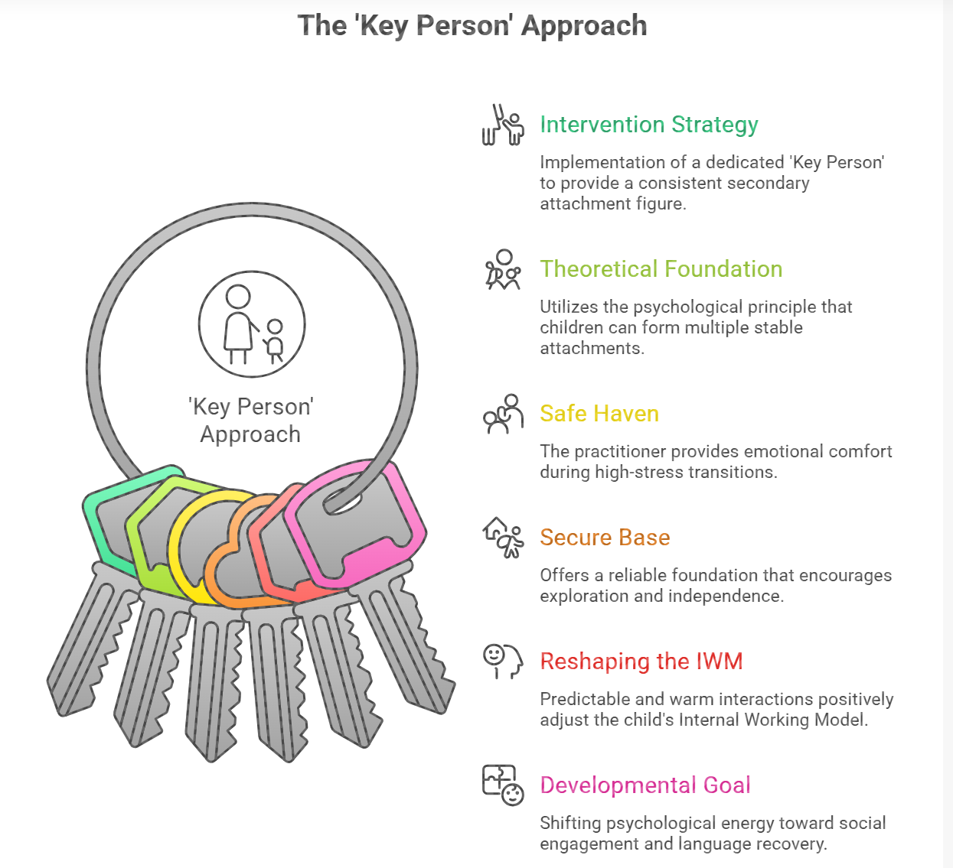
Proposed Support Plan: The 'Key Person' Approach
Intervention Strategy: Implementation of a dedicated 'Key Person' to provide a consistent secondary attachment figure within the Children's Centre.
Theoretical Foundation: Utilises the psychological principle that children can form multiple stable attachments to provide emotional security in professional settings (Bosmans et al., 2022).
Safe Haven & Secure Base:
  Safe Haven: The practitioner provides emotional comfort during the high-stress transition of morning drop-offs.
  Secure Base: Offers a reliable foundation that encourages Isaac to move away and explore the environment throughout the day.
Developmental Goal: Shifting psychological energy from 'proximity-seeking' toward social engagement and the recovery of expressive language skills.
Notes:
Intervention Strategy: "Having a Trainee Early Years Support Worker is the first step in our Early Health plan and focuses on providing a regular 'Key Person' for Isaac, beyond just administrative management, it is being there when he needs it.
Theoretical Foundation: "According to Bowlby's theory, this strategy is based on the psychology of the child having formed multiple secure attachments, with his primary attachment being with his mother. Professional practitioners can also be seen as viable emotional anchors for Isaac, ensuring he is able to operate within the Children's Centre environment (Bosmans et al., 2022).
Safe Haven & Secure Base: Throughout the day, the Key Person is available as 'Secure Base', which is a foundation for independent learning. 'Safe Haven' is a person who directly comforts during a high-stress morning drop-off time and alleviates Isaac's separation anxiety.
Developmental Goal: "The ultimate goal of this intervention is the change in psychological energy that Isaac is now experiencing; when he is clinging.

Slide 8
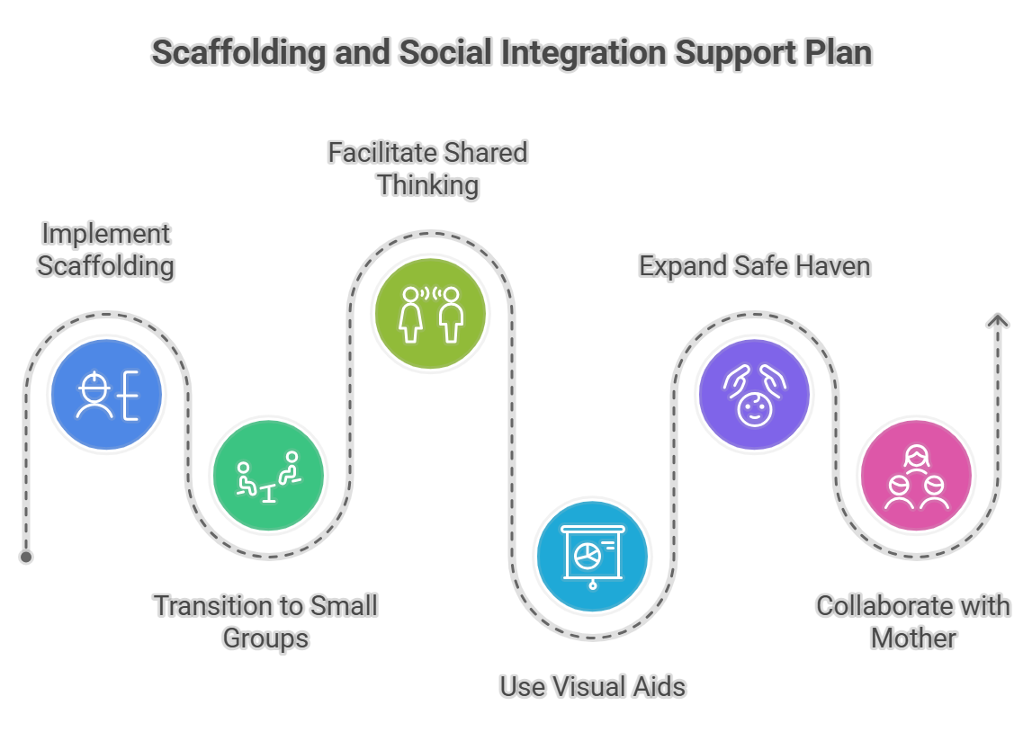
Proposed Support Plan: Scaffolding & Social Integration
Implementation of Scaffolding: Utilising the 'Key Person' to provide temporary, sensitive support that allows Isaac to attempt social tasks just beyond his current comfort level.
Play-Based Social Groups:
  Small-Group Interventions: Transitioning Isaac from one-on-one interaction into structured, low-pressure play groups of 2-3 children.
  Shared Sustained Thinking: The practitioner facilitates conversations during play to model language and social cues (Fedewa et al., 2024).
Bridging the Language Gap: Using visual aids and repetitive social routines to reduce the cognitive load of communication, while Isaac’s anxiety decreases.
Safe Haven Expansion: Gradually extending Isaac's sense of security from the 'Key Person' to the wider nursery environment and peer group.
Professional Collaboration: Regularly sharing successful social strategies with Isaac’s mother to ensure a consistent approach across home and the Children’s Centre.
Sources: Made by me
Notes:
Scaffolding: The second focus of our plan is 'scaffolding,' which is when we provide a little help for a child to get closer to an objective that they can't really do on their own. With Isaac, it won't be just dropping him in a large group and hoping he will play; we will use the Key Person to 'scaffold' his social interactions and 'bridge' him between his withdrawal and the social group.
Play-Based Social Groups: Small group interactions will be implemented the practitioner will guide the means of play while providing Isaac with modelling opportunities for him to learn the language he may require to participate in play, such as asking for a toy or responding when his peer is gesturing.
Bridging the Language Gap: To help with his delay in expressive language, we will rely on visual supports and repetitive social routines. This will take the pressure off Isaac to find the ‘right words' when he is still feeling anxious, so his mental effort can be focused on acquiring language, and his expressive language will eventually align with his developmental age.
Safe Haven Expansion: The aim here is to make the whole nursery, not just one person, a 'Safe Haven' that Identity ISAC is confident, hopeful and able to rely upon as a secure and rewarding partner. Grating success in these small groups will help build Isaac's confidence, and his 'Internal Working Model' will update to treat his peers as partners and safe people too.
Professional Collaboration: Finally, we must collaborate with Isaac’s mother. Involving her in these sessions, we can provide models for her of these scaffolding methods. This enables her to feel empowered, boosts her parenting confidence and imparts a clear ‘nurture' message when he is not at home and at the Children's Centre, giving him the stability needed for long-term development.

Slide 9
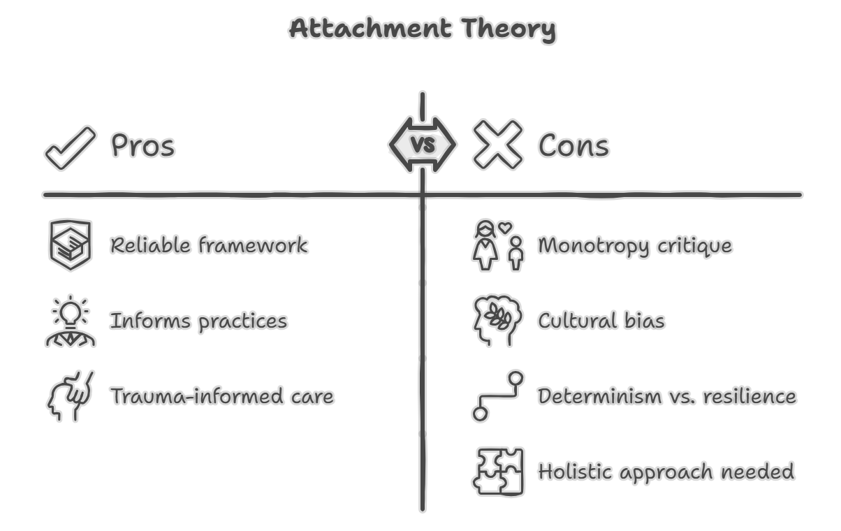
Critical Evaluation of Attachment Theory
Strengths in Practice:
  Provides a highly reliable framework for understanding the link between early emotional security and later social-cognitive competence (Bender et al., 2022).
  Directly informs evidence-based early years practices, such as the 'Key Person' approach and trauma-informed care.
Academic and Practical Limitations:
  Monotropy Critique: Historically over-emphasises the role of the biological mother, potentially leading to 'mother-blaming' and neglecting the value of multiple caregivers.
  Cultural Bias: Developed primarily within Western nuclear family structures; may not fully account for collective caregiving traditions common in diverse urban environments like London.
  Determinism vs Resilience: Criticised for being overly deterministic, modern psychology emphasises that children can be resilient and that 'Internal Working Models' can be updated through positive later experiences.
Application to Isaac: While the theory explains Isaac's current distress effectively, a holistic approach must also consider his resilience and the support of the wider community.
Sources: Made by me
Notes:
The main advantage of the theory is its predictive ability. It provides a 'gold standard' approach to its impact on language and peers, and a deeper understanding of the direct link between emotional security and achievements such as language acquisition and interactions with peers (Bender et al., 2022). However, it has some criticism:
Monotropy Critique: Bowlby's original theory of ‘Monotropy’ – that a child will become attached to one significant person – has received much criticism and is very unstable, particularly from feminist scholars, as it puts the unfair burden on the mother.
Cultural Bias: Secondly, the theory emerged out of a very narrow Western cultural context. Many children in London grow up in a cultural context in which ‘extended family' is typical and ‘multiple caregiving' is the norm.
Determinism vs Resilience: Thirdly, Bowlby is described as deterministic, that is, the child is ‘damaged' irreparably if the first three years are bad. This is not the case according to modern psychology.

Slide 10
Conclusion
In conclusion, this psychological analysis demonstrates that Isaac’s current developmental challenges—including his separation anxiety, social withdrawal, and language delays—are not isolated issues, but are deeply rooted in his early attachment history and environmental stressors.
By applying Bowlby’s Attachment Theory, we can move beyond a deficit-based view of his behaviour and instead recognise his actions as adaptive responses to an unpredictable 'Internal Working Model' shaped by maternal depression and unstable care.
Notes:
In conclusion, Isaac’s difficulties can be understood through Bowlby’s Attachment Theory. His disrupted childcare, maternal mental health context and limited social support may have affected his sense of security. A consistent Key Person, small-group play, language-rich routines and collaboration with his mother can help create the secure base he needs for emotional, social and language development.

Slide 11
References
Bauer, A., Best, S., Malley, J., Christiansen, H., Goodyear, M., Zechmeister-Koss, I. and Paul, J. (2021) ‘Towards a program theory for family-focused practice in adult mental health care settings: an international interview study with program leaders’, Frontiers in Psychiatry, 12, article 741225.
Bender, A.E., McKinney, S.J., Schmidt-Sane, M.M., Cage, J., Holmes, M.R., Berg, K.A., Salley, J., Bodell, M., Miller, E.K. and Voith, L.A. (2022) ‘Childhood exposure to intimate partner violence and effects on social-emotional competence: a systematic review’, Journal of Family Violence, 37(8), pp. 1263–1281.
Bosmans, G., Van Vlierberghe, L., Bakermans-Kranenburg, M.J., Kobak, R., Hermans, D. and van IJzendoorn, M.H. (2022) ‘A learning theory approach to attachment theory: exploring clinical applications’, Clinical Child and Family Psychology Review, 25(3), pp. 591–612.
Bowlby, J. (1969) Attachment and loss. Vol. 1: Attachment. New York: Basic Books.
DePinto, L. (2022) The attuned school clinician: an advanced clinical practice curriculum in attachment informed school-based mental health for social workers. Doctoral dissertation. University of Pennsylvania.
Fedewa, M., Watkins, L., Barber, A. and Baggett, J. (2024) ‘Supporting social play of preschoolers with and without autism: a collaborative approach for special educators and speech language pathologists’, Early Childhood Education Journal, 52(6), pp. 1023–1033.
Maksymenko, S. (2024) ‘Orthobiosis in human development: a genetic psychological perspective on personality traits and their pathologization’. Available at: https://ssrn.com/abstract=4709232 (Accessed: 18 May 2026).
Music, G. (2024) Nurturing natures: attachment and children’s emotional, sociocultural and brain development. 3rd edn. London: Routledge.
Tottenham, N. and Vannucci, A. (2025) ‘Attachment as prediction: insights from cognitive and developmental neuroscience’, Current Directions in Psychological Science, 34(3), pp. 195–206.
Vertel, A. (2023) ‘John Bowlby’s attachment theory as an alternative to psychoanalytic concepts of the early social-emotional development of a child’, Sumy State Pedagogical University Journal, 2(31), pp. 17–24.

