Slide 1
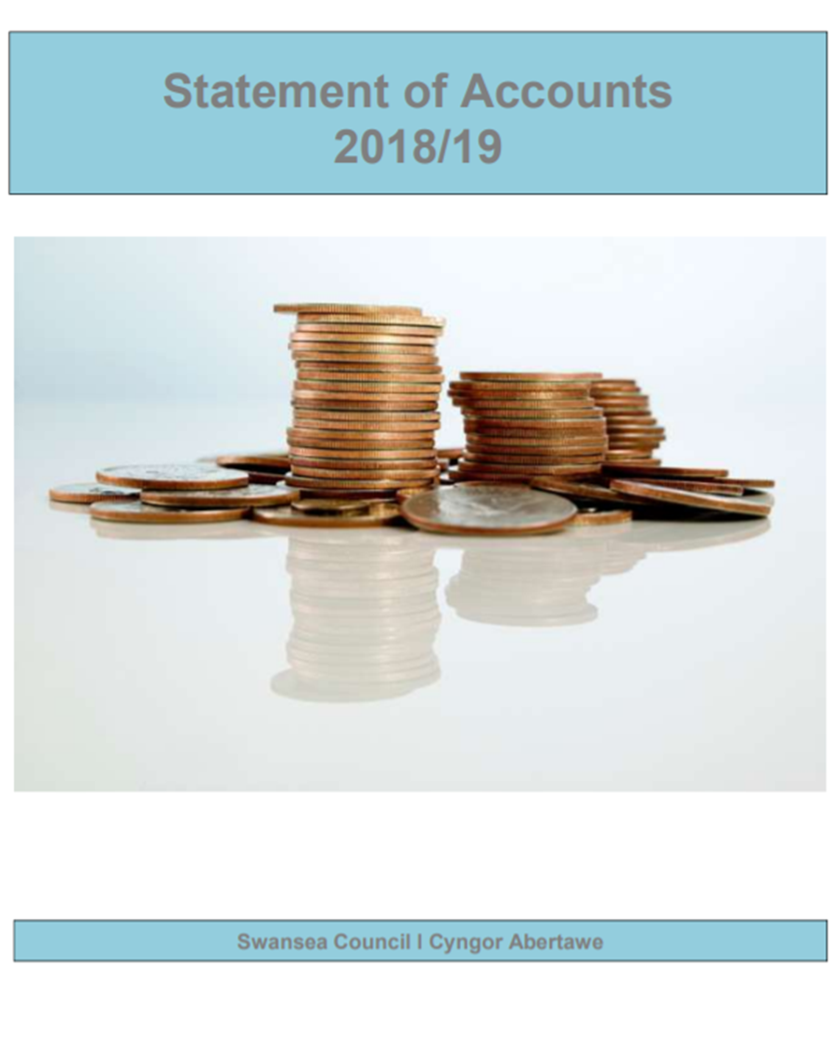
9.1. Utilising Resources
Accounts of the
City and County of Swansea 2018/19

Slide 2
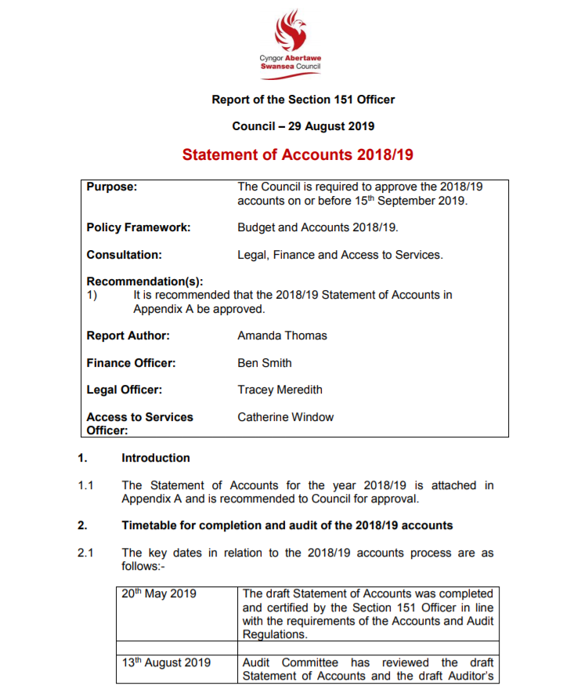
Objectives
To explain how Council’s are funded with particular reference to one Council in Wales – the City and County of Swansea
To discuss where the money comes from and where it goes
To explain the purpose of the Annual Governance Statement

Slide 3
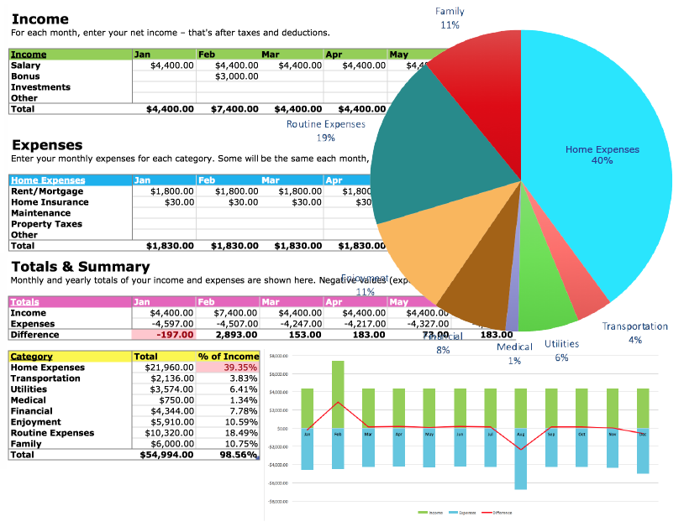
Accounts?
Can be a rather boring aspect of public services and policing!
Our focus is on financial management for non financial managers
Advanced level thinking but essential preparation for future management careers
In future responsibility for financial management could be yours
Get it wrong – go to prison
Always wear asbestos trousers

Slide 4
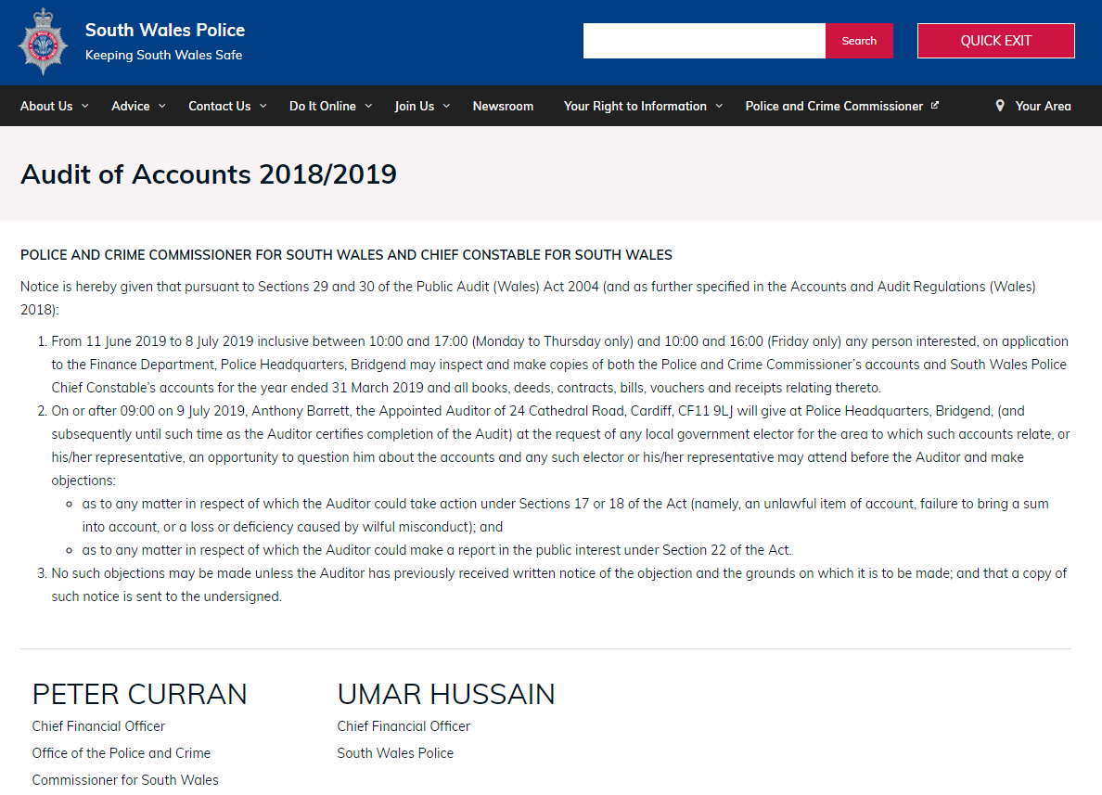

Slide 5
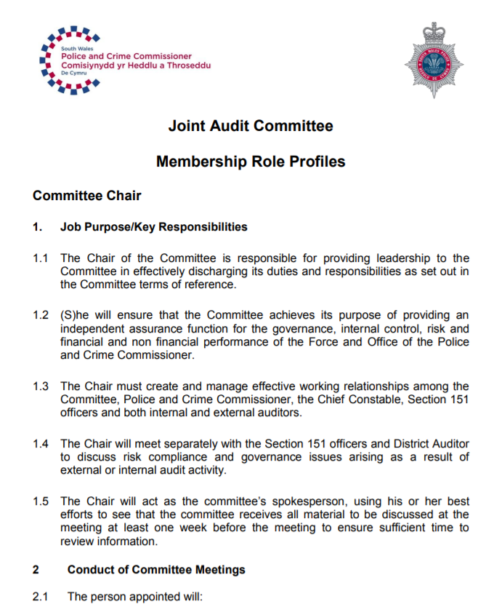
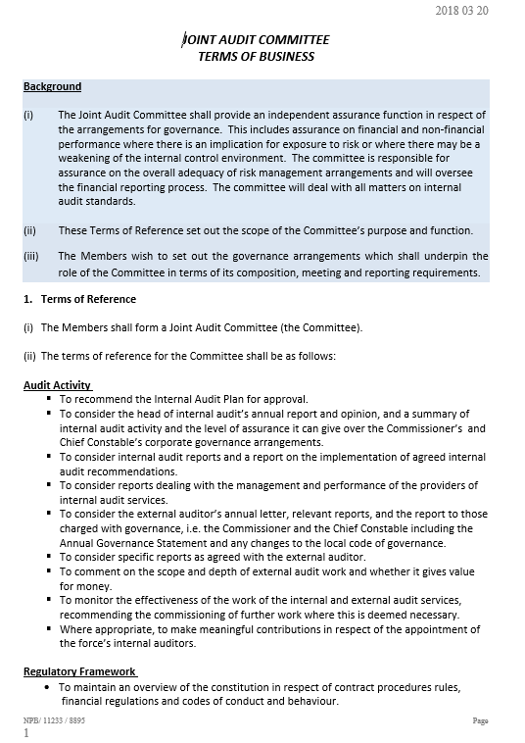

Slide 6
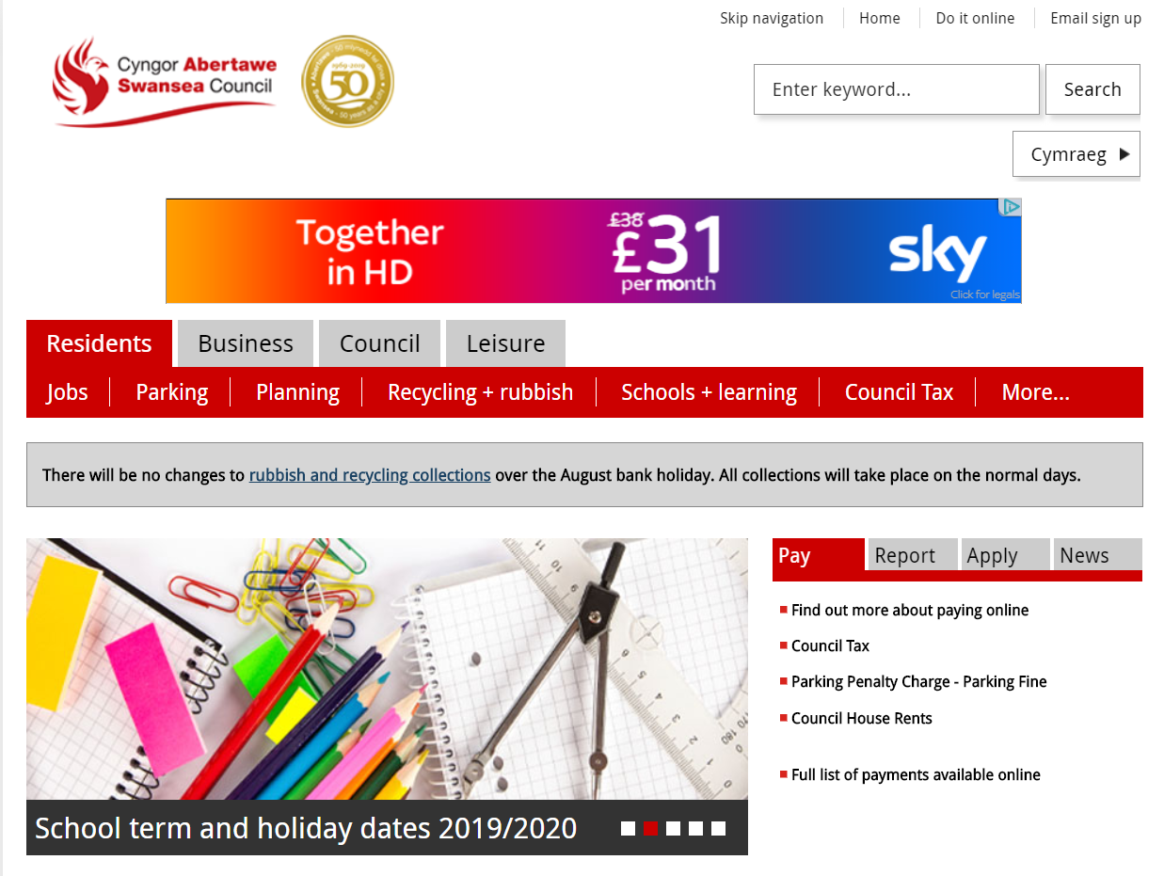
Principal & Community Councils
How many principal Council’s are there in Wales?
How many Community Councils?
What do they do?

Slide 7
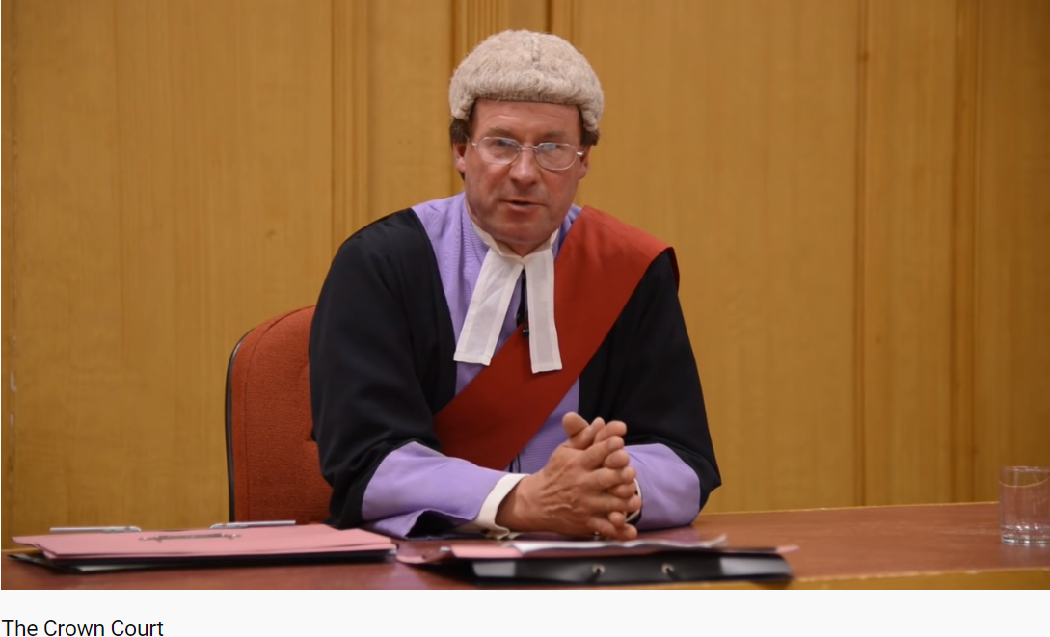
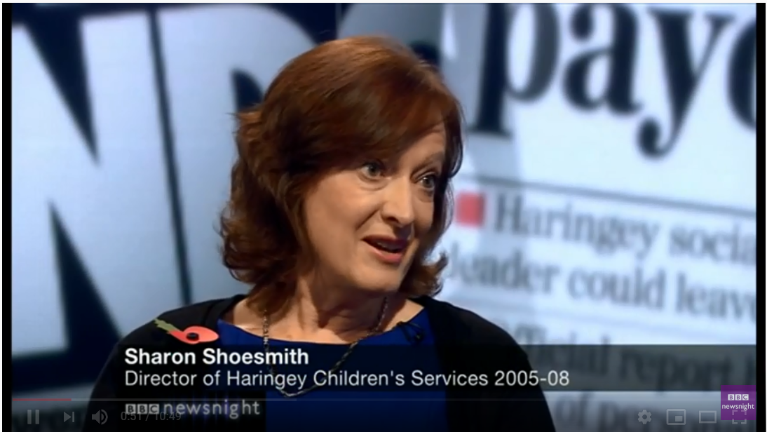
Without the money, there is no activity
Our resources come from the public and we remain publicly accountable
Control is everything
Comply with legal requirements
The media is fuelled by negative news and the sniff of a scandal

Slide 8
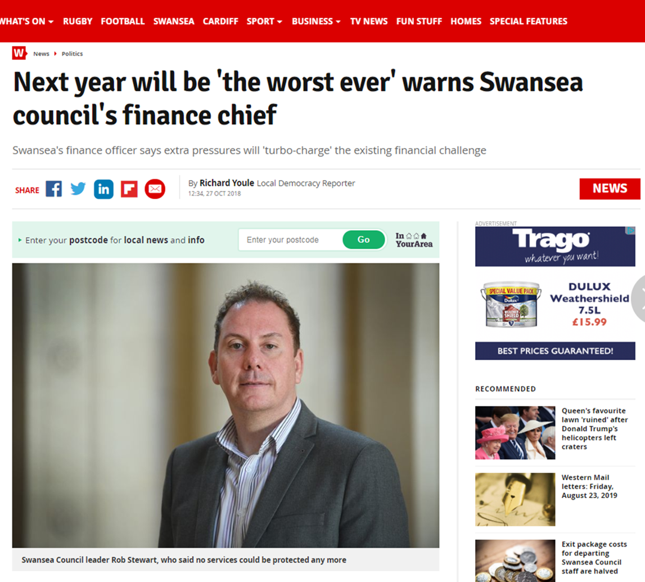

Slide 9
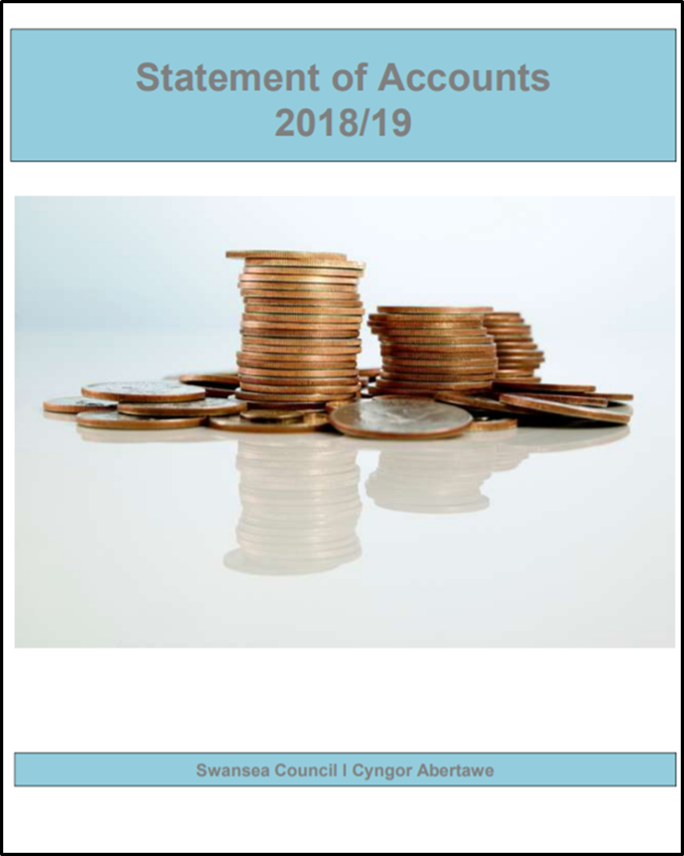
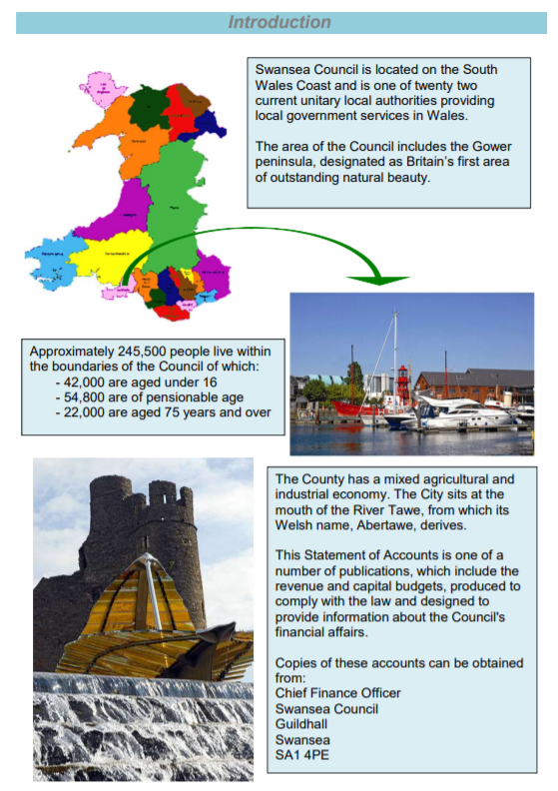

Slide 10
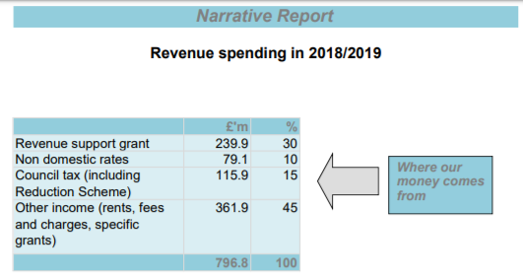
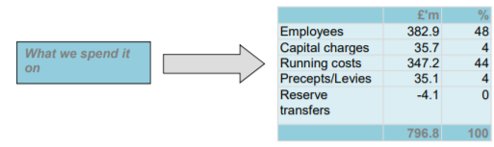
Overview

Slide 11
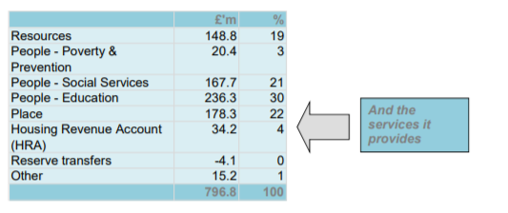
£796 million received from a variety of sources and spent on services for the people of Swansea
Figures show 100% monies received and 100% spent
Your personal bank statements show the same thing though the numbers are probably a bit different
Think in terms of money in and out; income and expenditure
Planning ahead is extremely important (budgeting)
If we do not have the money we cannot spend it

Slide 12
Revenue and capital expenditure
Revenue
Covers spending on the day to day costs of our services such as:
staff costs, maintenance of buildings and general supplies and equipment.
Covered by income we receive from Council taxpayers, business ratepayers, the fees and charges made for certain services, and by the grants we receive from Government.
Capital
Covers spending on assets such as roads, redevelopment and the major renovation of buildings. These assets will provide benefits to the community for several years and the expenditure is largely financed by borrowing, capital grants and the sale of fixed assets. Amounts borrowed for capital purposes are repaid in part each year as part of our revenue expenditure.
Sources of borrowing utilised include the Public Works Loan Board (PWLB) and capital markets.

Slide 13
Annual Governance Statement
In accordance with the law and proper standards
Public money is safeguarded and properly accounted for
Duty under the Local Government (Wales) Measure 2009 to secure continuous improvement in the way functions are exercised

Slide 14
Purpose of the Governance Framework
Systems and processes, culture and values, by which the Authority is directed and controlled
Activities through which it accounts to, engages with and leads the community
Monitor the achievement of its strategic objectives and to consider whether those objectives have led to the delivery of appropriate services and value for money
Internal control system is extremely important

Slide 15
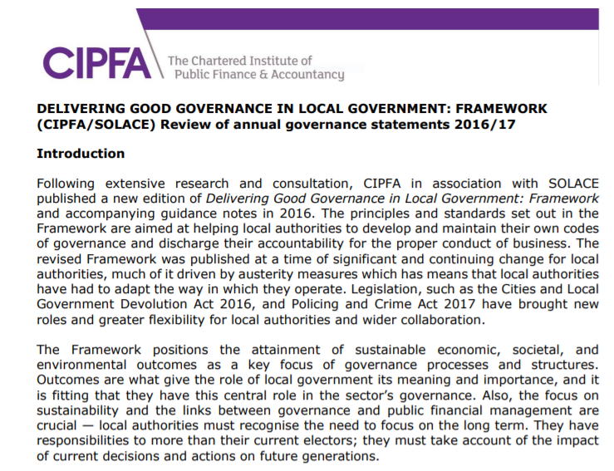
The Governance Framework
Council has adopted a Code of Corporate Governance based on the ‘Delivering Good Governance in Local Government’ framework published by the Chartered Institute of Public Finance and Accountancy

Slide 16
The Governance Framework
A) Behaving with integrity, demonstrating strong commitment to ethical values, and respecting the rule of law.
B) Ensuring openness and comprehensive stakeholder engagement.
C) Defining outcomes in terms of sustainable economic, social and environmental benefits.
D) Determining the interventions necessary to optimise the achievement of the intended outcomes.
E) Developing the entity’s capacity, including the capability of its leadership and the individuals within it.
F) Managing risks and performance through robust internal control and strong public financial management.
G) Implementing good practices in transparency, reporting and audit to deliver effective accountability.

Slide 17
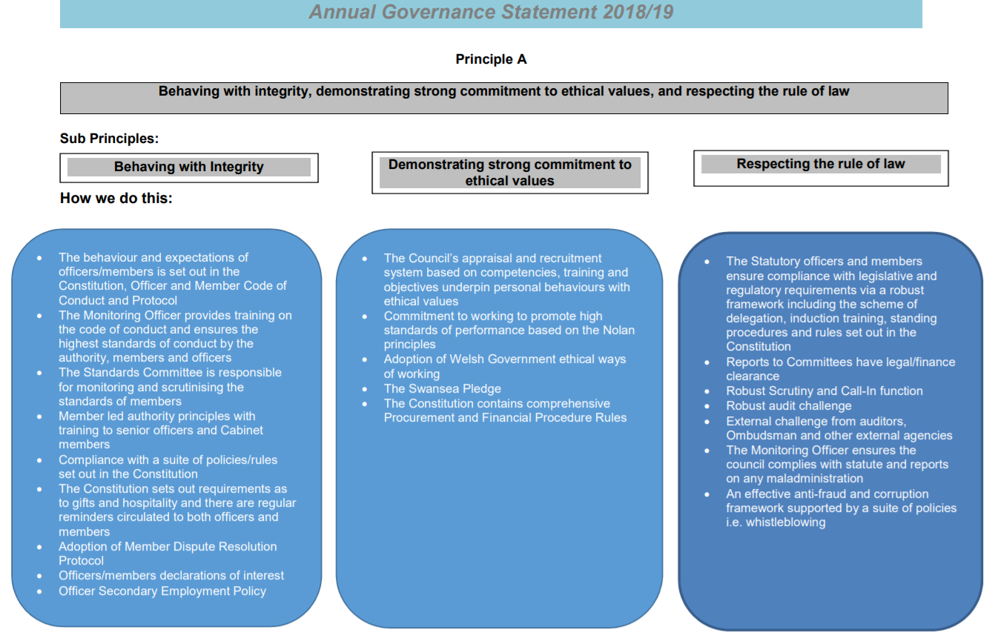

Slide 18
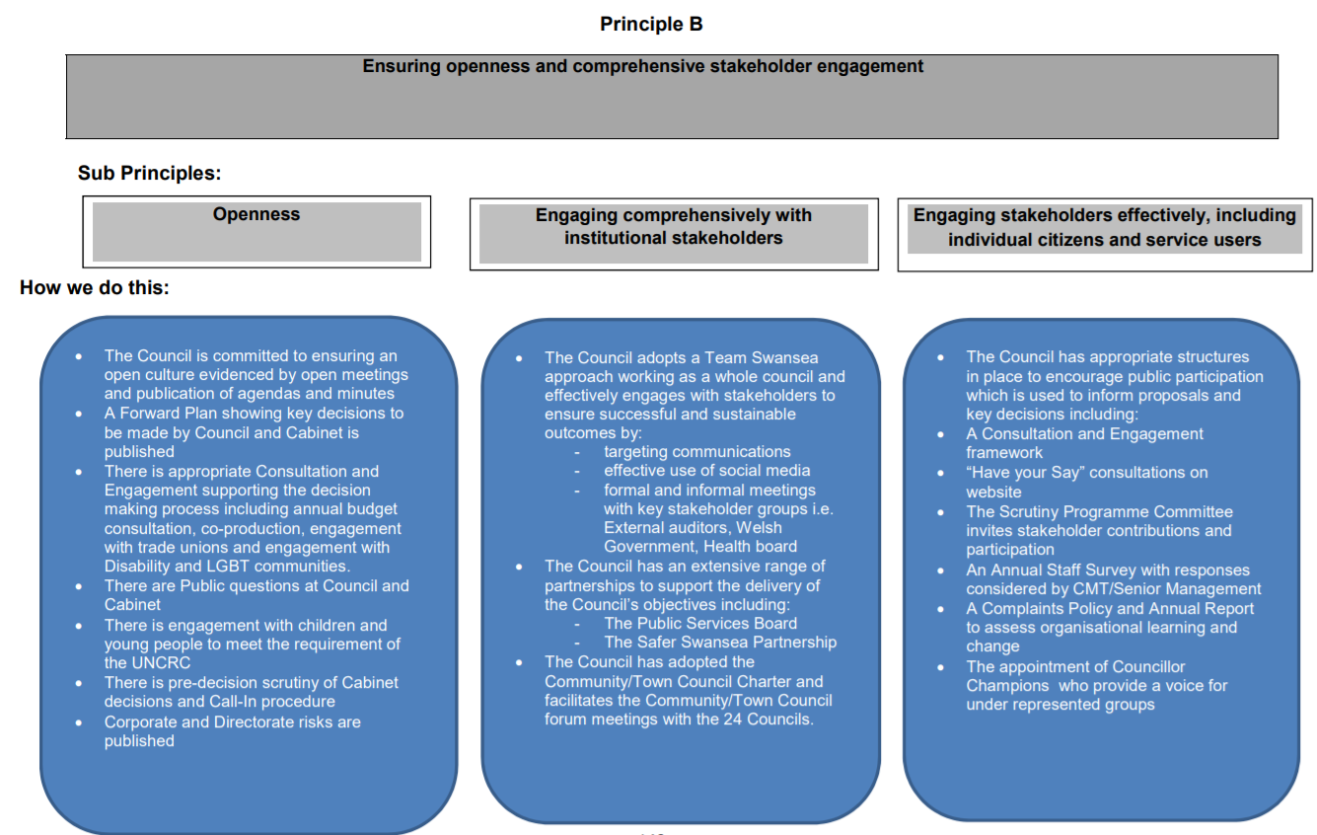

Slide 19
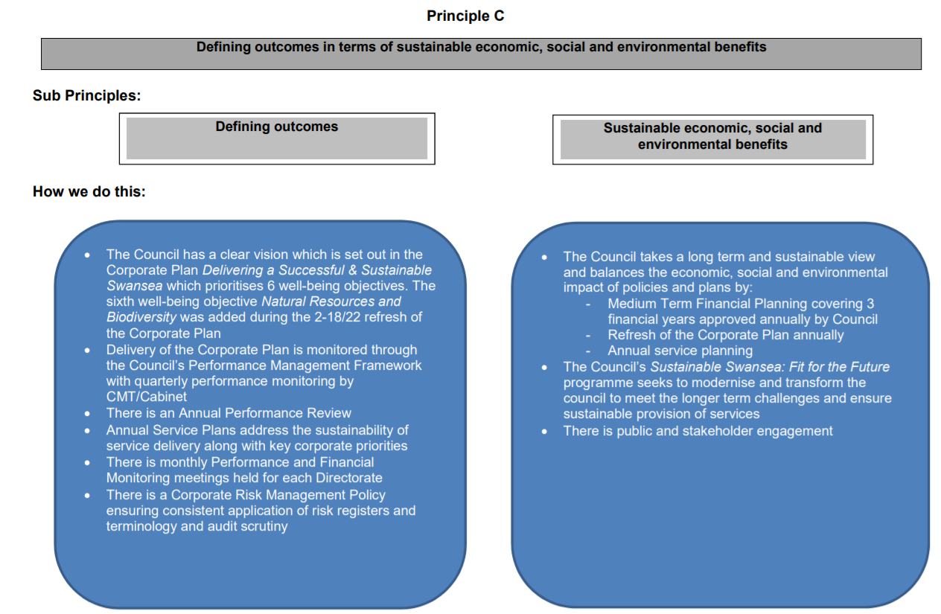

Slide 20
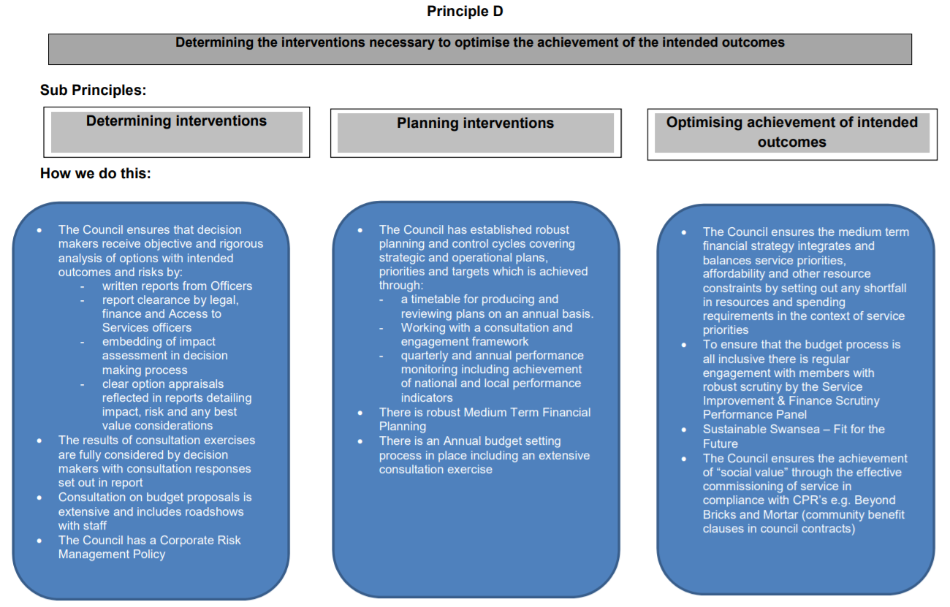

Slide 21
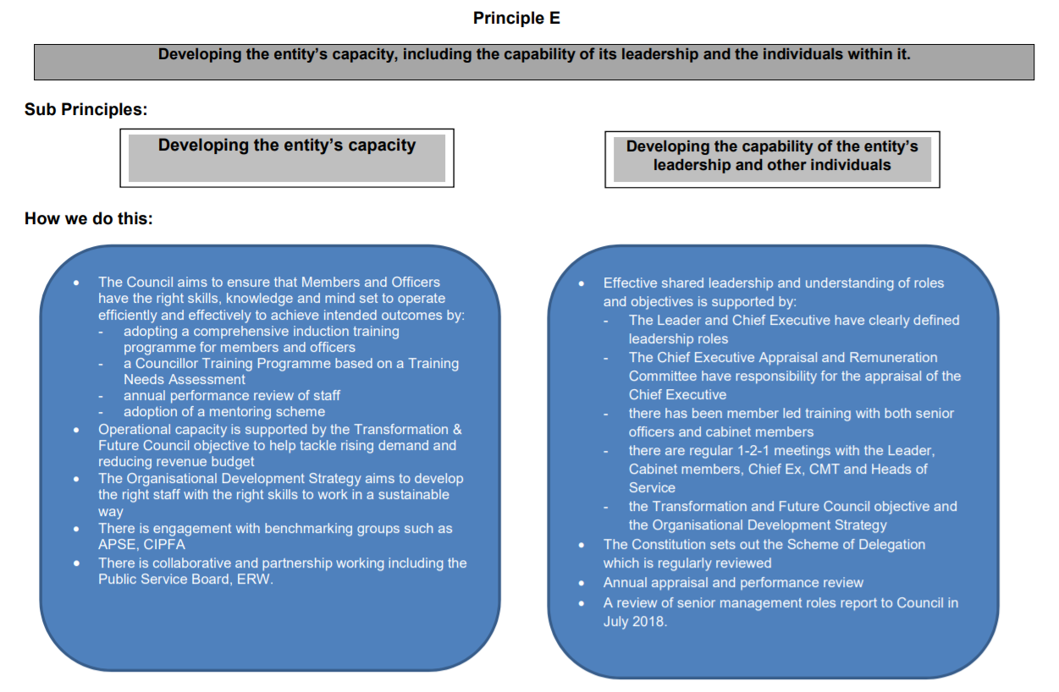

Slide 22
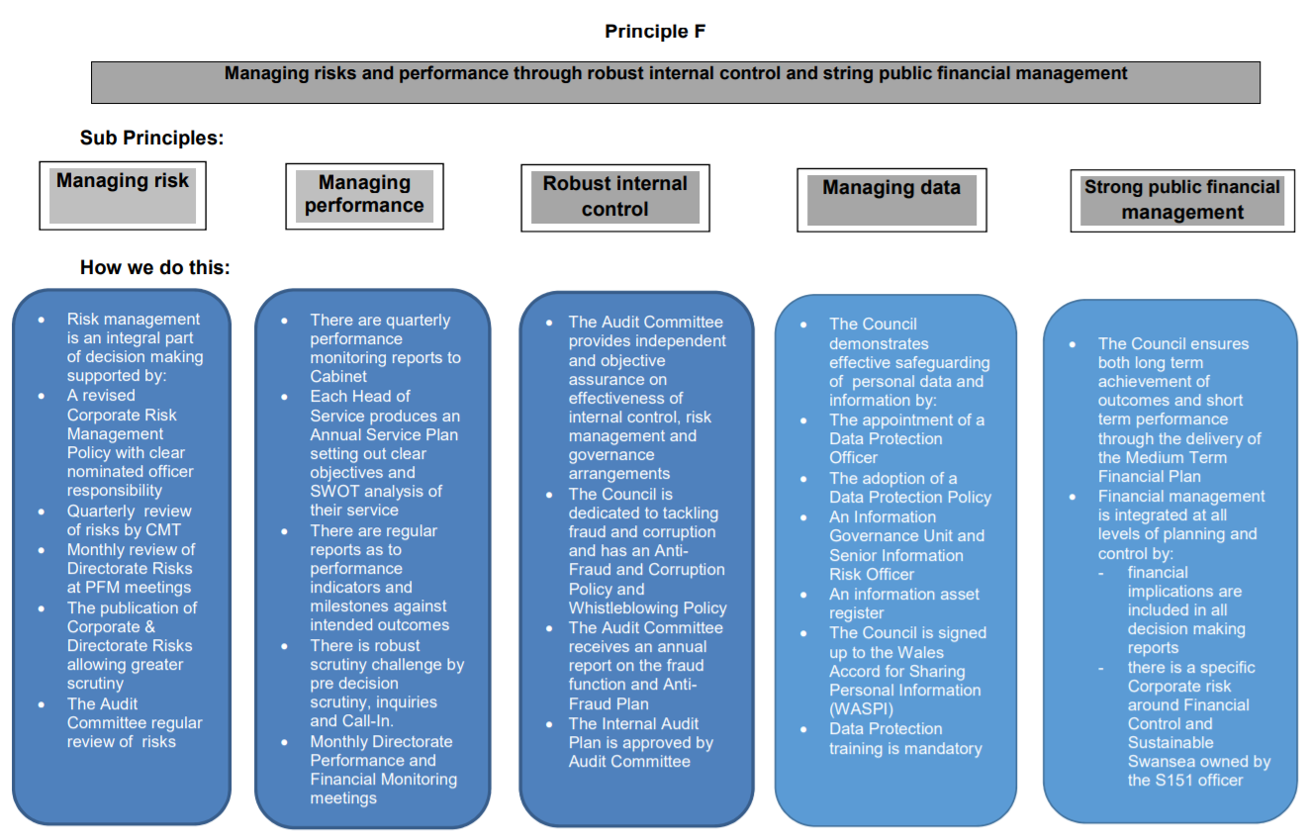

Slide 23
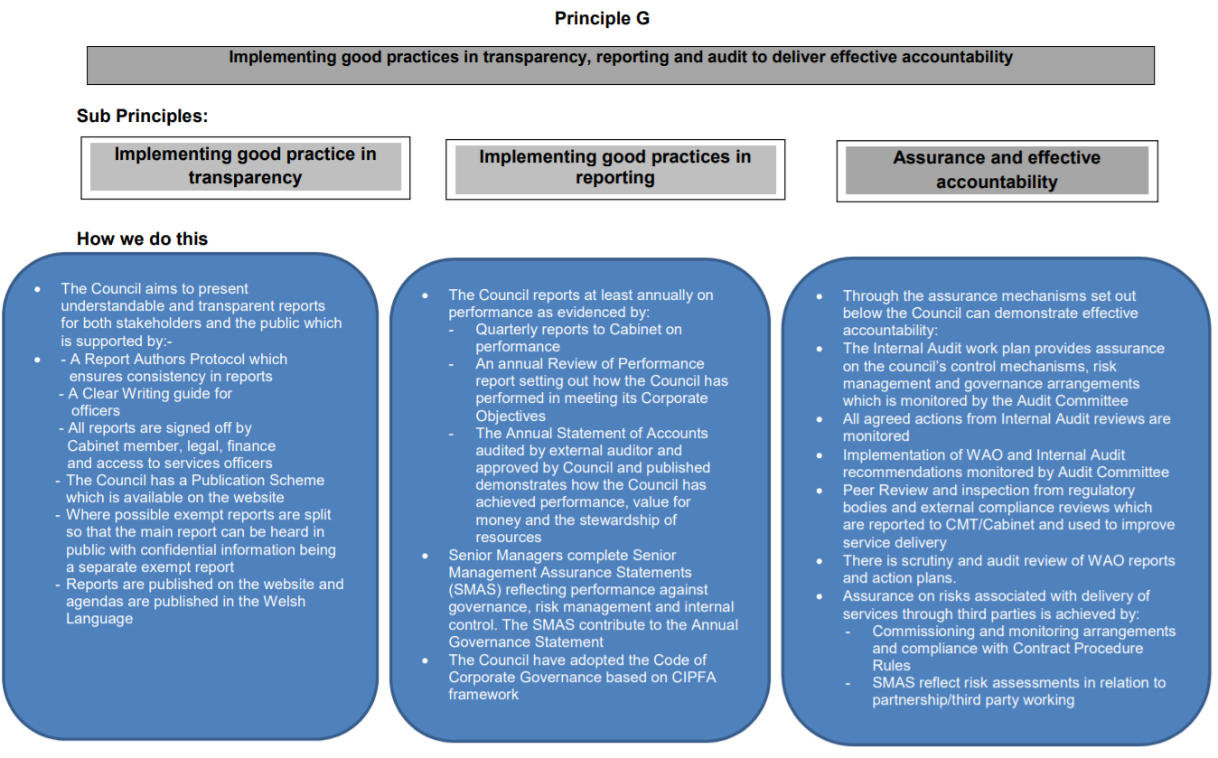

Slide 24
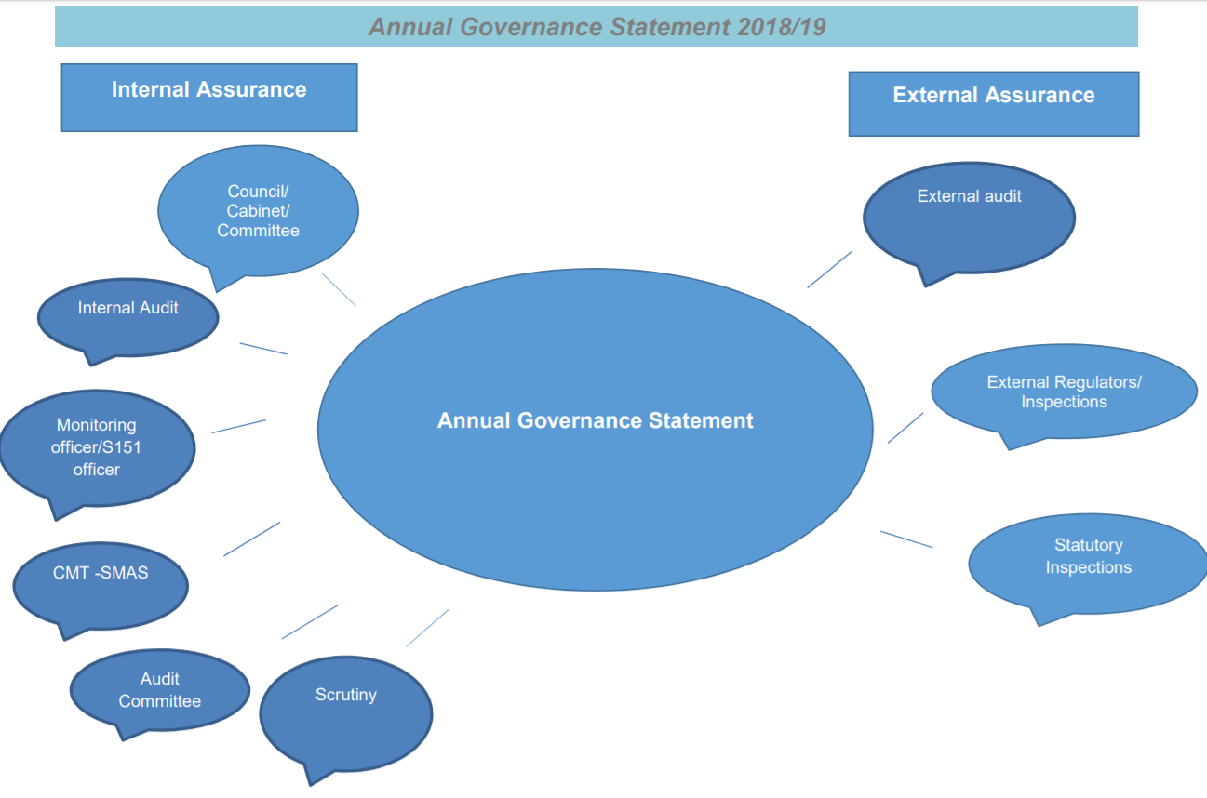

Slide 25
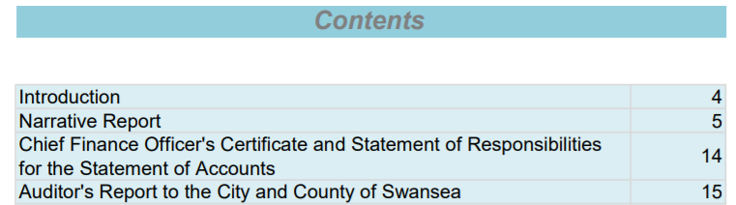
Looking for key assurances
Reading through accounts for non-financial managers can be an arduous and challenging task
Consider summary information and look for highlights
Look for internal assurances from the organisation leader finance officer (Section 151 for Councils) and chartered accountant
What does the external auditor say
Do they agree that a true and fair view is provided?

