Slide 1
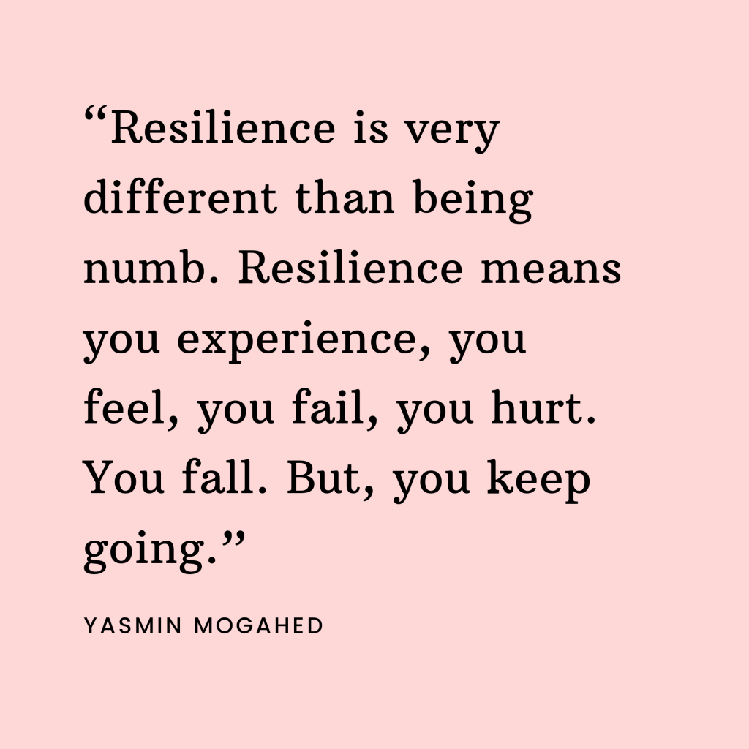
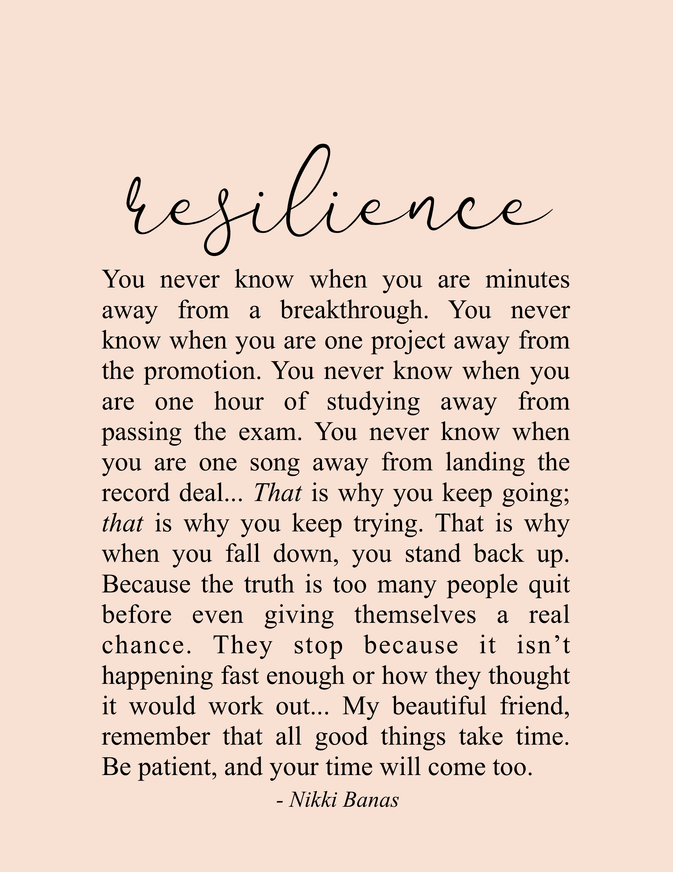


The importance of resilience, health and wellbeing as a university student
Eva thomas
2203669

Slide 2
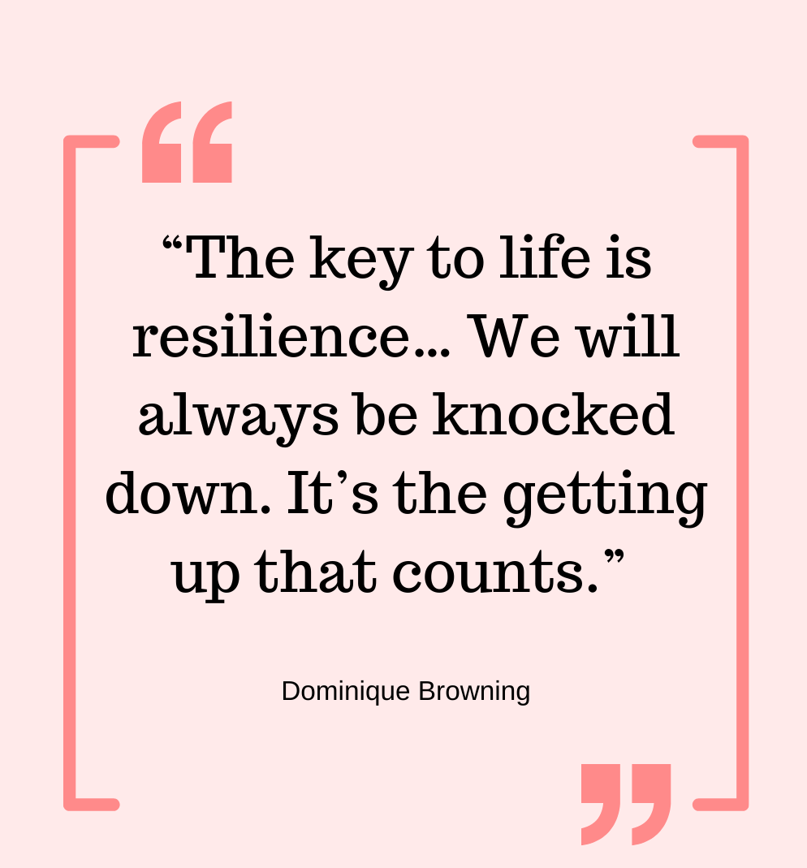
What is resilience?
The word ‘resilience’ refers to our bounce-back ability in the face of difficulty or challenges. Resilience is the ability to adapt and grow following adversity.
NHS Leadership Academy (2023)

Slide 3

What is wellbeing?
Well-being is a positive state experienced by individuals and societies. Similar to health, it is a resource for daily life and is determined by social, economic and environmental conditions. Well-being encompasses quality of life and the ability of people and societies to contribute to the world with a sense of meaning and purpose.
World health organisation (2021)

Slide 4
Looking after your well-being
Looking after your well-being is just as important as looking after your physical health, especially as a University student.
Here are many affordable, and even cost-free ways you can look after your well-being!

Slide 5
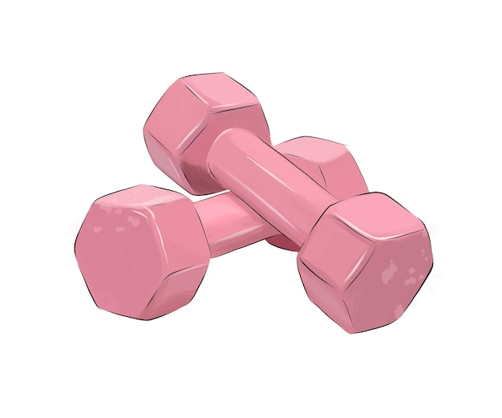
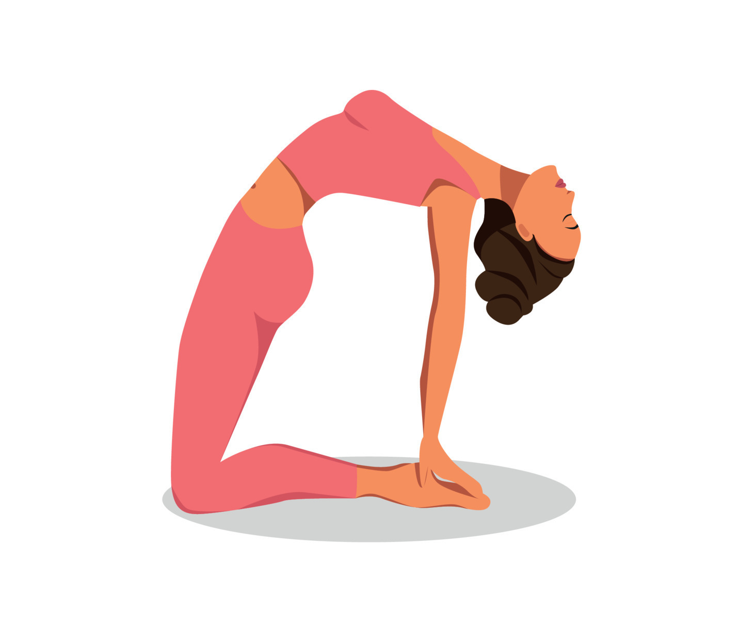
The importance of staying active
Physical activity is not only good for your body, but it's also great for your mind.
Being active releases chemicals in your brain that make you feel good - boosting your self-esteem and helping you concentrate as well as sleep well and feel better. Not bad for something many of us can do for free!
Mental health foundation (2021)

Slide 6
Student mental health
The proportion of home students (students who normally live in the UK) who disclosed a mental health condition to their university has increased rapidly since 2010 and was over 5% in 2020/21.
The Commons Library (2020)

Slide 7
Reference list
NHS Leadership Academy (2023) What is resilience – Leadership Academy
world health organisation (2021) Promoting well-being (who.int)
Mental Health Foundation https://www.mentalhealth.org.uk/explore-mental-health/a-z-topics/physical-activity-and-mental-health#:~:text=Physical%20activity%20is%20not%20only,us%20can%20do%20for%20free!
mind charity https://www.mind.org.uk/information-support/types-of-mental-health-problems/stress/managing-stress-and-building-resilience/
The Commons Library https://commonslibrary.parliament.uk/research-briefings/cbp-8593/
https://www.mayoclinichealthsystem.org/topics/resiliency#:~:text=The%20ability%20to%20recover%20quickly,positive%20responsiveness%20to%20challenging%20events.
https://www.who.int/news-room/fact-sheets/detail/physical-activity

