Slide 1
Project Management Plan Proposal Pitch Presentation
Participants: Cristina Anton- 2110293
Andreea Rotariu- 2107119
Andreea Vlasceanu- 2108084
Natalia Rupet- 2109475
Tutor name: Abel Agoba
Module: Managing Projects in the Workplace

Slide 2

Introduction
The aim of this pitch is to present our Project Management plan.
“Pharma”, a pharmaceutical company want to lunch a new product on Market: Vita-Sport Pro
During the pitch will be discuss as following:
Company background
Project description
Project scope
Work Breakdown Structure
Quad Chart
Gant Chart
Stakeholders’ classification
Allocation of resources
Risk analysis
Conclusion

Slide 3

About Pharma
Pharma refers to the sector that includes pharmaceutical companies, regulatory agencies, healthcare professionals, and scientific researchers all working together in the research, development, production, and distribution of drugs and medications (Britannica, 2023).
They have a significant impact on the introduction of innovative therapies to the market, enhancing healthcare outcomes, and contributing to advancements in medical science (Britannica, 2023).

Slide 4
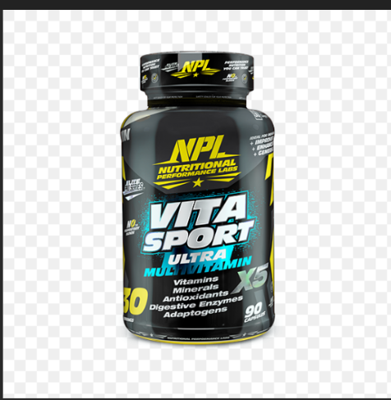

Project description
Title: "Launching Vita-Sport Pro: Multivitamins for Sportive“
Project Aim
The aim of this project is to collect data, evaluate pricing, and promote the Vita-sport Pro Vitamin product in order to successfully put it into the market.
Project Objectives
To perform market research on Vita-sport Pro Vitamin to gain insight into the target audience.
To develop a creative and compelling product package to appeal to the target customers.
To create a price strategy that would keep the product competitive in the market and profitable for the company.
To create promotional and distribution strategies to reach the target market and ensure product availability.

Slide 5

Project description
Project timeline: 3 months
This product is intended to allow athletes and individuals leading active lifestyles to improve their performance and recover faster.
The solution contains an assortment of vital vitamins and minerals in appropriate levels to help optimal functionality and recovery (Smith et al., 2014)
The usefulness and safety of this supplement have been decisively proved through thorough scientific testing.

Slide 6

Scope
Introduce Vita-sport Pro Vitamin product to people
Goal is to increase revenue and earnings
Duties include market analysis, online and offline advertising
Conduct surveys and studies to identify relevant client groups and demographics
Allocate resources (promotional materials, packaging materials, advertising budget)
Implement safeguards to minimize risks associated with the project.

Slide 7
Work Breakdown Structure
Product Launch
Implementation of offline marketing strategy
Implementation of website-based SEO marketing strategy
Meetings and discussion work
Project requirement identification
Development of Marketing Plan blueprints
Implementation of social media marketing
Project feasibility analysis
Development of Marketing plan Budget
Performance measurement
Performance measurement
Performance measurement
Documentation
Kick off meetings
Approvals
Implementation of further measures for improvement
Implementation of further measures for improvement
Implementation of further measures for improvement
Closure
Resource planning
Approvals

Slide 8
Quad Chart
Purpose | Customers
For promoting NPL Nutritional Multivitamins to intended users The main intent is to increase product sales and revenue generation. | Consumers segmented using demographic and behavioral segmentation Income group: Middle class Age group: 25-45 Gender: Both male and female Behavioral trait: Fitness enthusiast
Desired end Result | Measures for success
Increase in sales volume and value Increased profitability and revenue generation Increase in new consumer base | The sales volume and value of NPL Nutritional Multivitamins has increased by 12 % within 6 Months The profits generated had increased by 24% A total of 12 % increase in consumer base

Slide 9
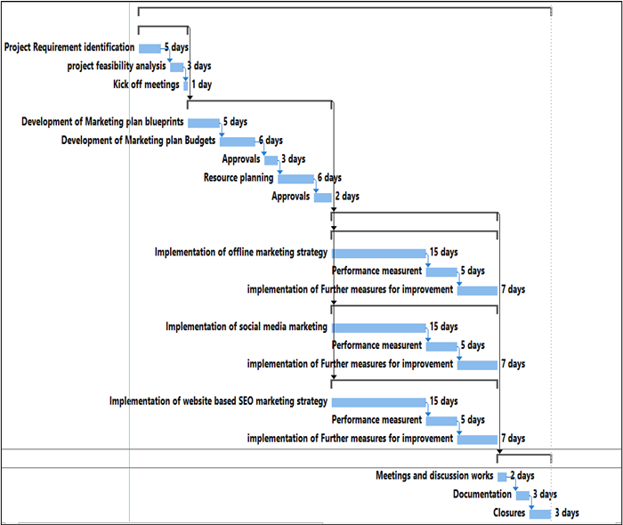
Gant Chart
Figure 1: Gantt chart

Slide 10
Stakeholders’ classification
Stakeholders | Type | Areas of interest | Ways of communication | Frequency of communication
Marketing manager | Internal Stakeholders | The ways the entire marketing and promotional strategies would be conducted, The results of the marketing and promotional campaigns (Zhuang et al. 2019) | Face-to-face, Emails and reports. | Daily
The CEO | Internal Stakeholders | Enhancements of NPL Nutritional Multivitamins’ marketing and promotional strategies (Chamidah et al. 2020 ) | Face-to-face, Emails and reports. | Weekly
Marketing management teams | Internal Stakeholders | Work requirements, Marketing content generation, ways the contents would be deployed (Civera et al. 2019) | Face-to-face, Emails and reports. | Daily
The investors | External Stakeholders | The financial gain made by the brand, the amount of financial capital that needs to be invested by them | Face-to-face, Emails and reports. | Monthly
The consumers | External Stakeholders | The benefits, NPL Nutritional Multivitamins would be providing to them | Face-to-face, Emails and reports. | By weekly
The government | External Stakeholders | The stakeholder is interested weather the project Is accomplished only after obtaining permits | Face-to-face, Emails and reports. | As and when required
Law enforcement agencies | External Stakeholders | The Marketing as well as promotions operations, complies with the legal codes of conduct. | Face-to-face, Emails and reports. | As and when required
Table 2: Stakeholder classification

Slide 11
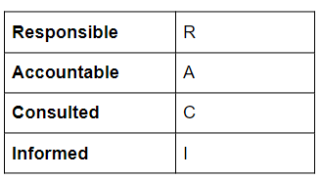
Resources Allocation
Tasks | Marketing manager | The CEO | Marketing management teams | The investors | The consumers | The government | Law enforcement agencies
Initiation | R A C I | C I | R A C I | I | I | C I | C I
Planning | R A C I | C I | R A C I | I | I | C I | C I
Offline marketing | R A C I | C I | R A C I | I | I | C I | C I
Social media marketing | A C I | C I | R A C I | I | I | C I | C I
website based SEO marketing strategy | A C I | C I | R A C I | I | I | C I | C I
Closure | A C I | C I | R A C I | I | I | C I | C I
Table 3: Responsibility Allocation Matrix
(Source: Influenced from Suhanda, and Pratami, 2021)

Slide 12
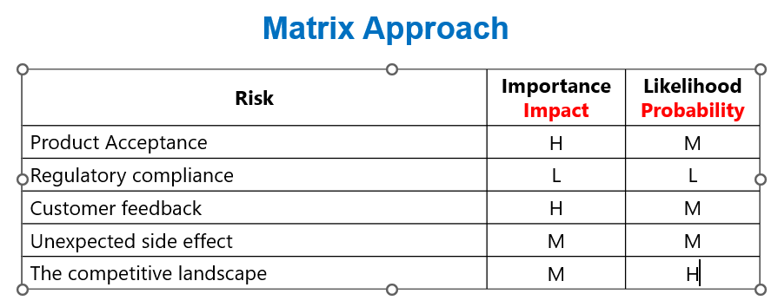
Risk Analysis
Despite the temptation of creating a new product, it is risky and, if ignored or unforeseen, could rapidly turn the promise of success into the perdition of failure.
Product acceptance: Sales and market penetration could be affected if the target market does not fully embrace or adopt the new product due to competition, lack of awareness, or customer preferences for existing alternatives (Brebbia, 2013).
Regulatory compliance: Non-compliance with applicable laws and regulations during the product launch poses a significant risk in the highly regulated pharmaceutical industry.
Customer feedback and unexpected side effects may arise, so it is essential to establish effective procedures for handling complaints, addressing concerns promptly, and ensuring the safety and effectiveness of the product.
The competitive landscape carries a certain level of risk as competitors may introduce similar products or employ aggressive marketing strategies, which can impact the market share and profitability of Vita-Sport Pro.

Slide 13

Conclusion
To ensure the successful execution of the Vita-Sport Pro launch project, it is crucial to have a clearly defined scope, a streamlined work breakdown structure, active stakeholder involvement, efficient resource allocation, and proactive risk mitigation.
The project can attain its goals, fulfil stakeholders' desires, and contribute to the company's expansion and triumph by considering these factors.

Slide 14
References
Brebbia, C.A. (2013) Risk analysis VIII. Southampton: Wit Press.
Brady, E., Cravens, D.W., Maister, D.A., Peter, J.P., Thompson, A.A. and Walker, O.C. (2007) Strategic marketing. North Ryde, Nsw: Mcgraw-Hill Custom Publishing.
Chamidah, N., Guntoro, B. And Sulastri, E., (2020). Marketing communication and synergy of pentahelix strategy on satisfaction and sustainable tourism. The Journal of Asian Finance, Economics and Business, 7(3), pp.177-190.
Civera, C., De Colle, S. and Casalegno, C., (2019). Stakeholder engagement through empowerment: The case of coffee farmers. Business Ethics: A European Review, 28(2), pp.156-174.
Frost, E., (2012). So What’sa Quad Chart, Exactly?: Exercises in Genre. GRASSROOTS WRITING RESEARCH JOURNAL, p.113.
Harlow, V.K. and Azoury, K. (2003) ‘SCENARIO-BASED FINANCIAL PLANNING: A NEW TOOL FOR UTILITY MANAGERS’. Proceedings of the Water Environment Federation 2003(9), pp. 63–72. doi: https://doi.org/10.2175/193864703784639561.
Klingebiel, R. and Rammer, C. (2013) ‘Resource allocation strategy for innovation portfolio management’. Strategic Management Journal 35(2), pp. 246–268. doi: https://doi.org/10.1002/smj.2107.
Lane, N. (2020) ‘Special issue: strategic sales and strategic marketing’. Journal of Strategic Marketing 17(3-4), pp. 189–190. doi: https://doi.org/10.1080/09652540903064621.
Suhanda, R.D.P. and Pratami, D., (2021). RACI matrix design for managing stakeholders in project case study of PT. XYZ. International Journal of Innovation in Enterprise System, 5(02), pp.122-133.
Zhuang, T., Qian, Q.K., Visscher, H.J., Elsinga, M.G. and Wu, W., (2019). The role of stakeholders and their participation network in decision-making of urban renewal in China: The case of Chongqing. Cities, 92, pp.47-58.

