Slide 1
BREEAM
Energy & Resource Management
(ACBA7003)
Lara Hopkinson

Slide 2
Topic for today
BREEAM:
  Primary aim?
  Strengths
  Weaknesses
  Opportunities

Slide 3
What does it stand for?
BREEAM:
Building
Research
Establishment
Environmental
Assessment
Method

Slide 4
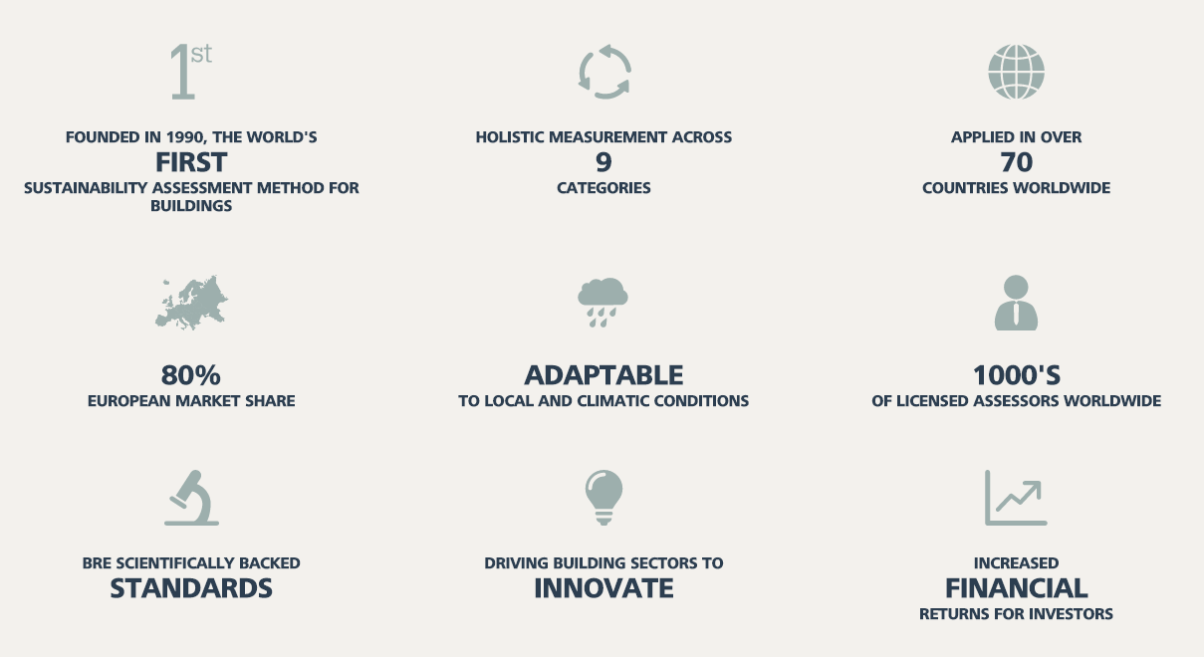
BREEAM at a glance
Source: www.bream.com

Slide 5
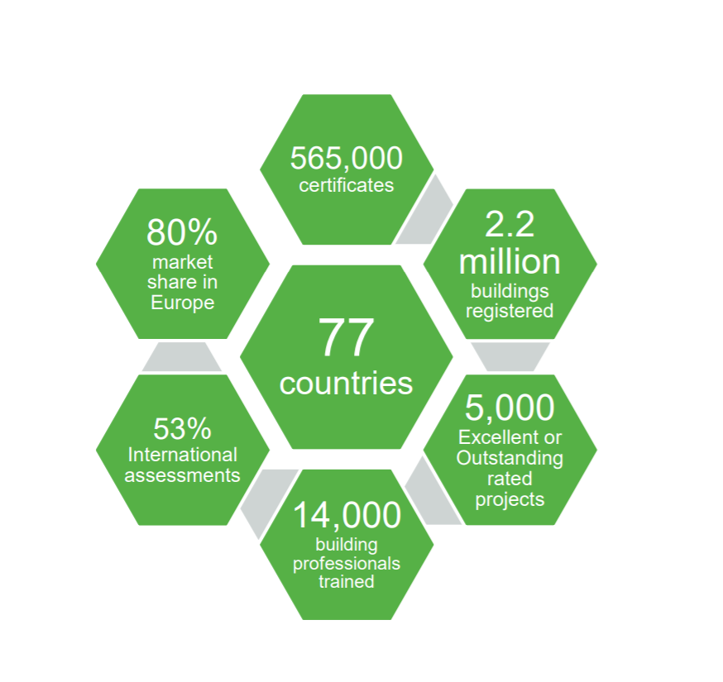
BREEAM in numbers

Slide 7
BREEAM ratings
Six differing ratings:
Outstanding ≥85%
Excellent ≥70%
Very good ≥55%
Good ≥45%
Pass ≥30%
Unclassified <30%

Slide 8
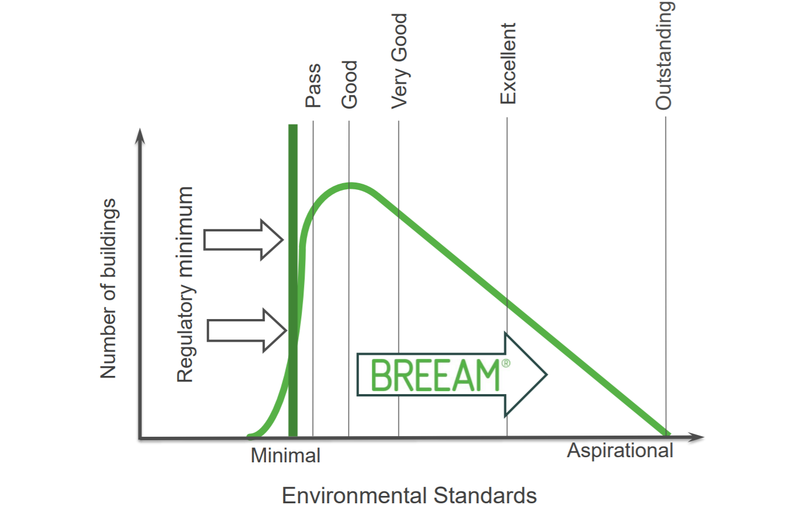
Going beyond regulations

Slide 9
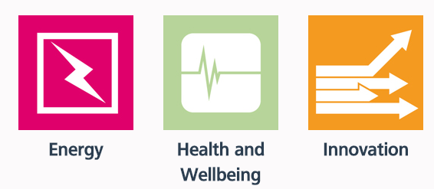
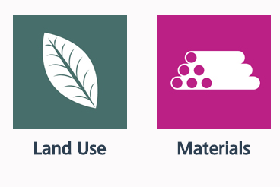
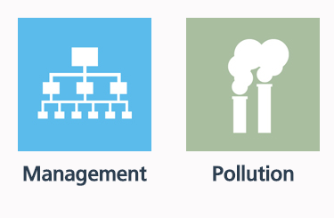
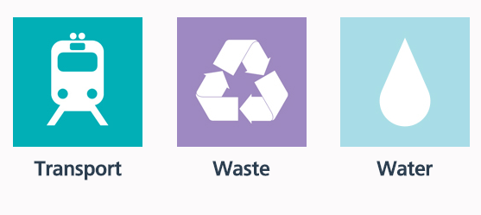
Categories

Slide 10

Innovation credit

Slide 11
Some innovation examples…
Date of decision | Innovation title | Innovation aim
01 Oct 2020 | Collection of urine from toilets for fertiliser | With an innovative recycling method, valuable nutrients recovered from urine can be made into fertiliser. As well as conserving natural resources, this reduces water pollution.
24 March 2020 | Single use plastic tracker | The innovation is to eliminate single-use plastics (SUPs) in the construction industry, and focuses on SUPs packaging, during manufacturing, delivery, on site storage of the materials to be used at the project, as well as at SUPs usage on site for welfare purposes.
02 March 2020 | A blue-green roof system | This proposal offered geo-technical benefits for storm water attenuation and surface water run-off management, and ecological benefits for local biodiversity while managing unique engineering and ecological challenges in widely varying extreme weather conditions.

Slide 12
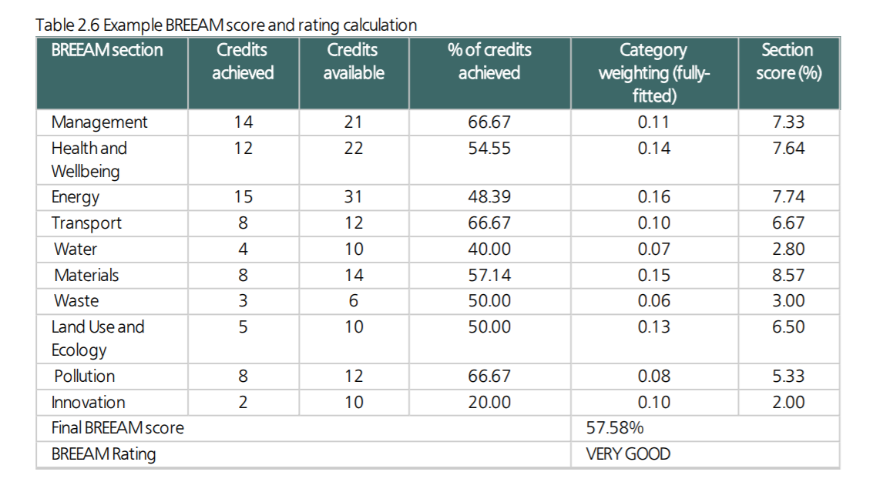
Example BREEAM score & rating

Slide 13

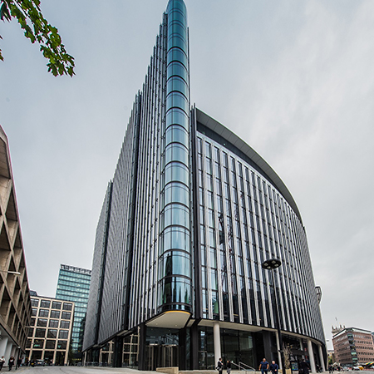

Exemplar – post construction

Slide 14
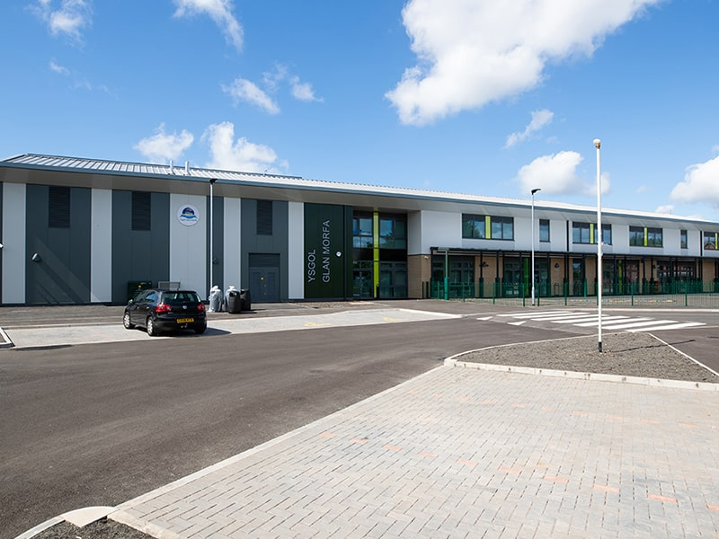
Exemplar – post construction public building

Slide 15
Strengths?
Allows comparison & benchmarking of different buildings
Independently audited
Adjusted to UK legislation and culture
Backed by UK Government
  Require BREEAM ratings on public buildings
Can assess any building with Bespoke version
  Can also adapt to local contexts
Based on carbon dioxide
More academic & rigorous

Slide 16

Weaknesses?
Very exacting requirements
  ‘Paper chase’
Complex weighting system
Market profile
Cost of compliance
No “one size fits all”
Based on carbon dioxide?
Source: www.stvincentplaza.com

Slide 17
Sources of information
Planning Portal (www.planningportal.gov.uk)
BREEAM (www.breeam.com)
UK Government (www.gov.uk)
Journal papers (on moodle)
  Also try Science Direct (www.sciencedirect.com)
  UWTSD library catalogue (http://librarycatalogue.uwtsd.ac.uk/)

