Slide 1
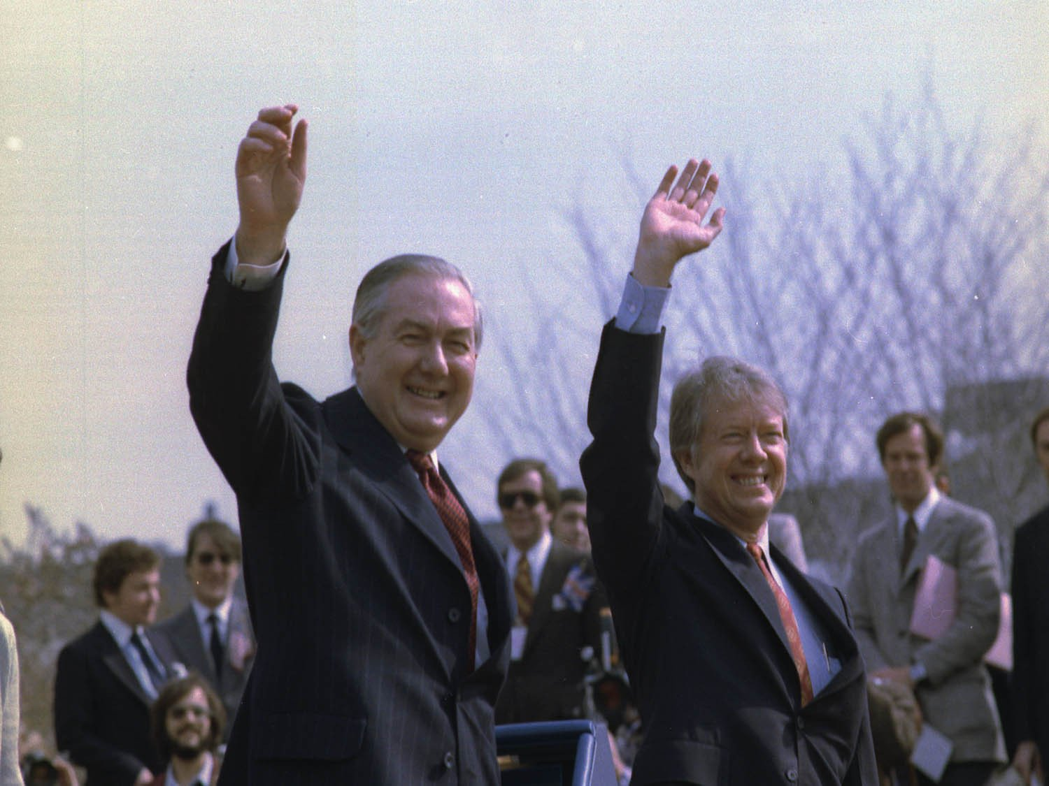
Crisis, What Crisis?
Thatcher, 1970s Britain and the End of Post-WWII ‘Consensus’

Slide 2
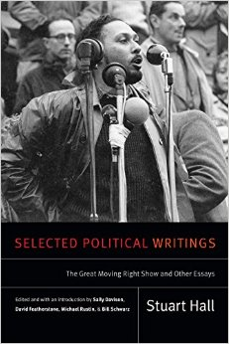
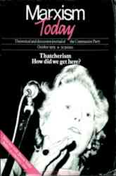
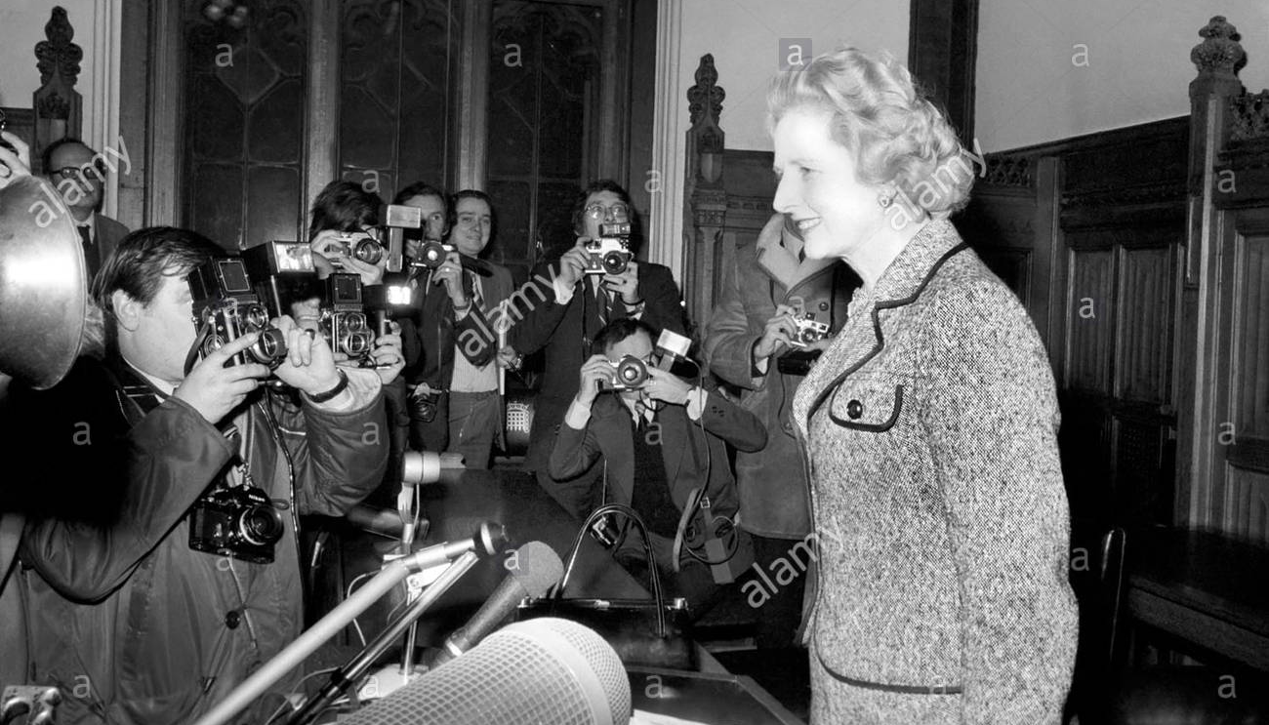
Defining Thatcherism
Stuart Hall, ‘The Great Moving Right Show ,’ Marxism Today, January 1979, pp. 14–20.
Noted “the emergence of ‘Thatcherism’” and a decisive shift in British politics since Margaret Thatcher’s election as Conservative Party leader (and ergo leader of the opposition) in February 1975

Slide 3
Defining Thatcherism
“No one seriously concerned with political strategies in the current situation can now afford to ignore the ‘swing to the Right.’
“ … The commonest response on the Left is probably to interpret the ‘swing to the Right’ as a simple expression of the economic crisis. Thus ‘Thatcherism’ is – give or take one or two elements – the corresponding political bedfellow of a period of capitalist recession: the significant differences between this and other variants of Tory ‘philosophy’ being conceived as without any specific pertinent political or ideological effects.
“This position neglects everything particular and specific to this historical conjuncture.”

Slide 4
DEFINING THE CRISIS
“ … In economic terms, Britain's structural industrial and economic weakness emerges in the immediate aftermath of the post-war boom. The 1960s are marked by the oscillations between recession and recovery, with a steady underlying deterioration …. By the end of the 1960s, the economy has dipped into fullscale recession – slumpflation … By the mid-1970s, the economic parameters are dictated by a synchronization between capitalist recession on a global scale, and the crisis of capital accumulation specific to Britain. Domestic politics has thus been dominated by crisis management and containment strategies: dove-tailed through an increasingly interventionist state, intervening both to secure the conditions of capitalist production and reproduction.”
Hall, ‘The Great Moving Right Show’

Slide 5
Defining Thatcherism:
End of Post-WWII ‘Consensus’
“‘Thatcherism’ succeeds … by directly engaging the ‘creeping socialism’ and apologetic ‘state collectivism’ of the [Edward] Heath [Conservative Prime Minister, 1970–1974] wing. It thus centres on the very nerve of consensus politics, which dominated and stabilized the political scene for over a decade. Of course, it aims for a construction of a national consensus of its own. What it destroys is that form of consensus in which social democracy was the principal tendency.”

Slide 6
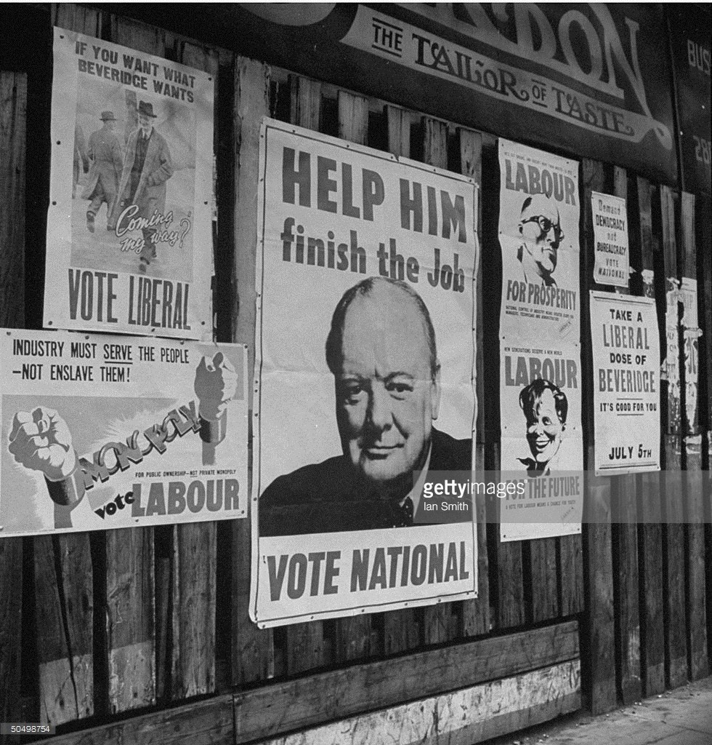
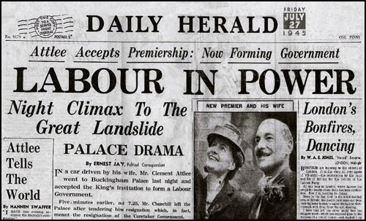
1945 General Election
Attlee Government, 1945–1951

Slide 7
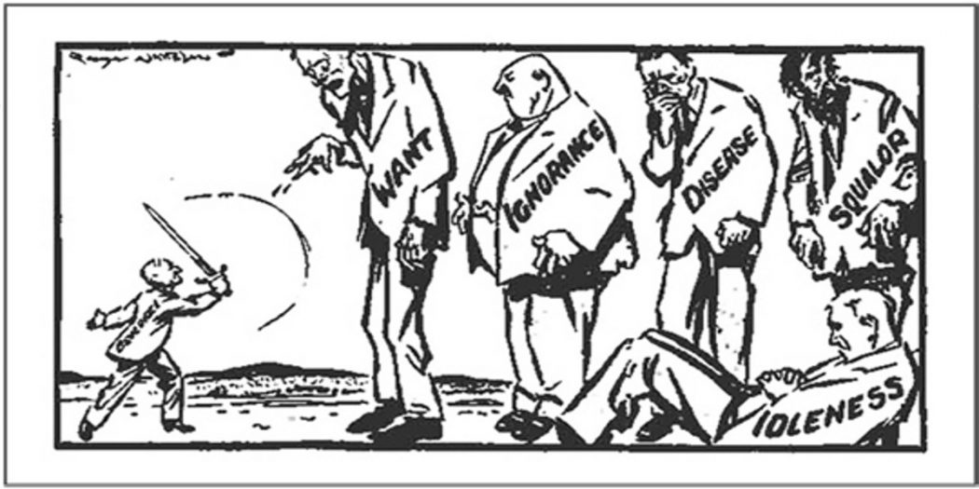
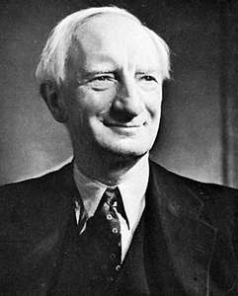
The Beveridge Report, 1942
William Beveridge
(1879–1963)

Slide 8
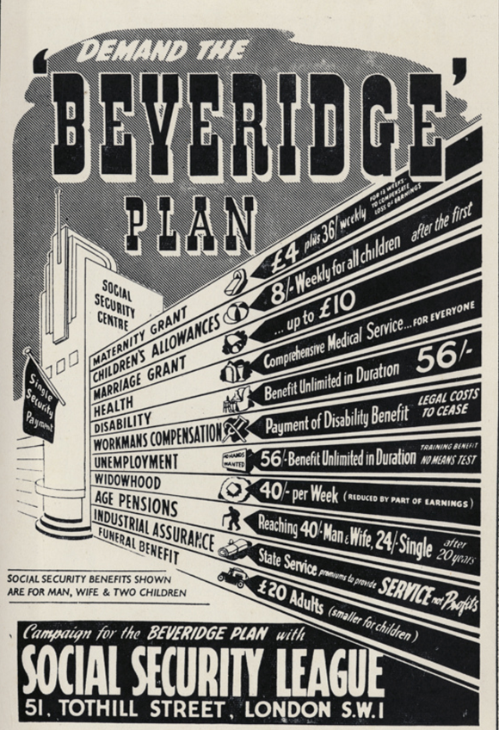
The Beveridge Report, 1942
Beveridge's five giants
Want: The need for an adequate income for all
Disease: The need for access to health care
Ignorance: The need for access to educational opportunity
Squalor: The need for adequate housing
Idleness: The need for gainful employment
Note: both Beveridge and JM Keynes were members of the Liberal Party (i.e. not Labour or Conservative)

Slide 9
Attlee Government, 1945–1951
Reforms to address Want
National Insurance Act 1946
provided financial protection in the event of unemployment and sickness
elderly received state pensions
Est. standardised minimal living conditions for the employed
Industrial Injuries Act 1946
Provided financial relief for those who were temporarily absent from work, and for those absent long-term
National Assistance Act 1948
Provided financial assistance for the unemployed or those who had not paid enough contributions into the National Insurance scheme
Provided for the elderly who had not been paying into the National Insurance scheme during their lives
Est. standardised minimal living conditions for the unemployed

Slide 10
Attlee Government, 1945–1951
Reforms to address disease
National Health Service Act 1948
-the National Health Service (NHS) was established in 1948, provided free access to medical care
Reforms to address squalor
New Towns Act 1946
twelve new towns were planned in order to reduce overcrowding
Housing Act 1949
councils could buy houses in disrepair and make improvements
householders could apply for assistance to make improvements

Slide 11
Attlee Government, 1945–1951
Reforms to address ignorance
Education Act 1944
all local authorities had to provide primary, secondary and further education
free education was available for all until the age of 15
Reforms to address idleness
Labour Government nationalised (brought under Government control) industries in Britain in order to create and maintain job levels. This included industries such as:
    Steel iron gas
    Coal electricity railways

Slide 12
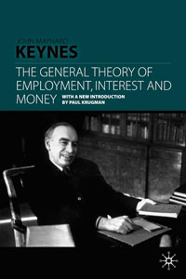
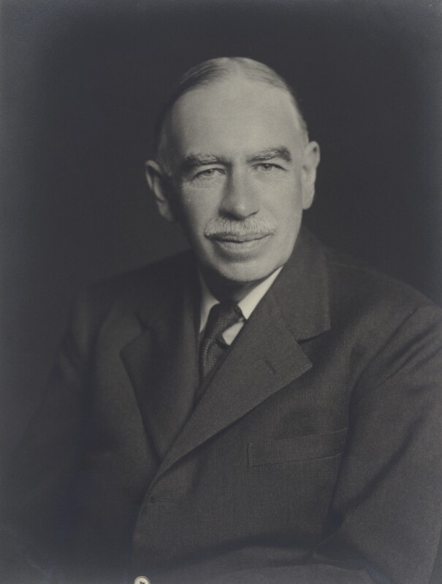
Keynesian Economics
INTERVENTIONIST: acknowledges limitations and problems with laissez-faire, and that sectors of the economy are better managed by a centralised state and the need for governments to make investments and spending commitments to stimulate economic prosperity
DEMAND-SIDE: argues that economic growth is most effectively created by high demand for products and services
FULL EMPLOYMENT: focus on people being in work and contributing taxes
COUNTERCYCLICAL FISCAL POLICY: during boom periods, governments ought to increase taxes or cut spending; during periods of economic woe, the government should undertake deficit spending
‘TAX AND SPEND’ and WEALTH REDISTRIBUTION
See also: BBC/Open University, ‘John Maynard Keynes,’ Masters of Money (2012): https://www.youtube.com/watch?v=CkHooEp3vRE
John Maynard Keynes
(1883–1946)

Slide 13
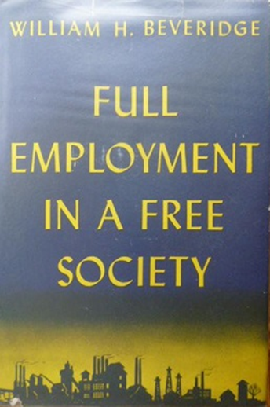
The Post-War Consensus
1. Governments accepted a commitment to maintain full employment by Keynesian techniques of economic management and intervention. Ministers would use their levers, such as cutting taxes and boosting state spending, to increase the level of economic activity.
Adapted from Dennis Kavanagh, ‘Thatcherism and the End of the Post-War Consensus,’ BBC History (2011):
http://www.bbc.co.uk/history/british/modern/thatcherism_01.shtml

Slide 14
The Post-War Consensus
2. Acceptance and some encouragement of the role of the trade unions. In contrast to pre-war years, governments recognised and consulted them regularly on workplace relations and economic policy. The unions’ access to government (e.g. Harold Wilson’s ‘Social Contract’) was increased partly by full employment and partly by governments turning, post-1961, to income policies as a way of curbing inflation.

Slide 15
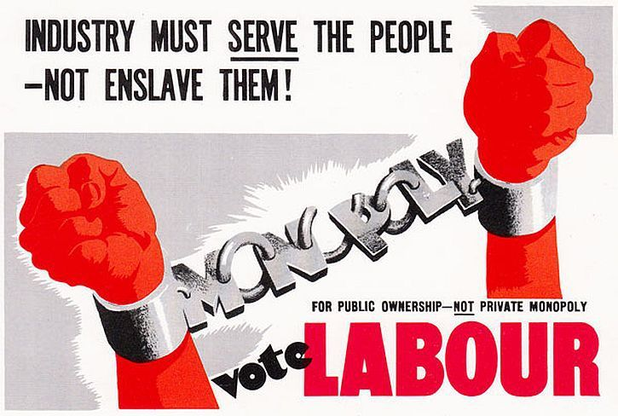
The Post-War Consensus
3. The mixed economy, with a large role for state ownership of the utilities (such as gas, electricity, coal, rail, etc.) and intervention and planning in the economy.

Slide 16
The Post-War Consensus
4. The Welfare State: object of the national insurance system and the National Health Service was to provide an adequate income and free health when a family’s income was hit by, for example, sickness, old age, unemployment or death of the main breadwinner. The services were provided out of general taxation, or insurance, and represented social citizenship.

Slide 17
The Post-War Consensus
5. There was a belief that government could play a positive role in promoting greater equality through ‘social engineering,’ e.g. by progressive taxation, redistributive welfare spending, comprehensive schooling and regional policies.

Slide 18
The Post-War Consensus
Foreign policy support for:
Transition of the British Empire to the Commonwealth
British membership of the North Atlantic Treaty Organisation (Nato)
Acquisition and retention of independent nuclear deterrent

Slide 19
1940 | PM: Winston Churchill | Wartime coalition
1945 |  | National Government (May–June)
1945 | Clement Attlee | Labour
1950
1951 | Winston Churchill | Conservative
1952
1955 | Anthony Eden
1955
1957 | Harold Macmillan
1959
1963 | Alec Douglas-Home
1964 | Harold Wilson | Labour
1966
1970 | Edward Heath | Conservative
1974 | Harold Wilson | Labour (minority)
1974 |  | Labour
1976 | James Callaghan
1977 |  | Labour (minority)

Slide 20
The Permissive Society
1967 Sexual Offences Act –decriminalised homosexual acts in private between two men aged 21+
1967 Abortion Act – legalised termination of pregnancies on certain grounds by registered practitioners, and through the National Health Service (NHS)
1967 Family Planning Act – made contraception and birth control pill readily available through the NHS
1968 Theatres Act – removed censorship provisions over plays
1970 Matrimonial Proceedings and Property Act – reformed divorce proceedings; entitled husbands and wives to equal shares of property in divorce settlements
1970 Equal Pay Act – prohibited any less favourable treatment between men and women in terms of pay and conditions of employment (in theory!)
Note: most of the above applied only to England and Wales in the first instance.

Slide 21
The Permissive Society
Efforts to legislate against racism
1965 Race Relations Act
Outlawed discrimination on “grounds of colour, race, or ethnic or national origins” in public
1968 Amendment
Extended to cover housing, public services employment

Slide 22
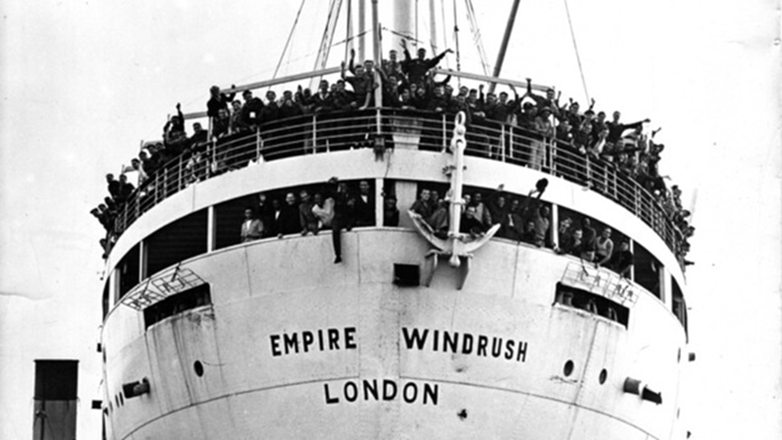
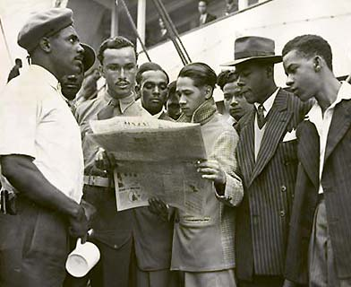
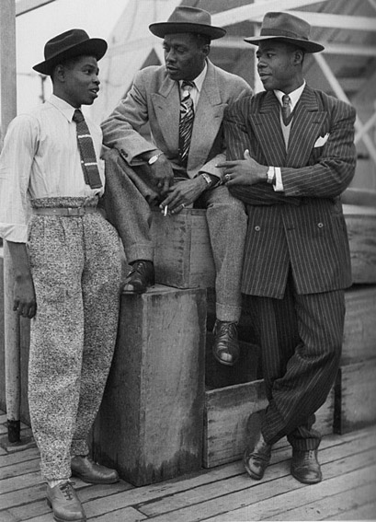
Migration in 20th-century Britain: The Windrush Generation
Arrival of West Indian migrants aboard Empire Windrush in 1948
1948 British Nationality Act officially conferred UK citizenship for people born or naturalised in either the United Kingdom or one of its colonies
Notes:
More famously, though, the years after the Second World War initiated a process of migration which brought to Britain greater numbers of men and women from the colonies than ever before
The 1948 Nationality Act officially conferred UK citizens to anybody born or naturalised within Britain and its colonies, the majority of which were in the process of transitioning to becoming independent nations within the British Commonwealth
The same year widespread publicity was generated by the arrival in London of the cruise ship Empire Windrush from Jamaica, which brought 492 passengers seeking work in Britain - many of whom had formerly served in the British military
The Empire WIndrush subsequently become a symbol for migration in the ppst-war period, to the extent that the phrase ‘Windrush Generation’ is often used as a shorthand to refer to the West Indians and South Asians who moved to Britain during the 1950s and 1960s.

Slide 23
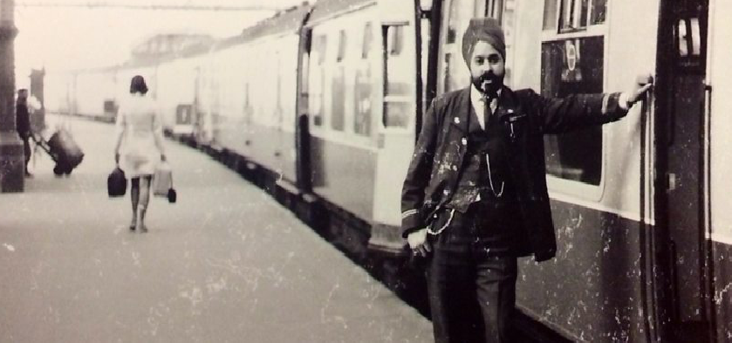
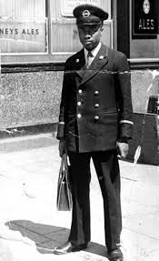
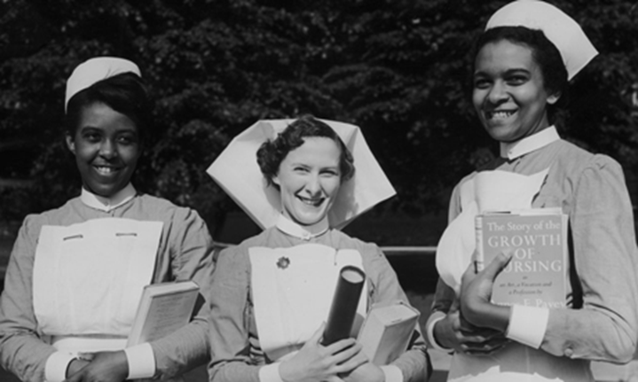
Migration in 20th-century Britain: The Windrush Generation
Recruitment by National Health Service, transport services
Cultural influences: food, music
Notes:
As already intimated, the mass migration of people from the Caribbean and the Indian subcontinent was a response to labour shortages in Britain
Seeking workers from the colonies, British companies, plus local and national state agencies, placed job advertisements in newspapers and other prominent locations overseas
The conditions for recruiting people from the colonies were advantageous because of the strategies of British imperialism: the development of economies of the colonies had been deliberately stifled to service the profits of the so-called mother country, resulting in chronic unemployment on Caribbean islands in particular
Likewise, the mismanagement of Indian independence created millions of displaced persons amongst who moving to Britain held special attraction
While migrants took up roles in every sector of the economy, special efforts were made to recruit doctors and nurses for the new National Health Service; additionally, transport authorities in London and other cities recruited West and East Indians to staff their buses, trams and trains
As well as their contribution to economy, the Windrush Generation made an equally telling impact on culture in Britain, the lifestyles of its residents and the shape of its towns and cities
The Indian, Pakistani or Bangladeshi-owned shop became a mainstay on street corners throughout urban Britain; likewise, the eating habits of many Britons was transformed by the opening of thousands of Indian curryhouses - with similar inroads made by the Mediterranean and Chinese restaurants opened by refugees from Cyprus and Hong Kong, two other onetime British colonies which suffered massive upheavals in the post-war period
Migrants also brought with them distinctive cultural habits and practices, as perhaps best exemplified by the lasting effect which various Caribbean idioms had on popular music in Britain
The first of these musical styles to make an notable impact on British airwaves was calypso, a genre combining brass and percussion instruments which originated in Trinidad and Tobago
The foremost British Calypsonian was Aldwyn Roberts, better known as Lord Kitchener, a Trinidadian who moved to Britain to pursue his music career and who was actually one of the passengers on the Empire Windrush in 1948 – show video .

Slide 24
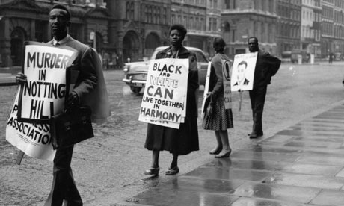
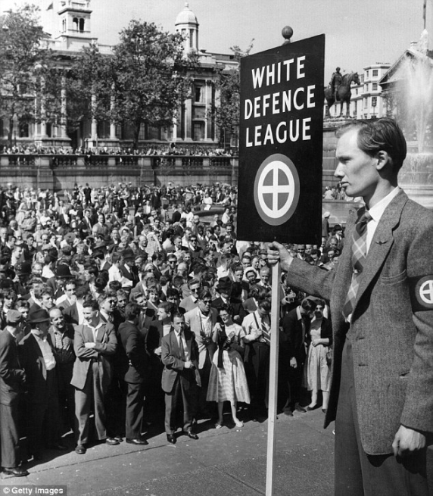
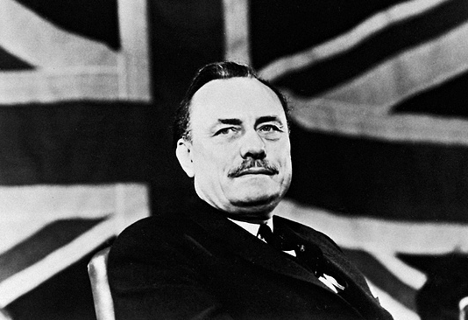
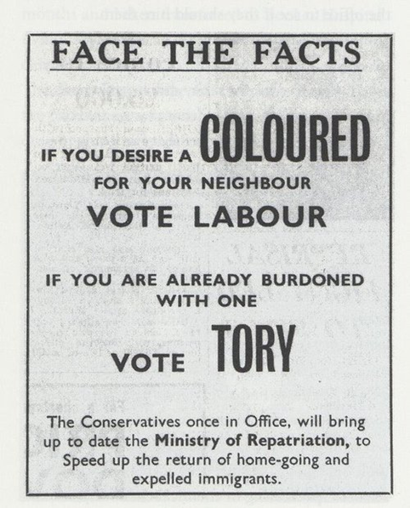
Migration in 20th-century Britain: Tensions, 1950s and 1960s
Racism and anti-immigrant sentiment pervasive in mid 20th-century – e.g. White Defence League (pictured middle)
Riots in Birmingham, Nottingham and London in 1958; white supremacist ‘Teddy Boys’ attacks on West Indians sparked mass protest by black community (above) and acted as beginnings of Notting Hill carnival
1964 General Election: flashpoint in Smethwick, West Midlands (see poster)
1968 Enoch Powell (pictured) warned of prospect of Britain “foaming with much blood” because of mass immigration
Notes:
The rosy picture painted by Lord Kitchener scarcely met the reality of life in Britain for migrants, however.
Show video – ask for comments
In interviews, Windrush pioneers typically speak of difficulty in finding reasonable accommodation, with landlords instead housing them in squalid, cramped conditions. Many were refused bank accounts or mortgage loans, with West Indians and South Asians subjected to hostility and outright racism at work or on the street
Throughout the 1950s, gangs of Teddy Boys, a subculture of white working-class males, were implicated in racially motivated disturbances and anti-immigrant sentiments coalesced around political organisations such as the White Defence League
In 1958, there were riots in English cities after white youths attacked West Indian men - the highest profile occurring in Notting Hill, London, where the black community organised a mass protest against their treatment within British society
The 1958 unrest was not just the product of the actions of isolated individuals, though
By the 1960s, racism and anti-immigration were recurrent features in British politics
At the 1964 General Election, for instance, the Conservative candidate Peter Griffiths became the MP for Smethick in the West Midlands, after running a campaign which deliberately mobilised the electorate against post-war immigrants to the town - the largest group of which were Punjabi Sikhs - mention poster
Later in the decade, another Tory, the shadow cabinet minister Enoch Powell, inflamed the mood further still when delivering a speech predicting dire consequences of mass immigration – warning that Britain would “foam with much blood” if it continued to admit migrants from the Commonwealth.

Slide 25
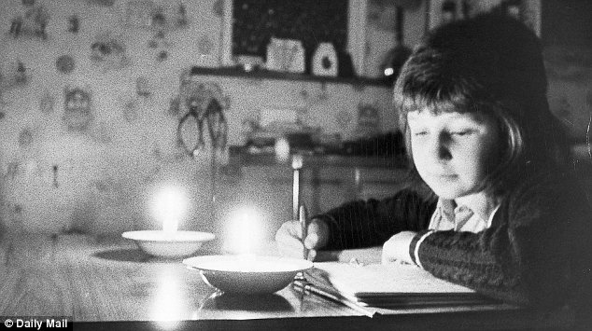
1970s Economic Crises
Three-Day Week, January 1 – March 7 1974
Commercial users of electricity limited to three specified consecutive days' consumption each week
Aim to conserve electricity owing to restricted supply of coal during miners’ strike and oil crisis caused by Organization of Arab Petroleum Exporting Countries (OPEC) trade embargo
Led to defeat of incumbent Conservative Government in two general elections in 1974 (1st producing Labour minority, 2nd small Labour majority)
IMF bailout, 1976
Financial crisis forced the government to borrow $3.9 billion from the International Monetary Fund
Unemployment
Unemployment reached 1.5million in 1978 – nearly treble the 1968 figure; national rate of unemployment exceeded 5% for the first time in the postwar era

Slide 26
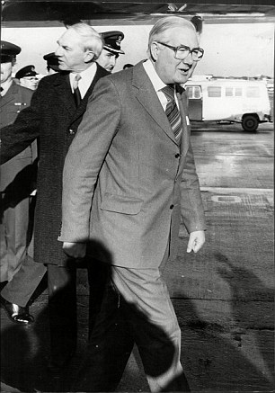
Defining the Crisis
Returning to the UK from an economic summit in Guadeloupe on January 10 1979, Prime Minister James Callaghan was asked by a journalist, ‘What is your general approach, in view of the mounting chaos in the country at the moment?”
Callaghan responded: “Well, that’s a judgment that you are making. I promise you that if you look at it from outside, and perhaps you’re taking rather a parochial view at the moment, I don’t think that other people in the world would share the view that there is mounting chaos.”
https://www.youtube.com/watch?v=dX06xqN6710:

Slide 27
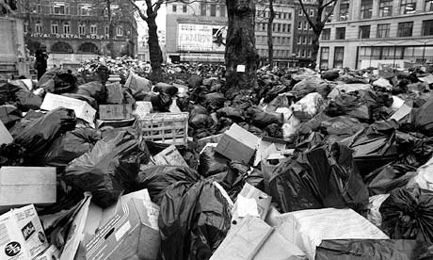
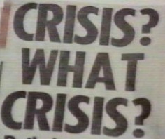
‘Winter of Discontent’
(Dec 1978–Feb 1979)
Widespread strikes by public sector trade unions against pay caps of Labour government
Lorry drivers, members of the Transport and General Workers’ Union (TGWU), inc. drivers of oil tankers went on national strike
Jan 22 biggest individual day of industrial action since the General Strike of 1926
Strikes by railway workers, ambulance drivers, nurses
Coincided with bitter weather conditions, refuse collectors, gravediggers
Leicester Square, London, 1979; Sun headline, January 11 1979

Slide 28
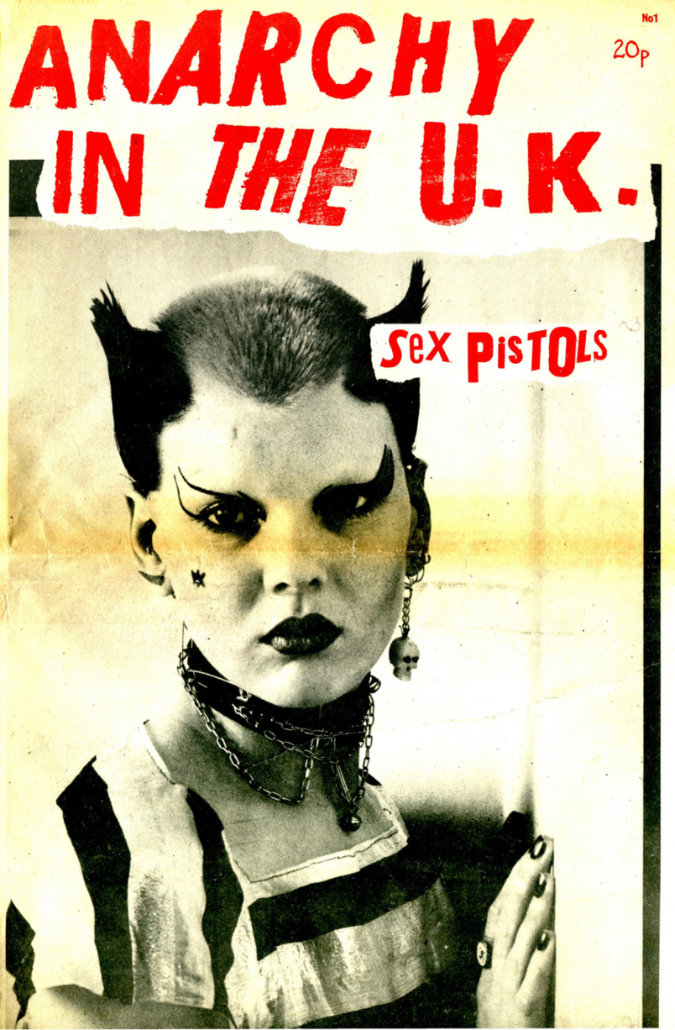

‘Anarchy in the UK’ (1977)
Right now ha, ha, ha, ha, ha
I am an anti-Christ
I am an anarchist
Don't know what I want
But I know how to get it
I want to destroy the passerby
'Cause I want to be anarchy
No dogs body
Anarchy for the UK
It's coming sometime and maybe
I give a wrong time, stop a traffic line
Your future dream has sure been seen through
'Cause I want to be anarchy
In the city
How many ways to get what you want
I use the best, I use the rest
I use the enemy [NME].
I use anarchy
'Cause I want to be anarchy
Its the only way to be
Is this the MPLA [Popular Movement for the Liberation of Angola]
Or is this the UDA [Ulster Defence Association]
Or is this the IRA [Irish Republican Army]
I thought it was the UK
Or just another country
Another council tenancy
I want to be anarchy
And I want to be anarchy
(Oh what a name)
And I want to be an anarchist
(I get pissed, destroy!)

Slide 29
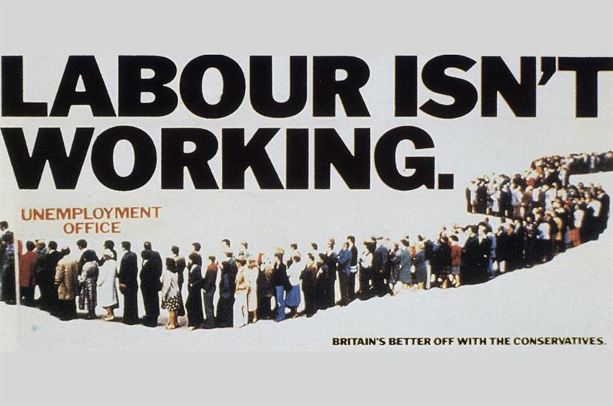
1979 General Election

Slide 30
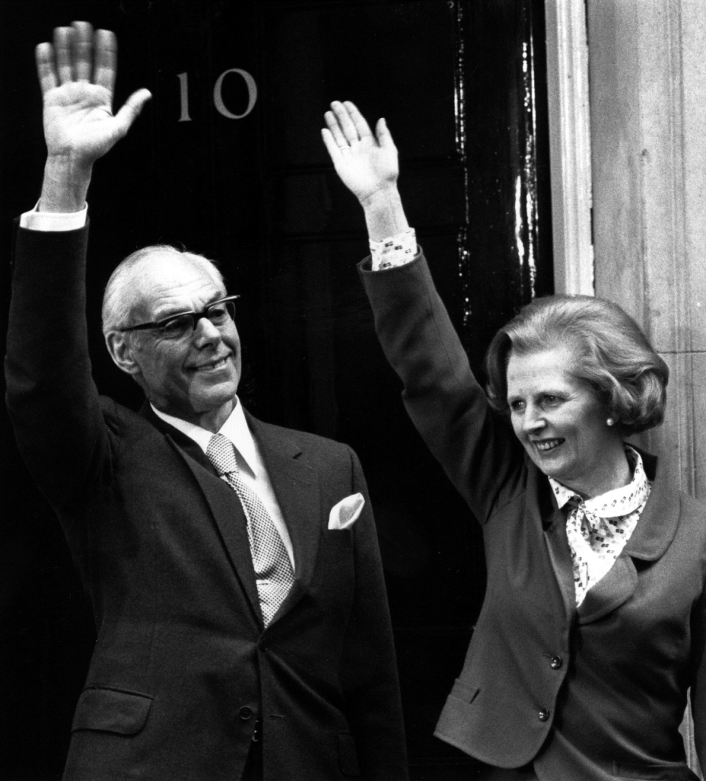
1979 General Election
“I know full well the responsibilities that await me as I enter the door of No. 10 and I'll strive unceasingly to try to fulfil the trust and confidence that the British people have placed in me and the things in which I believe. And I would just like to remember some words of St. Francis of Assisi which I think are really just particularly apt at the moment. ‘Where there is discord, may we bring harmony. Where there is error, may we bring truth. Where there is doubt, may we bring faith. And where there is despair, may we bring hope’”
Margaret Thatcher, 4 May 1979

Slide 31
From Demand side to Supply side – additional observations

Slide 32
WILLIAM BEVERIDGE
1879-1963
Oxford educated lawyer
1908 joined the Board of Trade – involved in Labour Exchange organisation and National Insurance
1914-18 involved with manpower mobilisation and at the Ministry of Food
1919-37 Director of the LSE

Slide 33
THE BEVERIDGE REPORT
The Report on Social Insurance and Allied Services’ (1942)
To counter want; disease; ignorance; squalor; idleness
All in work should pay a weekly National Insurance contribution to cover sick benefit; unemployment benefit; retirement; widows pension
Put forward on the assumption that a National Health Service of some description on the way

Slide 34
BEVERIDGE REPORT
Attempt to appeal to all parties including industry and employers: make British industry more competitive (healthier and more motivated workers); shift health and pension costs to the public account
Aim: full employment (i.e. below 3%)
Report became the basis of the new welfare state and instantly popular in the country
Implemented in a series of acts between 1945-49 covering N.I; family allowance ; pensions etc

Slide 35
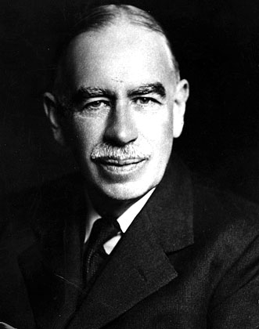
KEYNSIANISM
John Maynard Keynes (1883-1946)
Advocated a mixed economy and the active participation of the state including:
Central Bank involvement in monetary policy
Government stimulus programmes

Slide 36
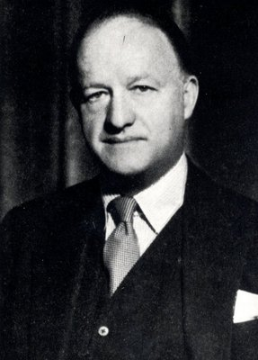
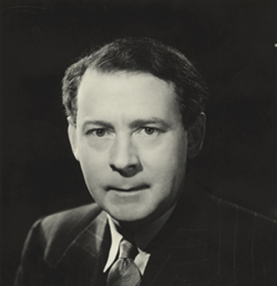
‘BUTSKELLISM’

Slide 37
‘BUTSKELLISM’
Satirical label given to the ‘Consensus’ politics and economic policy from the 1950s
Play on Rab Butler (1902-1982) Chancellor from 1952-55 under Churchill and Eden; and Hugh Gaitskill (1906-63), Chancellor 1950-51 under Attlee, and leader of the Labour Party from 1955-63
‘Consensus’ politics dominated economic policy from 1950 to the advent of Monetarism (advocating a mixed economy with state intervention over health and education policy)

Slide 38
CAPTURING ‘THATCHERISM’
1. Libertarian?:
Individual liberty and freedom
Rolling back the State – free market economics
Supply-side economics - control of the money supply
Low tax policy
‘Self Help’ approach to welfare
Privatisation of nationalised industry – steel, coal, gas and electricity,
Challenging and constraining

Slide 39
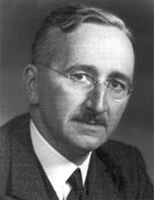
CAPTURING ‘THATCHERISM’
Friedrich Hayek (1899-1992)
Austrian-born; British citizen in 1938
Defended ‘Classical Liberalism’ and free market capitalism against socialism and collectivism

Slide 40
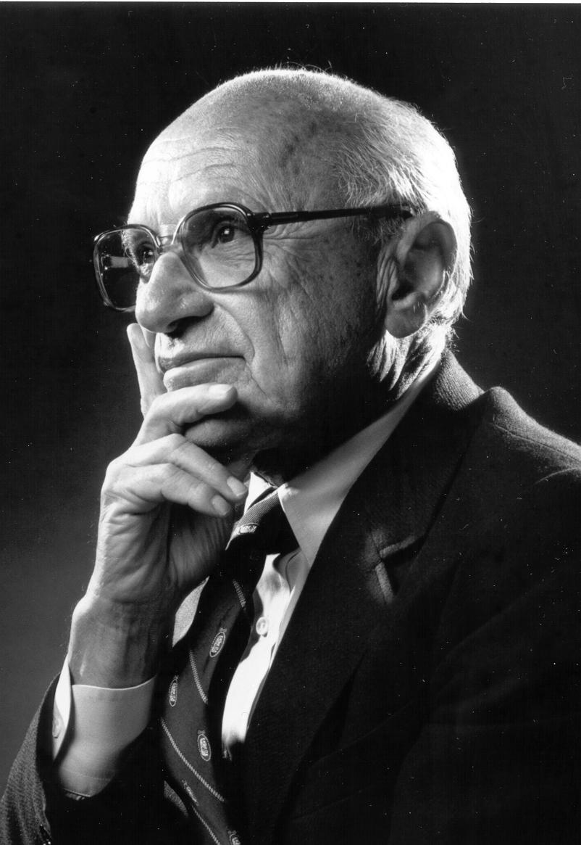
CAPTURING ‘THATCHERISM’
Milton Friedman (1912-2006)
Free market macro-economics and ‘Monetarism’
Control inflation by controlling the money supply

Slide 41
‘THATCHERISM’ contd...
Individual liberty and freedom
Minimal state involvement?
But also:
Policy of strong leadership to achieve ends e.g.
1. Law making to curb Trade Union power and the withdrawal of labour – limiting strike action and secondary picketing
2. Confrontation with miners – 1984-85
3. Privatisation of state industries – the mines, steel, energy and water industries
4. Tax Policy – late 1980s introduction of the Poll Tax (riots of 31 March 1990)

