Slide 1
LCLM5002
Developing and Managing Individuals and Teams
Student Name: Hasibull Khandeker
Student ID: 2423897
Teacher Name: Dr Doreen Nyaa Amundam

Slide 2
Table of Contents
1. Introduction
2. Company Overview
3. Job Role
4. Importance of Recruitment
5. Recruitment Process
6. Job Analysis
7. Job Description
8. Person Specification
9. Training Needs
10. Learning Theories
11. Training Methods
12. Benefits
13. Conclusion
14. References

Slide 3

Introduction
This presentation discusses how effective recruitment and employee development support organisational success.
It explains how teamwork and individual performance contribute to productivity.
Human Resource Management plays a vital role in selecting, training, and retaining skilled employees.
Source: (Lacerenza et al., 2018)

Slide 4

Company Overview – Tesco PLC
Tesco PLC is one of the largest retail companies in the UK. (Tesco PLC, 2024)
Founded in 1919, it operates supermarkets, convenience stores, and online services.
It employs over 300,000 staff and focuses on customer satisfaction and employee development.
Source: (Tesco PLC, 2024)

Slide 5

Selected Job Role
The selected job role is Customer Service Team Leader.
This role supervises staff, manages daily operations, ensures customer satisfaction, and supports teamwork within the store (Denysenko and Yurynets, 2022).

Slide 6

Importance of Recruitment
Recruitment helps organisations attract skilled employees.
Effective recruitment reduces staff turnover, improves motivation, enhances service quality, and increases organisational performance (Jordan and Troth, 2021).
Source: (Jordan and Troth, 2021)

Slide 7
Recruitment Process at Tesco
1. Identify vacancy
2. Conduct job analysis
3. Advertise job
4. Screen applications
5. Interview candidates
6. Select the best applicant
7. Offer employment
8. Provide induction training

Slide 8
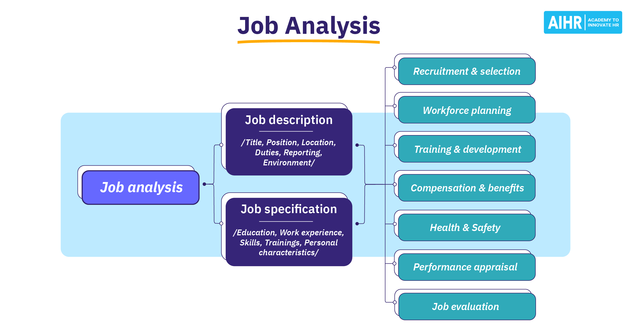
Job Analysis
Job analysis involves collecting information about duties, responsibilities, and skills.
For a Team Leader, it includes supervising staff, preparing schedules, handling complaints, and reporting performance to managers.
Source: (Edmondson and Harvey, 2018)

Slide 9
Job Description
Job Title: Customer Service Team Leader
Location: Tesco Store, UK
Main Duties:
- Lead staff
- Manage shifts
- Resolve customer issues
- Monitor performance
- Maintain store standards

Slide 10
Person Specification – Essential Requirements
Excellent verbal and written communication skills
Strong leadership and team management ability
Previous experience in retail or customer service
Essential Requirements:
Ability to solve problems effectively
Good time management and organisational skills
Basic computer and system knowledge

Slide 11
Person Specification – Desirable Requirements
Diploma or certificate in management
Desirable Requirements:
Experience in staff training or mentoring
Advanced IT and reporting skills
Knowledge of health and safety regulations
Ability to work flexible hours
Experience in performance evaluation

Slide 12
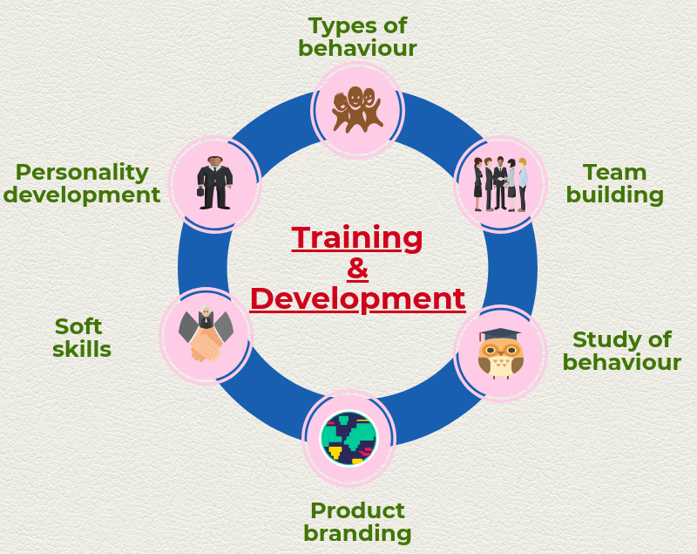
Training and Development Needs
New employees require induction training.
Team Leaders need leadership training, conflict management skills, customer service training, and digital system knowledge (Ramirez and Olson, 2020).
Source: (Boselie and van der Heijden, 2024)

Slide 13
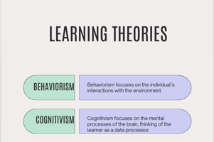
Learning Theories
Behaviourist Theory: Learning through rewards and punishment.
Cognitivist Theory: Learning through thinking and understanding (Pritchard, 2017).
Source: (Gelinas et al., 2017)

Slide 14
Learning Theories
Humanist/Experiential Theory: Learning through experience and personal growth.
Source: (Denysenko and Yurynets, 2022)

Slide 15
Training Methods at Tesco
Coaching and mentoring
On-the-job training
E-learning courses
Workshops and seminars
Performance-based rewards

Slide 16
Benefits to Organisation
Improved employee skills
Higher motivation
Better teamwork
Increased productivity
Better customer satisfaction
Reduced staff turnover

Slide 17

Conclusion
Effective recruitment ensures the right people are selected.
Training and development improve employee performance.
Learning theories help design suitable training programs.
Together, these practices support Tesco’s long-term success.

Slide 18
References
Boselie, P. and van der Heijden, B., (2024). Strategic human resource management: A balanced approach. McGraw-Hill.
Denysenko, M. and Yurynets, Z., (2022). Building teams of professionals and their role in economic development and strategic business management. Journal of strategic economic research, 1(23), pp.67-75.
Edmondson, A.C. and Harvey, J.F., (2018). Cross-boundary teaming for innovation: Integrating research on teams and knowledge in organizations. Human Resource Management Review, 28(4), pp.347-360.
Gelinas, L., Pierce, R., Winkler, S., Cohen, I.G., Lynch, H.F., and Bierer, B.E. (2017). Using social media as a research recruitment tool: ethical issues and recommendations. The American journal of bioethics, 17(3), pp.3-14.
Jordan, P.J. and Troth, A.C. (2021). Managing emotions during team problem solving: Emotional intelligence and conflict resolution. In Emotion and performance (pp. 195-218). CRC Press.
Lacerenza, C.N., Marlow, S.L., Tannenbaum, S.I., and Salas, E. (2018). Team development interventions: Evidence-based approaches for improving teamwork. American psychologist, 73(4), p.517.
Pritchard, A. (2017). Ways of learning: Learning theories for the classroom. Routledge.
Ramirez, J.J. and Olson, M.H., (2020). An introduction to theories of learning. Routledge.
Tesco PLC (2024) Tesco PLC. Available at: https://www.tescoplc.com/.

