Slide 1

Entrepreneurship

Slide 2
Mission
We are a social enterprise.
To contribute to the prevention of food waste in Swansea while also looking to help the local community.
A company that sells produce which otherwise would have been thrown away.

Slide 3
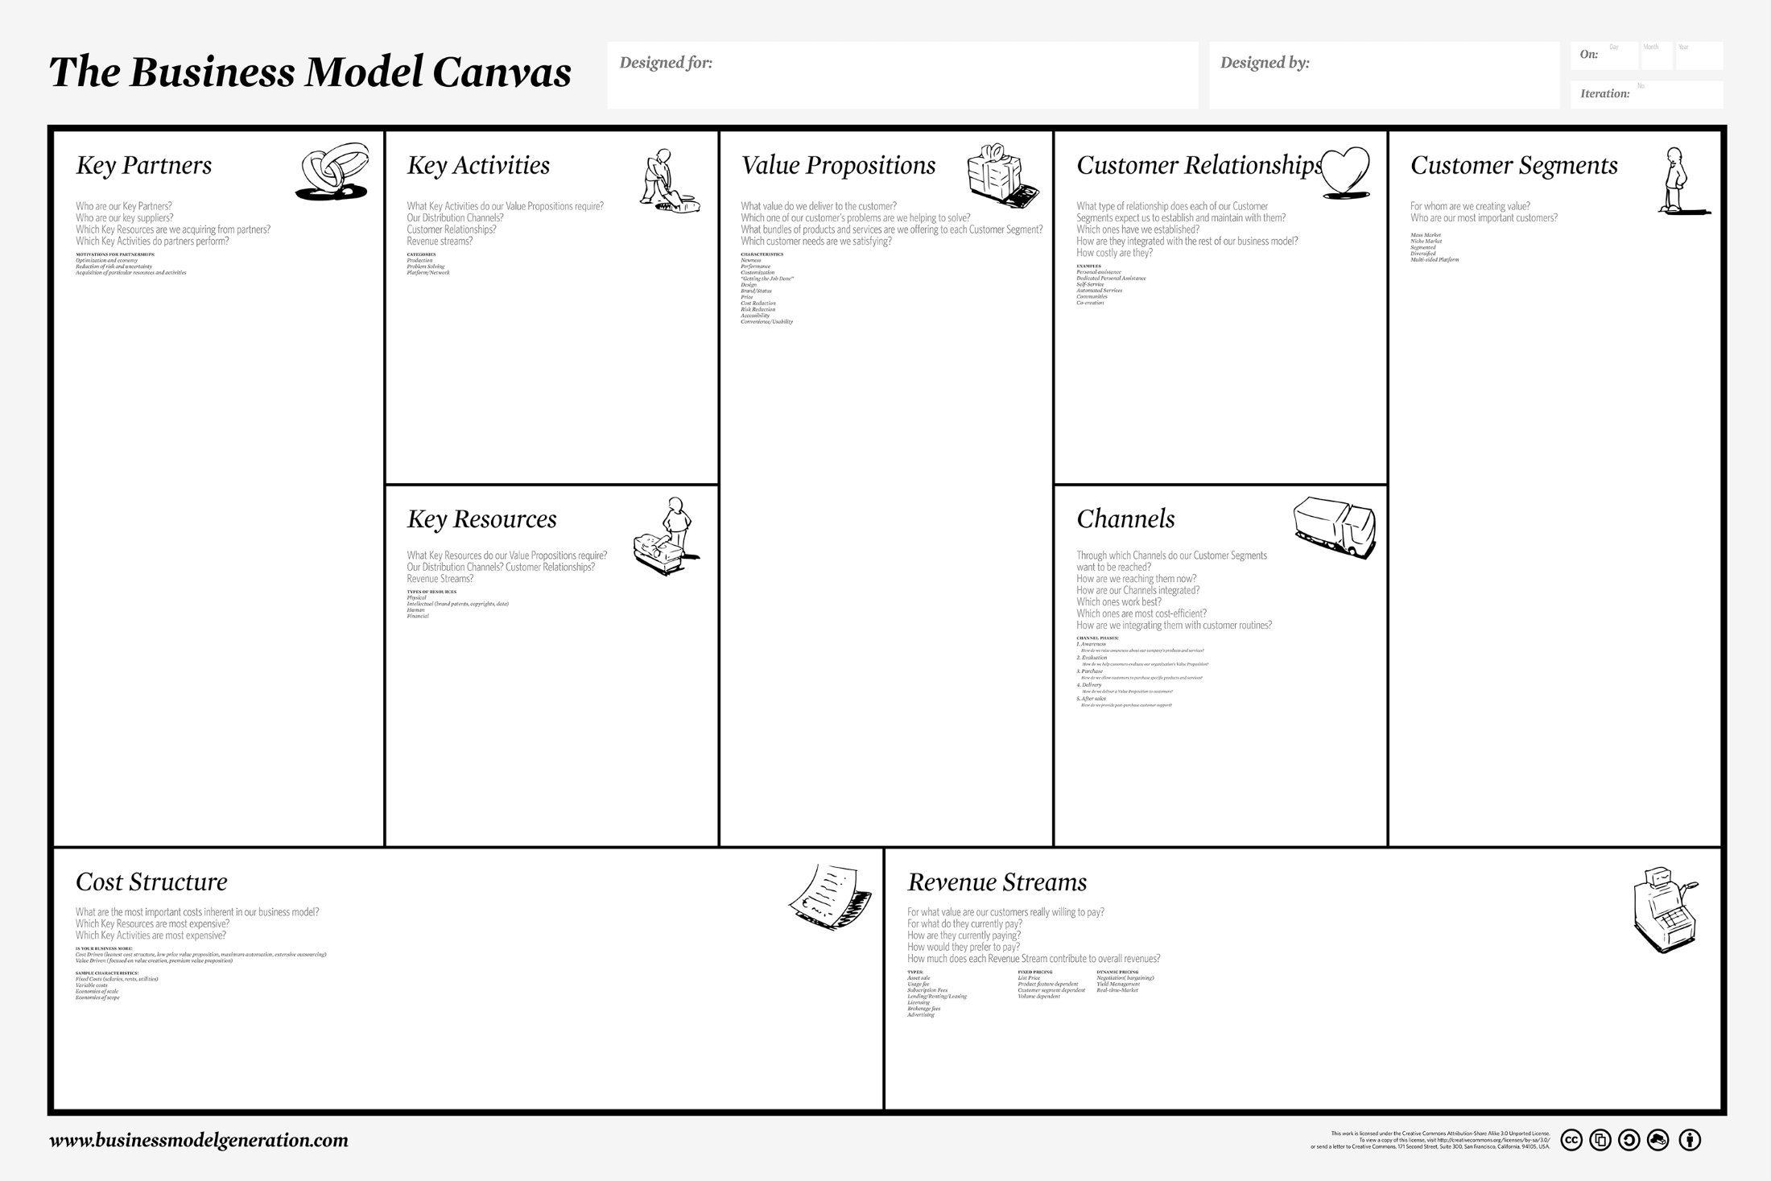
Homeless Charities (e.g shelter)
Farmers
Restaurants
Gyms
Reduce food waste
Reduce Homelessness
Reduce food waste
Reduce Homelessness
Undercut Supermarkets
Support local farmers
Special offers with gyms
Sponsor local teams
Healthy adults
Gym goers
1 in 7 uk adults gym members
(Quesnel, 2017)
Students
Very interested
People concerned with the ethics of their food.
Staff to operate
Large Financial backing
Equipment
Newspaper
Recycling target of 70% by 2025
(Messenger, 2017)
Social media
Influencers
Videos
Minimum wage of £7.50 per hour (Gov.uk, 2017)
Rent
Equipment (e.g Fridges, tills)
Marketing
Business to Business (profits lower)
Business to Consumer
Mark-up Pricing
“pricing an item by adding a standard increase to product cost” (Kotler et al., 2012)

Slide 4
Conclusion
Reliant on B2B and financial capital to start off with
Build a cult following
Developed through marketing
First mover advantage

Slide 5
Bibliography
Gov.uk. (2017). National Minimum Wage and National Living Wage rates - GOV.UK. [online] Available at: https://www.gov.uk/national-minimum-wage-rates [Accessed 21 Oct. 2017].
Kotler, P., Keller, K., Brady, M., Goodman, M. and Hansen, T. (2012). Marketing management. 2nd ed. Harlow: Pearson, p.974.
Messenger, S. (2017). Target to halve food waste by 2025. [online] BBC News. Available at: http://www.bbc.co.uk/news/uk-wales-40949771 [Accessed 2 Nov. 2017].
Quesnel, C. (2017). 2017 STATE OF THE UK FITNESS INDUSTRY REPORT - OUT TODAY. [online] The Leisure Database Company. Available at: http://www.leisuredb.com/blog/2017/5/5/2017-state-of-the-uk-fitness-industry-report-out-now [Accessed 2 Nov. 2017].

