Slide 1
Welcome to Marketing & Promoting Restaurant Facilities – BMGM6002
I will begin the Lecture at 9:30am, so use this as an opportunity to grab a beverage, access required documents or ask me any questions that you have. Please ensure that once we begin the lecture you have access to Moodle with your module handbook open.
Please ensure that during this lecture your camera remains on at all times.

Slide 2
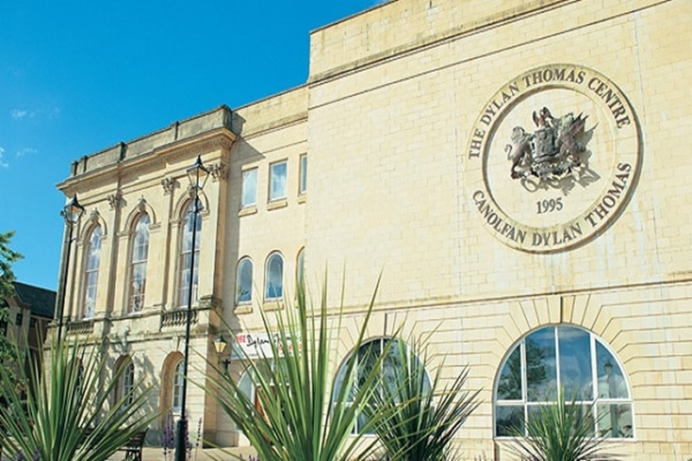
International Gastronomy Management
BMGM6002 Marketing & Promoting
Restaurant Facilities
Week 8 – Presentations & Module Feedback

Slide 3

Why is this important?
You should be using a desktop or laptop device with video, speakers and a microphone.
You will need to be able to access documents, write assignments and create presentations.
You will be asked to share your screen and “present” your work
These are all things that are either not possible or incredibly difficult to do on a phone.
Notes:
Rules of lecture : keep cameras on
We expect and plan to log student interaction, to get the best from these sessions please engage with your lecturer and ensure you contribute to discussions.
You will get out what you put in.

Slide 4

Aims for today:
Bring the Module to a close

Slide 5

Week 4 – I set you a marketing workshop task.
Today, you will present your sustainable restaurant concept to the group.

Slide 6
Workshop Tuesday 20th May
This Tuesday will be a workshop instead of our usual online session.
You will be
Creating an idea for a sustainable restaurant somewhere in Cardiff. This should include the following elements:
  Audience: Who needs your product? Decide on your audience – who are they/? How can you research them? Build a profile.
  Competition – who are they? Develop a positioning map.
  Sustainability:
    How will it fulfil the principles and pillars of sustainable gastronomy?
    What key environmental legislation and regulations will it need to comply with?
    Will any of its practices adopt the circular economy ideals (no waste/only green energy etc)?
  Decide on a name (justify that choice)
  Pick a location (explain why there)
  Deciding on the theme/décor etc (colour choices)
  How many covers will it have?
  What type of food will it serve/ what type of dining will it offer (casual, al la carte etc).
  Who will be your suppliers?
    https://about.openfoodnetwork.org.uk/swansea-food-mapping-project/
    https://foodinnovation.wales/directory/
Develop a logo (again, think colours etc) Use a free logo creation tool like
  Logo Design | Design Your Own Beautiful Logo
  SMASHINGLOGO | ‎Design a Logo You Love
Create a piece of digital content e.g. using Canva or any tool you like. The content should be focussed on launching the restaurant and should target your chosen audiences on an appropriate digital platform/s (justify your choice)
  Canva for beginners video…
https://www.youtube.com/watch?v=V9LtRF6EbyY
  Getting Started: Record a Video

Slide 7


Module Feedback
Q1. Module code: BMGM6002
Q2. Module Name: Marketing & Promoting Restaurant Facilities
Q3. Institute: Institute of Management and Health
Q4. Campus: Not based on campus
Q5. onwards………answer the most suited to you.
Module Evaluation Questionnaire (Page 1 of 8)

