Slide 1
Psychology in Health and Social Care (LCHS4010_LON)
Psychology for Health and Social Care
Lesson 04: Psychodynamic Perspectives- Understanding Self and Other’s

Slide 2
Objectives:
By the end of today’s session learners will be able to explore different psychological explanations on:
What constitutes the notion of Self in a person?
What makes a person different from others?
How Self relates with Others?
How personality traits affects teamwork and group dynamics?

Slide 3
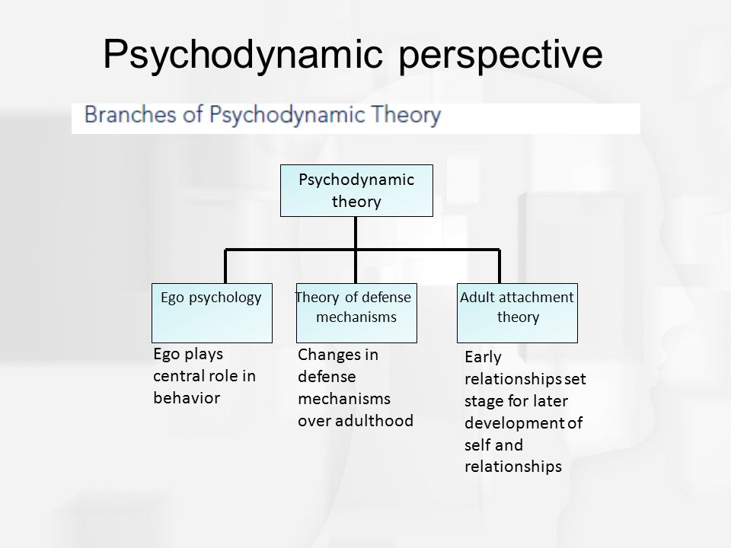

Slide 4
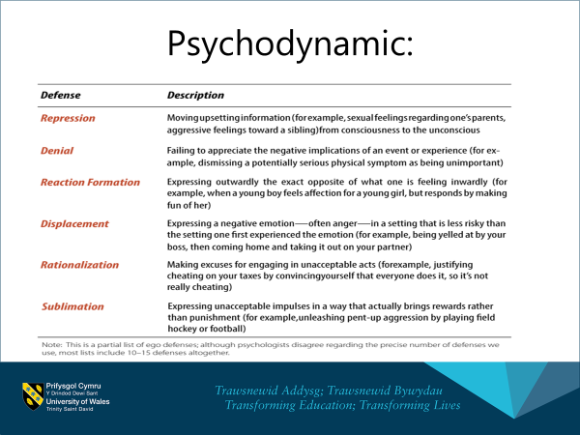

Slide 5
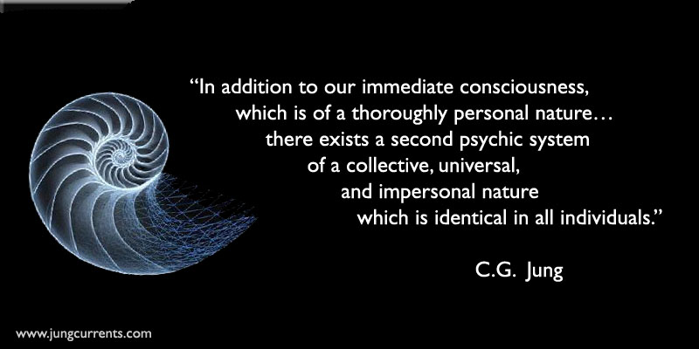
Carl Jung on Self and personality Formation

Slide 6
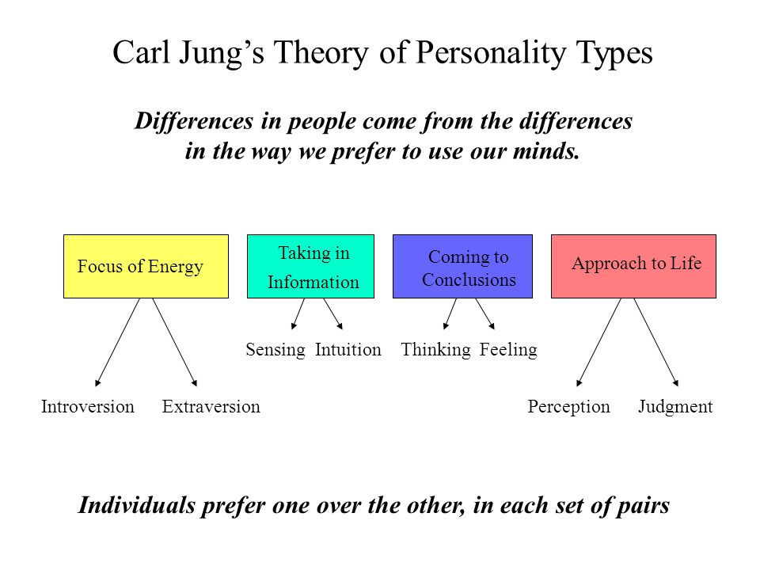

Slide 7
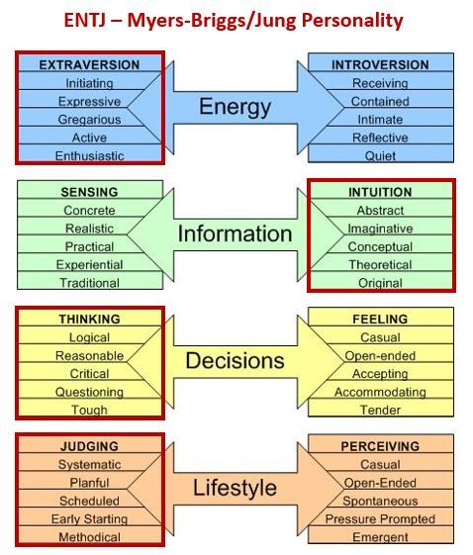
ENTJ: Extravert-iNtuitive-Thinker-Judger. Extraverts are outgoing, energetic and action-oriented.

Slide 8
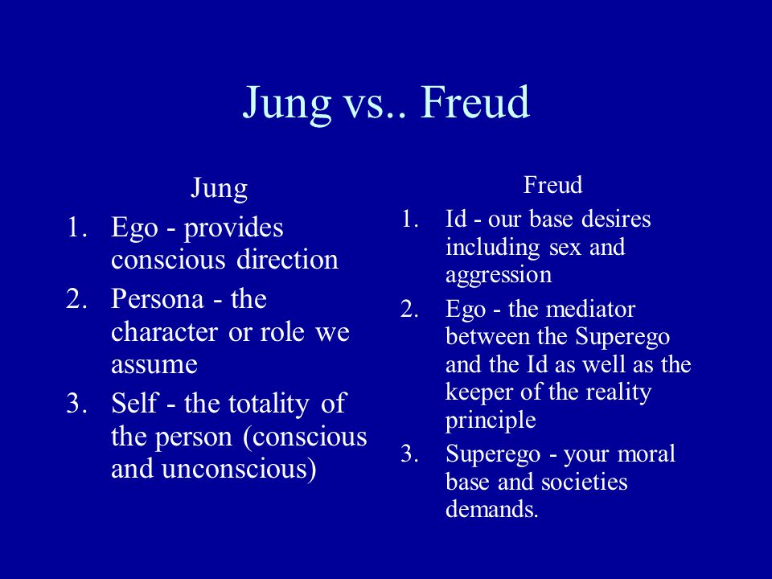

Slide 9
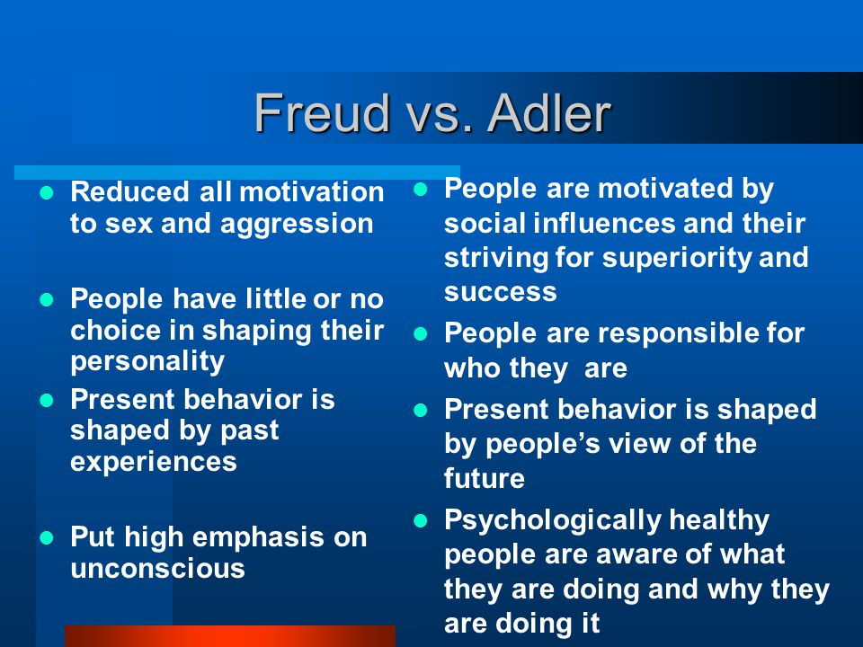

Slide 10
Personality Test
What is your personality type?
https://www.123test.com/jung-personality-test/
https://www.youtube.com/watch?v=MJUBHyxDq6Y

Slide 11
Birth Order Theory- Alfred Adler
Adler believed the social and community aspects of a person's life were just as important as internal thoughts and emotions.
Adler's desire to understand how social factors influence personality extended to child development.
His birth order theory described how the family environment shaped a child's thoughts and behaviours.
Birth order personality traits are not necessarily present when a child is born into a family. For example, the first child is not born with specific personality traits ingrained in his or her psyche.
Instead, in birth order theory, Adler illustrates how family environments and dynamics play a role in shaping personality during a child's formative years.

Slide 12
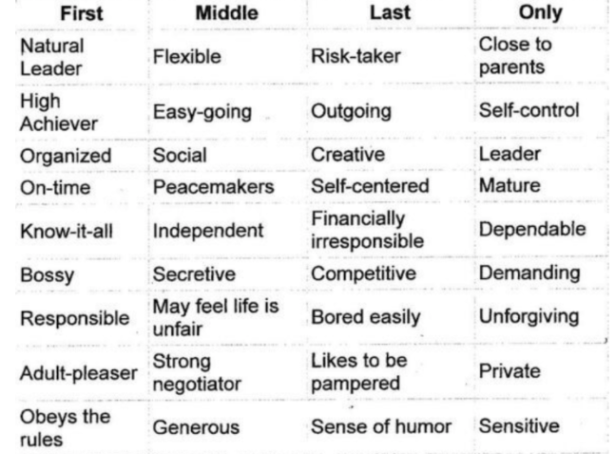

Slide 13
Seminar 05:
How Self relates with Others
Work in groups and develop a 5 min role play identifying:
How personality traits affect social and professional relationship dynamics?

Slide 14
References:
Kilmann, R.H. and Thomas, K.W., 1975. Interpersonal conflict-handling behavior as reflections of Jungian personality dimensions. Psychological reports, 37(3), pp.971-980.

