Slide 1

Health and Safety In Housekeeping
Jomirun Nessa 2212101

Slide 2
What will we talk about?
What you will be handling
Our Responsibilities for your health and safety
Your responsibility for health and safety
First Aid Response
Emergency Response

Slide 3
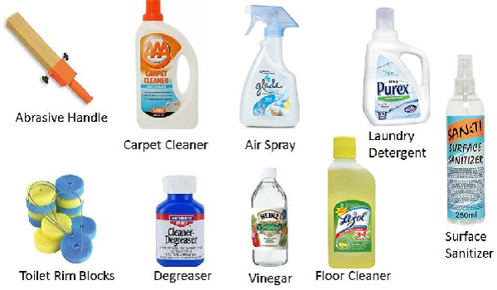
What will you be handling?
In housekeeping, you will be dealing with a handful of chemical disinfectants. These chemicals can cause a range of issues when misused. Not only can you harm yourself, but you can also harm your coworkers and even guests.

Slide 4
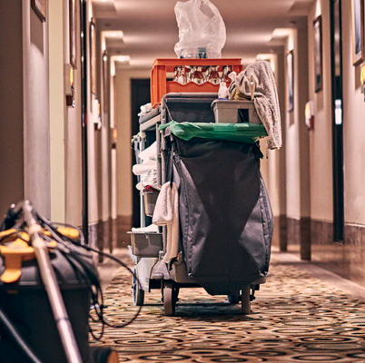
Our Responsibilities
At Hilton hotel, we will make sure never to put any of our employees in dangerous situations or have them use chemicals proven to be highly dangerous. We will never put you around chemicals that cause issues on contact.

Slide 5
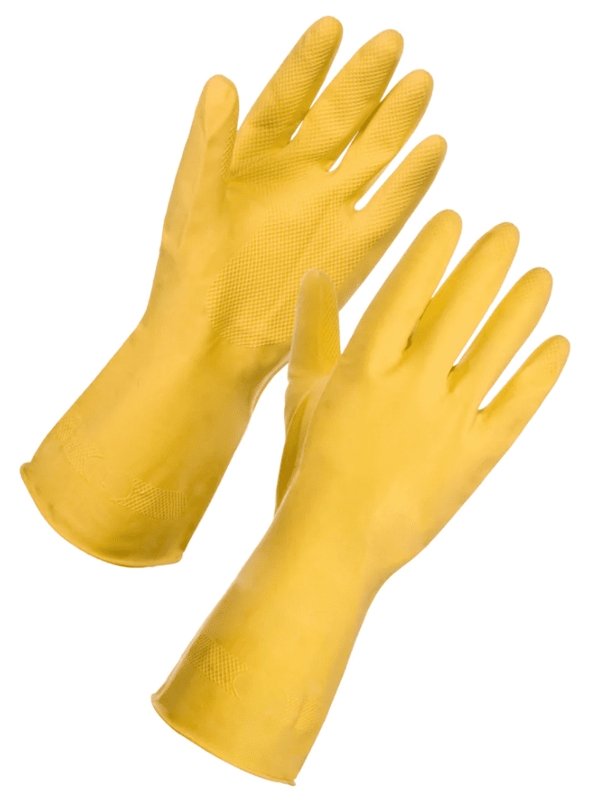
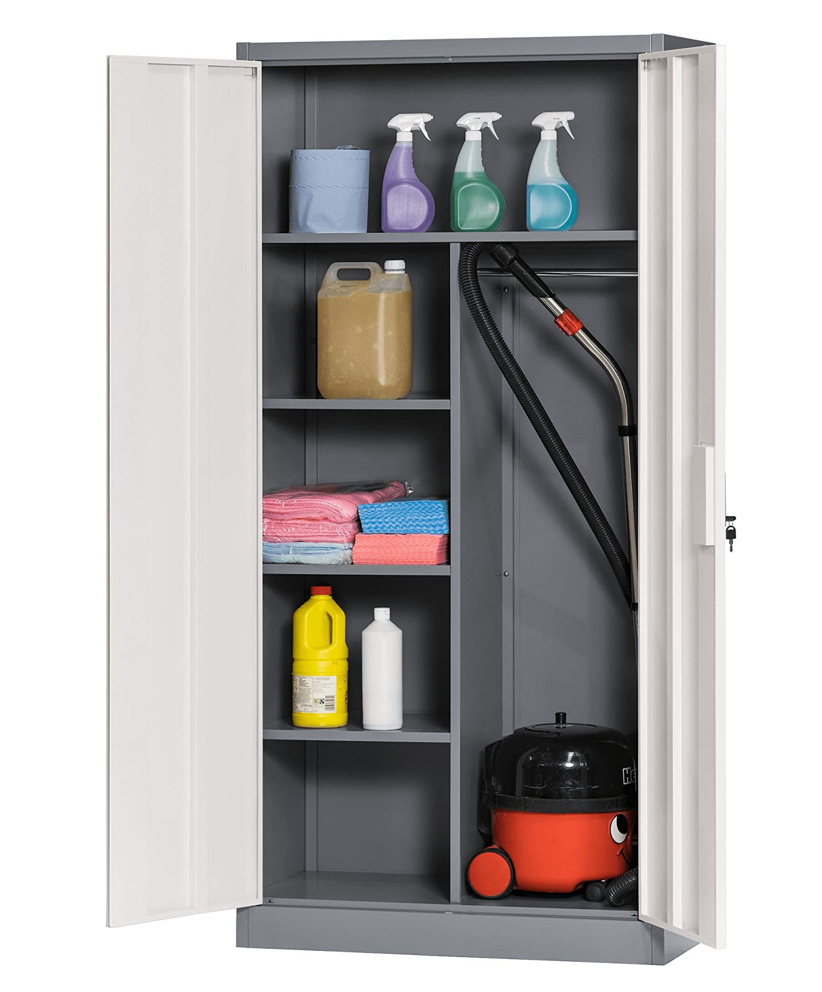
Your Responsibilities
Make sure you wear gloves when using any of the cleaning chemicals
Make sure to tightly seal ALL cleaning supplies/ put them in locked
Do not leave anything out in reach for small children
Account for every supply, and make sure that everything is back to where it is supposed to be

Slide 6
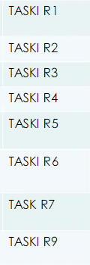
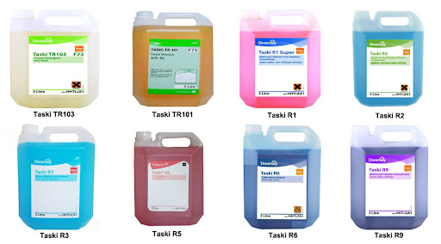
What cleaning chemicals you will be dealing with?
Most hotel chains use the TASKI R Series of cleaning chemicals. These chemicals are CAN cause irritation when applied to skin. As well as this, heavy amounts of these chemicals can cause problems by the fumes.

Slide 7
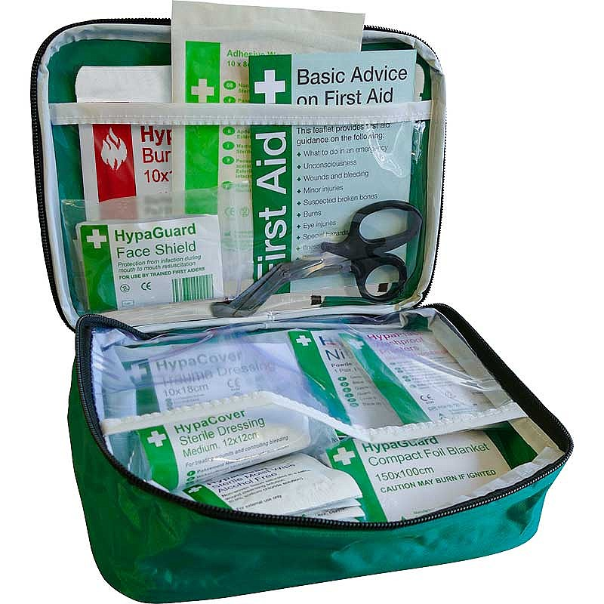
In case of minor injuries;
A first aid kit is located on every floor. If there is anyone who appears to have minor burns or cuts, use the first aid kit and follow the instructions. If these do not work, contact emergency services immediately.

Slide 8

In case of injuries needing Emergency care;
Contact Emergency services immediately. Put the person in a position that is comfortable for them and make sure that the danger is not in a place the patient can touch.

Slide 9

In Conclusion
Handle all chemicals with great care, and make sure to note everything. It may seem to be a non-issue, but it can be the difference between someone going to the Emergency Room or not
When an incident does occur, follow the instructions on important life-saving equipment.

Slide 10
References
https://www.safer.me/toolbox-talk/housekeeping-toolbox-talk/
https://www.safetyandhealthmagazine.com/articles/12470-tips-for-effective-workplace-housekeeping
https://www.hsa.ie/eng/topics/health_and_safety_presentations
https://www.legislation.gov.uk/ukpga/1974/37/contents
http://www.hsd.qmul.ac.uk/a-z/housekeeping/
https://www.ensuresafetytraining.co.uk/news/good-hs-habits-housekeeping/
https://www.hsewebsite.com/housekeeping/
https://www.hse.gov.uk/coshh/industry/cleaning.htm
https://www.ncbi.nlm.nih.gov/pmc/articles/PMC4096065/

