Slide 1
Assignment Support
Movement Analysis (1500 words)
Conduct a kinesiological evaluation of a sporting action that occurs predominantly in 2 dimensions (planes of motion). Compare the data from two athletes of different abilities, or one athlete working at two intensities in order to justify training recommendations that might improve technique, enhance performance and or reduce the potential for injury.

Slide 2
Kinesiological Analysis
Conduct a video analysis of an athletic performance in order to compare two outcomes.
            Two athletes
            Impact of fatigue
            Fast v slow
            Different techniques
Complete a journal based article of the research

Slide 3
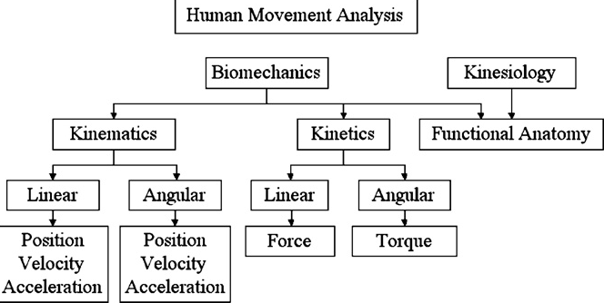
Movement Analysis

Slide 4
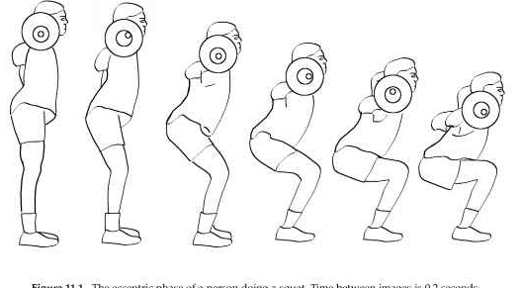
Kinesiological Analysis
The description and analysis of a skill or movement in terms of anatomical structure and movement patterns in order to prescribe improvements.
The press up
https://www.youtube.com/watch?v=6SkKPgKX_gY
https://www.youtube.com/watch?v=l-Db8-aJpRM
The front squat
The golf swing
https://www.youtube.com/watch?v=zKQcSvnlC-U

Slide 5

Describing Movements
Defining the movement
Phases of the movement
Describing the movement anatomically
Recording the movement
Measuring the spatial and temporal characteristic of whole and phases of the athlete
Analysing the data
Interpreting the data
Using the data to change the movement

Slide 6
Describing the Movement
In theory for each phase
 | Movement | Muscles | Type of contraction | Axis of rotation | Plane of motion
Ankle
Knee
Hip
etc

Slide 7
Defining performance
From measurement for each phase
 | Movement | Muscles | Type of contraction | Time | ROM | Max Velocity | Max Acceleration
Ankle
Knee
Hip
etc

Slide 8
Determining Kinematics

Slide 9
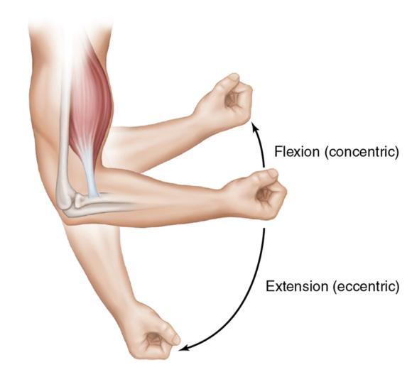
Displacement
The shortest distance in the specific direction from the initial to finals position of a body’s motion
Linear displacement
Angular displacement

Slide 10
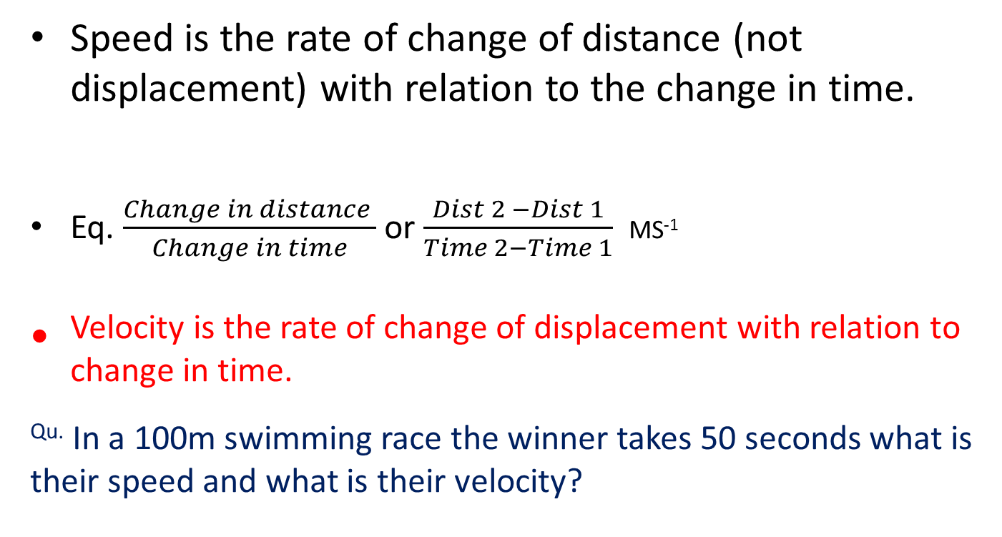
Speed and Velocity
Speed is the rate of change of distance (not displacement) with relation to the change in time.
Eq. $\frac{Change in distance }{Change in time}$ or $\frac{Dist 2 −Dist 1}{Time 2−Time 1}$ MS⁻¹
Velocity is the rate of change of displacement with relation to change in time.
^{Qu.} In a 100m swimming race the winner takes 50 seconds what is their speed and what is their velocity?

Slide 11
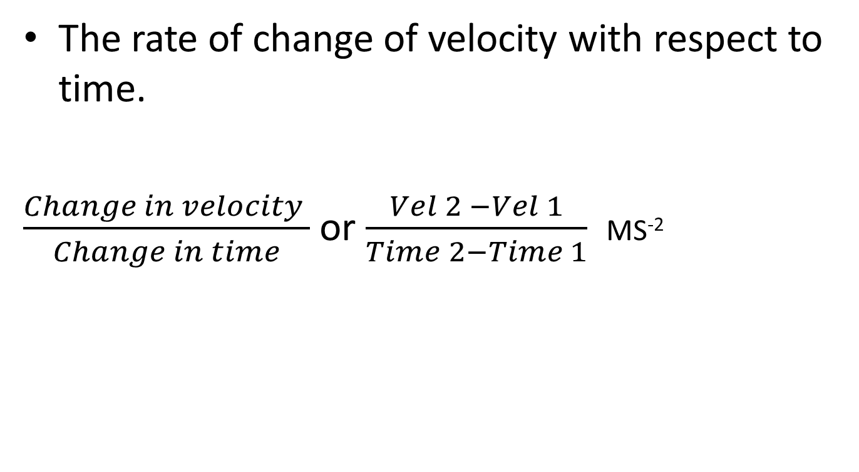
Acceleration
The rate of change of velocity with respect to time.
$\frac{Change in velocity }{Change in time}$ or $\frac{Vel 2 −Vel 1}{Time 2−Time 1}$ MS⁻²

Slide 12
Analysing Performance
You analyse a 100m sprint and collect the following data
Time (s) | Distance (m)
0 | 0
1 | 6
2 | 14
3 | 23
4 | 33
5 | 43
6 | 52
7 | 60
8 | 70
9 | 80
10 | 91
11 | 100

Slide 13
Speed
Time (s) | Speed (ms⁻¹)
0 | 0
0.5 | 6
1.5 | 8
2.5 | 9
3.5 | 10
4.5 | 10
5.5 | 9
6.5 | 8
7.5 | 10
8.5 | 10
9.5 | 11
10.5 | 9
When calculating the speed we are actually calculating the average speed between the two times. Therefore when the speed is plotted it is at the average point between the time intervals.

Slide 14
Acceleration
Time (s) | Accleration (ms⁻²)
0 | 0
0.25 | 24
1 | 3
2 | 1
3 | 1
4 | 0
5 | -1
6 | -1
7 | 2
8 | 0
9 | 1
10 | -2
When calculating the acceleration we are actually calculating the average acceleration between the two times. Therefore when the acceleration is plotted it is at the average point between the time intervals.

Slide 15
Analysing the data

Slide 16
Writing the Report
1500 Kinesiological analysis written as a journal article
Rough word count
        Abstract 100 words
        Introduction 250 word
        Methods 200 word
        Results 300 words
        Discussion 300 words
        Conclusions 100 words
        References 5-10 sources

Slide 17
Abstract
Comes first but written last
An overview of the study
Include a key sentence for each section of the main article
Do not include
Extended back ground information
Reference to other studies
Abbreviations, Jargon or confusing terms
Images, tables, graphs or reference to them

Slide 18
Introduction/ Literature review
An overview of the context and issues of your study.
A theoretical anatomical description of the action and phases.
Any research related to your study.
A statement and justification of the research question.

Slide 19
Method Section
Overview of the study design
Describe and reference (if appropriate) specific data collection protocols / techniques, include specific equipment used.
Explain how the results / data will be analysed.
Describe potential limitations to data collection.

Slide 20
Results Section
Introductory context for understanding the results by restating the research problems and research design.
Inclusion of appropriately referenced tables, figures and graphs.
Systematic presentation and description of the key information /data collected referencing key data presented in tables, graphs and figures.
Thematic or ordered presentation and description of the data, starting with that you deem most important.
Synthesis of key findings that specifically and directly relate to your research question.

Slide 21
Graphical Data
Graphs are described as figures and need a reference and title.
The Reference and Title go below the graph.
Figure 1: Angular displacement of knee joint during front squat.

Slide 22
Results Section
Try to Avoid
Discussing or interpreting results
Reporting background information to explain the data
Ignoring negative results
Including raw or intermediary data
Confusing tables, figures or graphs.
Unlabelled or referenced tables, figures or graphs.
Starting the section with tables, figures or graphs.
Try to
Be factual and concise
Refer to all tables, figures or graphs.
Group finding in themes and order of importance.

Slide 23
Discussion Section
Explain and discuss each major finding/result as they relate to your research question.
  The sequencing of providing this information is important; first state the answer, then the relevant results, then cite the work of others. If necessary, point the reader to a figure or table to enhance the “story”.
Discuss and evaluate conflicting or unexpected data.
Describe and justify advice and recommendations for training and performance.

Slide 24
Conclusions
Provides the reader with a clear and concise answer to the research question.
The key finding/s but no data.
The key meaning and implications but no new information
The importance of your research

Slide 25
References
Use the SHOE referencing guide – try to get between 5 and 10.
Cite them right.

Slide 26
Writing Style
Abstract--past tense [a summary description of what I did]
Introduction--present tense [I am describing the study to you now]
Literature Review--past tense [the studies you are reviewing have already been written]
Methodology--past tense [the way that you gathered and synthesized data has already happened, otherwise, how could you write your paper?]
Results--past tense [the findings have already been discovered]
Discussion--present tense [I am talking to you now about how I interpreted the findings]
Conclusion--present tense [I am summarizing the study for you now]

Slide 27
Finalising the article
Having completed the writing leave for a bit
Then
Re-read for clarity and succinctness and amend the order, structure and flow of your article
(don’t worry about grammar and spelling yet!)
Eliminate unnecessary words, tables etc
Simplify writing style and terminology – big words aren’t always better, they are often confusing resulting in the reading not following the article.

Slide 28
Proof reading
Finish the article in terms of sense and context
Check for errors;
Grammar
Spelling
References

