Slide 1
Change: EI & innerCoherence

Slide 2
What is Intuition?
Quietly reflect and write/type down your definition.

Slide 3
Intuition
Intuition is the ability to acquire knowledge without inference or the use of reason.^{[1]}
"The word 'intuition' comes from the Latin word 'intueri', which is often roughly translated as meaning 'to look inside'’ or 'to contemplate'."^{[2]}
The word intuition comes from the Latin word intueri, meaning “look within.” Webster defines it as “the power or facility of attaining direct knowledge …without evident rational thought. "^{[3]}
[1] Oxford English Dictionary
[2] Carlin Flora. "Gut Almighty". Psychology Today. Vol 40. Issue 3:68-75,2007.
[3] http://resistancetraining.wordpress.com/2007/01/04/your-intuitive-intelligence/

Slide 4
Intuition and Business Success
In the latter half of the last century business decisions and results were defended using such rational, linear measures as rate of return, cost of capital, net income, etc. But all the while the most successful leaders were using an additional tool – intuition.
And today intuition is being touted by management consultants as “essential.” In a study of 13,000 business executives by Harvard researcher Jagdish Parikh, the executives credited 80 percent of their business success to relying on their intuition.
And research conducted by Ashley Fields, a senior advisor to Shell Oil, concluded that among Fortune 500 companies, “intuitive information processing strategies are most often found at the highest levels of an organization.” Intuition is not just valuable in the business world. It can often lead to powerful creative, personal and relationship insights and breakthroughs
Ref: http://resistancetraining.wordpress.com/2007/01/04/your-intuitive-intelligence/

Slide 5
Accessing Your Intuition
Relax: For many people intuition is most available just before sleep, upon awakening or while doing something very relaxing, while meditating or contemplating. All of these have something in common – the alpha-state brainwaves often associated with meditation and creative contemplation. Here are some methods you can use to access your intuitive intelligence:
A Kung Fu Exercise: Shut your eyes and ask someone to approach you as quietly as possible. Say “stop” when you think they are within an arm’s length. You’ll be surprised how rapidly you’ll increase your skill and accuracy.
A ‘Now’ Exercise: Here’s an exercise management consultants are teaching top business executives: Remove from any past or future concerns for a few minutes, and let yourself simply experience what is directly in front of, and around, you. Don’t judge or comment.
Simply BE present ‘in’ the moment.
Ref: Based on http://resistancetraining.wordpress.com/2007/01/04/your-intuitive-intelligence/

Slide 6
Act
The most powerful way to build your intuitive intelligence is to begin to act on your intuition.
Simply allowing yourself to act on your intuition will gradually build your “intuitive intelligence.”
Consider that study of 16,000 business executives who credited 80 percent of their business success to relying on their intuition.
Building your self awareness will not only increase your intuitive intelligence. It will increase your probability of success and achievement in your personal, business or professional life.

Slide 7
Intuition : Intuitive Intelligence
According to HEC Paris International Business school “Intuitive intelligence is the ability to combine our analytical mind with our intuitive aptitude to solve problems in an innovative way and succeed in the new economy.
The following 10 Podcasts introduce this model and real-life business examples show how to apply intuitive intelligence for business re-enginneering i.e. Change.
This breakthrough approach has been implemented successfully by global companies such as L'Oréal, Estée Lauder, Ralph Lauren, SAP Business Objects, Bristol Myers Squibb or Hachette.
Podcasts: http://itunes.apple.com/us/itunes-u/intuitive-intelligence-video/id397034635
Source: http://itunes.apple.com/us/itunes-u/intuitive-intelligence-video/id397034635

Slide 8
Coherence
Each person has an inner ‘energetic core’ known as the point of ‘coherence’.
This point provides people with a focused positive peaceful point of inner-strength resilience and serenity to do what is right for them and to ride and enjoy the waves of change with empowerment and ease.
Discovering this inner-resource is now a very common and effective personal and professional development technique.
It can help people to develop themselves and behave in a more Positive Professional ethical and socially responsible manner.
It is also a very common and effective stress and change management method.

Slide 9
IHM: Institute of HeartMath
Reduce Stress Increase Creativity & Productivity:
http://www.youtube.com/watch?v=rZTHHzA1IAU
Using Technology for Stress Reduction:
http://www.youtube.com/watch?v=A021KzYOWQo
Science of the Heart:
http://www.youtube.com/watch?v=pp-r_f8-qz8&feature=related

Slide 10
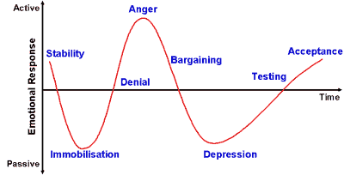

Coherence & the Emotional Rollercoaster
When this technique is used the emotional roller-coaster experienced by people changes from this:
To this: a positive state of Ease and acceptance:
Image source: http://changingminds.org/disciplines/change_management/kubler_ross/kubler_ross.htm

Slide 11
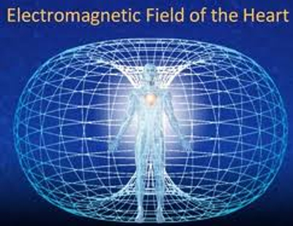
Intuitive Intelligence & Empowerment
Feeling your Core Energy
Ref: http://www.heartmath.com

Slide 12
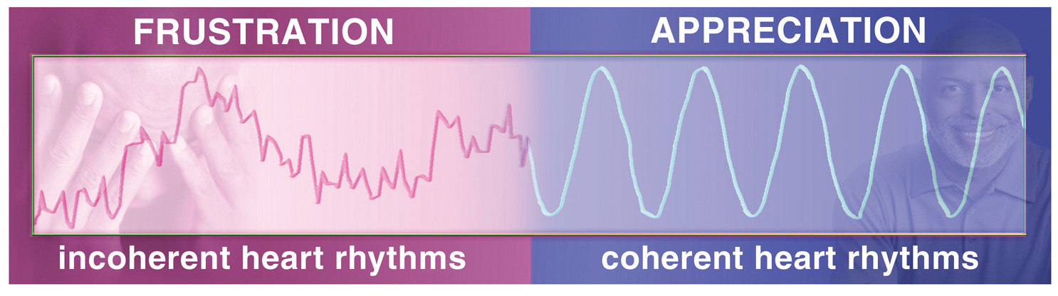
The Core Energy regulates physiology
The core energy both empowers and relaxes / settles the body’s physiology, mental emotional and physical activity energy.
As a result a more centred coherent empowered and peaceful state of being is achieved.
This allows for Positive thoughts and emotions to arise and a new positive perspective and outlook to be re-established.

Slide 13
The Core of Emotional Intelligence
The core of Emotional and Intuitive Intelligence allows for Self-Awareness and comes from the Heart of each person.
This core-energy allows each person to be aware of and regulate their thoughts emotions and actions.
The core-energy allows for ‘new’ thoughts/emotions to be created that are outside the box of existing ‘conscious’ thought patterns and ‘subconscious’ beliefs which maybe preventing someone from accepting change and moving forward positively.
The core allows for the creation of new more aligned Positive thoughts/emotions to be created.
The core-energy is the source of Respectful Professional and Ethical Behaviour, Creativity/Innovation.

Slide 14
For more information
Developing Your Intuition:
http://www.heartmath.com/personal-use/developing-your-intuition.html.
E-learning: Revitalise your workforce programme:
http://www.heartmath.com/corporate/

Slide 15
SQ
At appropriate events.

