Slide 1
Introduction
Yvonne Thomas
2015419

Slide 2
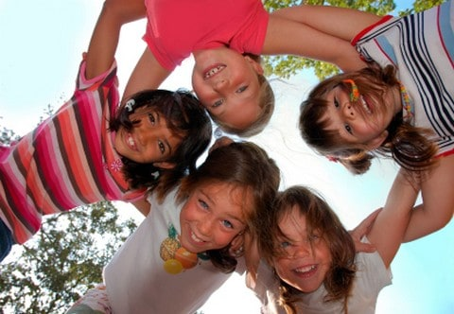
Group work
Group formation is like a jigsaw, not all pieces fit together but if you move them around it works.

Slide 3

Why do people join groups?
To meet others
To express themselves
To feel empowered
For fun
They think it is cool

Slide 4
Benefits of joining a group
To develop social skills
Promote community cohesion
To have that much needed support
To make friends
To be in a safe environment
To develop confidence and self-esteem

Slide 5

Disadvantages of joining a group
Can cause conflict within the group
Could exclude some young people
It could fail to empower young people
It could reinforce stigmas

Slide 6
TEAMWORK MAKES THE DREAM WORK
It teaches social skills, active listening, effective speaking and how to adhere to peers.

Slide 7
Leadership roles
Leader
Lion
Listener
Dog
Silent observer
Cat
Information source
Owl
Tension releaser
Monkey

Slide 8
Effective group work
planning
communication
funding

Slide 9
Ineffective group work
Staff not adequately trained
Aggressive behaviour
External pressure affecting the group

Slide 10
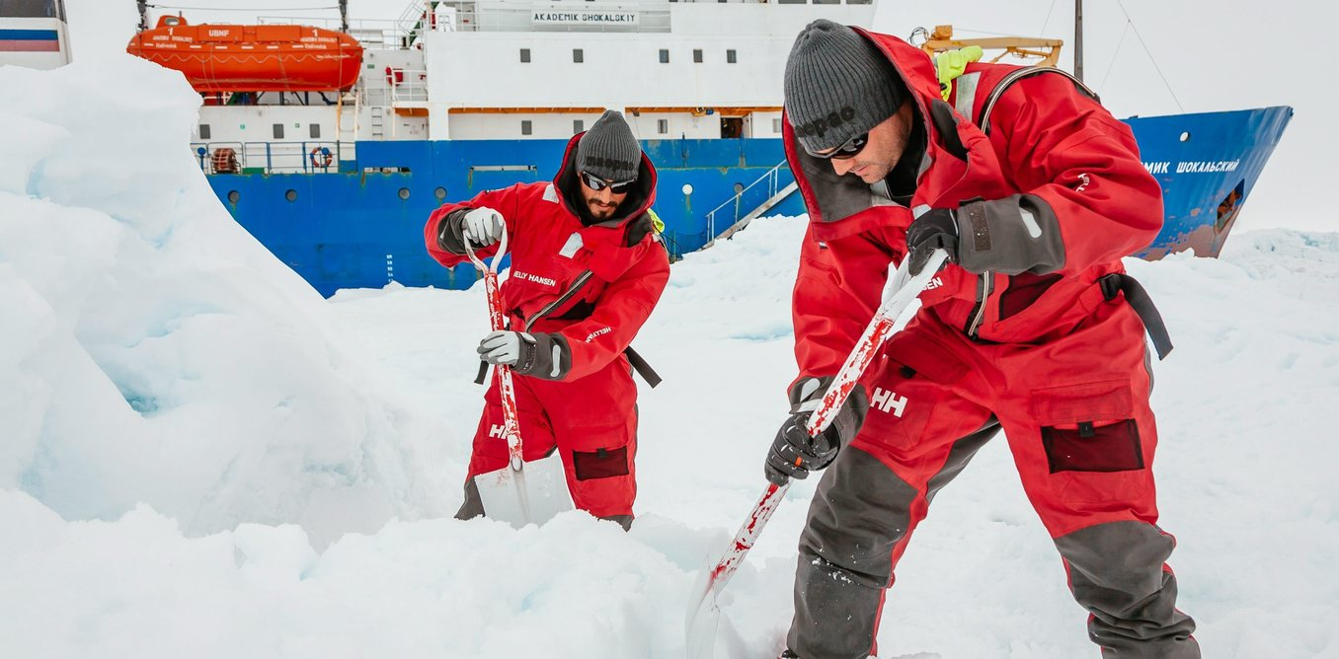
ICEBREAKERS

Slide 11
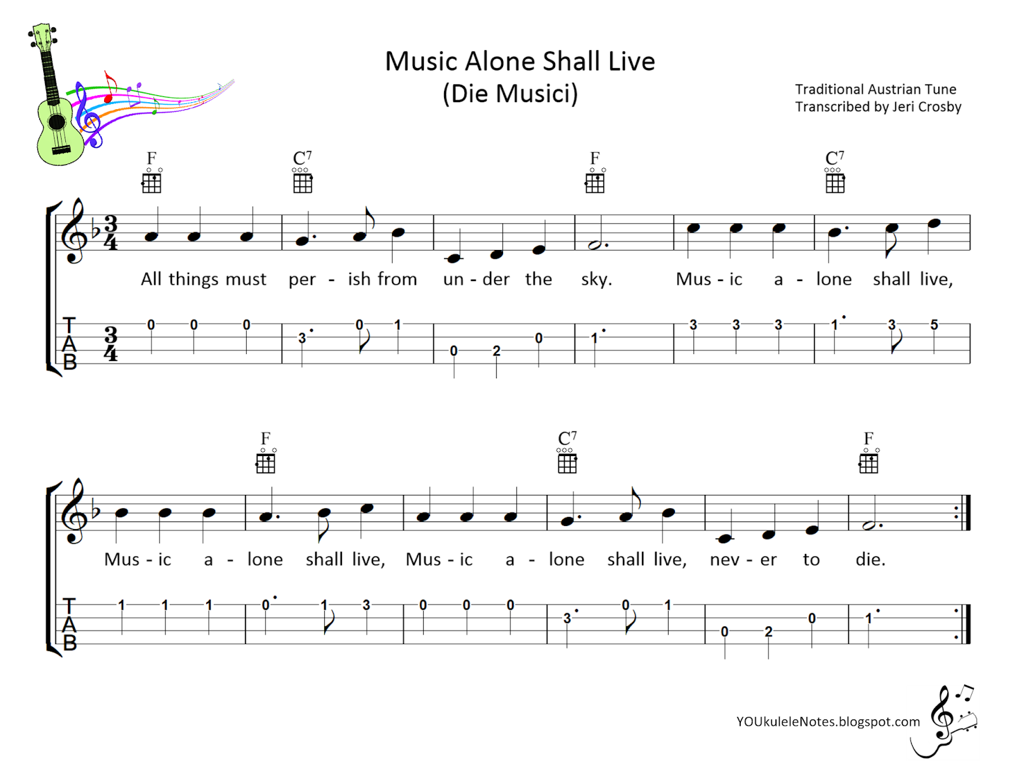
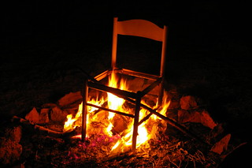

Song scramble
The hot seat.
This Photo by Unknown Author is licensed under CC BY-NC-ND

Slide 12
Marshmallow challenge
https://nam12.safelinks.protection.outlook.com/?url=https%3A%2F%2Fyoutu.be%2FRtQr9w2pL74&amp;data=05%7C01%7C%7Cad01ce340be1446cb7c708da6fa3d0eb%7C84df9e7fe9f640afb435aaaaaaaaaaaa%7C1%7C0%7C637945046609769847%7CUnknown%7CTWFpbGZsb3d8eyJWIjoiMC4wLjAwMDAiLCJQIjoiV2luMzIiLCJBTiI6Ik1haWwiLCJXVCI6Mn0%3D%7C3000%7C%7C%7C&amp;sdata=3UQz72y%2BF8IK2NCrknHY3UnePgRGgvir1tYe%2FcnaQ14%3D&amp;reserved=0

Slide 13
Tuckmans theory
ADJOURNING
FORMING
STORMING
PERFORMING
NORMING

Slide 14

Forming
Individuals’ behaviour is driven by a desire to be accepted by others and avoid conflict. Serious issues and feelings are avoided, and people focus on being busy with routines like team organisation, who does what, when to meet and so on. But individuals are also gathering information and impressions about each other and about the scope of the task and how to approach it. This is a comfortable stage to be in, but the avoidance of conflict means that not much gets done.

Slide 15
Storming
Individuals in the group can only remain nice to each other for so long, as important issues start to be addressed. Some peoples’ patience will break early and minor confrontations will arise that are quickly dealt with or smoothed over. These may relate to the work of the group itself or to roles and responsibilities within the group. Some will observe that it is good to be getting in to the real issues while others will remain in the comfort and security of stage 1.

Slide 16
Norming
As stage 2 evolves, the rules of engagement for the group become established, and the scope of the groups tasks or responsibilities are clear and agreed. Having had their arguments, they now understand each other better and can appreciate each other’s skills and experience. Individuals listen to each other, appreciate, and support each other and are prepared to change pre conceived views. They feel part of a cohesive, effective group. However, individuals must work hard to attain this stage and may resist any pressure to change, especially from the outside for fear that the group will break up or revert to storming.

Slide 17
Performing
Not all groups reach this stage, characterised by a state of independence and flexibility. Everyone knows each other well enough to be able to work together and trusts each other enough to allow independent activity. Roles and responsibilities change according to need in an almost seamless way. Group identity, loyalty and morale are all high and everyone is equally task orientated and people orientated. This high degree of comfort means that all the energy of the group can be directed towards the task in hand.

Slide 18

Adjourning
This is about completion and disengagement, both from the task and group members. Individuals will be proud of having achieved much and pleased to have been part of such an enjoyable group. They need to recognise what they have done and consciously move on.

Slide 19
Conclusion
Thank you for listening. Any questions?

