Slide 1

Name: Asteria Joseph Nyamhanga Wilson
Student Number: 2311121
Presentation Title: Integration of Health, Wellbeing, and Sustainable Development for the enhancement of Smoking Cessation
Lecturer’s Name: Parese Ahmed, Philip Jones, Samuel Assan and Junaid Shaikh
Module Code: BMHP6030
Module Title: Health, Wellbeing and Sustainable Development

Slide 2

Introduction
The title of the presentation is “Integration of Health, Wellbeing, and Sustainable Development for the enhancement of Smoking Cessation”
This presentation looks at UK Smoking Cessation Services from a Sustainable Healthcare Development Perspective.
The presentation focuses on ways the health, wellbeing and sustainable development can be integrated and relevant within health care systems.
The integration of holistic health care has long been embraced nationally for the benefit of prevention, wellbeing and sustainable service delivery (von Schoen-Angerer et al., 2023).
Source: NHS, 2025
Notes:
In this presentation, the contribution of health, wellbeing and sustainable development to health and care in the UK is explored. Attention is drawn to services not only for smoking cessation but also to holistic approaches to healthcare, and sustainable healthcare delivery.

Slide 3
Definitions and Key Concepts
Health is one's body, mind, and society functioning optimally without the presence of diseases (WHO, 2026).
Wellbeing is defined as physical, emotional, mental and social skills that will enable an individual's life to be more healthy.
  Subjective wellbeing is defined as personal happiness, satisfaction of emotions and perceptions about the overall quality of life (Das et al., 2020).
  Objective wellbeing is measured by several aspects, including access to healthcare, income stability, education and social support (Voukelatou et al., 2020).
Sustainable development is able to address contemporary health care needs without compromising the wellbeing possibilities for future generations.
New policies and preventive measures are proposed for the coming decades, where more susceptible to WHO Sustainable Development Goals (United Nations, 2023).
Health
Wellbeing
Sustainable Development
Source: Author
Notes:
This slide introduces the key concepts of this presentation. The WHO definition goes beyond physical illness and also considers mental, social well-being. Wellbeing takes a unique and a whole-of-life perspective. Sustainable development is a fundamentally two part process of protecting future generations and it meets today's healthcare needs.

Slide 4
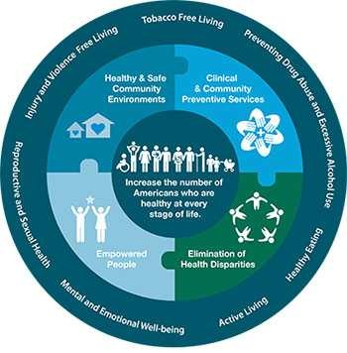
Integration of health and wellbeing approaches
There is an increasing use of holistic well-being policies that focus on prevention, recovery, and improvement of long-term well-being in the UK health services.
WHO Health in All Policies is about collaboration between different sectors to address some of the wider determinants affecting the health status (WHO, 2026).
NHS Net Zero commitment focuses on reducing emissions and improving the well-being of patients.
According to the executives, it is noted that over 70% of those who have been surveyed feel good (NHS England, 2026).
Source: (CDC, 2026)
Notes:
This slide gives an overview of how the approaches of health and wellbeing are now being integrated into health services in the UK. Amidst holistic care, holistic health refers to well-being from a comprehensive perspective by integrating the relationship between the physical, mental, emotional and social aspects of life.

Slide 5
Theoretical Perspectives
Bio-psychosocial Model looks at every factor that involves the individual and relates to their biological, psychological and social processes (Tam et al., 2024).
Ecological Models focus on ecological factors, like environment, communities, organizations health impacting behaviours (Fenta et al., 2023).
The Holistic Model places emphasis on the idea of holistic wellness like physical, mental, emotional, social, and spiritual wellbeing (Silva et al., 2025).
Implications of such theories influence both the delivery and preventative aspects, and the delivery of patient-centred services in the integrated healthcare services.
Theoretical considerations
Bio-psychosocial
Ecological
Holistic Model
Source: Author
Notes:
They have great relevance to the design and provision of health care in the UK. More recently, the provision of smoking cessation and mental health support and wellbeing services are frequently co-provided, drawing on a mix of medical and non-medical treatments.

Slide 6
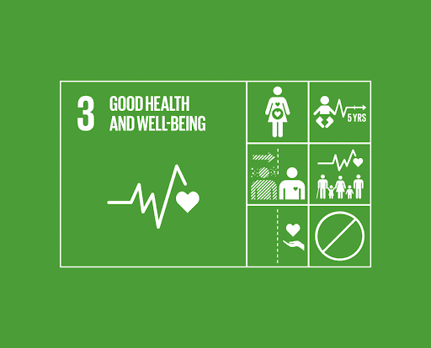
Sustainable Development Goals
For sustainable development towards Goal 3 of healthy lives and wellbeing at all ages, Goal 3 concentrates on providing sustainable healthcare systems (United Nations, 2023).
SDG 3 contributes to the prevention of diseases, increased access to health, mental health and wellbeing and the decrease of premature deaths at the global level.
Prevention-focused and equity-oriented health improvement policies, currently adopted by the NHS, are increasingly aligned with SDG 3 (NHS England, 2025).
By helping to decrease preventable diseases and enhance the wellness of people, the help offered to smokers to end smoking is aligned to SDG 3.
Source: (SOCI, 2026)
Notes:
This slide will put the SDG 3 (Healthy lives and wellbeing for all) in focus. The UK has aligned these priorities with the preventative measures within the NHS and public health programmes.

Slide 7

Sustainable Development Goals [CONTD.]
The healthcare systems in the United Kingdom focus on prevention, early intervention and outcomes for health of the general population in the longer term.
Methods used to assess well-being have been commonly adopted when dealing with mental and emotional well-being (Fu and Zhang, 2024).
Environmental and organisational stresses from the healthcare sector could be alleviated using sustainable practices.
Over 100,000 individuals made attempts at quitting smoking using the NHS Quit Smoking service (Dobbie et al. 2026).
Source: (United Nations, 2026)
Notes:
This slide provides an overview of how health, wellbeing and sustainability are laid by the UK health care system. The emphasis on today is more than ever on prevention, and bettering health in the long-term.

Slide 8

Policy and Governance
The NHS Long Term Plan focuses on the adoption of preventive measures that can enhance the smoking behavioural remissions among citizens(NHS England, 2026).
Mental health programs that adheres to WHO Health in All Policies help in the provision of proper health care services.
The smoking cessation initiaves in the long term plan assist in enhancing the supporting health care services for prevention approaches (Lin et al., 2023).
However, regulatory and funding limitations are observed where, delay and restriction in implementation is observed in holistic and long term plan.
Source: (British Association for community and child health, 2026)
Notes:
Steps to enable the NHS Long Term Plan to be implemented to promote preventive and holistic health care systems throughout the United Kingdom. Smoking cessation services also boost prevention.

Slide 9
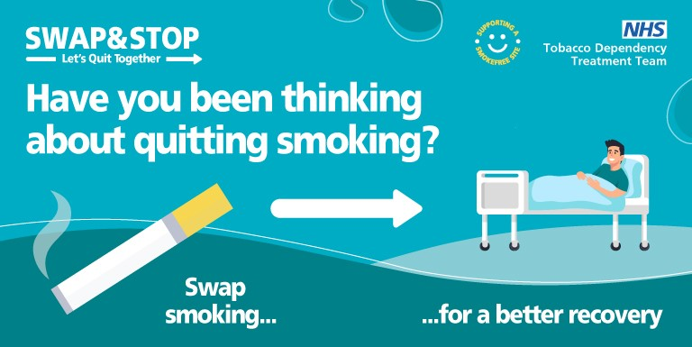
Relevant Case Studies
The integration of the NHS tobacco dependence program alongside other healthcare services can help the individual to quit smoking.
Incorporation of mental health services along with the smoking cessation helps achieve better results compared to clinical smoking cessation approaches.
Interventions within the hospital environment have shown to encourage vulnerable groups to smoke earlier on (Ugalde et al., 2021).
Integrated set of resources that contribute to improved and sustained wellbeing from the health service delivery.
Source: (HDFT, 2026)
Notes:
This case study illustrates inter-agency working by NHS services to support those who have mental health issues and are trying to stop smoking. The programme consists of behavioural counselling, hospital interventions and clinical treatments to support vulnerable patients.

Slide 10

Service Delivery
Enhanced wellbeing among the Better Health and Every Mind Matters interventions.
The accessibility and effective means of communication for those who have difficulty accessing health care using the NHS App and e-Consultations service (NHS, 2026).
The application of the process can enhance the smoking cessation treatment through health promotion campaigns.
Counselling and rehabilitation; nutrition advice and emotional support and aid services are paid attention to in holistic hospital models (Marques and Battistella, 2025).
Source: (NHS, 2026)
Notes:
Multiple services working for the delivery of holistic health within the NHS. Ways to promote healthier lifestyles include programmes such as Better Health, Every Mind Matters. Examples include NHS App, makes services more accessible and communicative.

Slide 11
Relevant Case Studies
Comprehensive Geriatric Assessment is a multi-disciplinary healthcare approach which is based on an assessment of older people (Choi et al., 2022).
The services rendered by CGA are vital in helping provide all the aspects of healthcare that include physical, psychological, medical and social components.
Integrating the assessment in the process of budgeting and organizing the delivery of healthcare services (Helal, 2024).
The application of the Health Belief Model (HBM) is applied in this disciplinary healthcare approach through coherent relationship between them.
Perceived Susceptibility
CGA (Elderly patient Risk)
Perceived Severity
CGA (Evaluate serious health consequences)
Perceived Benefits
Personalised Intervention
Cues to Action
Self Efficacy
Multidisciplinary assessments encouragement
Supporting Confidence
Source: Author
Notes:
In this study, we discussed the application of Comprehensive Geriatric Assessment to promote comprehensive healthcare for older people. Multidisciplinary assessment includes better coordinated care, treatments and wellbeing support.

Slide 12
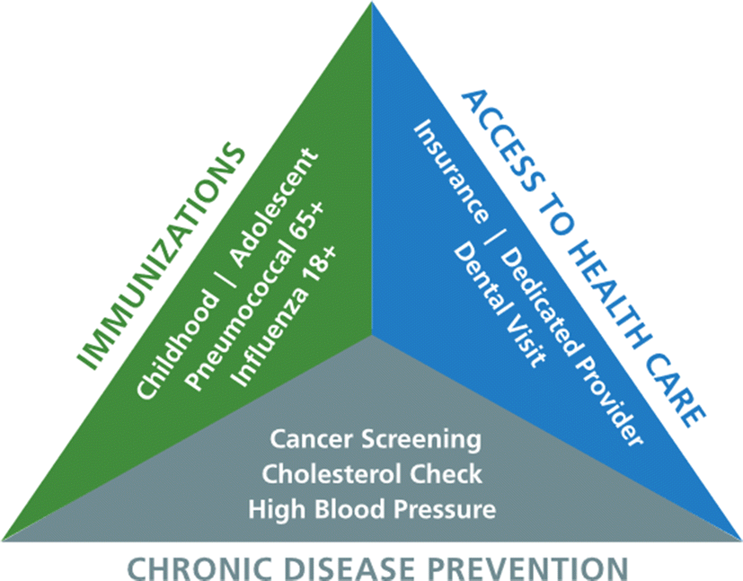
Public Health Initiatives
Health education and preventive healthcare efforts based on principles of public health are designed to encourage a healthy lifestyle.
Health education programs have the capacity to enhance community health and wellbeing by changing behaviours and lifestyle (Garg, 2025).
The uptake of smoking cessation or wellbeing prevention services in the UK are more prevalent with increasing understanding of individuals.
Public awareness of risks of smoking and healthier habits were enhanced through the following NHS campaigns described (Alosaimi et al., 2025).
Source: (Batarseh et al., 2020)
Notes:
Public health programs create health and disease prevention benefits for communities. NHS campaigns have been a great help to raise public awareness of the risks of smoking and promoting healthier behaviours.

Slide 13

Relevant Case Studies
Previous campaigns have been introduced across single areas, such as by the Smoke free campaigns which have supported quitting smoking.
Smoker Stoptober campaigns have been introduced here in the UK as part of the supportive national public health campaigns carried out (GOV.UK, 2022).
NHS behavioural support increases the motivation or confidence in efforts to quit smoking.
Smoking ban promotion through mass media elevated all communities to an awareness of the health risks of smoking (Perman-Howe et al., 2022).
Source: (GOV.UK, 2022)
Notes:
The UK smokers are motivated to quit through the 'Stoptober' initiative through awareness creation at the national level and behavioral support. The campaign increases awareness on the danger of smoking as well as providing confidence, motivating people to lead healthier lifestyles with the assistance of the NHS.

Slide 14
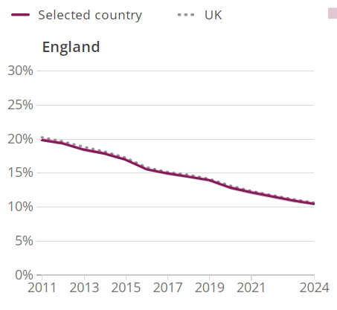
Equity and Access
NHS Stoptober participation is helping to improve the long term health of our population in the country.
Nationally, health inequalities persist, stunting access to health care services, quality of care and wellbeing.
Communities in the United Kingdom (UK) that are significantly affected where the prevalence of smoking was more than 16% (ONS, 2025).
Thousands are annually taking advantage of NHS Stop Smoking Services and this provision is helping to close gaps in the use of healthcare throughout the country.
Source: (ONS, 2025).
Notes:
Health inequalities remain a challenge for disadvantaged communities in the UK in accessing health and wellbeing. The philosophy of inclusion policies in the NHS and smoking cessation policies is to help minimise these inequalities with the provision of support services in an equitable manner.

Slide 15
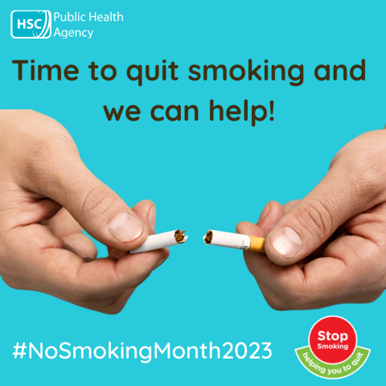
Recommendations
Extending the NHS Smoking Cessation program by initiating awareness programs in workplaces, schools, and communities.
Enhancing telemedicine by offering guidance to vulnerable populations on becoming digitally literate.
Including screening for mental health in all smoking cessation and preventive care programs.
Mandating NHS trusts to create and implement a Net Zero plan every year.
Source: (Public Health Agency, 2026)
Notes:
Inequalities in the NHS are tackled by providing equitable access to health care services and interventions for vulnerable groups. Furthermore, smoking cessation programmes and community-based interventions have the potential to further decrease health inequalities.

Slide 16
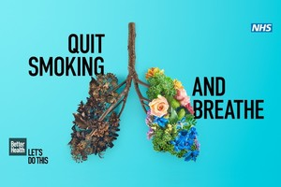
Conclusion
Development of modern healthcare services in the UK has become a major influence of health, wellbeing and sustainability.
A holistic approach to health fosters health promotion, access and better health outcomes in the long-term nationally.
NHS smoking cessation programmes provide successful interventions that are integrated in supporting healthier communities of populations.
Healthcare strategies that are sustainable heighten equitable healthcare delivery and a better future health outcome.
Source: (Public Health England, 2026)
Notes:
The above presentation highlights the growing importance of adding health, wellbeing, and sustainability into the health care system of the UK. The holistic approach to health care and smoking cessation helps prevent diseases as well as promote public health.

Slide 17
References
Alosaimi, H., Alnouri, H., Alasiri, I., Almushawah, S., Mohammed, M., Abdulrahman, A., Alotaibi, R.A., Alfawaz, R., abdulbaqi, A., Banjar, W., Alaama, T. and Aleiasa, M. (2025) ‘Advancing life expectancy in Saudi Arabia: insights from global best practices’, Archives of Gerontology and Geriatrics Plus, pp. 100-163. Available at: https://doi.org/10.1016/j.aggpp.2025.100163.
Batarseh, F.A., Ghassib, I., Chong, D. (Sondor) and Su, P.-H. (2020) ‘Preventive healthcare policies in the US: solutions for disease management using Big Data Analytics’, Journal of Big Data, 7(1). Available at: https://doi.org/10.1186/s40537-020-00315-8.
British Association for community and child health (2026) B-BISS: Introduction to the NHS Long Term Plan, British Association for Community Child Health. Available at: https://www.bacch.org.uk/pages/b-biss-introduction-to-the-nhs-long-term-plan (Accessed: 10 June 2026).
CDC (2026) Health in All Policies | AD for Policy | CDC, Iiab.me. CDC.gov. Available at: http://medbox.iiab.me/modules/en-cdc/www.cdc.gov/policy/hiap/index.html (Accessed: 10 June 2026).
Choi, J.-Y., Lee, J.Y., Shin, J., Kim, C.O., Kim, K.J., Hwang, I.G., Lee, Y.-G., Koh, S.-J., Hong, S., Yoon, S.-J., Kang, M., Kim, J.W., Kim, J.H. and Kim, K. (2022) ‘COMPrehensive geriatric AsseSSment and multidisciplinary team intervention for hospitalised older adults (COMPASS): a protocol of pragmatic trials within a cohort’, BMJ Open, 12(8), pp. 60-913. Available at: https://doi.org/10.1136/bmjopen-2022-060913.
Das, K.V., Jones-Harrell, C., Fan, Y., Ramaswami, A., Orlove, B. and Botchwey, N. (2020) ‘Understanding subjective well-being: perspectives from psychology and public health’, Public Health Reviews, 41(1). Available at: https://doi.org/10.1186/s40985-020-00142-5.
Dobbie, F., Hiscock, R., Leonardi-Bee, J., Murray, S., Shahab, L., Aveyard, P., Coleman, T., McEwen, A., McRobbie, H., Purves, R. and Bauld, L. (2026) ‘Evaluating Long-term Outcomes of NHS Stop Smoking Services (ELONS): a prospective cohort study’, Health Technology Assessment, 19(95), pp. 1–156. Available at: https://doi.org/10.3310/hta19950.
England, N. (2025) NHS England» Five years of a greener NHS: progress and forward look, England.nhs.uk. Available at: https://www.england.nhs.uk/long-read/five-years-greener-nhs-progress-forward-look/ (Accessed: 21 May 2026).
Fenta, E.T., Tiruneh, M.G. and Anagaw, T.F. (2023) ‘Exploring Enablers and Barriers of Healthy Dietary Behavior Based on the Socio-Ecological Model, a Qualitative Systematic Review’, Nutrition and Dietary Supplements, Volume 15, pp. 13–23. Available at: https://doi.org/10.2147/nds.s395444.

Slide 18
References
Fu, Q. and Zhang, X. (2024) ‘Promoting community resilience through disaster education: Review of community-based interventions with a focus on teacher resilience and well-being’, PLOS ONE, 19(1), pp. 296393–296393. Available at: https://doi.org/10.1371/journal.pone.0296393.
Garg, R.K. (2025) ‘The alarming rise of lifestyle diseases and their impact on public health: A comprehensive overview and strategies for overcoming the epidemic’, Journal of Research in Medical Sciences, 30(1). Available at: https://doi.org/10.4103/jrms.jrms_54_24.
GOV.UK (2022) Stoptober Launches to Give Smokers the Confidence to Quit, GOV.UK. GOV.UK. Available at: https://www.gov.uk/government/news/stoptober-launches-to-give-smokers-the-confidence-to-quit (Accessed: 21 May 2026).
GOV.UK (2022) Stoptober Launches to Give Smokers the Confidence to Quit, GOV.UK. GOV.UK. Available at: https://www.gov.uk/government/news/stoptober-launches-to-give-smokers-the-confidence-to-quit (Accessed: 10 June 2026).
HDFT (2026) Swap & Stop Smoking Services, Harrogate and District NHS Foundation Trust. Available at: https://www.hdft.nhs.uk/patients/swap-stop-lets-treat-smoking-tabacco-dependency/ (Accessed: 10 June 2026).
Helal, A. (2024) ‘Integrated Healthcare Delivery Models: A Comprehensive Review Of Clinical, Public Health, And Allied Medical Services’, The Review of Diabetic Studies , pp. 788–796. Available at: https://doi.org/10.70082/66jb2188.
Lin, A.F.C., Cunliffe, C., Chu, V.K., Chan, V., Leung, A.C., Lau, R.P., Lam, K.K., Yeung, J.C., Leung, K., Ng, L. and Chu, E.C.-P. (2023) ‘Prevention-Focused Care: The Potential Role of Chiropractors in Hong Kong’s Primary Healthcare Transformation’, Cureus [Preprint]. Available at: https://doi.org/10.7759/cureus.36950.
Marques, L.M. and Battistella, L.R. (2025) ‘Well-being as a core element of rehabilitation: preventing mental health challenges in a global context’, Global Health Journal, 9(1). Available at: https://doi.org/10.1016/j.glohj.2025.02.004.
NHS (2025) Stop smoking services - NHS North East London, NHS North East London. Available at: https://northeastlondon.icb.nhs.uk/service/stop-smoking-services/ (Accessed: 10 June 2026).

Slide 19
References
NHS (2026) Online Services – a guide to Apps, NHS. Available at: https://www.kingcrosssurgery.co.uk/2021/09/10/online-services-a-guide-to-apps/ (Accessed: 10 June 2026).
NHS (2026) Welcome To Zscaler Directory Authentication, Digital.nhs.uk. Available at: https://digital.nhs.uk/about-nhs-digital/digital-first-messaging (Accessed: 21 May 2026).
NHS England (2024) NHS England» Tobacco dependency programme, www.england.nhs.uk. Available at: https://www.england.nhs.uk/ourwork/prevention/tobacco-dependency-programme/ (Accessed: 21 May 2026).
NHS England (2026) NHS Long Term Plan, NHS England. Available at: https://www.longtermplan.nhs.uk/ (Accessed: 21 May 2026).
NHS England (2026) Statistics National Patient and Staff Surveys, NHS England. Available at: https://www.england.nhs.uk/statistics/statistical-work-areas/patient-surveys/ (Accessed: 21 May 2026).
O’Connell, N., Burke, E., Dobbie, F., Dougall, N., Mockler, D., Darker, C., Vance, J., Bernstein, S., Gilbert, H., Bauld, L. and Hayes, C.B. (2022) ‘The effectiveness of smoking cessation interventions for socio-economically disadvantaged women: a systematic review and meta-analysis’, Systematic Reviews, 11(1). Available at: https://doi.org/10.1186/s13643-022-01922-7.
ONS (2025) Adult smoking habits in the UK, Ons.gov.uk. Office for National Statistics. Available at: https://www.ons.gov.uk/peoplepopulationandcommunity/healthandsocialcare/healthandlifeexpectancies/bulletins/adultsmokinghabitsingreatbritain/2024 (Accessed: 21 May 2026).
Perman-Howe, P.R., McNeill, A., Brose, L.S., Tildy, B.E., Langley, T.E. and Robson, D. (2022) ‘The effect of tobacco control mass media campaigns on smoking-related behaviour among people with mental illness: a systematic literature review’, Nicotine & Tobacco Research, 24(11). Available at: https://doi.org/10.1093/ntr/ntac079.
Public Health England (2026) Surge in smokers trying to quit see increased success rates in 2020, GOV.UK. Available at: https://www.gov.uk/government/news/surge-in-smokers-trying-to-quit-see-increased-success-rates-in-2020 (Accessed: 10 June 2026).

Slide 20
References
Silva, I.S., Santos, P., Leal, T., Schifferdecker-Hoch, F. and Soares, L. (2025) ‘Systematic Literature Review 7DHW (7 Dimensions of Holistic Wellbeing)’, Archives of Clinical Investigation, pp. 1–20. Available at: https://clinicsearchonline.org/uploads/articles/1767089529ACI-RA-49-Galley_Proof_____+.pdf (Accessed: 21 May 2026).
SOCI (2026) SUSTAINABLE DEVELOPMENT GOAL 3: Ensure healthy lives and promote well-being for all at all ages., SociSDG. Available at: http://socisdg.com/en/blog/sustainable-development-goal-3-ensure-healthy-lives-and-promote-well-being-for-all-at-all-ages/ (Accessed: 10 June 2026).
Tam, L.M., Hocker, K., David, T. and Williams, E.M. (2024) ‘The Influence of Social Dynamics on Biological Aging and the Health of Historically Marginalized Populations: A Biopsychosocial Model for Health Disparities’, International journal of environmental research and public health/International journal of environmental research and public health, 21(5), pp. 554–554. Available at: https://doi.org/10.3390/ijerph21050554.
Ugalde, A., White, V., Rankin, N.M., Paul, C., Segan, C., Aranda, S., Wong Shee, A., Hutchinson, A.M. and Livingston, P.M. (2021) ‘How can hospitals change practice to better implement smoking cessation interventions? A systematic review’, CA: A Cancer Journal for Clinicians, 72(3). Available at: https://doi.org/10.3322/caac.21709.
United Nations (2023) Goal 3: Ensure healthy lives and promote well-being for all at all ages, United Nations Sustainable Development Goals. Available at: https://www.un.org/sustainabledevelopment/health/ (Accessed: 21 May 2026).
United Nations (2026) Department of Economic and Social Affairs, United Nations. Available at: https://social.desa.un.org/issues/disability/sustainable-development-goals-sdgs-and-disability (Accessed: 10 June 2026).
von Schoen-Angerer, T., Manchanda, R.K., Lloyd, I., Wardle, J., Szöke, J., Benevides, I., Martinez, N.S.A., Tolo, F., Nicolai, T., Skaling-Klopstock, C., Parker, T., Suswardany, D.L., van Haselen, R. and Liu, J. (2023) ‘Traditional, complementary and integrative healthcare: global stakeholder perspective on WHO’s current and future strategy’, BMJ Global Health, 8(12), p. e013150. Available at: https://doi.org/10.1136/bmjgh-2023-013150.
Voukelatou, V., Gabrielli, L., Miliou, I., Cresci, S., Sharma, R., Tesconi, M. and Pappalardo, L. (2020) ‘Measuring objective and subjective well-being: dimensions and data sources’, International Journal of Data Science and Analytics, 11(11). Available at: https://doi.org/10.1007/s41060-020-00224-2.
WHO (2026) Promoting Health in All Policies and intersectoral action capacities, world health organization. Available at: https://www.who.int/activities/promoting-health-in-all-policies-and-intersectoral-action-capacities (Accessed: 21 May 2026).
World Health Organization (2026) Constitution of the world health organization, World Health Organization. Available at: https://www.who.int/about/governance/constitution (Accessed: 21 May 2026).

Slide 21


