Slide 1
Dynamic Routing
Lecture 3

Slide 2
Objectives
3.1 Dynamic Routing Protocols
  Purpose of dynamic routing protocols.
  Use of dynamic routing and static routing
3.2 RIPv2
  Configure the RIPv2 routing protocol.
3.3 The Routing Table
  Components of an IPv4 routing table entry for a given route.
  Parent/child relationship in a dynamically built routing table.
  Determine which route will be used to forward a IPv4 packet.
  Determine which route will be used to forward a IPv6 packet.
3.4 Summary
Notes:
2

Slide 3
3.1 Dynamic Routing Protocols

Slide 4
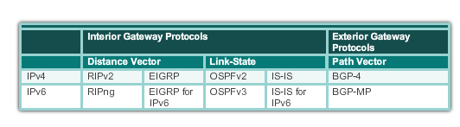
Dynamic Routing Protocol Evolution
Dynamic routing protocols have been used in networks since the late 1980s.
Newer versions support the communication based on IPv6.
Routing Protocols Classification

Slide 5
Dynamic Routing Protocols Components
Routing Protocols are used to facilitate the exchange of routing information between routers.
The purpose of dynamic routing protocols includes:
Discovery of remote networks
Maintaining up-to-date routing information
Choosing the best path to destination networks
Ability to find a new best path if the current path is no longer available

Slide 6
Dynamic Routing Protocols Components (cont.)
Main components of dynamic routing protocols include:
Data structures - Routing protocols typically use tables or databases for its operations. This information is kept in RAM.
Routing protocol messages - Routing protocols use various types of messages to discover neighboring routers, exchange routing information, and other tasks to learn and maintain accurate information about the network.
Algorithm - Routing protocols use algorithms for facilitating routing information for best path determination.

Slide 7
Static Routing Uses
Networks typically use a combination of both static and dynamic routing.
Static routing has several primary uses:
Providing ease of routing table maintenance in smaller networks that are not expected to grow significantly.
Routing to and from a stub network. A network with only one default route out and no knowledge of any remote networks.
Accessing a single default router. This is used to represent a path to any network that does not have a match in the routing table.

Slide 8
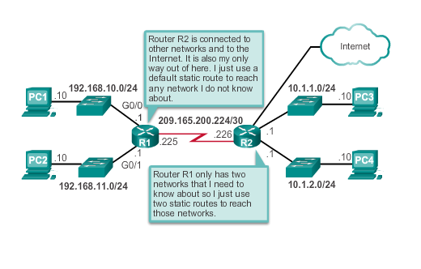
Static Routing Uses (cont.)

Slide 9
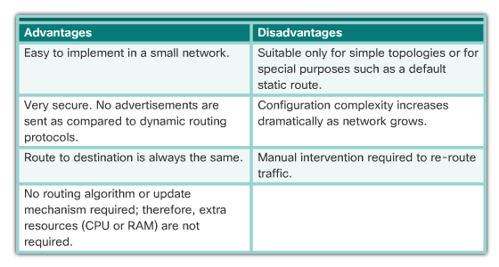
Static Routing Advantages and Disadvantages

Slide 10
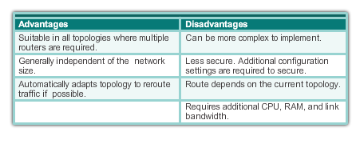
Dynamic Routing Advantages & Disadvantages

Slide 11
3.2 RIPv2

Slide 12
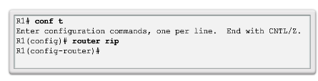
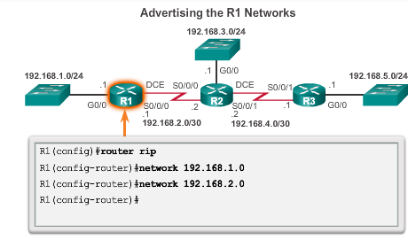
Router RIP Configuration Mode

Slide 13
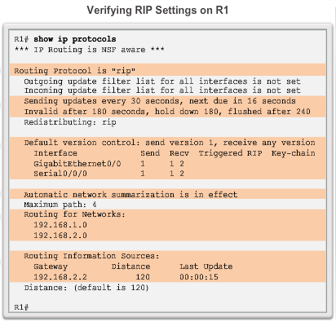
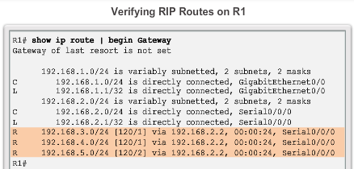
Verify RIP Routing

Slide 14
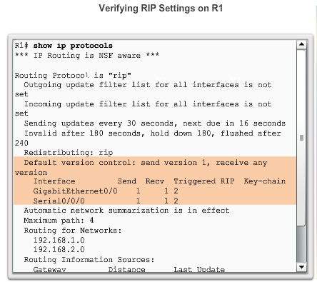
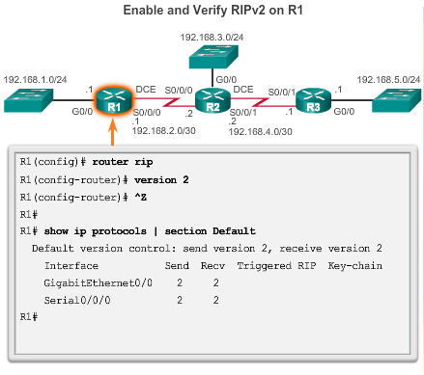
Enable and Verify RIPv2

Slide 15
Disable Auto Summarization
Similarly to RIPv1, RIPv2 automatically summarizes networks at major network boundaries by default.
To modify the default RIPv2 behavior of automatic summarization, use the no auto-summary router configuration mode command.
This command has no effect when using RIPv1.
When automatic summarization has been disabled, RIPv2 no longer summarizes networks to their classful address at boundary routers. RIPv2 now includes all subnets and their appropriate masks in its routing updates.
The show ip protocols now states that automatic network summarization is not in effect.

Slide 16
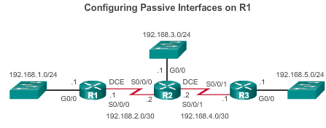
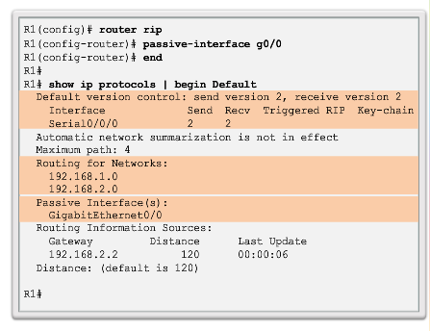
Configuring Passive Interfaces
Sending out unneeded updates on a LAN impacts the network in three ways:
Wasted Bandwidth
Wasted Resources
Security Risk

Slide 17
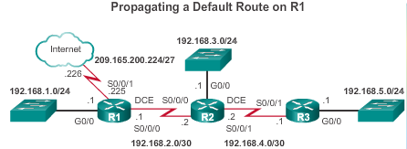
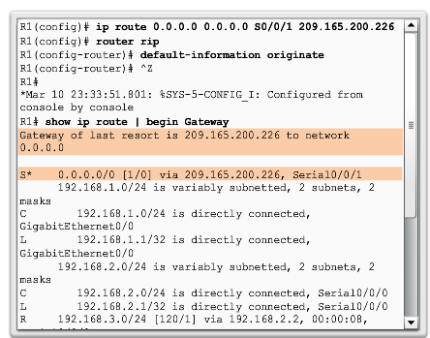
Propagate a Default Route

Slide 18
3.3 The Routing Table

Slide 19
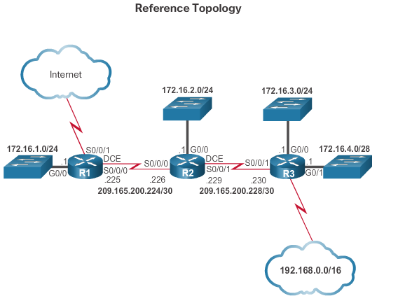
Routing Table Entries

Slide 20
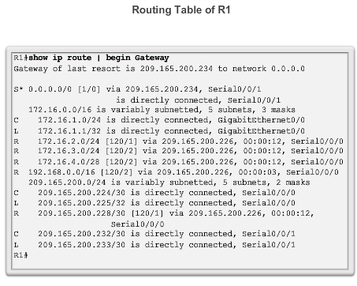
Routing Table Entries

Slide 21
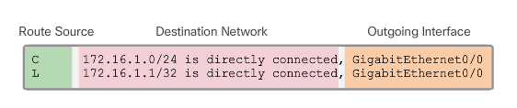
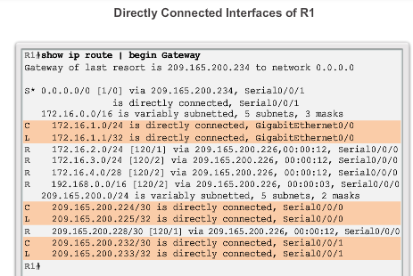
Directly Connected Entries

Slide 22
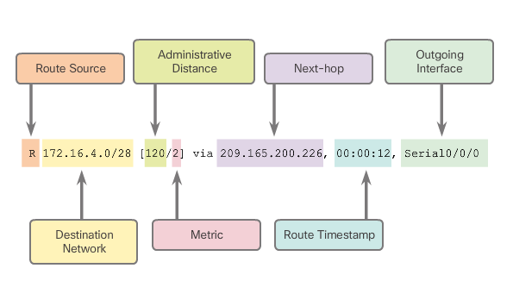
Remote Network Entries

Slide 23
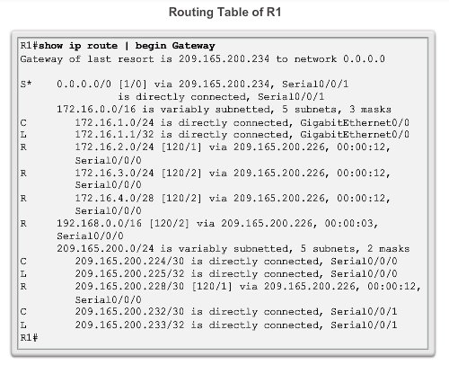
Routing Table Terms
Routes are discussed
in terms of:
Ultimate route
Level 1 route
Level 1 parent route
Level 2 child routes

Slide 24
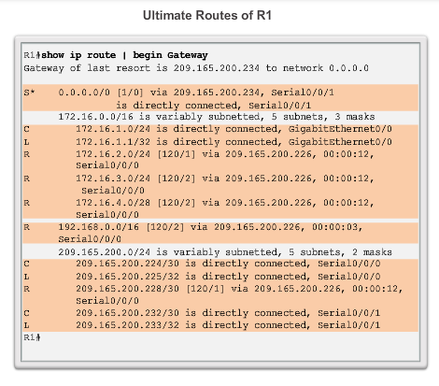
Ultimate Route
An ultimate route is a routing table entry that contains either a next-hop IP address or an exit interface.
Directly connected, dynamically learned, and link local routes are ultimate routes.

Slide 25
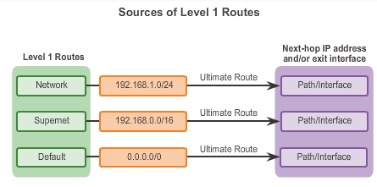
Level 1 Route

Slide 26
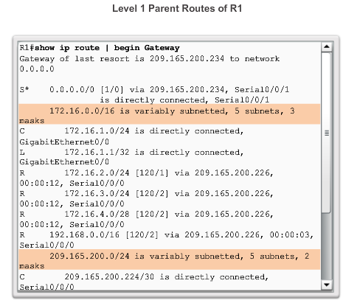
Level 1 Parent Route

Slide 27
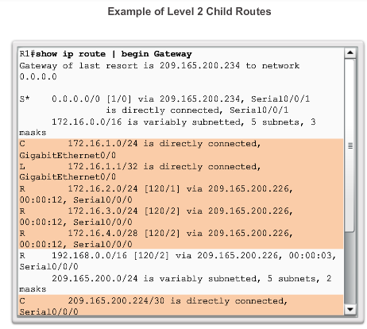
Level 2 Child Route

Slide 28
Route Lookup Process
If the best match is a level 1 ultimate route, then this route is used to forward the packet.
If the best match is a level 1 parent route, proceed to the next step.
The router examines child routes (the subnet routes) of the parent route for a best match.
If there is a match with a level 2 child route, that subnet is used to forward the packet.
If there is not a match with any of the level 2 child routes, proceed to the next step.

Slide 29
Route Lookup Process (cont.)
The router continues searching level 1 supernet routes in the routing table for a match, including the default route, if there is one.
If there is now a lesser match with a level 1 supernet or default routes, the router uses that route to forward the packet.
If there is not a match with any route in the routing table, the router drops the packet.

Slide 30
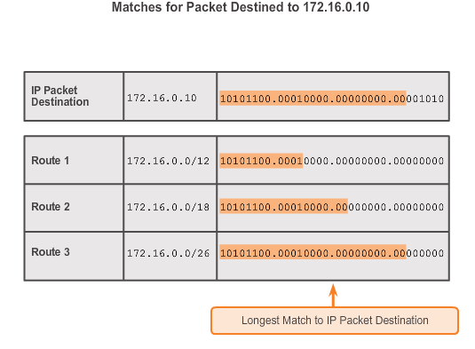
Best Route = Longest Match

Slide 31
IPv6 Routing Table Entries
Components of the IPv6 routing table are very similar to the IPv4 routing table (directly connected interfaces, static routes, and dynamically learned routes).
IPv6 is classless by design, all routes are effectively level 1 ultimate routes. There is no level 1 parent of level 2 child routes.

Slide 32
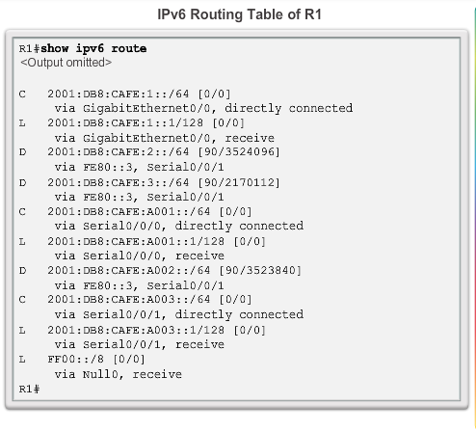
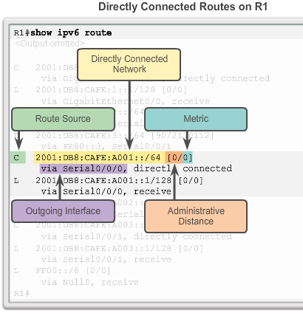
Directly Connected Entries

Slide 33
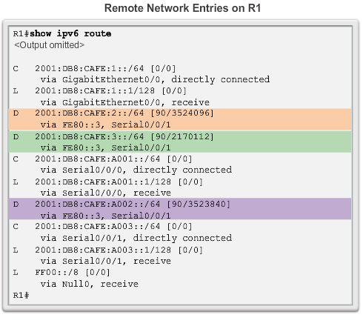
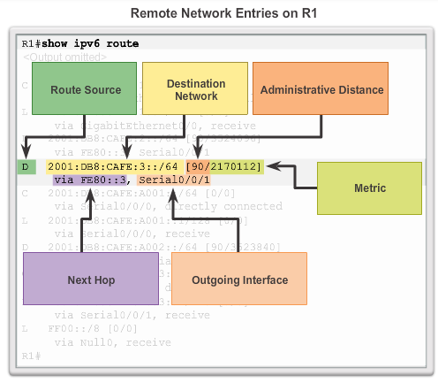
Remote IPv6 Network Entries

Slide 34
3.4 Summary

Slide 35
Summary
Dynamic routing protocols:
Used by routers to automatically learn about remote networks from other routers.
Purpose includes: discovery of remote networks, maintaining up-to-date routing information, choosing the best path to destination networks, and ability to find a new best path if the current path is no longer available.
Best choice for large networks but static routing is better for stub networks.
Function to inform other routers about changes.
Notes:
Chapter 3: Summary

Slide 36
Summary (cont.)
Dynamic routing protocols:
Responsible for discovering remote networks, as well as maintaining accurate network information.
Upon a change in the topology routing protocols propagate that information throughout the routing domain.
Convergence: The process of bringing all routing tables to a state of consistency, where all of the routers in the same routing domain, or area, have complete and accurate information about the network. Some routing protocols converge faster than others.
Notes:
Chapter 3: Summary

Slide 37
Summary (cont.)
Dynamic routing protocols:
Cisco routers use the administrative distance value to determine which routing source to use.
Each dynamic routing protocol has a unique administrative value, along with static routes and directly connected networks.
Directly connected networks are preferred source, followed by static routes and then various dynamic routing protocols.
Notes:
Chapter 3: Summary

Slide 38
Summary (cont.)
Dynamic routing protocols:
Each dynamic routing protocol has a unique administrative value, along with static routes and directly connected networks. The lower the administrative value, the more preferred the route source.
A directly connected network is always the preferred source, followed by static routes and then various dynamic routing protocols.
Routing table entries contain a route source, a destination network, and an outgoing interface.
Route sources can be either connected, local, static, or from a dynamic routing protocol.
IPv4 routing tables can contain four types of routes: ultimate routes, level 1 routes, level 1 parent routes, and level 2 child routes.
Because IPv6 is classless by design, all routes are effectively level 1 ultimate routes. There is no level 1 parent of level 2 child routes.
Notes:
Chapter 3 Summary

Slide 39
Section 3.1
Terms and Commands
Static routing
Dynamic routing
RIPv1
RIPv2
OSPF
IS-IS
IGRP
EIGRP
BGP
Routing table
Stub network
Update messages
router rip
no router rip
network network-address
show ip protocols
show ip route
version 2
no version
no auto-summary
passive-interface
passive-interface default
no passive-interface
ip route 0.0.0.0 0.0.0.0
default-information originate
Notes:
New Terms and Commands

Slide 40
Section 3.3
Terms and Commands
Classful routing
Classless addressing
Route source (C and L)
Destination network
Outgoing interface
Administrative distance (AD)
Metric
Route timestamp
Ultimate route
Level 1 route
Level 1 parent route
Level 2 child route
Network route
Supernet route
Default route
Notes:
New Terms and Commands

