Slide 1

LCHS4001
Academic and Employability Skills
The Role and Skills of a Healthcare Assistant
Name: Dominika Borovska
ID Number: 2439736

Slide 2

Role Choice and Rationale
Why I Chose the Healthcare Assistant Role
I chose the role of Healthcare Assistant because it is a key position within health and social care that involves providing direct, hands-on support to patients. This role allows me to work closely with individuals who may be vulnerable, unwell, or in need of daily assistance, making a meaningful contribution to their wellbeing. Healthcare Assistants are often the first point of contact for patients, which highlights the importance of strong interpersonal skills and compassionate care (NHS, 2023).
Importance of the Role in Healthcare
The Healthcare Assistant role is essential in supporting nurses and other healthcare professionals to deliver safe and effective care. By assisting with personal care, monitoring patients, and communicating concerns, Healthcare Assistants help maintain high standards of patient safety and dignity. The increasing demand for healthcare services further emphasises the importance of this role within the healthcare system (Skills for Care, 2022).

Slide 3

Overview of the Healthcare Assistant Role
Working Environments
As a Healthcare Assistant, I can work in a range of health and social care settings, including hospitals, residential care homes, and community-based services. In each setting, the role focuses on supporting patients with their daily needs while promoting comfort, safety, and dignity. The flexibility of the role allows Healthcare Assistants to adapt their skills to meet the needs of different patient groups (NHS, 2023).
Key Duties and Responsibilities
Supporting patients with personal care like washing, dressing & eating
Assisting with mobility and ensuring patient safety
Monitoring and recording vital signs under supervision
Communicating patient needs and concerns to nurses & doctors.
Maintaining dignity, confidentiality, and infection control standards.
These responsibilities highlight the importance of professionalism and patient-centred care within the Healthcare Assistant role.

Slide 4

Initial Research Process
Sources Used
Official healthcare websites, including the NHS, to obtain accurate role information
Skills for Care guidance to understand required morals and skills
Professional resources to support academic credibility
Research Method and Keywords
Used focused keywords such as “Healthcare Assistant duties,” “skills for Healthcare Assistants,” and “person-centred care”
Checked publication dates and authorship to ensure reliability
Compared information across various sources to confirm accuracy
This structured research approach helped me develop a clear understanding of the role while improving my academic research and evaluation skills (Cottrell, 2019).

Slide 5
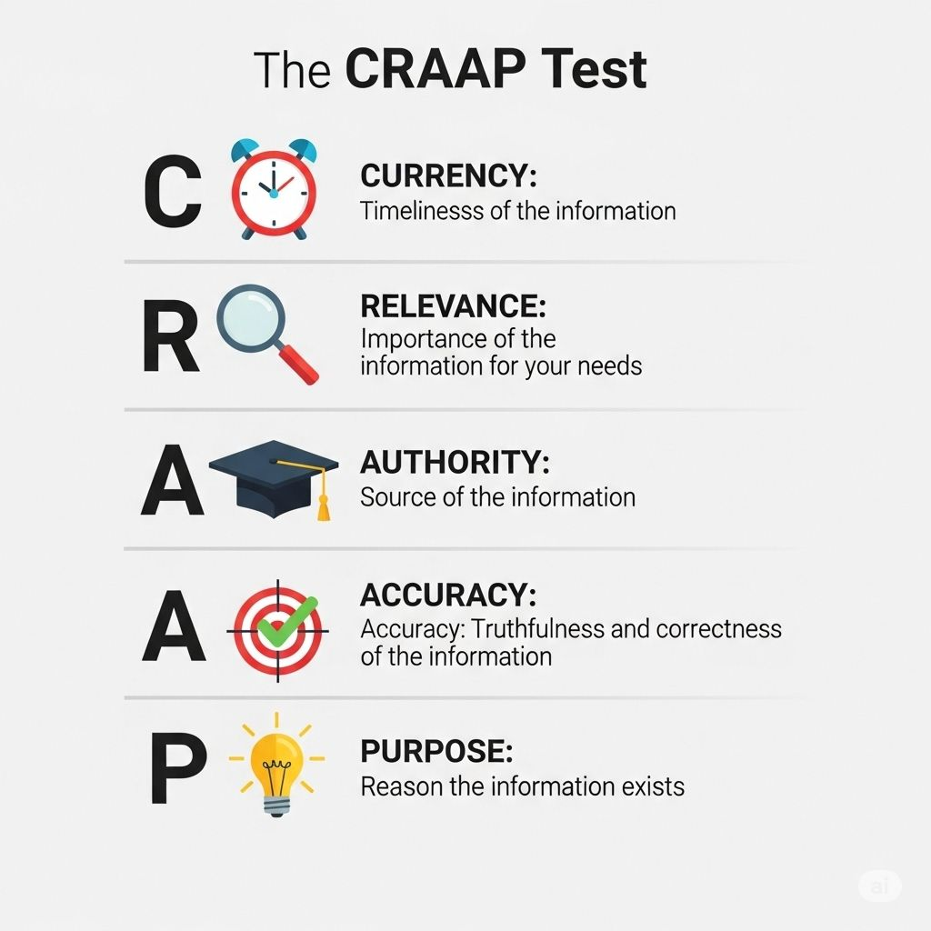
CRAAP Test Evaluation of a Source
Selected Source
For this assessment, I evaluated the NHS webpage on the Healthcare Assistant role using the CRAAP test to assess its suitability for academic use (NHS, 2023).
CRAAP Test Criteria
Currency: The information is regularly reviewed and updated, ensuring it reflects current healthcare practices and expectations (NHS, 2023).
Relevance: The content is directly relevant to my chosen role and supports the aims of this assessment by clearly explaining the Healthcare Assistant position.
Authority: The NHS is a nationally recognised and trusted healthcare organisation, making the source highly credible.
Accuracy: The information is factual, clearly written, and consistent with other professional guidance, such as Skills for Care.
Purpose: The purpose of the source is to inform and educate, not to persuade, making it suitable for academic use.

Slide 6

Challenges Faced During Research
Challenges Identified
Finding a large volume of information made it difficult to decide which sources were most relevant to the Healthcare Assistant role
Some websites lacked clear authorship or publication dates, reducing their academic reliability
Balancing detailed information with concise content suitable for a short presentation was challenging
How I Addressed These Challenges
I prioritised official and professional sources, such as the NHS and Skills for Care, to improve reliability
I applied critical reading skills to evaluate sources and exclude unreliable material
I refined my search strategy by using focused keywords and reviewing fewer, higher-quality sources
These strategies helped improve my research skills and confidence in academic work (Cottrell, 2019).

Slide 7

Skills Identified for the Role
Key Skills Required for a Healthcare Assistant
Communication skills are essential to interact effectively with patients, relatives, and the multidisciplinary team.
Clear communication helps ensure patient needs are understood and concerns are reported accurately.
Teamwork skills are required to work collaboratively with nurses, doctors, and other Healthcare
Assistants to deliver safe and coordinated care. Effective teamwork supports patient safety and continuity of care.
Compassion and empathy are central to providing person-centred care, particularly when supporting vulnerable or distressed patients.
Compassion helps maintain dignity and trust during care delivery.
Importance of These Skills
These skills directly support safe, dignified, and high-quality care in everyday practice. They align with professional expectations and standards within health and social care.

Slide 8

Next Steps in Research and Learning
Further Research Plans
I will expand my research by using academic textbooks and peer-reviewed journal articles to gain a deeper understanding of communication, teamwork, and compassion in healthcare practice.
I plan to use library databases to ensure sources are academic, reliable, and suitable for my written report.
Academic and Professional Development
I will organise my notes under clear headings to support structured academic writing.
I will continue using reflective practice to evaluate my learning and identify areas for improvement.
Seeking feedback from tutors will help me strengthen both my academic writing and presentation skills.
These next steps will support the successful completion of Task 3 and contribute to my ongoing professional development as a Healthcare Assistant (Gibbs, 1988; Royal College of Nursing, 2021).

Slide 9

Conclusion
This presentation has explored the role of the Healthcare Assistant and highlighted its importance within health and social care settings. The Healthcare Assistant role involves providing essential, hands-on support to patients while working closely with nurses and other healthcare professionals to deliver safe, effective care.
Through this research process, I have developed a clearer understanding of the key responsibilities of the role and the professional standards required in practice. The presentation has also identified communication, teamwork, and compassion as essential skills that support excellent care and positive experiences.
Reflecting on the research process has helped me recognise the importance of using reliable sources and critically evaluating information to support academic work. I will continue to develop these skills through further research, reflection, and feedback.
This will support my ongoing development as a future Healthcare Assistant, ensuring that I provide care that is respectful, safe, and compassionate always.

Slide 10
Reference
Arnold, E.C. and Boggs, K.U. (2020) Interpersonal Relationships: Professional Communication Skills for Nurses. 8th edn. St. Louis: Elsevier.
Bach, S. and Grant, A. (2015) Communication and Interpersonal Skills in Nursing. 3rd edn. London: Learning Matters.
Cottrell, S. (2019) The Study Skills Handbook. 5th edn. London: Red Globe Press.
Francis, R. (2013) Report of the Mid Staffordshire NHS Foundation Trust Public Inquiry. London: The Stationery Office.
Freshwater, D. and Stickley, T. (2004) ‘The heart of the art: Emotional intelligence in nurse education’, Nursing Inquiry, 11(2), pp. 91–98.
Gibbs, G. (1988) Learning by Doing: A Guide to Teaching and Learning Methods. Oxford: Oxford Polytechnic.
NHS (2023) Healthcare Assistant. Available at: https://www.nhs.uk (Accessed: 10 January 2026).
NHS England (2022) Leading a Culture of Compassion in Healthcare. London: NHS England.
Royal College of Nursing (2021) Principles of Nursing Practice. London: RCN Publishing.
Skills for Care (2022) The Care Certificate Standards. Leeds: Skills for Care.
West, M.A., Eckert, R., Collins, B. and Chowla, R. (2014) Caring to Change: How Compassionate Leadership Can Stimulate Innovation in Health Care. London: The King’s Fund.

