Slide 1

Student Name: Slavina Stoyanova
Student Number: 2127720
Module Code: BMSW 5102_BIRM
Module Title: Developing Relationship and Workplace Achievement
Lecturer Name: Ehsan Khajeb
Assignment Title: 360- degree feedback
This Photo by Unknown author is licensed under CC BY-SA-NC.

Slide 2

Introduction
Such a student in University Trinity Saind David Was given me a case study to introduce 360- degree feedback such a part of performance management process.
This presentation will present the importance and benefits of 360- degree feedback.
This presentation include the achieving contribution for employees in the process.
The feedback have become of the most popular process in nova days

Slide 3

360-degree feedback concept
According to Ward (2004) , feedback have many names but the same meanings
360- degree feedback is known as a multi- source feedback;
Can be called group performance review as well;
All-round feedback;
Multi-rater feedback;
Upwards feedback;
Peer appraisal.
It was first used in 1940s
It is a process for receiving anonymous , confidential feedback for employees from people working around them.

Slide 4

360- degree Feedback as a performance management process
As a performance management there are two classic uses of 360- degree feedback achievements – development and appraisal
( Atwar er et al.,2007;atwater and Waldman,1998;ward,2004;Tyson and Ward,2004).
According to Fletcher(2001), the majority of multi-source feedback systems have been applied with a developing accent.

Slide 5
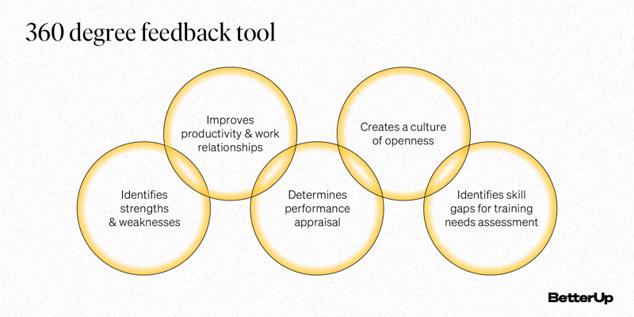

The purpose of 360- degree Feedback
According to Carter and colleagues (2005) the purpose of 360 –degree feedback is:
Needs for self-improvement;
Accent the importance of teamwork;
Performance evaluation;
Trainings needs;
Compensation;
Strategic developments.

Slide 6


Why the 360-degree Feedback is so important for employees
360-degree Feedback is process valuable for the employees, helping them in career growth , organizational performance to be in higher level and career development.
The feedback helps employees in organization to understand the strengths and weaknesses and provide opportunity for improvements and achieving goals.
It been established that 360-degree Feedback is very useful for the employees, keep them motivated and engaged at work.

Slide 7

Why the 360-degree Feedback is so important for the employers
The 360-degree feedback had been proposed for companies to established the assessment the performance system.
Thise who receive 360-degree Feedback may become to more sensible of how others see them.
The Feedback helps organization all staff ( leaders, peers ) to aims the same goals.
The majority of the organization prioritize the employee development using 360-degree tool to evaluate workers performance and potential and provide them opportunity to grow.

Slide 8
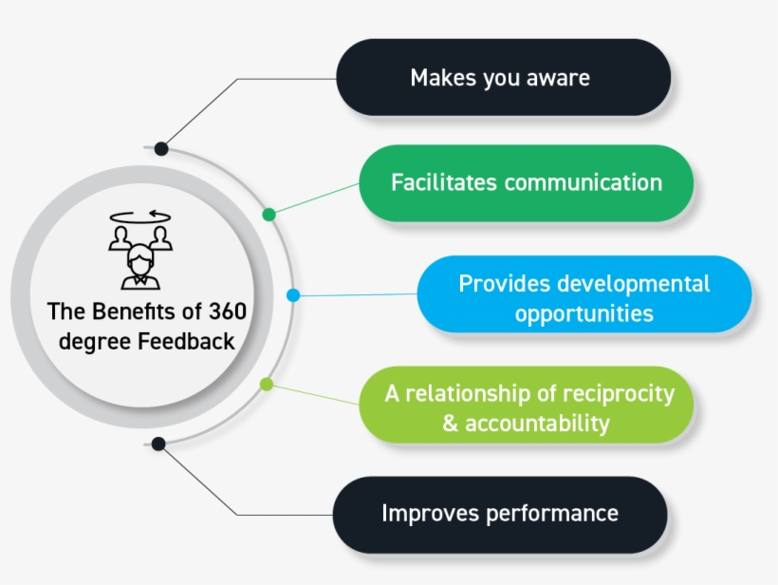
The benefits of the 360-fegree Feedback Concept to Employees
The most thorough evaluation is known as 360-degree Feedback, where employee's performance is evaluated based on input from every source they interact with while working for the employer.
According to Carruthers, 2003, around ninety percent of Fortune 500 companies or multi-rater feedback used this ,often known as 360-degree feedback .
The Feedback promote support for the employees, give them confidence and encourage by success .

Slide 9


The benefits of 360-degree feedback for the employers
Providing 360-degree feedback help organization to increase organizational environment;
Leaders improving their behaviors;
Communication between leaders and their peers, followers, customers is improving;
Organization culture became more stronger ,openness and engage;
Most leaders have greater interest of the Feedback;
It is easy to complete the feedback
This Photo by Unknown author is licensed under CC BY.

Slide 10
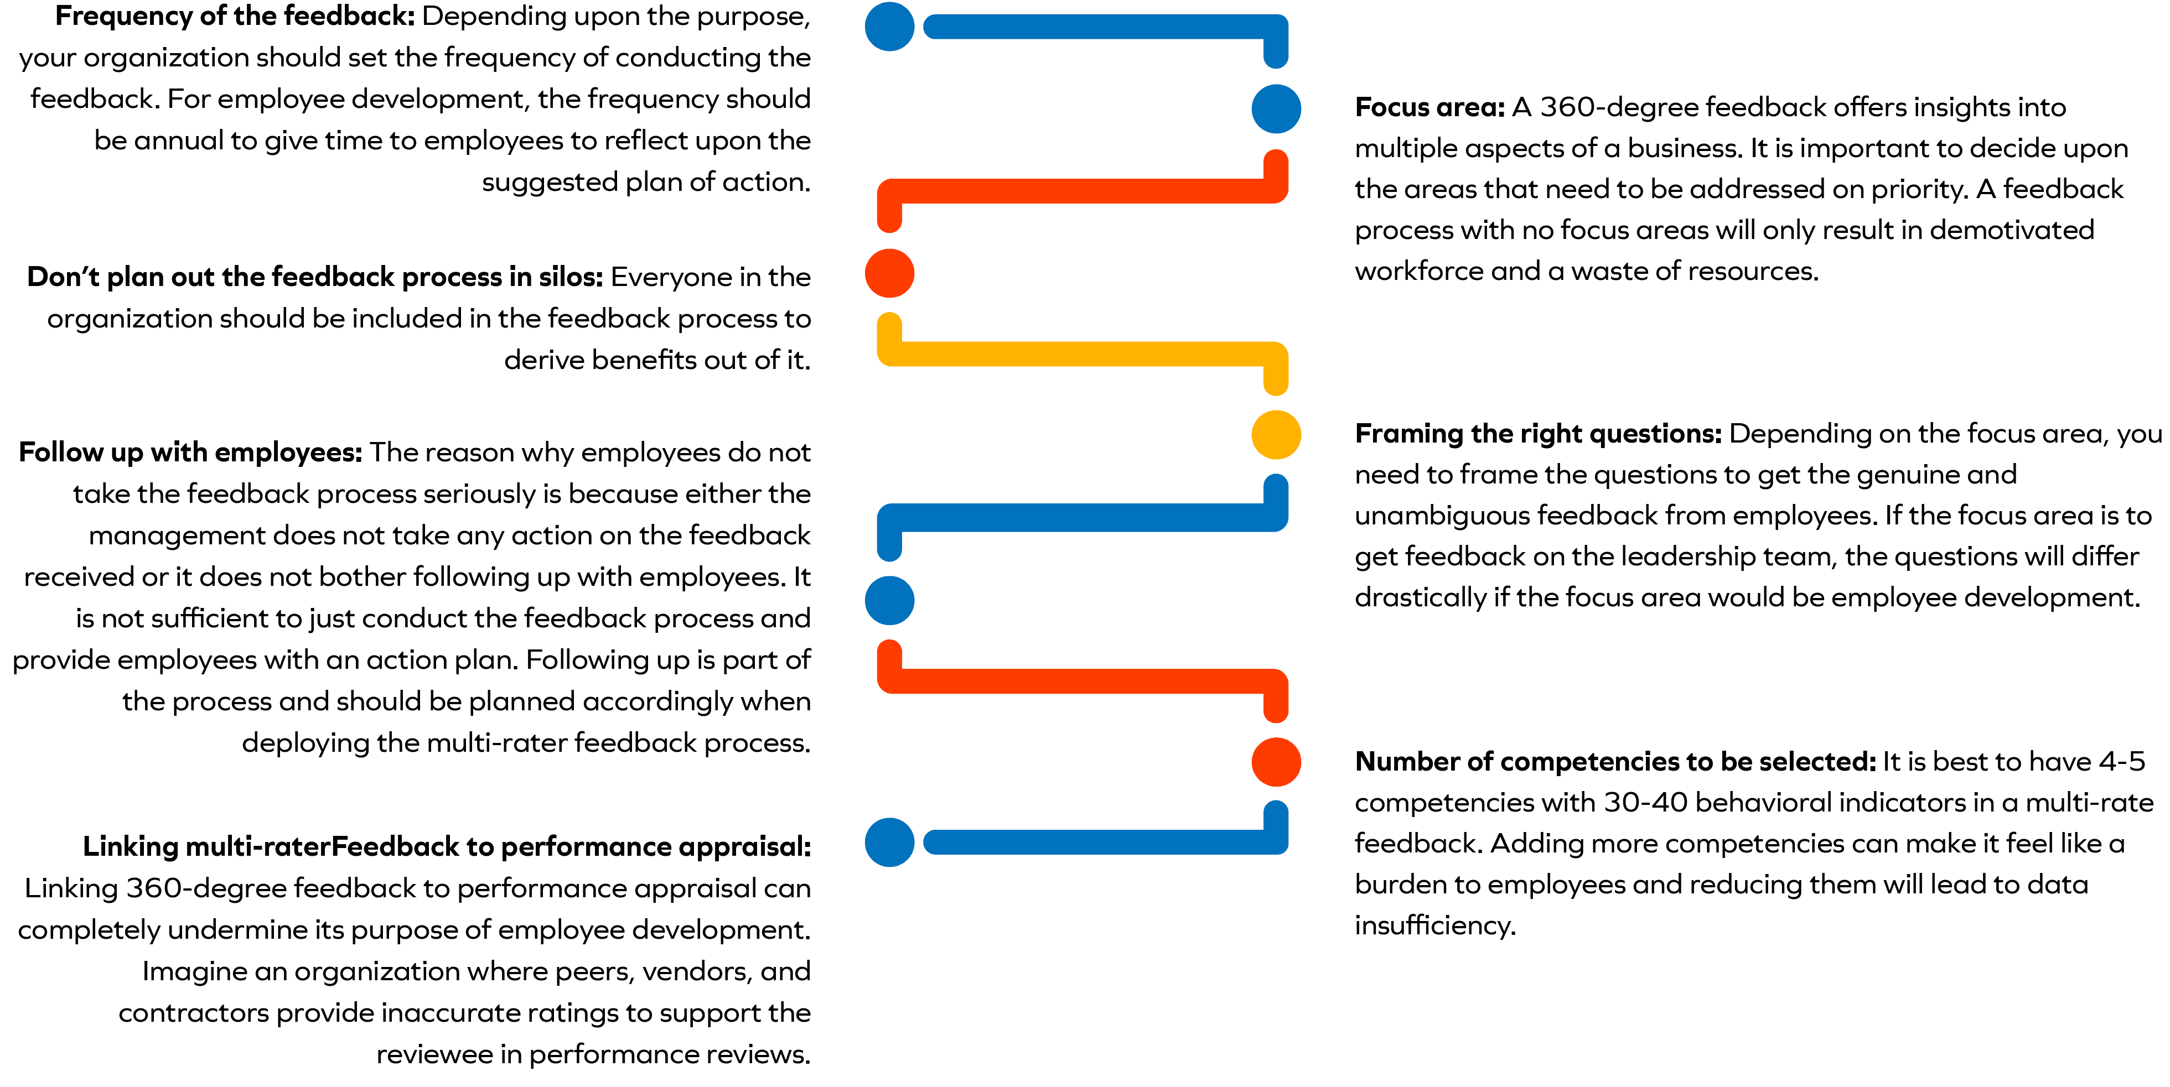
Key issue whilst implementing 360-degree Feedback

Slide 11

Conclusion
This presentation presented the 360-degree feedback such as efficacy system.
By using 360-degree feedback process, we understanding the powerful using that process and how this helps for behavior change.
By using 360-degree feedback employers helping employees to grown and achieve the same goals for the organization.
The organization have to use 360-degree feedback to improve the efficiency ,to improve productivity and engagement.
An organization is successful , when their team is successful.

Slide 12

Reference list
Church, A.H. and Bracken, D.W., 1997. Advancing the state of the art of 360-degree feedback: Guest editors' comments on the research and practice of multirater assessment methods. Group & Organization Management, 22(2), pp.149-161.
360-feedback-2.jpg (440×267) (internationalsuccessacademy.com)
9 HR Centers of Excellence ideas | center of excellence, talent management, human resources (pinterest.com)
Kanaslan, E.K. and Iyem, C., 2016. Is 360 degree feedback appraisal an effective way of performance evaluation. International Journal of Academic Research in Business and Social Sciences, 6(5), pp.172-182.
360 Degree Feedback: Definition, Benefits, and Examples (betterup.com)
Mohapatra, M., 2015. 360 degree feedback: a review of literature. Research Scholar of Management KIIT University Bhubaneswar Orissa, 2(1), pp.112-116.
Curtis, D., 1996. Employers appreciate 360‐degree feedback. Management Development Review, 9(5), pp.34-36.
Chandhana, K. and Easow, D.T., 2015. Performance Appraisal Method Used in Top 10 IT Companies-360 Degree Feedback & Balanced Score Card: A Review. Bonfring International Journal of Industrial Engineering and Management Science, 5(2), pp.73-77.

Slide 13
Reference list
Leadership 360 Feedback Surveys | Simple Questions | People Insight
Waldman, D.A. and Atwater, L.E., 1998. Power of 360 Degree Feedback. Routledge.
9 Tips for Successful 360˚ Feedback : 9 tips for a Sucessful 360 Degree Feedback (internalchange.com)
Bracken, D.W. and Rose, D.S., 2011. When does 360-degree feedback create behavior change? And how would we know it when it does?. Journal of Business and Psychology, 26(2), pp.183-192.

