Slide 1
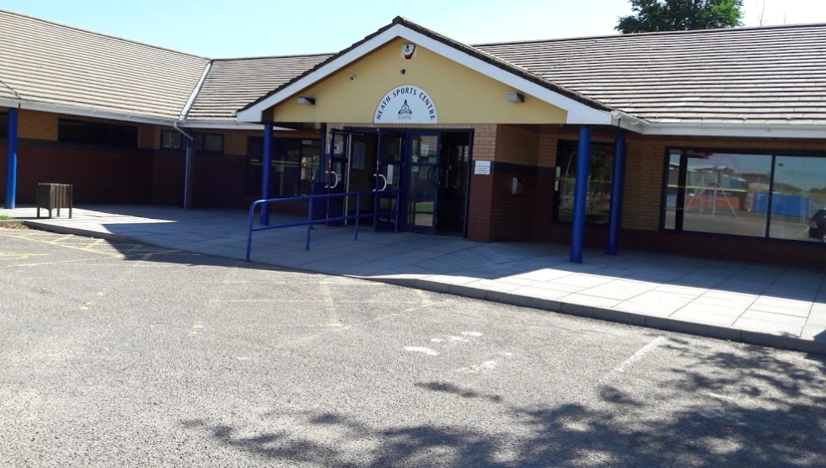

Critical Analysis of the Promotion and Retention Strategies at Neath Sports Centre.
Rhys Surringer

Slide 2
Research Rationale
WHY?
I have worked in the sports and leisure industry for over 10 years
I currently work at Neath Sports Centre as a Gym Instructor, Group Exercise Instructor and Supervisor.
I have seen a decline in participation at the gym and fitness classes due to an increase in competition in the area.

Slide 3
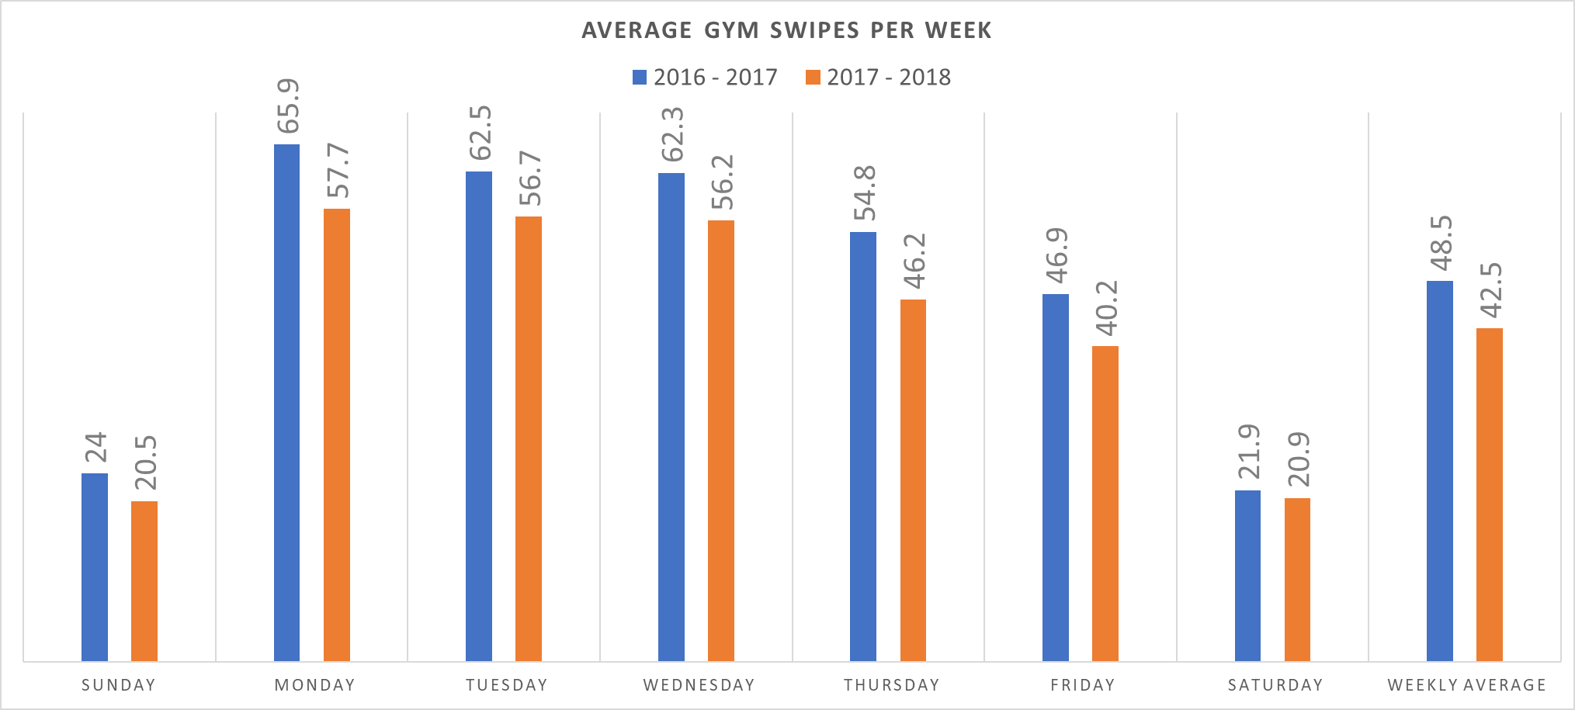
Neath Sports Centre

Slide 4
Neath Sports Centre

Slide 5
Aim
What am I looking for?
Critical evaluation of the recommended best practice framework for promotion and retention of customers at Neath Sports Centre.

Slide 6
Objectives
Evaluate the current market for best practice models in relation to recruitment and retention.
Analyse current practice at Neath Sports Centre with regard to their recruitment and retention strategy.
Identify key recommendations for improving future performance at Neath Sports Centre.

Slide 7
Background
Neath Sports Centre is part of Celtic Leisure, a not for profit leisure trust.
It was established in 2003 to manage leisure facilities on behalf of Neath Port Talbot Council.
Celtic Leisure manages six leisure facilities in the area.

Slide 8
Neath Sports Centre Background
'Neath Sports Centre caters for the fitness and leisure needs of the local and wider communities. Whether you’re a child looking to get into sport, local worker looking to get fit, or simply someone looking to unwind, this is the perfect place for you.'
'As well as the sport, fitness, and leisure offerings, the venue also houses a bar for all visitors as well as Centre users.'
24 station fitness gym
Strength and Conditioning gym
8 court sports hall
Athletics track and flood-lit field
All weather flood-lit pitch
Licensed bar
Creche Facilities

Slide 9
Miniature Literature Review
‘As a result of Nuffield Health's innovative approach they are already seeing real results in member engagement and motivation. 70 per cent of customers who have had a health MOT have retained membership, versus 53 per cent of those who have not had one. Retaining membership is the most important factor in terms of the outcome for the member and success of the health club.’ (PR Newswire Europe Including UK Disclose, 2010).
‘Online workouts more common than classes. Some 14% of UK adults have taken part in an online workout in the last 12 months. This makes them more likely to be done than a class at a private health and fitness club (9%) or boutique studio (6%). Taking part in online workouts is far more common amongst women than men at 18% versus 11%.’ (Walmsley, 2017).
‘Participants responded in similar ways, noting that routines such as lifting weights or using the cardio machines were not as enjoyable and added more to the monotony and obligation of having to be at the gym to keep oneself in good physical shape. Interestingly, if the workout involved sport or athletic competition participants were more apt to express enjoyment about going to the gym and working out.’ (Jakubauskas, 2009).

Slide 10
Access to resources
Access the reports from the current market in relation to recruitment and retention of customers.
Research the current practice at Neath Sports Centre with regard to their recruitment and retention strategy.
Question the existing customers at Neath Sports Centre.

Slide 11
Research Methodology
Self administrated Questionnaire for 80-100 existing customers.
Semi structured research interviews for Leisure Centre Managers.
Self administrated Questionnaire for 80 – 100 members of the public.

Slide 12
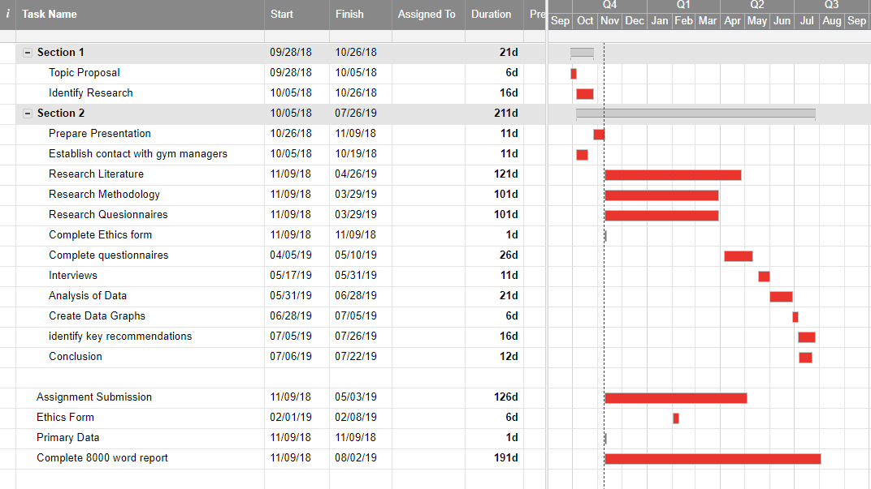
Timeline

Slide 13
References / Bibliography
Jakubauskas, M. (2009). Men's consumption of fitness and exercise: An exploration of motivations for exercise and fitness involvement.
Walmsley, D. (2017). Sports Participation - UK - September 2017 - Market Research Report. [online] Reports.mintel.com. Available at: http://reports.mintel.com/display/793797/# [Accessed 9 Nov. 2018].
PR Newswire Europe Including UK Disclose, (2010.) Nuffield Health Fitness & Wellbeing Finds Higher Retention Rate for Gym Members Who Undergo Health MOT. PR Newswire Europe Including UK Disclose, pp.PR Newswire Europe Including UK Disclose, Nov 22, 2010.

Slide 14
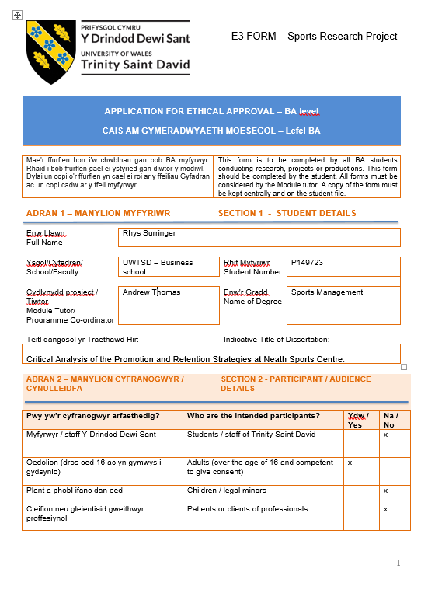
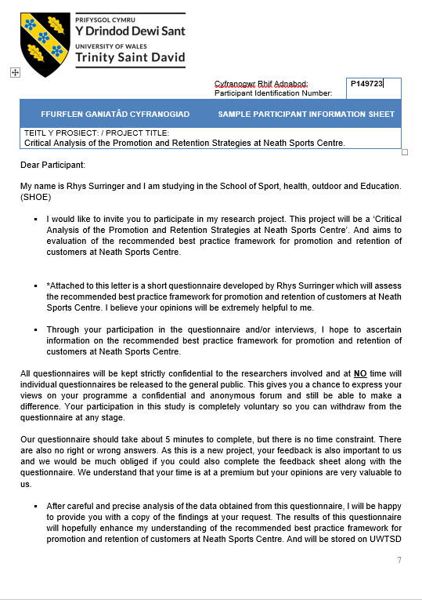
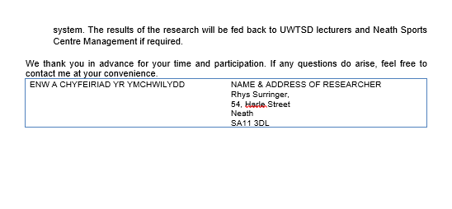
Ethical Considerations

Slide 15
Questions?

