Slide 1
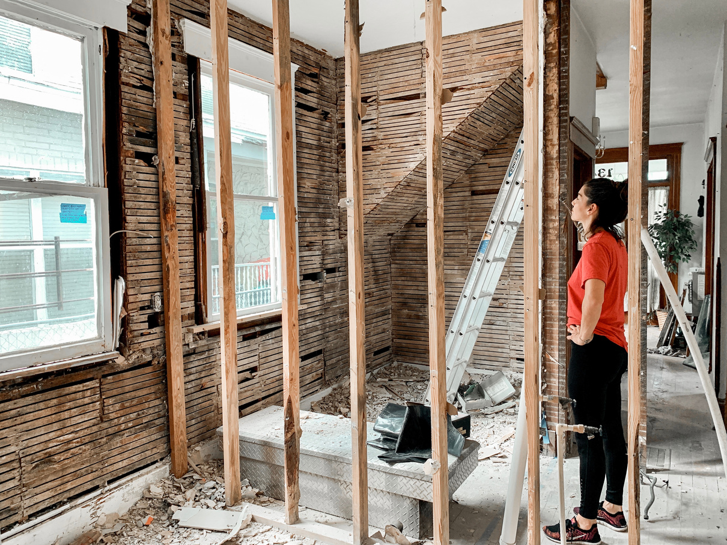
HavenDecor Ltd.
Business Plan Proposal
Programme: Certificate in Higher Education Business Skills for the Workplace
Module Name & Code: Enterprise and Entrepreneurship (LCLM4006)
Assignment Title: Part 2: Individual Presentation Pitch
Lecturer Name: Roopa Aruvanahalli Nagaraju
Student Name: Savarage Ackerson
Student ID: 2437754
Notes:
Good morning, everyone. My name is Savarage Ackerson, and today I am presenting the business proposal on HavenDecor Ltd This presentation describes our vision of a new entrant into the home interiors market one which will bridge the gap between minimalist design and traditional handcrafted art. Over the next five minutes, I will take you through what our concept is, our strategic advantages, and the $100 million or so cash roadmap we need to get this venture off the ground.

Slide 2
Table of Contents
Notes:
This is a slide shows the table of contents of the whole presentation.

Slide 3



Business Overview
HavenDecor Interior Design
Concept: A "Conscious Comfort" online brand bridging minimalist design with traditional handcrafted art.
Mission: To democratise sustainable luxury by sourcing directly from artisan cooperatives, ensuring fair wages while keeping prices accessible.
Product Line: Sustainable home goods including organic cotton textiles, recycled rugs, and hand-woven bamboo/rattan lighting.
@havendecorsite
Notes:
Let's begin with who we are. HavenDecor is operated on the basis of "Conscious Comfort". We are an online-first brand with a very specific mission: to democratise luxury sustainability. Traditionally, ethically sourced homeware comes with a hefty price tag which is alienating for the average buyer. We wish to solve this by getting the produce straight from the artisan cooperatives, ensuring honest pay for the creators, while keeping our retail prices reasonable (Shaw, 2019). Our first product range is based on sustainable essentials such as organic cotton textiles, recycled rugs, and hand-woven bamboo lighting. These products are addressing a growing market segment that wants to minimise the impact of their consumption on the environment, without throwing aesthetics out the window (Niinimaki et al., 2020).

Slide 4





Unique Selling Points
Story Driven Products
Virtual Stylish Service
Price Advantages
connecting the consumer to the artisan, unlike mass-market goods.
AR driven tools allowing consumers to visualise products in their own rooms
Due to direct sourcing, price roughly 30% lower than the high-end brands
@havendecrsite
Notes:
Moving to what makes us different in the market. First of all, we provide storey-driven products. Unlike mass-market goods, all of the goods connect the consumer to the artisan, adding value in terms of emotion and brand loyalty through narrative marketing (Lundqvist et al., 2013). Secondly, we are trying to tackle the main pain point of online furniture shopping, uncertainty, by introducing AR-driven tools. This technology delivers the capacity for customers to see a product in their own living spaces and this has been shown to be a significant factor in reducing return rates (Heller et al., 2016). Finally our direct-sourcing model gives us a unique price advantage and can time period price our goods about 30% less than high end sustainable assailants.

Slide 5

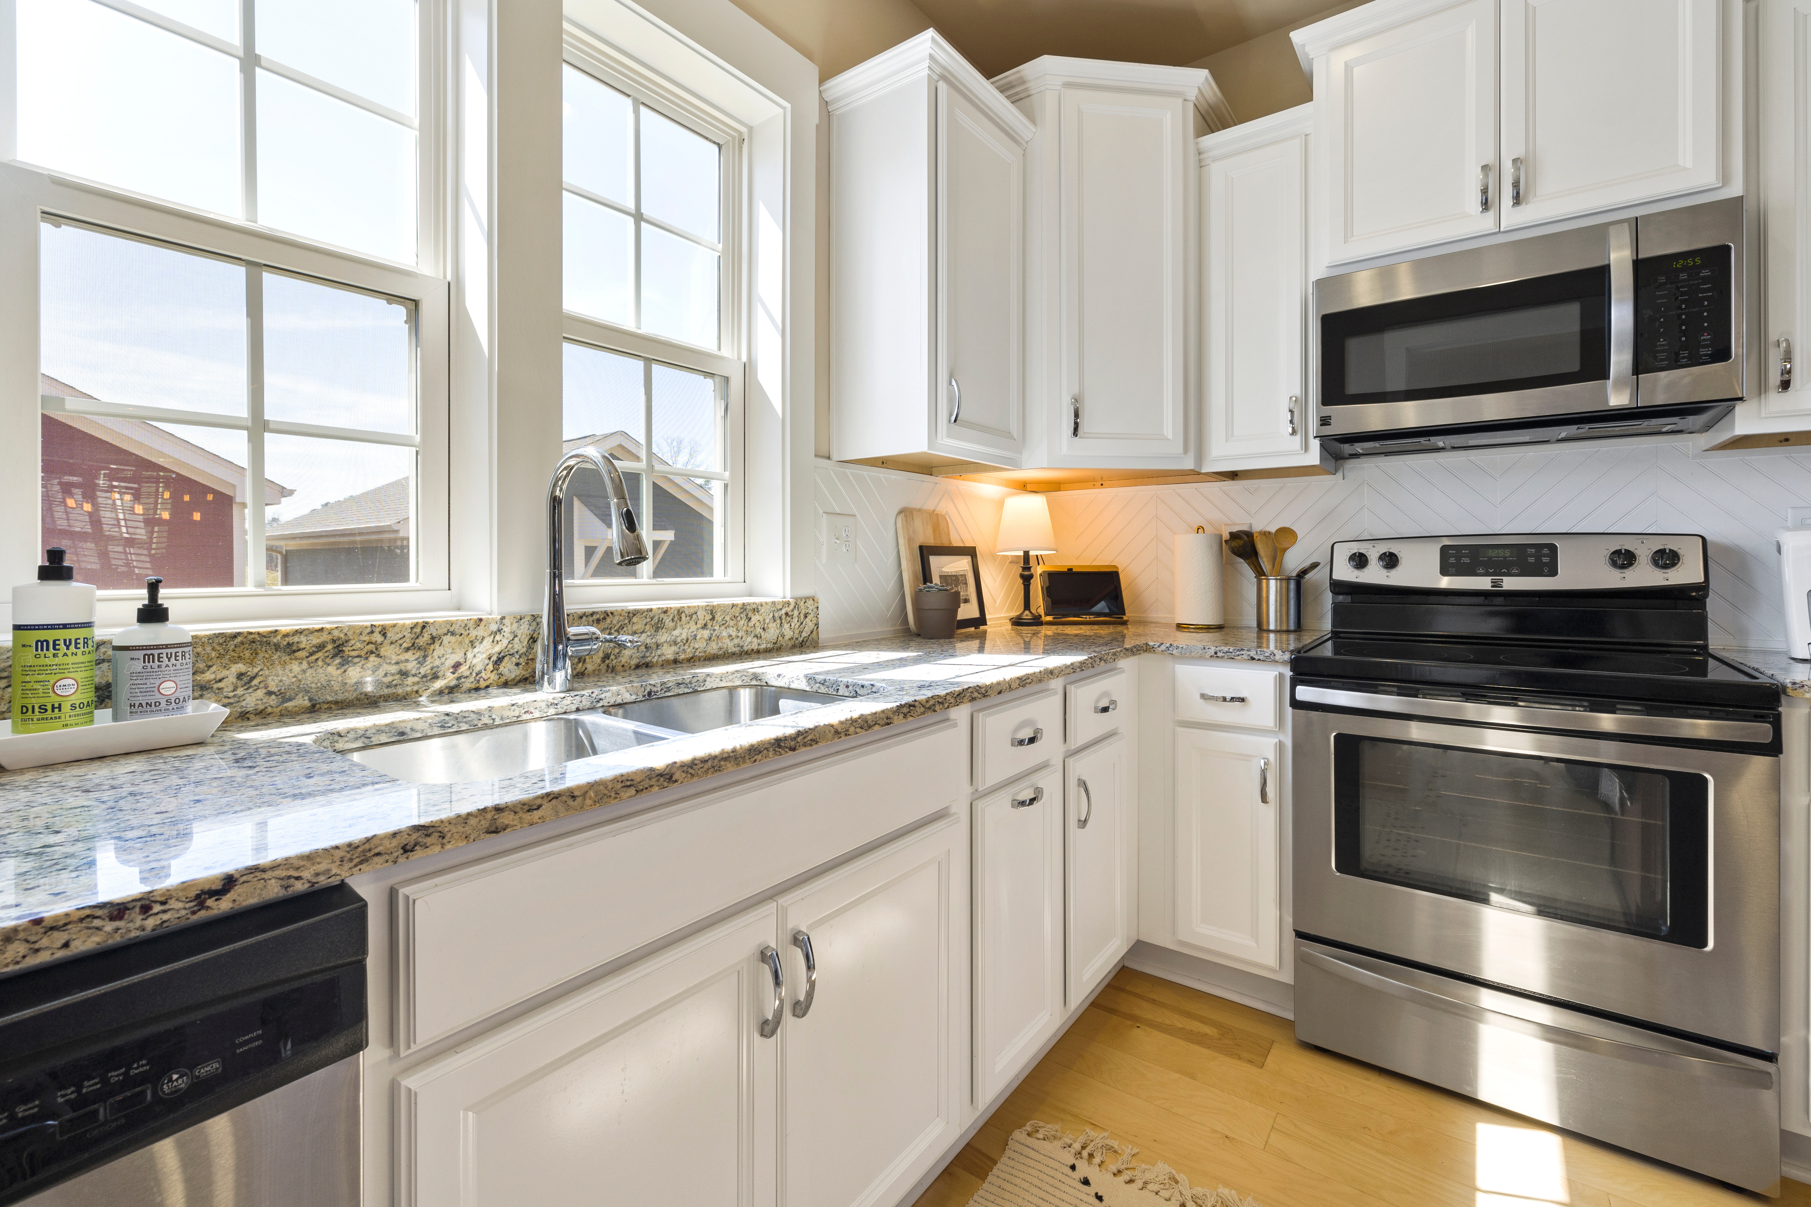


Management and Legal Structure
Legal Format:
Private Limited Company
Management Team:
  CEO: Vision, investor relations, and artisan partnerships.
  COO: Logistics, warehousing, and quality control.
  CMO: Brand strategy and customer acquisition.
  CTO (Outsourced): Managing e-commerce systems to minimize fixed costs.
@havendecorsite
Notes:
To implement this vision, we have set up the Private Limited Company form of organisation. This format offers the required liability protection for shareholders and now you have the ability to invest on scale. As Chief Executive Officer (CEO), I will be responsible for leading the vision and artisan partnerships. We have brought in a Chief Operating Officer (COO) to manage the complexity of the logistics and quality control and a Chief Marketing Officer (CMO) to lead customer acquisition. To stay lean on the startup methodology and keep down the fixed cost, we have chosen to outsource the role of Chief Technology Officer (CTO) to take care of our ecommerce platforms at the outset (Blank, 2013).

Slide 6


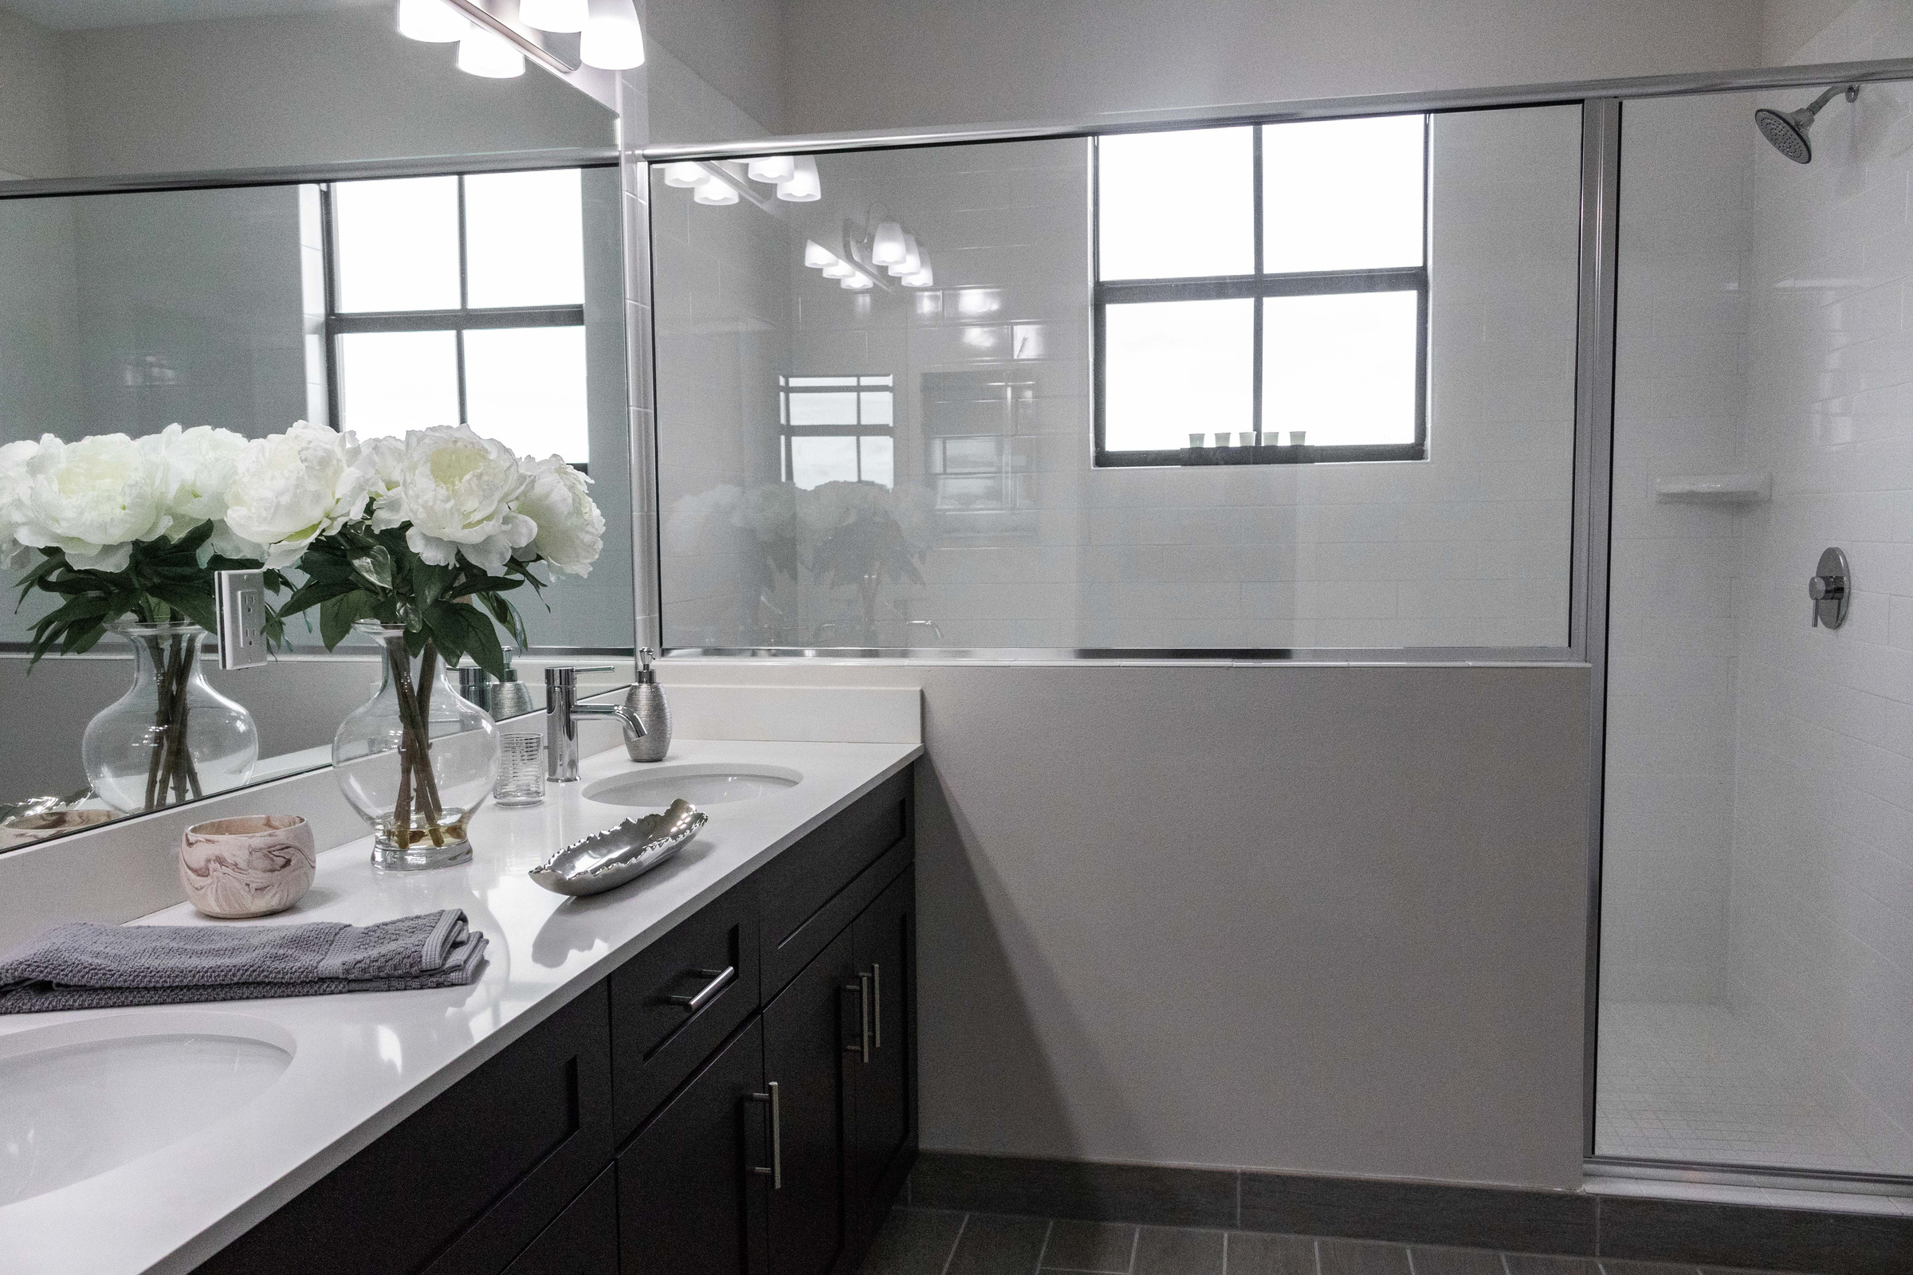
External Factors (PESTEL)
Social Factor
Conscious Consumerism- Younger generations are increasingly choosing to purchase from companies that share their moral values.
Work From Home Shift- Remote work has become a reality, transforming houses into multi-purpose spaces for business and relaxation, raising demand for aesthetics.
Economic Factor
Lipstick Effect- Despite high inflation, customers continue to spend on modest, cheap luxuries (like vases or cushions) to raise emotions while postponing major purchases (like houses/cars) (Mcdonald and Dildar, 2020).
Technological Factor
Customer Expectations- they expect to get simple online shopping and AR based visualisation services.
Notes:
Our timing for entry is supported by important factors from outside the industry. Socially, we are seeing 'Conscious Consumerism' on the rise. Younger generations, especially Gen Z and Millennials, are focusing on buying from companies with which they share their ethical values (Francis and Hoefel, 2018). Technologically, the move to working from home has transformed homes into multi-purpose spaces, causing people to desire aesthetic upgrades. We are taking advantage economically of the "Lipstick Effect." Research from MacDonald and Dildar (2020) shows that during inflationary periods, consumers still purchase relatively luxurious items they can afford - such as cushions or vases - to make themselves feel better, while waiting to make big-ticket items purchases such as a property or car.

Slide 7


Marketing Strategies
Social & Influencer
Instagram and Pinterest will serve as primary discovery platforms, with "shoppable posts" allowing for effortless purchasing (Nummelin, 2015).
Working with creators with modest but active audiences in interior design and sustainability.
B. Content & Retention
Launch of "The Haven Journal" blog, which will feature style advice for small spaces as well as material education (for example, the benefits of organic cotton).
Automated procedures, such as a "Welcome Series" that offers a 10% discount to new members, can help drive initial conversion.
www.havendecorltd.com
Notes:
Our marketing strategy is a digital-first marketing. Instagram and Pinterest will act as our main discovery engines - that will be used not only for brand awareness but as sales channels via "shoppable posts" that eliminate friction between discovery and purchase (Nummelin, 2015). We will work with micro-influencers within the interior design space that have a highly engaged audience. For retention we will launch "The Haven Journal", the content blog that provides style tips as well as material education. We will also have an automated email marketing including a "Welcome Series" which uses a discount as a sales promotion to new subscribers, as this is a tried and tested tactic to boost initial conversion rates (Chaffey and Ellis-Chadwick, 2019).

Slide 8



Funding Requirement and Sources
Total seed capital required is £150,000.
Source Breakdown:
Founder Contribution (20%): The owners invested £30,000.
Angel Investors (47%) raised £70,000 through the Seed Enterprise Investment Scheme (SEIS).
Start-Up Loan (33%), a £50,000 government-backed low-interest loan.
Notes:
Last, having a look at the financials. To start HavenDecor, we need total seed capital of 150,000 British pounds. We have secured 20% (£30,000) (in form of founder contributions) to prove commitment. We are looking to the Angel Investors for a £70,000 via Seed Enterprise Investment Scheme (SEIS), which provides tax reliefs to reduce the risk to the investor (HMRC, 2023). The remaining £50,000 is covered by a government-backed Start-Up Loan. This capital is spent mostly on buying inventory (£60,000), so that we meet demand and then platform development and a good marketing campaign to get off the ground.

Slide 9


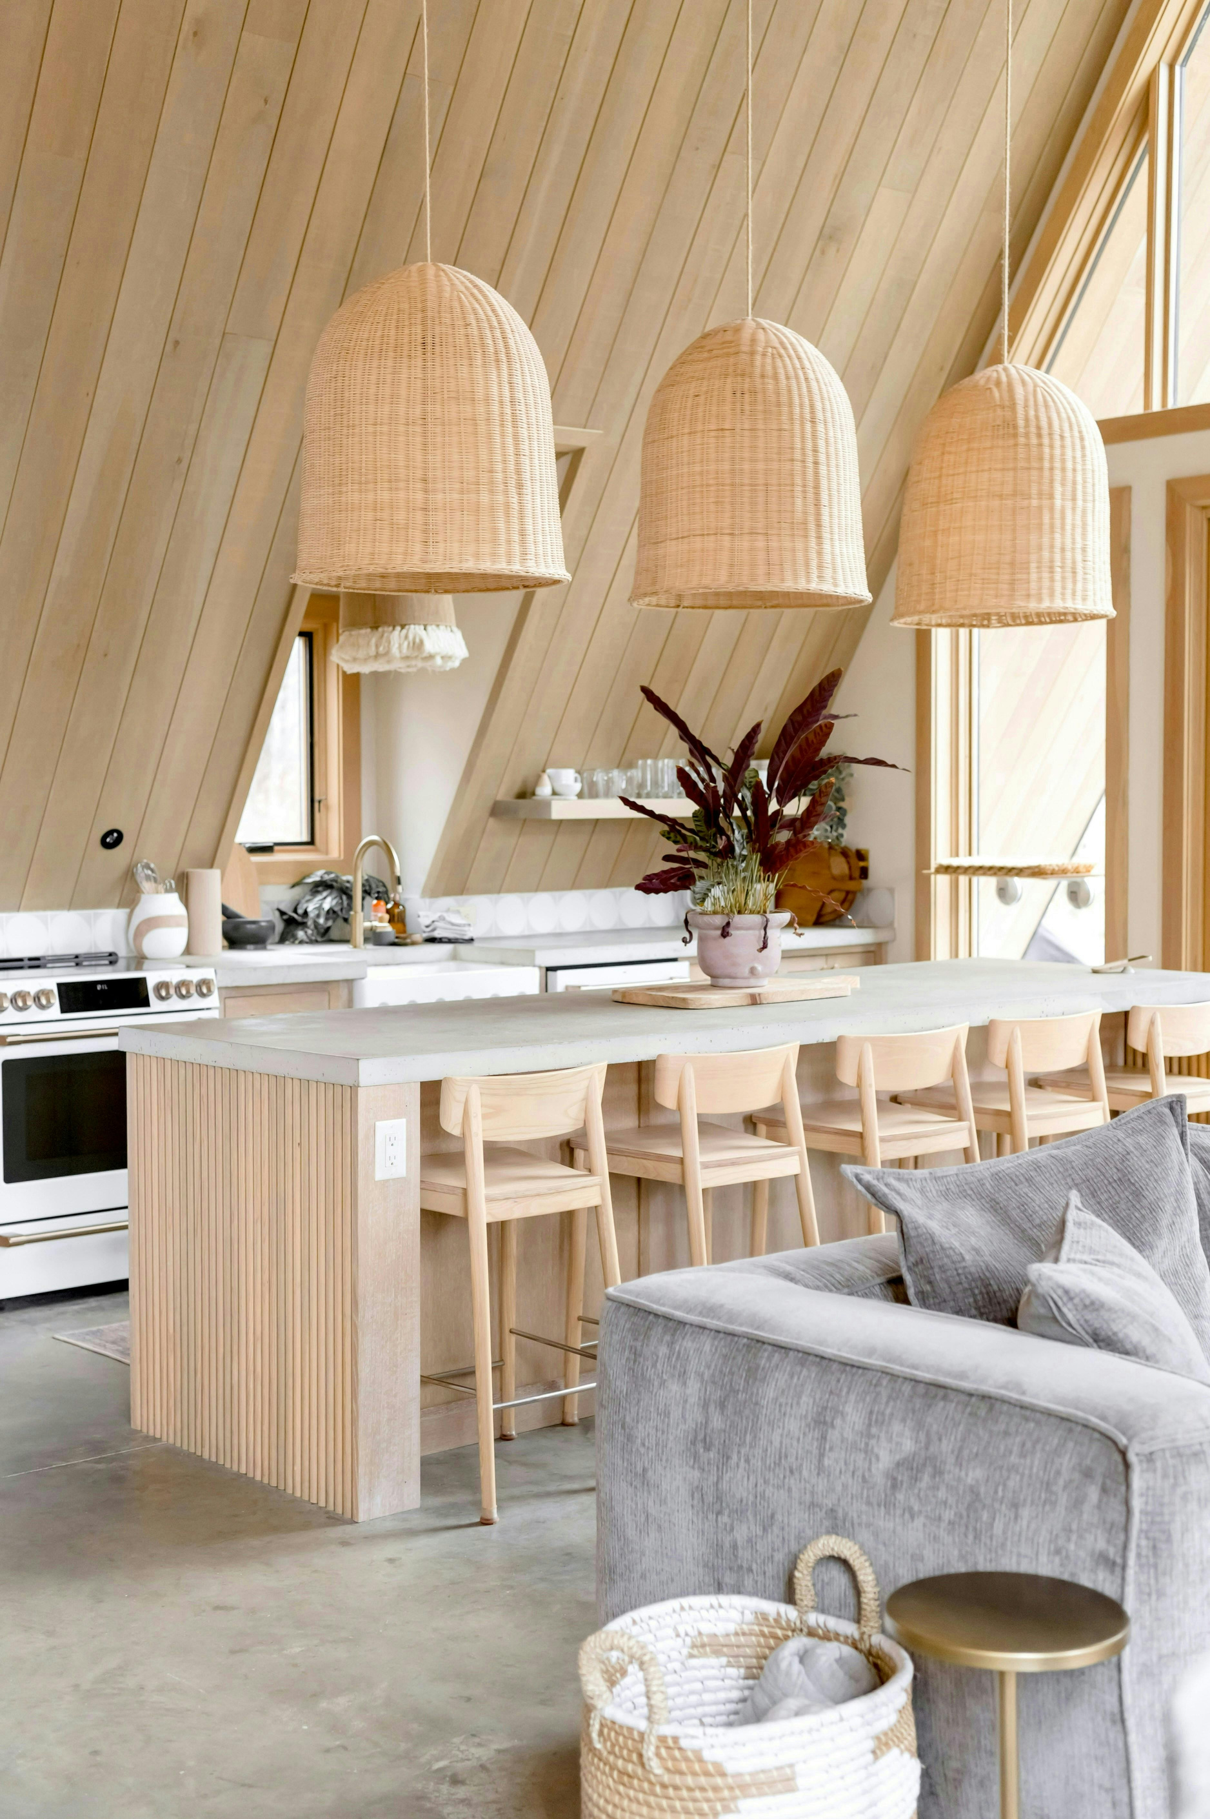
Estimated Expenditure
1st Month Projected Expenditures
Legal: £5,000 (Incorporation & contracts).
Logistics: £15,000 (Warehouse deposit & packaging).
Platform Development: £25,000 (Shopify Plus & AR integration).
Inventory Procurement: £60,000 (Bulk purchasing & freight).
Launch Marketing: £30,000 (Influencers, PR, Paid Ads).
Contingency: £15,000 (Reserve for currency/import variations).
Notes:
We have strategically allocated our £150,000 seed capital to have priority growth and stability. The largest portion, £60,000, is used for stock purchase before any stock decline occurs while the £30,000 is used for an aggressive launch marketing campaign for immediate traffic (Author). We are investing £25,000 in an e-commerce platform with high-tech that has AR to guarantee high conversion rates and the other remaining money guarantee important logistics, legal frameworks and the important contingency amount of £15,000 to cushion the risk of international supply chain volatility (Author).

Slide 10
References
Blank, S. (2013). The Four Steps to the Epiphany: Successful Strategies for Products that Win. 5th ed. Pescadero: K&S Ranch.
Chaffey, D. and Ellis-Chadwick, F. (2019). Digital Marketing: Strategy, Implementation and Practice. 7th ed. Harlow: Pearson.
Francis, T. and Hoefel, F. (2018). ‘True Gen’: Generation Z and its implications for companies. McKinsey & Company. Available at: https://www.mckinsey.com/industries/consumer-packaged-goods/our-insights/true-gen-generation-z-and-its-implications-for-companies [Accessed 20 May 2024].
Heller, J., Chylinski, M., de Ruyter, K., Mahr, D. and Keeling, D.I. (2016). Let Me Imagine That for You: Transforming the Retail Frontline Through Augmenting Customer Mental Imagery. Journal of Retailing, 92(2), pp.309–314.
HMRC (2023). Seed Enterprise Investment Scheme (SEIS). [online] GOV.UK. Available at: https://www.gov.uk/guidance/venture-capital-schemes-apply-to-use-the-seed-enterprise-investment-scheme [Accessed 22 May 2024].
Kotler, P., Armstrong, G. and Opresnik, M.O. (2021). Principles of Marketing. 18th ed. Harlow: Pearson Education.
Lundqvist, A., Liljander, V., Gummerus, J. and van Riel, A. (2013). The impact of storytelling on the consumer brand experience: The case of a firm-originated story. Journal of Brand Management, 20(4), pp.283–297.
MacDonald, D. and Dildar, Y. (2020). Social and psychological determinants of consumption: Evidence for the lipstick effect during the Great Recession. Journal of Behavioral and Experimental Economics, [online] 86, p.101527. doi:10.1016/j.socec.2020.101527.
Mintel (2023). Homewares Retailing: UK Market Report 2023. [online] Mintel Store. Available at: https://store.mintel.com/report/homewares-retailing-uk-market-report [Accessed 21 May 2024].
Niinimäki, K., Peters, G., Dahlbo, H., Perry, P., Rissanen, T. and Gwilt, A. (2020). The environmental price of fast fashion. Nature Reviews Earth & Environment, 1(4), pp.189–200.
Nummelin, M. (2015). Instagram as a Marketing Tool: A Qualitative Study on Social Media Marketing for Swedish Interior Design SMEs. Bachelor’s Thesis. Luleå University of Technology.
Osterwalder, A. and Pigneur, Y. (2010). Business Model Generation: A Handbook for Visionaries, Game Changers, and Challengers. Hoboken, NJ: John Wiley & Sons.
Porter, M.E. (2008). The Five Competitive Forces That Shape Strategy. Harvard Business Review, 86(1), pp.78–93.
Shaw, D. (2019). The Conscious Consumer: Promoting Economic Justice Through Fair Trade. London: Routledge.
Statista (2023). E-commerce share of total retail sales in the United Kingdom (UK) from 2008 to 2023. [online] Statista. Available at: https://www.statista.com/statistics/285978/e-commerce-share-of-retail-sales-in-uk/ [Accessed 21 May 2024].
Notes:
This is a slide that appears in the academic and industrial sources that were used to back up this business plan.

Slide 11
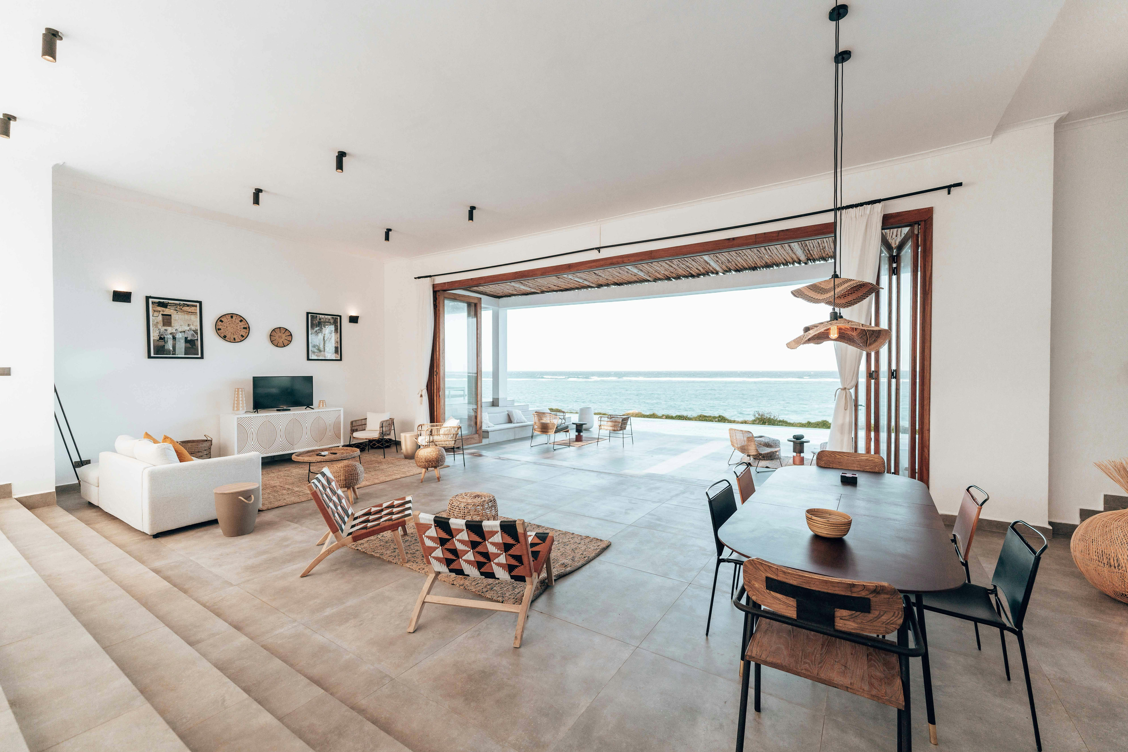


Thank you so much
  @havendecorsite
  Anywhere St., Any City
Notes:
Thank you for the time and attention. I truly believe HavenDecor is in a position to capture the hearts of the conscious consumer and I am happy to take questions you may have.

