Slide 1
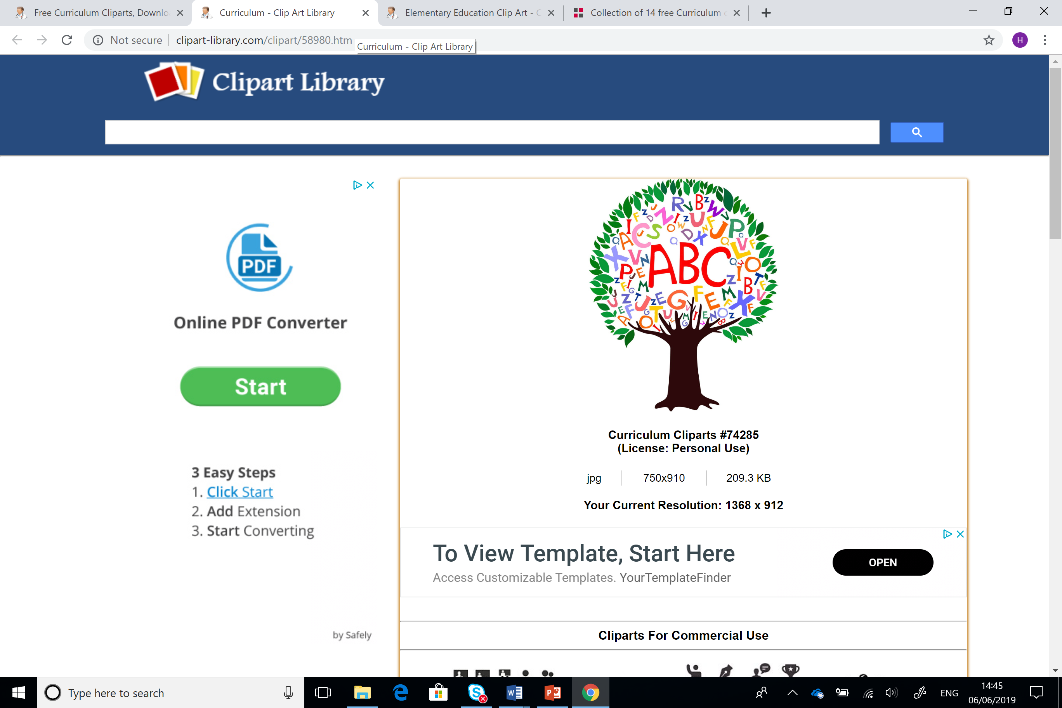
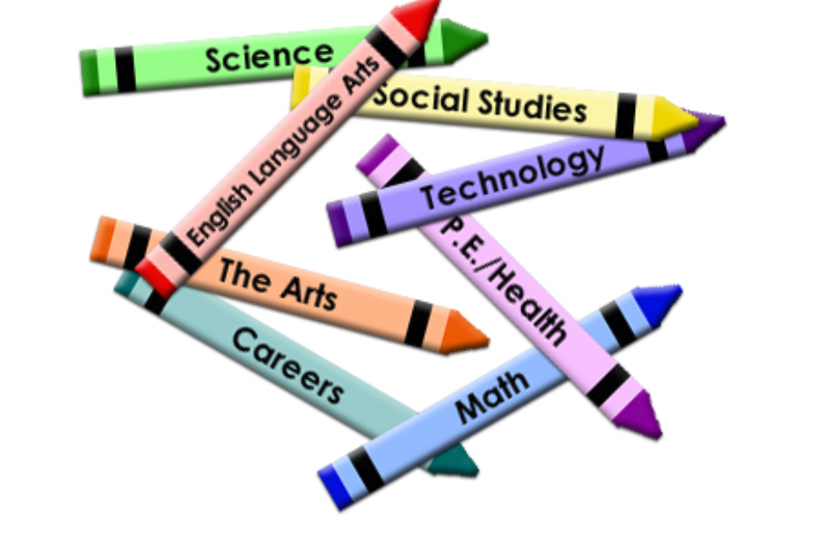
Astudiaethau Cwricwlwm ac Asesu
Curriculum and Assessment
Sesiwn 3/Session 3

Slide 2
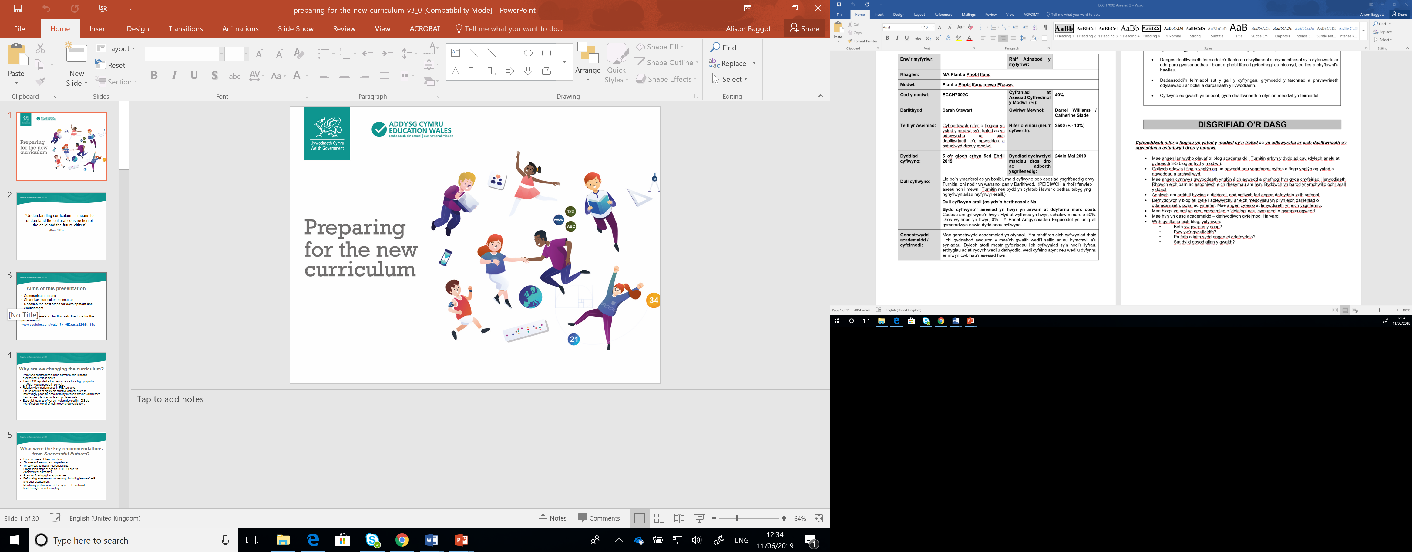
Cwricwlwm i Gymru 2022
Curriculum for Wales 2022
Ar hyn o bryd mae cwricwlwm newydd yn cael ei ddatblygu yng Nghymru
Bydd y cwricwlwm newydd yn cael ei gyflwyno yn 2022
Pa argraff a gewch chi am fwriad y cwricwlwm newydd o’r clip canlynol:
https://www.youtube.com/watch?v=0jEaastz224&t=14s
(Welsh Government, 2019)
At present there is a new curriculum being developed in Wales.
This new curriculum will be introduced in 2022
What impressions do you get about the aspirations of the new curriculum from the following clip
https://www.youtube.com/watch?v=0jEaastz224&t=14s

Slide 3
Pam bod angen newid y cwricwlwm?
Why is there a need for curriculum change?
Y teimlad bod diffygion yn y system bresennol a gyda threfniadau asesu
Perfformiad isel yn arolygon PISA
Cynnwys manwl a lefelau uchel o atebolrwydd o fewn ysgolion yn arwain at lai o greadigrwydd
Cwricwlwm presennol wedi ei ddyfeisio yn 1988 a dim yn adlewyrchu y byd technolegol, global presennol
(Llywodraeth Cymru, 2019)
Perceived shortcomings in the current curriculum and assessment arrangements.
Relatively low performance in PISA surveys.
A very prescriptive content and high levels of accountability has led to less creativivity within schools
Essential features of our curriculum devised in 1988 do not reflect our world of technology and globalisation.
(Welsh Government, 2019)

Slide 4


Beth sy’n newid?
What’s changing?
More emphasis on skills and applying knowledge
More emphasis on digital competence
Teachers will have more freedom in the way they teach
Curriculum for Wales 2022 has been developed to reflect the strengths that the Foundation Phase has brought to education in Wales in the way they teach
Mwy o bwyslais ar sgiliau a defnyddio gwybodaeth
Mwy o sylw ar gymhwysedd digidol
Mwy o ryddid i athrawon yn y ffordd maent yn dysgu
Cwricwlwm wedi ei ddatblygu i adeiladu ar gryfderau’r Cyfnod Sylfaen a’r ffordd mae hwn yn cael ei addysgu

Slide 5

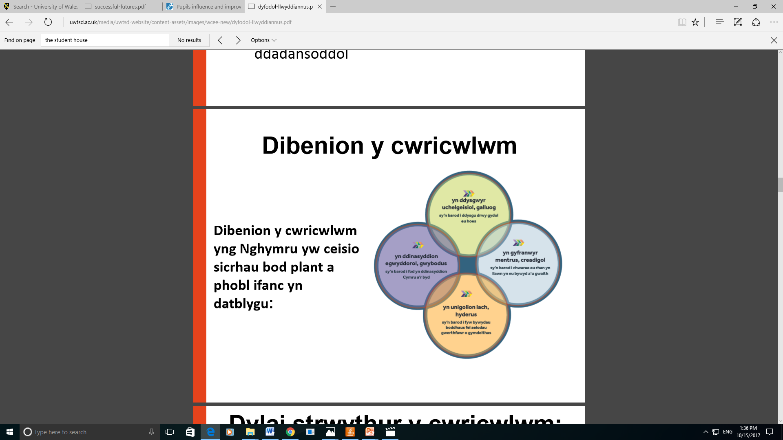
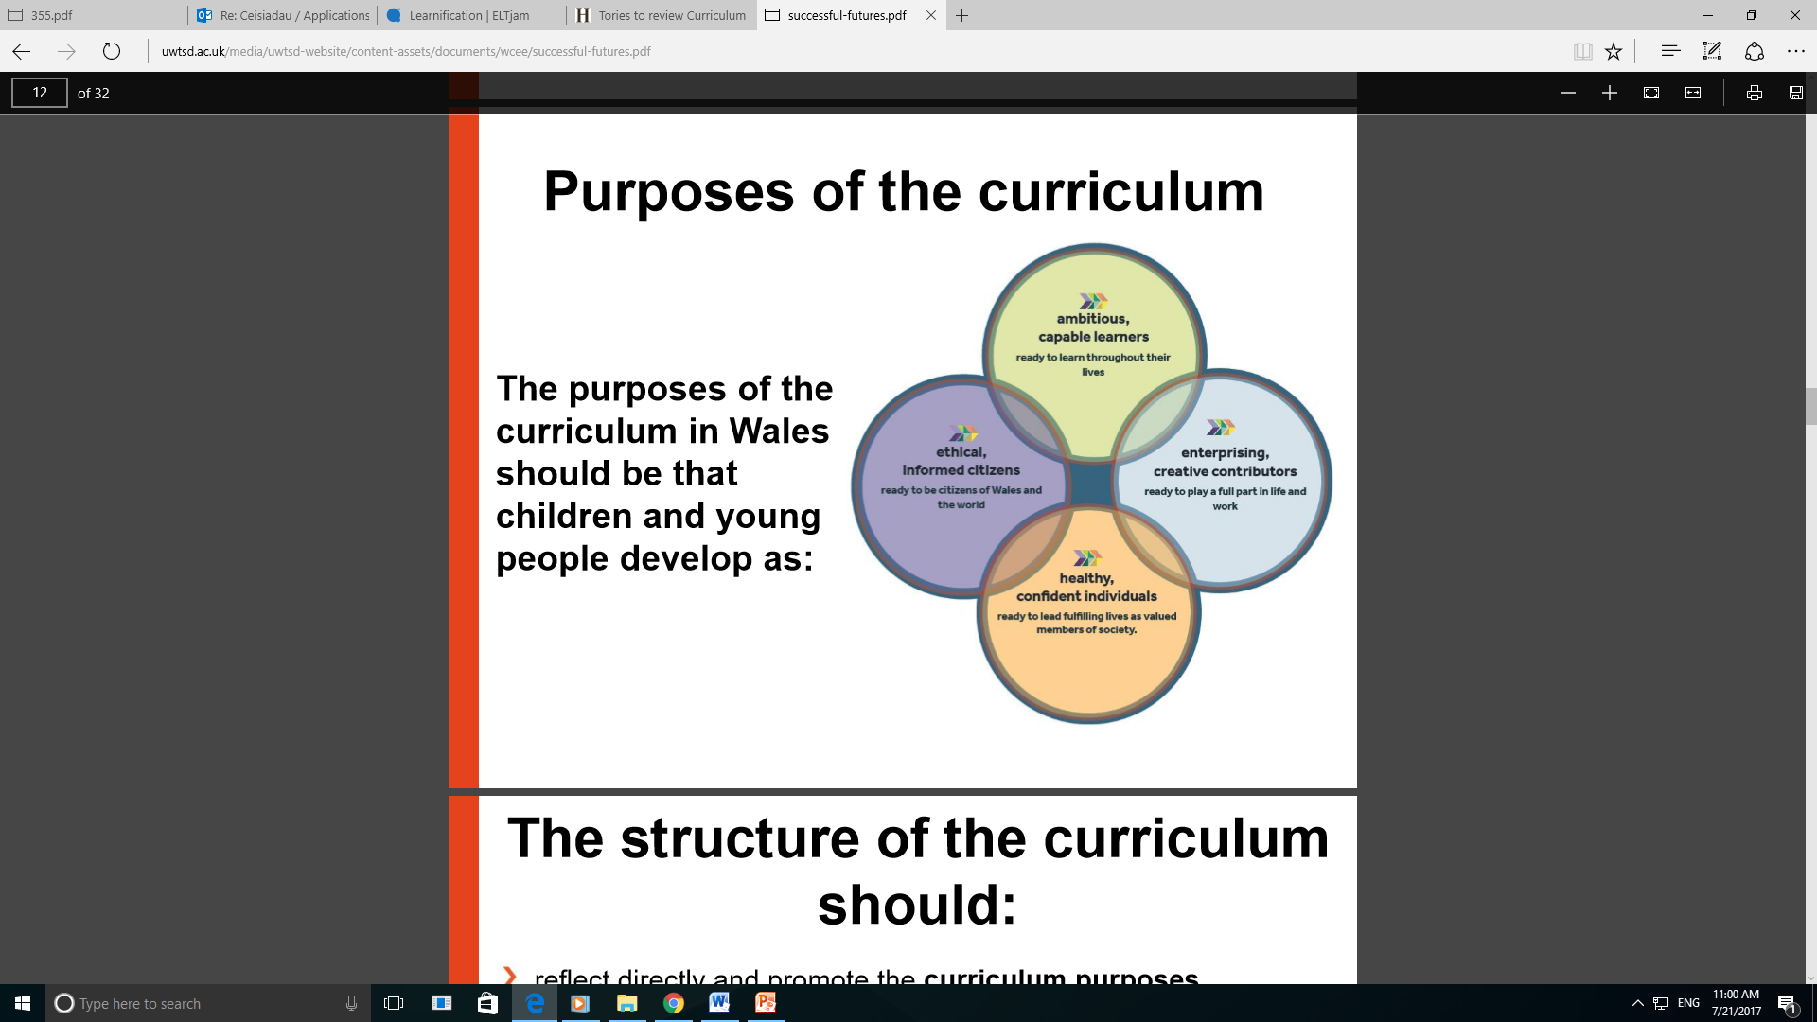
Beth sy’n newid?
What’s changing?
Pedwar diben y cwricwlwm
Four purposes of the curriculum
(Donaldson, 2015)
Notes:
New Welsh curriculum – what makes it so different? – YouTube
4-purposes-of-education.jpg (2700×1891) (d6vsczyu1rky0.cloudfront.net)

Slide 6






Meysydd Dysgu a Phrofiad
Celfyddydau Mynegiannol
Dyniaethau
Iechyd a Lles
Gwyddoniaeth a Thechnoleg
Mathemateg a Rhifedd
Ieithoedd, Llythrennedd a Chyfathrebu
Mae’r cwricwlwm newydd wedi cael ei drefnu i feysydd dysgu a phrofiad – sut mae hyn yn wahanol i’r cwricwlwm presennol?

Slide 7
Areas of learning and experience
Expressive Arts
Humanities
Health and Well-being
Science and Technology
Mathematics and Numeracy
Languages, Literacy and Communication
The new curriculum is organised along areas of learning and experience – how is this different from the current curriculum?

Slide 8

Meysydd dysgu a phrofiad
Areas of learning and experience
Mae’r meysydd dysgu a phrofiad wedi eu cynllunio i weithio gyda’i gilydd fel rhan o gwricwlwm cyfan.
Dylid penderfynu sut i weithredu rhain o ddydd i ddydd yn yr ysgolion unigol. Dylai dysgu gael ei gynllunio ar draws y gwahanol meysydd dysgu a phrofiad, gan adeiladu ar gysylltiadau, dibyniaethau a rhyng- ddibyniaethau
The areas of learning and experience are designed to operate together as part of a holistic curriculum.
Decisions as to how these should translate into day-to-day activities should take place in settings and schools. Learning should be coherent and planned across the different areas of learning and experience, building on inherent links, dependencies and interdependencies

Slide 9
Datganiadau o’r hyn sy’n bwysig/llwybrau
Statements of ‘what matters’/strands
  The new curriculum areas of learning and experience are organised along ‘what matters’ statements.
  These ‘what matters’ statements cover key ideas in this area of learning and experience
  Mathematics and Numeracy example
Mae’r cwricwlwm newydd wedi ei drefnu ar hyd datganiadau o’r hyn sy’n bwysig o fewn y meysydd dysgu a phrofiad
Mae’r datganiadau o’r hyn sy’n bwysig yma yn cwmpasu syniadau allweddol yn y maes dysgu ac addysgu
Enghraifft Mathemateg a Rhifedd

Slide 10

Cynnydd
Progression
Y bwriad yw y bydd pob dysgwr yn symud ar hyd yr un continwwm dysgu ar gyfer pob maes dysgu a phrofiad, a hynny o 3 i 16 oed. Caiff cynnydd ei nodi drwy gamau cynnydd ar bum pwynt ar y continwwm dysgu, sy’n cyfateb yn fras i’r disgwyliadau ar gyfer dysgwyr 5, 8, 11, 14 ac 16 oed.
Yng nghanllawiau’r meysydd dysgu a phrofiad, mynegir camau cynnydd drwy gyfres o ddeilliannau cyflawniad ar gyfer pob datganiad o’r hyn sy’n bwysig.
Camau cynnydd Mathemateg a Rhifedd
The intention is that learners will progress along the same continuum of learning for each area of learning and experience from ages 3 to 16. Progression is signalled through progression steps at five points on the continuum of learning, relating broadly to expectations at ages 5, 8, 11, 14 and 16.
In the area of learning and experience guidance, progression steps are articulated through a series of achievement outcomes for each what matters statement.
Progression steps for Mathematics and Numeracy

Slide 11
Cynllunio ar gyfer dysgu
Planning for learning
Cysylltiadau gyda meysydd eraill o ddysgu a phrofiad
Profiadau, gwybodaeth a sgiliau – mae’r adran hon yn fan cychwyn ar gyfer dylunio a datblygu’r cwricwlwm o fewn ysgolion
Links within and with other areas of learning and experience
Experiences, knowledge and skills – this section is a common starting point for curriculum design and development in schools.

Slide 12
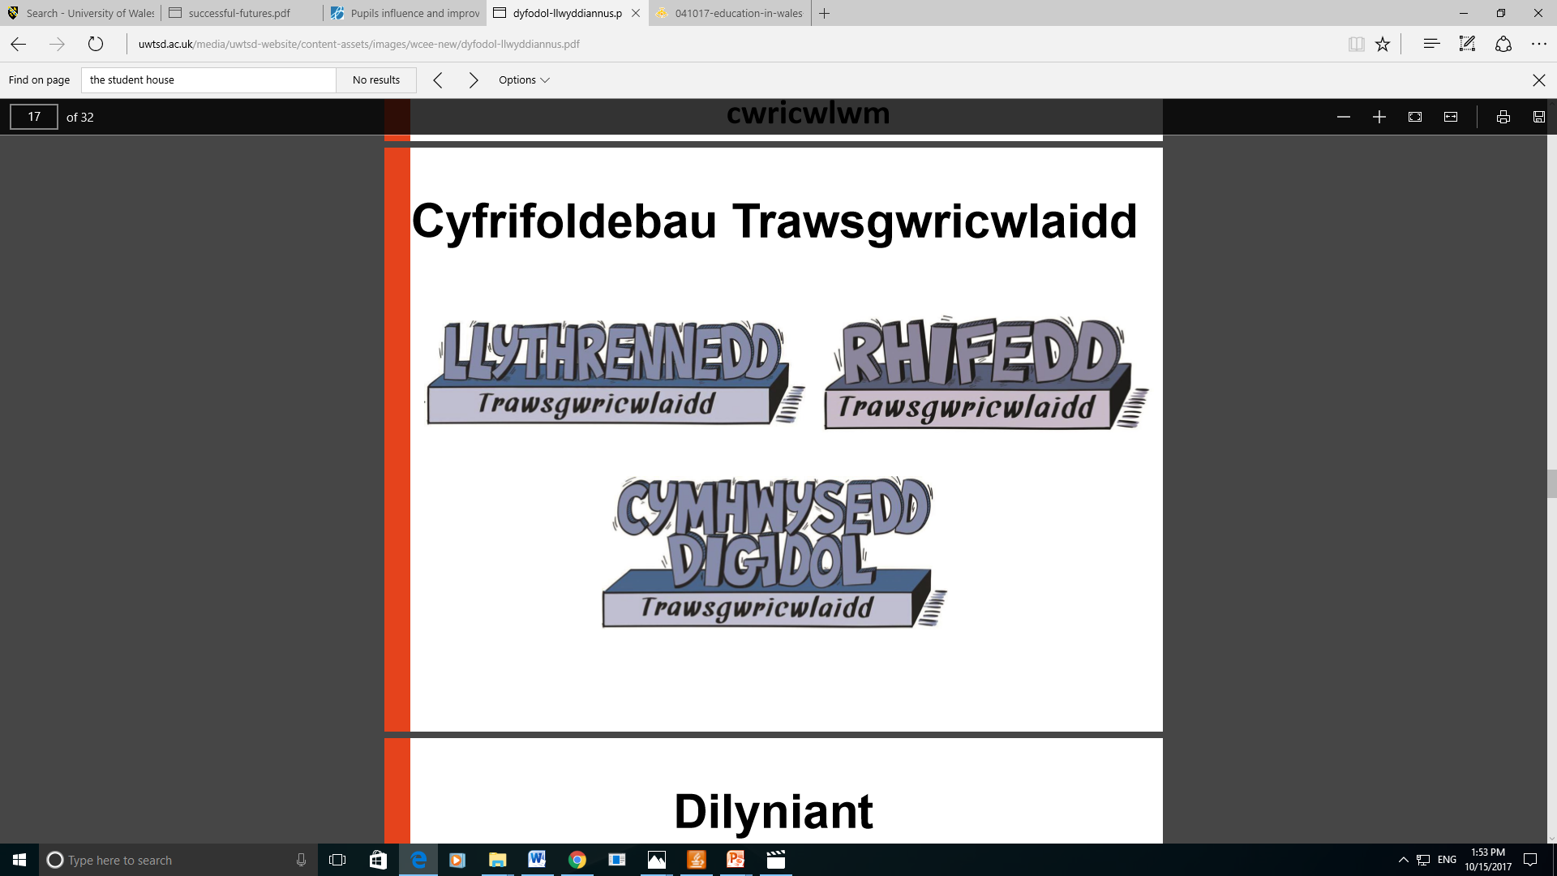
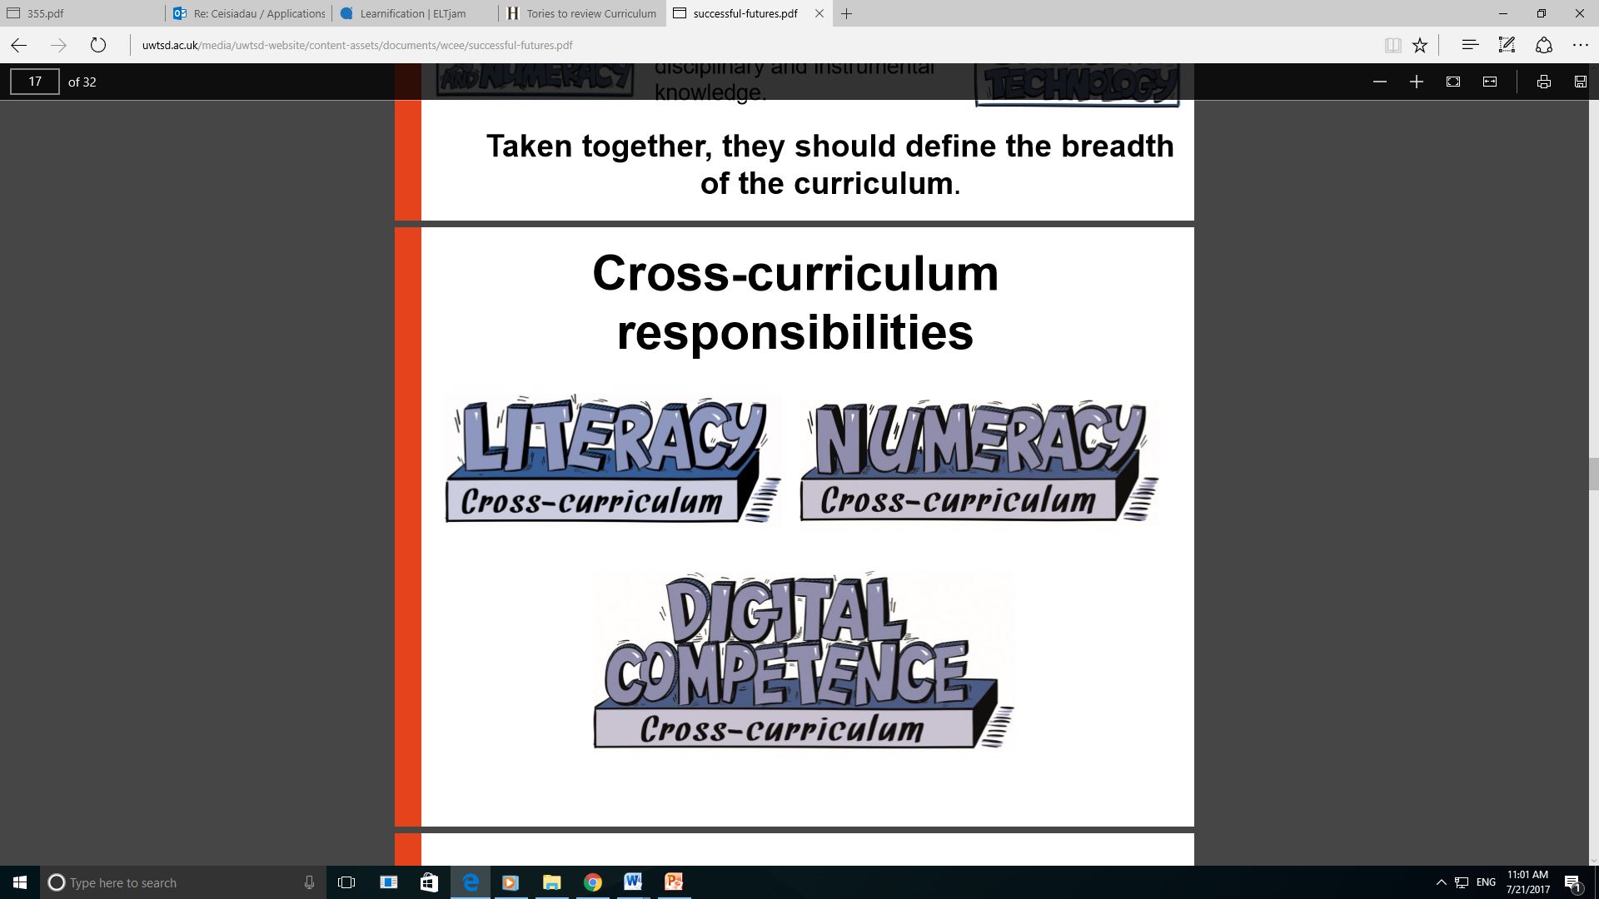
Cyfrifoldebau traws –gwricwlaidd
Cross –curricular responsibilities

Slide 13
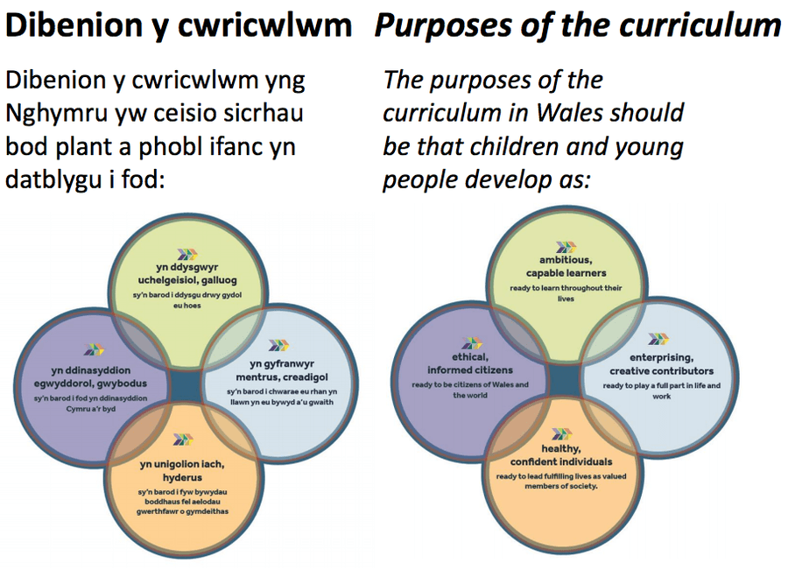
Beth arall sy’n cael ei gynnwys yn y cwricwlwm newydd?
What else is included in the new curriculum?
Addysg cydberthynas a rhywioldeb
Addysg grefyddol
Y Gymraeg a Saesneg
Y dimensiwn Cymreig a’r persbectif rhyngwladol
Sgiliau ehangach
Addysg hawliau dynol a Chonfensiwn y Cenhedloedd Unedig ar Hawliau’r Plentyn
Gyrfaoedd a phrofiadau sy’n gysylltiedig â gwaith
Relationships and sexuality education
Religious education
The Welsh and English languages
Welsh dimension and international perspective
Wider skills
Human rights education and the United Nations Convention on the Rights of the Child
Careers and work-related experiences

Slide 14
Tasg / Task:
Dewisiwch un maes dysgu a phrofiad:
https://hwb.gov.wales/cwricwlwm-i-gymru
Mewn grwpiau cynlluniwch weithgaredd sy’n cwrdd â gosodiadau ‘yr hyn sy’n bwysig’ yn y maes hwn
Ystyriwch unrhyw gysylltiadau y gellir gwneud i feysydd dysgu a phrofiad eraill er mwyn datblygu dysgu traws-gwricwlaidd
Choose one key area of learning and experience: https://hwb.gov.wales/curriculum-for-wales
In groups plan an activity which meets the ‘what matters’ statements for this area of learning and experience
Consider how your activity could link with other areas of learning and experience to develop cross – curricular learning.

Slide 15

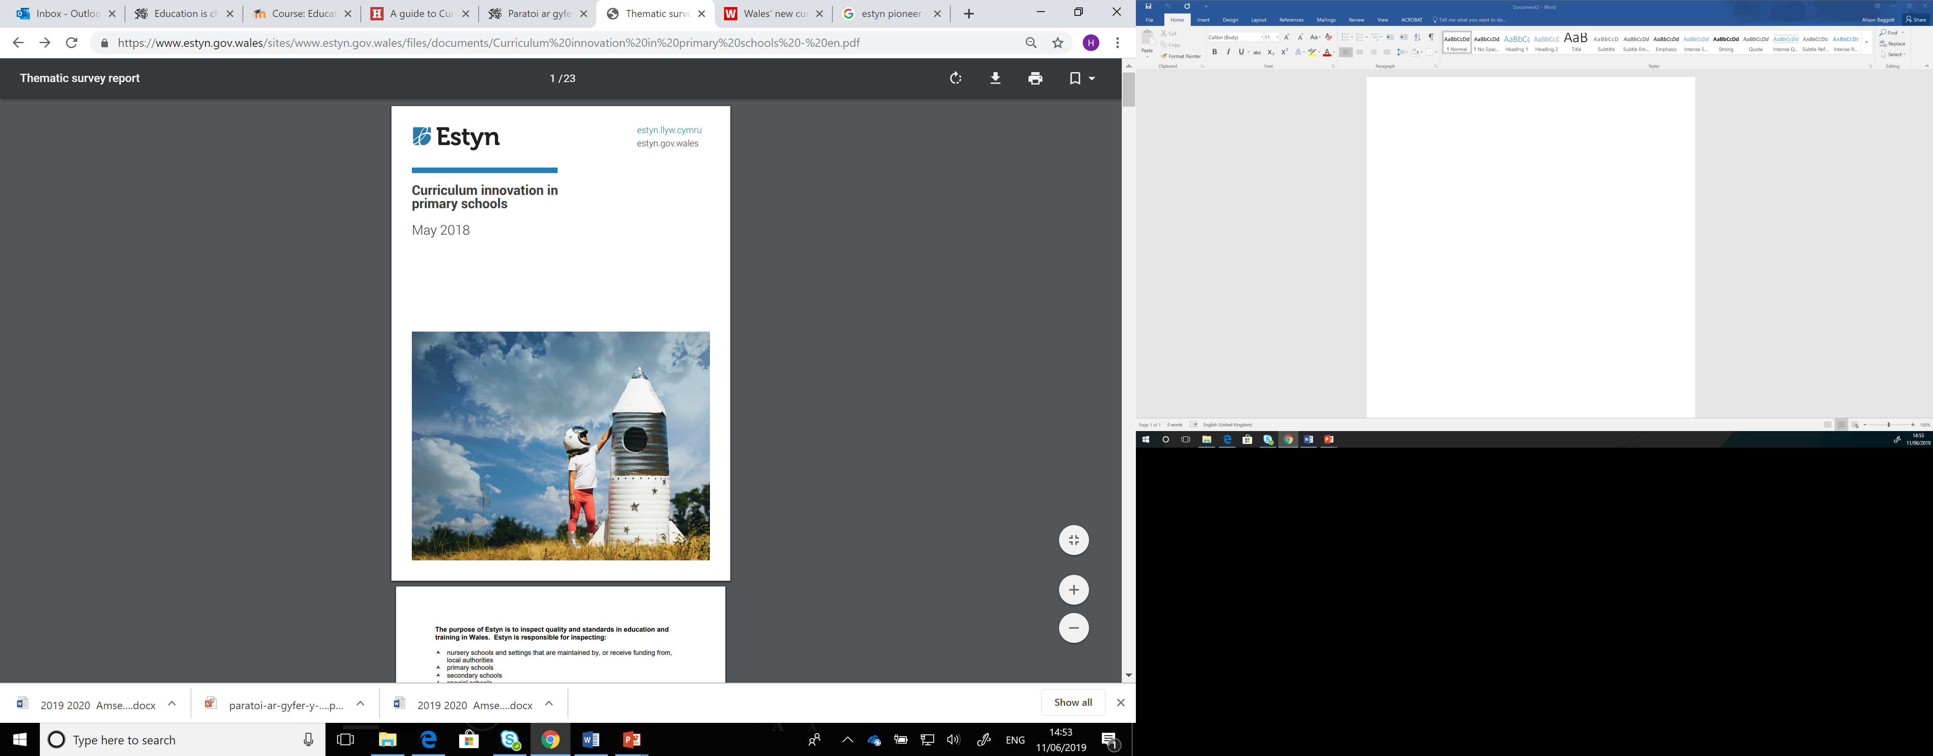
Ysgolion Arloesol
Pioneer Schools
Dilynwch y ddolen i’r ddogfen uchod: https://www.estyn.llyw.cymru/adnoddau-gwella/esblygu-arferion-y-cyfnod-sylfaen-yng-nghyfnod-allweddol-2-yn-cynhyrchu-cwricwlwm-arloesol/
Edrychwch ar astudiaeth achos ‘Ysgol Heulfan’
Sut mae’r ysgol hon yn cwrdd â gofynion y cwricwlwm newydd
Pa ddulliau addysgu arloesol sydd yma?
(Estyn, 2018)
Follow the link to the above document. https://www.estyn.gov.wales/effective-practice/evolving-foundation-phase-practices-key-stage-2-generates-pioneering-curriculum
Look at the case study ‘Ysgol Heulfan’
How does this school meet the needs of the new curriculum?
What innovative teaching and learning approaches are used here?

Slide 16
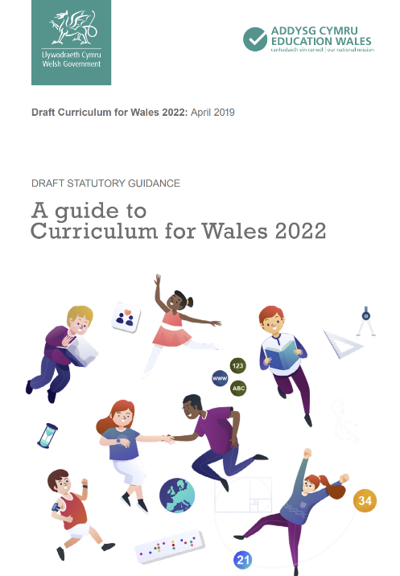
Cymhwysedd digidol/Digital competence
The new curriculum outlines the importance of Digital Competence introduced in schools through the Digital Competence Framework in 2017
Mae’r cwricwlwm newydd yn amlinellu pwysigrwydd Cymhwysedd Digidol a gyflwynwyd yn ysgolion yn 2017 trwy’r Fframwaith Cymhwysedd Digidol

Slide 17
Y Fframwaith Cymhwysedd Digidol
The Digital Competency Framework
Gwyliwch y clip (Ysgol Gynradd Yr Eglwys yng Nghymru Usk) canlynol a thrafodwch gyda phartner beth yw nod y FfCD a sut mae’r ysgol hon wedi ei ymgorffori drwy ddull ysgol-gyfan. Beth yw’r buddiannau i’r disgyblion?
Watch the following clip (Usk Church in Wales Primary School) and discuss with your partner what the DCF aims to achieve and how the school has incorporated it through a whole-school approach. What are the benefits for the pupils?

Slide 18
Y Fframwaith Cymhwysedd Digidol
The Digital Competence Framework
“Cymhwysedd digidol yw’r set o wybodaeth, sgiliau ac agweddau i alluogi defnydd hyderus, creadigol a hollbwysig o dechnolegau a systemau. Mae’n galluogi person i fod yn ddinesydd digidol hyderus, i ryngweithio a chydweithio’n ddigidol, i gynhyrchu gwaith yn ddigidol ac i fagu hyder mewn perthynas â thrin data a meddwl cyfrifiadurol (datrys problemau).”
LlC, 2016
“Digital competence is the set of knowledge, skills and attitudes to enable the confident, creative and critical use of technologies and systems. It is the skillset that enables a person to be a confident digital citizen, to interact and collaborate digitally, to produce work digitally and to be confident in handling data and computational thinking (problem solving).”
WG, 2016

Slide 19
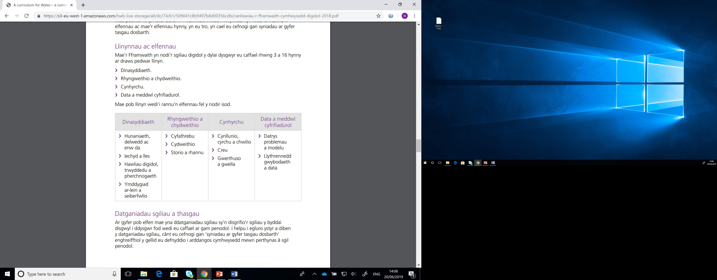
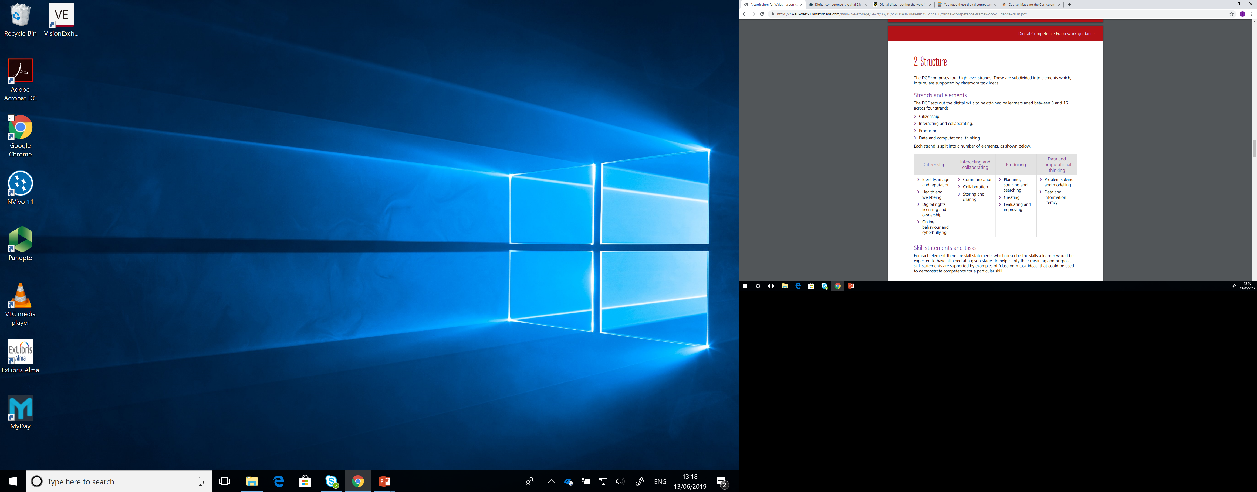
Strwythyr / Structure
Pedwar llinyn ac elfennau o fewn bob llinyn
Four strands and elements within each strand

Slide 20
Dinasyddiaeth / Citizenship
Deall beth mae’n ei olygu i fod yn ddinesydd digidol a gwneud cyfraniad cadarnhaol i’r byd digidol o’u cwmpas
I fod yn barod am agweddau cadarnhaol a negyddol o fod yn ddinesydd digidol
Datblygu strategaethau i’w cefnogi nhw i fod yn gynhyrchwyr a defnyddwyr digidol
Understand what it means to be a digital citizen making a positive contribution to the digital world around them
To be prepared for the positive and negative aspects of being a digital citizen.
Develop strategies to support them to become independent consumers and producers

Slide 21
Rhyngweithio a chydweithio
Interacting and collaboration
Archwilio gwahanol ddulliau cyfathrebu electronig
Storio data
Dulliau ffurfiol ac anffurfiol o gyfathrebu
Rhannu data
Cydweithio electronig
Explore methods of electronic communication
Store data
Formal and informal methods of communication
Sharing data
Electronic collaboration

Slide 22
Cynhyrchu / Producing
Cynllunio (gan gynnwys chwilio am wybodaeth), creu, gwerthuso a gwella cynnwys digidol
Creu gan ddefnyddio amrediad eang o ddulliau amlgyfrwng
Planning (including searching for and sourcing information), creating, evaluating and improving digital content.
create using a wide range of multimedia components

Slide 23
Data a meddwl cyfrifiadurol
Data and computational thinking
dealltwriaeth o bwysigrwydd data a llythrennedd gwybodaeth drwy archwilio agweddau ar gasglu, cynrychioli a dadansoddi data
Mae meddwl cyfrifiadurol yn gyfuniad o sgiliau ymholi gwyddonol, datrys problemau a meddwl
learners will gain an understanding of the importance of data and information literacy by exploring aspects of collection, representation and analysis.
Computational thinking is a combination of scientific enquiry, problem solving and thinking skills

Slide 24
Tasg / Task
Mewn grwpiau edrychwch ar y Fframwaith Cymhwysedd Digidol (FfCD)
Defnyddiwch y fframwaith i weld sut allwch chi gynnwys rhyw elfen o gymhwysedd digidol yn y weithgaredd a gynlluniwyd yn y dasg cynt neu…
Dyfeisiwch dasg sy’n cynnwys o leiaf dau linyn o’r Fframwaith Cymhwysedd Digidol
In groups look at the Digital Competence Framework (DCF).
Use the framework to see how you could include some aspect of digital competence into the activity you developed in the previous task or…
Devise a task covering at least two of the strands on the Digital Competence Framework

Slide 25
Iechyd a Lles – maes dysgu newydd
Health and Wellbeing – a new area of learning
Gwyliwch y clip ac ysgrifennwch ddisgrifiad byr yn egluro beth rydych chi’n meddwl yw pwrpas y maes dysgu a phrofiad hwn
Watch the following clip and write a short description of what you think this area of learning and experience is about
https://www.youtube.com/watch?v=oSIWo5nxF2A
Beth allai hyn gynnwys?
What could this include?

Slide 26
Iechyd a Lles
Health and Wellbeing
Successful learning dependent on good health and well-being
Support good mental, emotional, well-being and physical health
Encourage positive relationships
Encourage pupils to make good choices with regard health
Pupils to consider how social influences may impact their values/behaviour
Enable learners to develop the behaviours, habits and dispositions which will support their health and well-being in a rapidly changing world
(Welsh Government, 2019)
Cyswllt clir rhwng dysgu llwyddiannus a iechyd a lles da
Cefnogi iechyd meddwl, emosiynol, lles a chorfforol
Annog perthnasau positif
Annog disgyblion i wneud penderfyniadau doeth ynglyn a iechyd
Disgyblion i ystyried effaith dylanwadau cymdeithasol arnynt
Datblygu ymddygiadau ac arferion fydd yn cefnogi eu iechyd a’u lles mewn byd sy’n newid yn gyflym
(Llywodraeth Cymru, 2019)

Slide 27
Tystiolaeth i gefnogi Iechyd a Lles
Evidence to support Health and Wellbeing
Cynulliad Cymru (2018) Cadernid Meddwl
‘Mae’r diwygiad cyfredol o’r cwricwlwm yn gyfle unwaith-mewn cenhedlaeth i brif-ffrydio lles emosiynol ac iechyd meddwl mewn addysg. Ymhellach, mae ysgolion yn helpu i hyrwyddo lles a chefnogi plant a phobl ifanc i ddatblygu’r gwydnwch a meithrin y sgiliau sydd eu hangen i fynd i’r afael â straen a phryder’
Welsh Assembly (2018) Mind over Matter
‘Reform of the curriculum in Wales offers a once-in-a-generation opportunity to embed well-being into our children’s lives. Furthermore, schools are ideally placed to make a significant contribution to building an emotionally resilient population of young people, reducing stigma and promoting good mental health.’

Slide 28
Tystiolaeth i gefnogi Iechyd a Lles
Evidence to support Health and Wellbeing
Cynulliad Cymru (2019) Gweithgarwch Corfforol Ymhlith Plant a Phobl Ifanc
Argymhellion yn cynnwys:
Lleihau’r bylchau mewn sgiliau modur sydd i’w gweld ar hyn o bryd yn y Cyfnod Sylfaen yn ganolbwynt y cwricwlwm newydd
Trafod gyda disgyblion pa weithgareddau corfforol bydden nhw’n hoffi
O leiaf 120 munud yr wythnos ar ymarfer corff safonol
Welsh Assembly (2019) Physical Activity of Children and Young People
Recommendations included:
Gaps in developing motor skills in the Foundation Phase to be addressed with the new curriculum
Consult with pupils on what physical activities they would like
At least 120 minutes a week on good quality physical education

Slide 29
Beirniadaeth o’r maes dysgu Iechyd a lles
Criticism of the new Health and Well-being area of learning
Mae barwnes Grey – Thompson a nifer o ACau yn anhapus gyda’r cwricwlwm newydd oherwydd nid oes amser yn cael ei glustnodi’n benodol ar gyfer Addysg Gorfforol. Byddai hi’n dymuno gweld o leiaf 2 awr yr wythnos
Maent yn pryderu bydd hyn yn arwain at ymarfer corff yn dod yn llai pwysig
Mae mwy na ¼ o blant 4 a 5 oed yn ysgolion Cymru yn or-dew erbyn hyn.
Baroness Grey-Thompson and many AM are unhappy with the new curriculum because there is no stipulated time for PE– they would like to see at least 2 hours a week
They fear this will lead to PE becoming marginalised in the new curriculum
More than a ¼ of 4 and 5 year olds in Welsh schools are now obese.
(Health, Social care and Sports committee cited in BBC news, 2019)

Slide 30
Rhestr Gyfeirnodi
Reference list
Carpenter, A. (2018) School’s Week: What role should schools play in teaching pupils to spot fake news? Available online: https://schoolsweek.co.uk/what-role-should-schools-play-in-teaching-pupils-to-spot-fake-news/ (accessed 13/6/19)
School Education Gateway (2017) Digital Competence. Available online: https://www.schooleducationgateway.eu/en/pub/resources/tutorials/digital-competence-the-vital-.htm (accessed 13/6/19)
Estyn (2018) Preparing for the Digital competency Framework. Available online: https://www.estyn.gov.wales/sites/www.estyn.gov.wales/files/documents/Preparing%20for%20the%20DCF%20eng.pdf (accessed 13/6/19)
European Commission (2018) Boosting children’s digital literacy - an urgent task for schools https://ec.europa.eu/jrc/en/news/boosting-children-s-digital-literacy-urgent-task-schools
National Literacy Trust (2018) Fake news and critical literacy. Available online: file:///C:/Users/A.Baggott/Downloads/Fake_news_and_critical_literacy_-_final_report.pdf (accessed 13/6/19)
UNICEF (2017) Children in a Digital World. Available online: https://www.unicef.org/publications/files/SOWC_2017_ENG_WEB.pdf (accessed 19/6/19)
Welsh Government (2015) Well-being of Future Generations Act. Available online: https://futuregenerations.wales/wp-content/uploads/2017/02/150623-guide-to-the-fg-act-en.pdf (accessed 19/6/19)
Welsh Government (2017) Education in Wales: Our National Mission. Available online: https://gov.wales/sites/default/files/publications/2018-03/education-in-wales-our-national-mission.pdf
Welsh Government (2017) Digital Competence Framework Guide. Available online: https://s3-eu-west-1.amazonaws.com/hwb-live-storage/6e/7f/33/19/c3494e069deaeab755d4c156/digital-competence-framework-guidance-2018.pdf (accessed 20/6/19)

Slide 31
Rhestr cyfeirnodi
Reference list
Crowter, (2019) BBC news: Wales NHS bill will rise without PE lessons. Available online: https://www.bbc.co.uk/news/uk-wales-48597716 (accessed 12/6/19)
Estyn (2018) Curriculum Innovation in Primary Schools. Available online: https://www.estyn.gov.wales/thematic-reports/curriculum-innovation-primary-schools (accessed 12/6/19)
Estyn (2019) Happy and healthy: School impact on pupils’ health and wellbeing. Available online: https://www.estyn.gov.wales/sites/www.estyn.gov.wales/files/documents/Healthy%20and%20Happy%20report%20En_0.pdf (accessed 12/6/19)
Welsh Assembly (2018) Mind over matter: A report on the step change needed in emotional and mental health support for children and young people in Wales. Available online: https://www.assembly.wales/laid%20documents/cr-ld11522/cr-ld11522-e.pdf (accessed 12/6/19)
Welsh Assembly (2019) Physical Activity of Children and Young People. Available online: http://www.assembly.wales/laid%20documents/cr-ld12369/cr-ld12369-e.pdf (accessed 12/6/19)
Welsh Government (2019) Draft curriculum for Wales: Health and Wellbeing. Available online: https://s3-eu-west-1.amazonaws.com/hwb-live-storage/b3/3c/8c/5f/267e48f8bf37c66bd3d8bb5b/draft-statutory-guidance-health-and-well-being.pdf (accessed 12/6/19)
Welsh Government (2019) A guide to curriculum for Wales 2022. Available online: https://s3-eu-west-1.amazonaws.com/hwb-live-storage/cd/b4/f8/7c/b7d34ffb968d9a09de4d460c/a-guide-to-curriculum-for-wales-2022.pdf (accessed 12/6/19)
Whitehead, M. (2010) Physical literacy throughout the lifecourse. (New York: Routledge)

