Slide 1
BMIH6001
BA International Hotel Management
Contemporary Themes in the Hotel and Hospitality Sector.
Student Name luciana maria dobra
Student ID 2019290

Slide 2
I Confirm that I have not used any AI tools in the research and creation of this assignment. I confirm that I have not presented any AI generated materials as my own work. I confirm I have copies of my drafts, notes, and other resources I used, which I may be asked to provide in evidence.

Slide 3
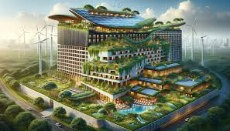
Introduction
Sustainability is now a crucial focus in the hotel and hospitality industry.
Consumers demand eco-friendly practices, pushing hotels to adopt green initiatives.
Sustainability is not just a trend but a competitive advantage for hotels.
Major players like Hilton, Premier Inn, and Savoy Hotel are leading the way in green initiatives, setting a benchmark for the industry.
As sustainability continues to evolve, hotels must adapt or risk falling behind, making it a pivotal issue for future growth and success.
Notes:
Rising consumer awareness and environmental concerns make sustainability essential. Hotels must focus on environmental sustainability to be competitive. Eco-friendly business methods are gaining popularity among governments and customers. Travellers are increasingly choosing sustainable hotels—millennials and Gen Z are willing to pay more (Nowacki et al., 2023). Hotels must promptly adapt to this customer preference shift to stay competitive. Many hotels are implementing green practices like trash management, water conservation, and energy-efficient technology. These methods reduce environmental impact and save money over time. Premier Inn has installed solar panels, and Hilton has smart energy management systems. After the UK passed the Climate Change Act, which mandates huge carbon emission reduction, government regulations are tightening. This law requires hotels to be sustainable or face fines.

Slide 4

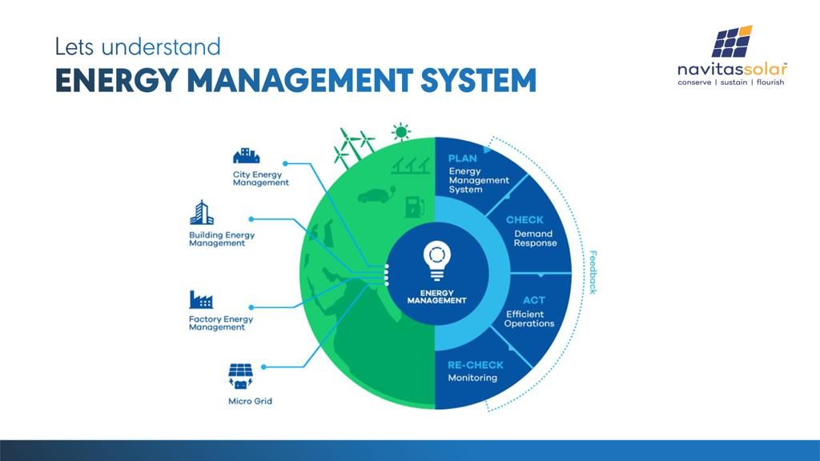
Overview of Literature
Growing demand for sustainability (Cooper & Hall, 2019).
LEED-certified buildings and renewable energy use
Real-time energy management systems
Greywater recycling in water-scarce areas.
ISO 14001 and Green Tourism Business Scheme (GTBS) certifications.
Importance of green credentials for guest satisfaction.
Notes:
Academics like Cooper & Hall (2019) say investors, governments, and customers drive sustainability demand. Sustainability is becoming a financial strategy for hotels, not only a moral or ethical option. Green techniques are helping hotels reduce their environmental footprint and gain a competitive edge. Dawson et al. (2012) say energy efficiency, waste management, and water conservation are the three primary sustainability pillars of hotels. Hotels are investing in energy-efficient technology to reduce energy use and boost their environmental credentials. One of the biggest achievements in this industry is using LEED-certified buildings, which use solar panels and geothermal energy to reduce carbon emissions. LEED-certified UK hotels and others aid the nation's sustainability goals, according to Clegg et al. (2021). Premier Inn reduced its energy expenditures and environmental effect by installing solar panels and energy-efficient lighting (Conrady & Buck, 2012). Real-time energy management systems allow hotels to optimise energy use, especially during low occupancy (Cooper & Hall, 2019). These systems are popular because they improve visitor comfort without wasting electricity. Discuss garbage management. Hotels are aiming to reduce landfill waste. Hilton has led the way with zero-waste programs. These programs emphasise recycling and composting to minimise landfill waste (Brotherton, 2015). Hilton UK hotels recycle and compost over 50% of their waste, avoiding landfills. Even smaller boutique hotels use similar strategies, but less so. Trash reduction, which helps the environment, boosts the hotel's reputation among eco-conscious guests. Hotels are also improving water conservation. Many UK hotels use water reclamation, smart irrigation, and low-flow fittings, especially in water-scarce areas (Brotherton, 2015). The Ritz-Carlton in London has a rainwater harvesting system to reduce laundry and irrigation water use. Some southern England hotels recycle greywater to minimise water use. Government regulations also affect hotel sustainability. The UK's Climate Change Act of 2008 and goal of carbon neutrality by 2050 have encouraged hotels to adopt greener practices (Dawson et al., 2012). These criteria may help hotels avoid penalties and get government subsidies, making sustainability financially viable. More hotels are demonstrating sustainability with ISO 14001 and GTBS certificates. Paban, (2020) believe hotel visitors with these certificates are happier, proving green credentials' marketing potential.

Slide 5
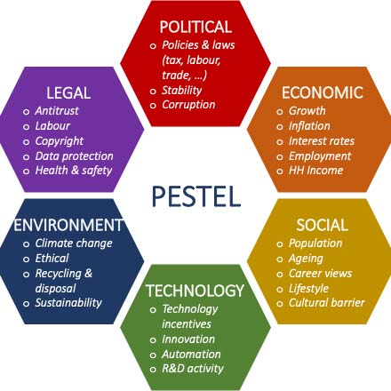
Application to the Hotel and Hospitality Sector: PESTEL Analysis
Political Factors:
Government regulations, e.g., Climate Change Act (2008).
Government incentives: subsidies and tax credits.
Industry pressure for energy-efficient systems and waste management.
Economic Factors:
High costs of sustainable investments (LEED-certified buildings).
Long-term savings vs. initial financial burden.
Financial challenges for small and independent hotels.
Social Factors:
Rising demand for eco-friendly hotels.
Influence of millennials and Gen Z travelers.
Guest support for green practices, but inconsistent engagement.
Technological Factors:
Adoption of energy-efficient technologies (smart thermostats, solar panels) (López-Bernabé et al., 2021).
Real-time energy management systems.
Cost barriers for smaller hotels.
Environmental Factors:
Hotels as major contributors to carbon emissions.
Need for eco-friendly practices: water and waste management.
Balancing luxury and sustainability.
Legal Factors:
Environmental Protection Act and Building Regulations.
Compliance with sustainability certifications (ISO 14001).
Challenges for small hotels to meet legal standards.
Notes:
First, government policies shape hotel sustainability efforts. A key impetus is the UK Climate Change Act 2008, which mandates 80% carbon emission reduction by 2025. Hotels must implement water- and waste-efficient systems and reduce energy use by law. Larger hotel companies have invested in sustainability due to government incentives including tax rebates and subsidies for eco-friendly technologies like wind turbines and solar panels. Hotels can dramatically cut long-term costs by monitoring energy usage. Sustainable projects have proven financial benefits, but smaller hotels with tighter profit margins or those in poor areas may struggle to implement them due to large upfront costs. Many tourists, especially millennials and Gen Z, want eco-friendly hotels. In 2023, the Global Sustainable Tourism Council found that 76% of travellers will choose sustainability when booking a hotel (World Economic Forum, 2023). Younger generations are willing to pay more for eco-friendly hotels, giving sustainable firms an edge. Solar power and green building materials draw eco-conscious guests to Cornwall hotels. Visitors claim they support green initiatives but do not always. Visitors' reluctance to reuse towels or use less water inhibits hotel sustainability. Hotels are adopting sustainability faster because to technology. Hotels use solar panels, smart thermostats, and real-time energy management to reduce energy use. Smart energy management systems control heating and cooling by room occupancy, saving energy and waste. The Hilton energy usage is decreased by over 24% while producing heat and power. Despite their benefits, smaller hotels may not have the funds to install the infrastructure needed to implement these technologies. Long-term savings may allow larger chains to recover these costs, but smaller hotels may not. Environmental elements encourage sustainability most in the hotel industry. Hotels are substantial carbon dioxide emitters due to their high lighting, heating, and cooling energy use. Many hotels are reducing garbage, conserving water, and using energy-efficient architecture to help the environment (Kostić et al., 2019). However, not all hotels can use every sustainable method. Urban hotels may struggle to install solar panels or wind turbines due to space or weather issues. Sustainability and luxury can be hard to balance. Hotels may be required to offer energy-intensive amenities like air conditioning or heated pools to be eco-friendly without affecting guest comfort.

Slide 6
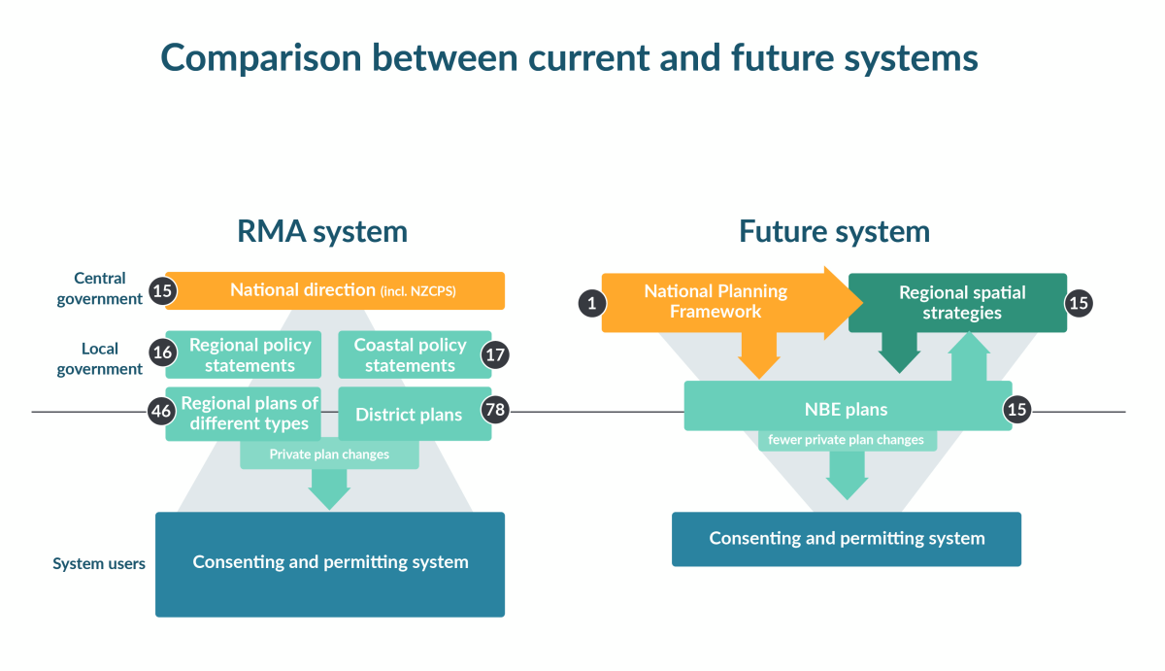
Evaluate Future Policy and Management Options
Adoption of Circular Economy Principles
Increased Use of Renewable Energy
Stakeholder Engagement
Government Subsidies and Incentives (Tan et al., 2022)
Sustainability Certifications
Notes:
Hotel and hospitality management must prioritise many crucial challenges for long-term sustainability. Interesting circular economy strategies. Recycling and reusing minimise waste and boost resource efficiency. Hotel closed-loop waste management systems reuse food, greywater, and other materials for landscaping, irrigation, and energy. The method reduces operating costs and environmental impact. Another important policy choice is renewable energy. Hotel energy dependence can be minimised by investing in solar, wind, or geothermal energy. Saving power helps hotels meet government carbon reduction goals. Solar and geothermal energy may be reliable and sustainable in places with abundant natural resources. The costly initial investment is outweighed by long-term cost savings and energy independence. Stakeholder engagement is key to sustainability goals. Hotels must collaborate with suppliers, the community, and employees to create a sustainability strategy (Rubio-Mozos et al., 2020). By using eco-friendly suppliers, hotels can reduce their carbon footprint. Encouragement to conserve energy or recycle can also change staff and tourist behaviour. Sustainable hotel culture increases brand name and guest loyalty. Government subsidies and incentives are essential for smaller hotels. Green technology and certifications are expensive, therefore governments can help smaller enterprises with subsidies or tax incentives. Large or small, this subsidy lets all hotels join the sustainability movement. Sustainability certifications like Green Key and ISO 14001 will grow. These credentials improve hotels' marketability and regulatory compliance. Certified sustainable hotels are more trusted and stayed at. These concepts can help hotels balance expansion and sustainability (Aleksandrovna et al., 2021).

Slide 7

Conclusion
Sustainability's Impact
PESTEL Analysis Recap
Successful Case Studies
Challenges for Small Hotels
Future Outlook
Notes:
Sustainability is a moral imperative and a cornerstone to hotel and hospitality success. Our PESTEL analysis showed how political, economic, social, technical, environmental, and legal factors make hotel sustainability important. Government regulations force the sector to develop greener practices, and consumer demand, especially from younger generations, supports the move. As mentioned, Hilton, Marriott, and Premier Inn demonstrate how profitable and favourable sustainability efforts can be for a brand's image. By using waste management, renewable energy, and energy-efficient technologies, these sector leaders have shown that sustainability can save money over time. Low initial costs and resources hurt smaller hotels. Despite these obstacles, government backing, financial incentives, and stakeholder involvement can help smaller businesses pursue sustainability. Sustainable economic growth and environmental responsibility will remain a competitive advantage to build a resilient future.

Slide 8
Reference
Aleksandrovna, T.M., Nazhmidenovna . D.G., Mizamgalievna , A.E., Rysty, B., Gumira B., Madina, A. and Shakizada, N., 2021. Sustainable hotel development. Academy of Strategic Management Journal, 20, pp.1-16
Brotherton, B. (2015). Researching Hospitality & Tourism (2nd Edn). Sage, London
Clegg, S.R., Skyttermoen, T., & Vaagaasar, A.L. (2021). Project Management: A Value Creation Approach. Sage, London.
Conady . R. & Buck.M. (2012). Trends and Issues in Global Tourism. Springer.
Cooper, C. Hall, M. (2019). Contemporary Tourism: An International Approach (4th Edn). Goodfellows, Oxford.
Dawson, J. Lemelin, H, & Stewart, E. (2012). Last Chance Tourism: Adapting Tourism Opportunities in a Changing World. Routledge, London.
Kostić, M., Ratković, M. and Forlani, . 2019. Eco-hotels as an example of environmental responsibility & innovation in savings in the hotel industry. Hotel and Tourism Management, 7(2), pp.47-56
López-Bernabé, E., Foudi, S., Linares, P. and Galarraga, I., 2021. Factors affecting energy-efficiency investment in the hotel industry: Survey results from Spain. Energy Efficiency, 14(4), p.41
Nowacki, M., Kowalczyk-Anioł, J. and Chawla, Y., 2023. Gen Z’s attitude towards green image destinations, green tourism and behavioral intention regarding green holiday destination choice: A study in Poland and India. Sustainability, 15(10), p.7860.
Paban, M. (2020) ‘Green marketing towards Hotel Sustainability: Insight of India, Oppourtunities and challenges’, Zbornik radova Departmana za geografiju, turizam i hotelijerstvo, (49–2), pp. 181–194. doi:10.5937/zbdght2002181p
Rubio-MozoS .E., García-Muiña, F.E. and Fuentes-Moraledp.8652l .2020. Sustainable strategic management model for hotel companies: A multi-stakeholder proposal to “walk the talk” toward SDGS. Sustainability, 12(20), p.8652.
Tan, H., Iqbal, N. and Wu, Z., 2022. Evaluating the impact of stakeholder engagement for renewable energy sources and economic growth for CO2 emission. Renewable Energy, 198, pp.999-1007.
World Economic Forum (2023) Survey of travellers finds 76% want more sustainable options, World Economic Forum. Available at: https://www.weforum.org/agenda/2023/04/survey-of-travelers-finds-76-want-more-sustainable-options/ (Accessed: 27 September 2024).

