Slide 1
BMOE7014
Mixed methods
Nalda Wainwright

Slide 2

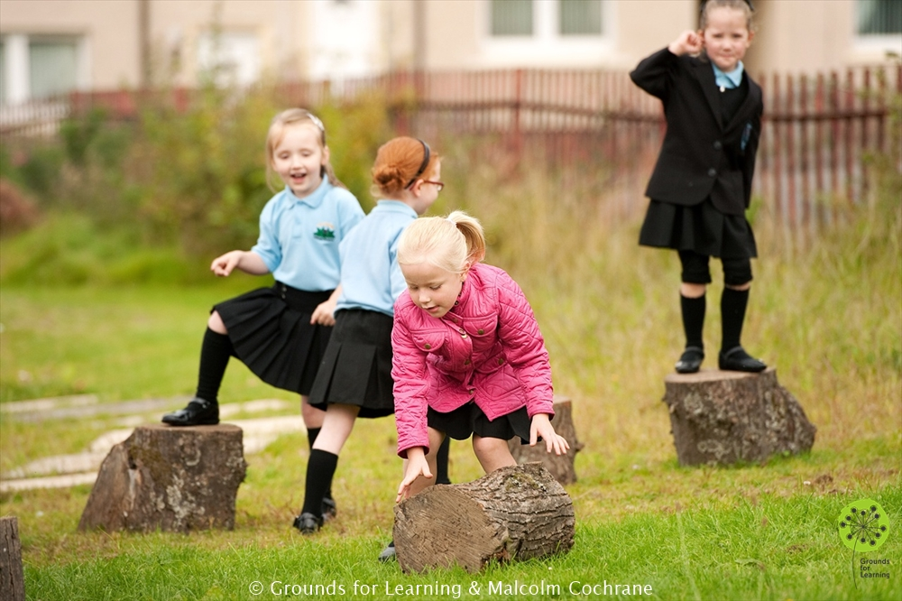
Session overview
Distinguish between quantitative, qualitative and mixed research designs.
Identify when qualitative and qualitative approaches can complement each other.
Select from a range of mixed methods designs.
Explain when mixed methods designs may not be appropriate in particular in relation to your own research problems

Slide 3
Definition
Mixed methods consists of:
‘the collection or analysis of both quantitative and qualitative data in a single study in which the data are collected concurrently or sequentially, are given a priority, and involve the integration of data at one or more stages in the process of research’ (Creswell et al., 2003: 212).

Slide 4
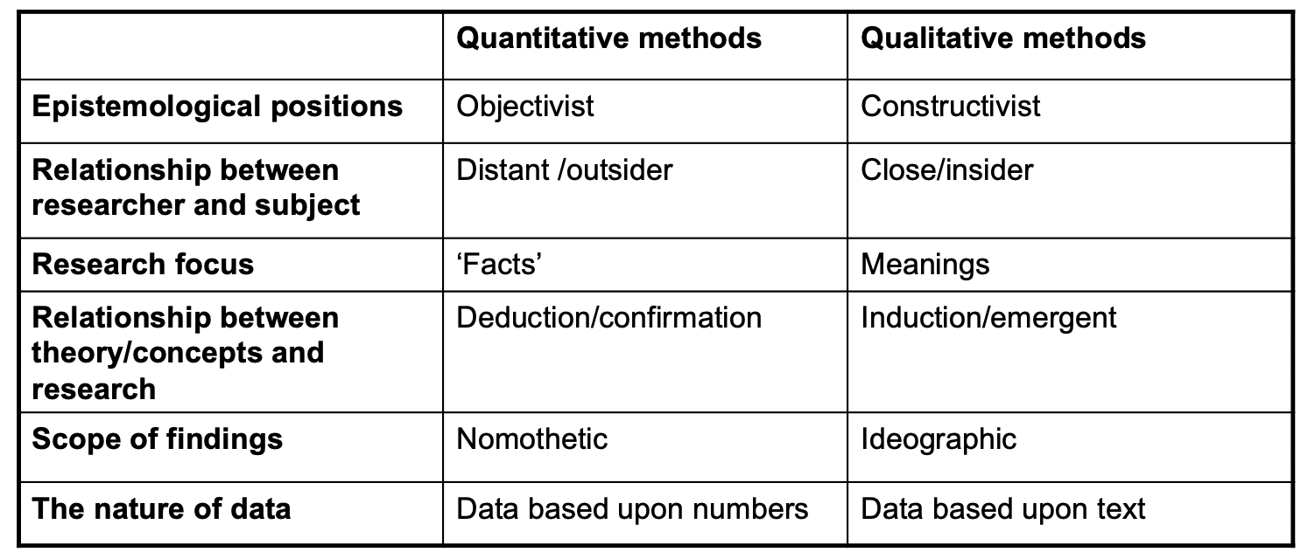
Recap: differences between quantitative and qualitative methods
Notes:
Nomothetic is relating to the discovery of scientific laws –that are general
Ideographic is relating to study or discovery of particular facts and processes, not generalisable

Slide 5


Epistemological positions
Quantitative research emanates from an objectivist position which holds that reality exists independently of the researcher – the truth is ‘out there’.
Qualitative research is more closely linked to a constructivist paradigm, which sees truth and meaning as constructed and interpreted by individuals

Slide 6


Relationship between researcher and subjects
Quantitative research, researchers aim to keep themselves at a distance (emotional/physical) from those they are researching.
Qualitative research usually involves direct contact between researcher and those they are researching, sometimes for long periods of time – getting in amongst the pigeons

Slide 7
Research focus
Quantitative research concentrates on the gathering of ‘facts’, in order that ‘truth claims’ can be established.
Task : Remembering Quants session Think of some examples of quantitative questions
E.g.
What is the impact of a health and fitness unit of work on year 10 pupils’ physical activity motivation?
Is there a relationship between physical competence and reading age in 5 year old pupils?

Slide 8
Research focus
Qualitative researchers contend that truth and meaning do not exist in some external world but are constructed through peoples’ interactions with the world.
Task : Remembering Quals session ……Think of some examples of qualitative questions
Eg.
How do pupils’ experiences of a health and fitness unit of work influence their to physical activity participation?
How does movement in influence academic behaviours in young children?

Slide 9
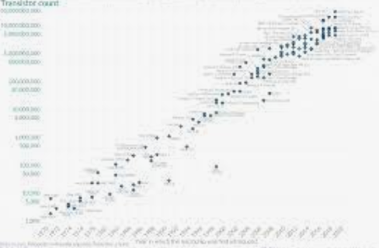

Scope of findings
Quantitative methods are regarded as nomothetic which attempts to establish law-like findings that hold irrespective of time.
Qualitative research is ideographic which locates its findings in specific time periods and localities and is much more concerned with the depth and intensity of findings rather than breadth (generalizability).

Slide 10


The nature of data
Quantitative studies generate data in the form of numbers, often depicted positively as reliable and rigorous, probably because of their association with ‘science’.
Qualitative research generates what is claimed to be ‘rich’ or ‘deep’ data, usually in the form of text but sometimes in photographs, maps or other visual media.

Slide 11
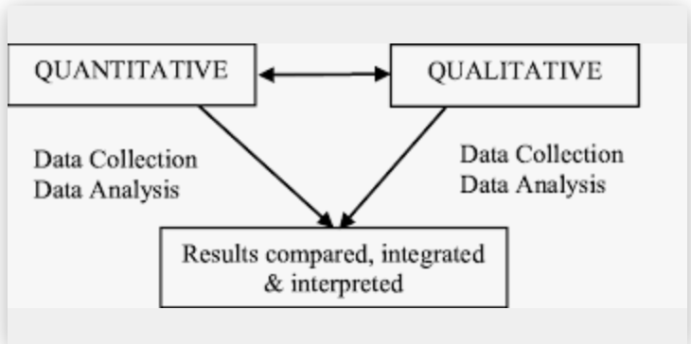
Mixed methods allow researchers to…
Generalise from a sample to a population (as in quantitative research).
Gain a richer, contextual understanding of the phenomenon being researched (as in qualitative research).

Slide 12
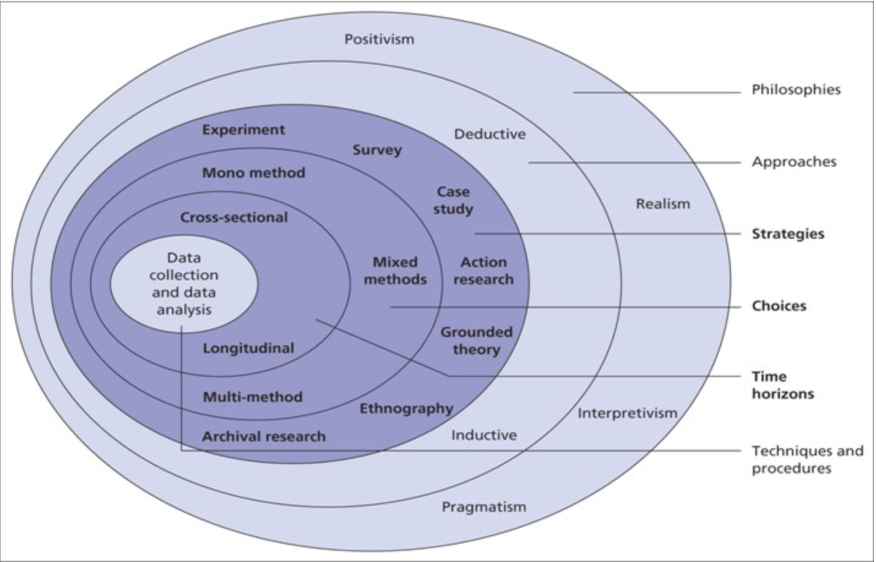
Ontology
Remember the research Onion from the first session

Slide 13
Research paradigm..
Pragmatism. - in social science research and in education in particular, the research problems are often complex and as such do not fit neatly into qualitative / quantitative paradigms. By taking a pragmatic position to the research, methods are selected to address different aspects of the research
Post positivism – emerged as a reaction to limitations of positivist approach to research creating a mixed paradigm. (See the post positivism article on Moodle)

Slide 14
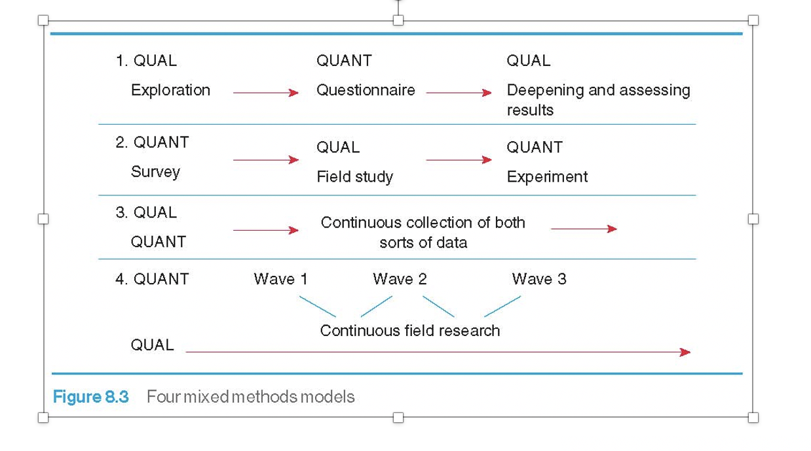
How can we mix methods?

Slide 15

Qualitative then quantitative
Little is known about the research problem or research setting.
Qualitative study explores, identifies and can provide clarity about the kinds of variables requiring further investigation.

Slide 16
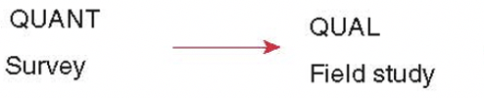
Quantitative then qualitative
Quantitative study could be used to identify important results that qualitative fieldwork could then seek to explain.
Quantitative survey is used to identify groups of respondents with strongly contrasting views about a subject. These polarised groups can then be used for follow up qualitative interviews to gain an in-depth understanding.

Slide 17
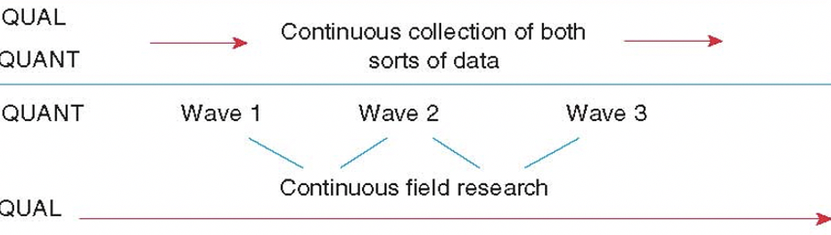
Quantitative and qualitative concurrently
Continuous collection of both sorts of data.
The quantitative and qualitative data may focus on similar themes or on different themes.

Slide 18
Benefits of mixed methods designs (Greene et al., 1989)
Triangulation. Seeks convergence, corroboration, correspondence of results from different methods.
Complementarity. Seeks elaboration, enhancement, illustration, clarification of results of one method with the results from the other.
Development. Seeks to use the results of one method to help or inform the other method.
Initiation. Seeks the discovery of paradox and contradiction, new perspectives, the recasting of questions or the results from one method with questions or results from the other method.
Expansion. Seeks to extend the breadth and range of inquiry by using different methods from different inquiry components.

Slide 19
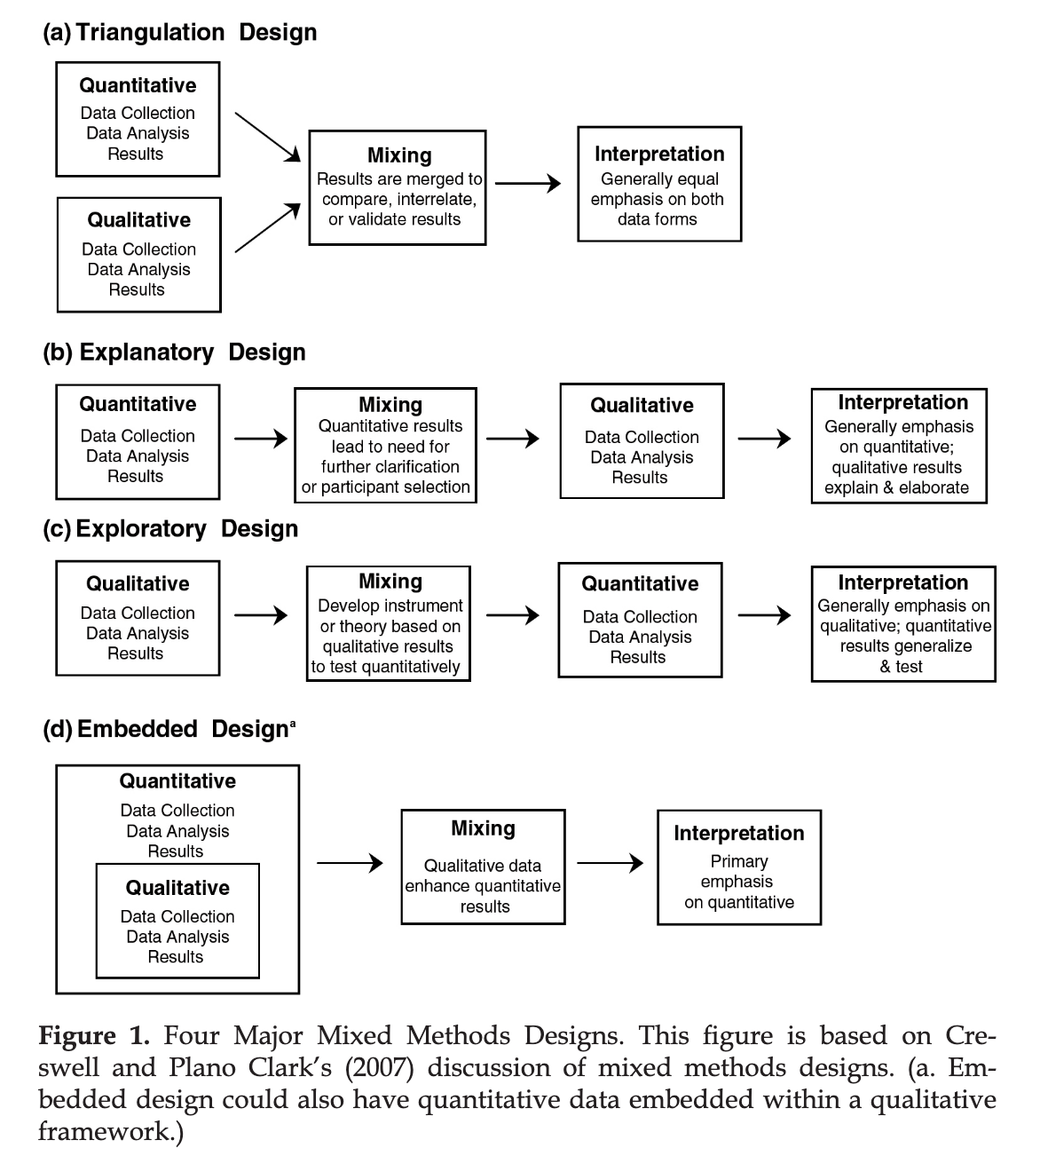
Plano Clark et al 2008- examples of mixed methods designs found in research

Slide 20
Potential weaknesses of mixed methods
Lack of clarity of how the methods are used in the study to answer the research question
Problems in managing to synthesise quantitative and qualitative findings.
Lack of integration in many studies.

Slide 21
Examples of mixed methods research
Title: An investigation into the perceived level of personal subject knowledge and competence of a group of pre-service physical education teachers towards the teaching of secondary school gymnastics
Aim: to examine the perceived level of personal subject knowledge and competence to teach gymnastics among trainees
RQ: What are trainee teachers’ level of perceived subject knowledge and competence to teach gymnastics?
Methods :
Questionnaires x 2
Semi-structured interviews
See the paper on Moodle

Slide 22
The contribution of the foundation phase in Wales to physical literacy
Aim: To develop an understanding of the contribution of the Foundation Phase in Wales to children’s physical literacy
RQ 1. How are teachers interpreting the LOs of the Foundation Phase in relation to physical literacy?
RQ 2. What is impact of the Foundation Phase on children’s physical literacy ?

Slide 23
Methods?
RQ 1. How are teachers interpreting the LOs of the Foundation Phase in relation to physical literacy?
Documentary analysis, semi structured interviews, participant observation
RQ 2. What is the impact of the Foundation Phase on children’s physical literacy?
Repeated measures TGMD2, BOT-2 , Physical self perception scale, participant observation.

Slide 24

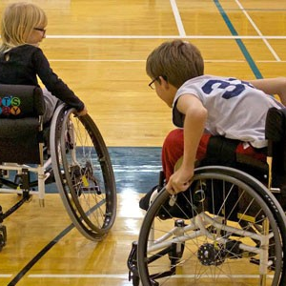
Let’s consider your research problems
What questions can you ask about your problem?
Think of quantitative questions
Think of qualitative questions
Will using mixed methods be appropriate for your problem?

Slide 25
Summary
Quantitative and qualitative research methods have traditionally been associated with conflicting research paradigms based upon different epistemological positions.
Many researchers now recognize that quantitative and qualitative approaches can be combined into a mixed methods design.
Mixed methods approaches:
  can be based upon different types of research question, sampling procedures, data collection methods or approaches to data analysis.
  are flexible and can include sequential designs with quantitative methods preceding qualitative, or vice versa, or concurrent designs.
  should be based upon the kinds of questions being addressed and how the design can aid in the answering of these questions.

